Slide 1
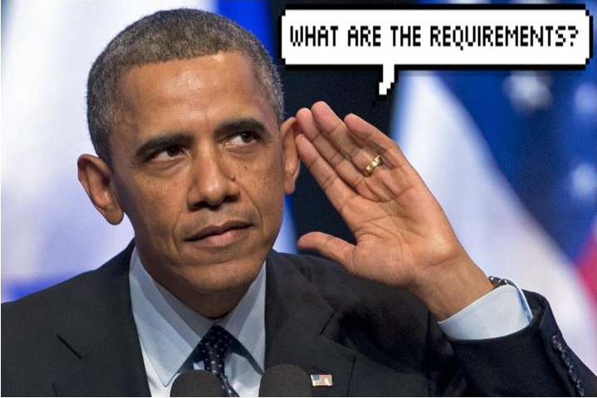
Question Answering
Building a Relationship Extraction Module
Mentor:
Kuldeep Singh
Patrick Seume
Kai Kenklies
Victor Ouku

Slide 2
Requirements for integration into the whole system
Precision/Recall:
Description: The module should have high values for both precision and recall regarding the task of finding relationships from the used knowledge base.
Preprocess knowledge base:
Description: A list of all possible relationships has to be obtained from all the data in the used knowledge base.
Exchangeability:
Description: The module should be designed in such a way that in the overall architecture it can be easily replaced by other modules.
Isolation:
Description: The modules internal states and logic should be hidden from the outside environment. Communication should happen via predefined interfaces.

Slide 3
Requirements for functionality
Function: Extract relationship
Description: Extracts Relationship and identifies the best corresponding relationship from DBPedia
Inputs: Query with named entities
Source: shared Database
Outputs: Query + mapping to ontology. In some markup language.
Destination: Shared Database
Ressources: DBPedia
Pre-Condition: Entities are allready identified
Post-Condition: Query is unchanged. Most likely relationship mapping has been found and both are saved in the shared database.

