Slide 1



SaBo (Semantic Blockchain) Framework
Mentor(s): Héctor, Prof. Dr. Maria-Esther Vidal Team Members: Firas, Ernane, Matthew
#SaBoFramework #SemanticBlockchain

Slide 2
Overview
Section 1.
Architectural components
Section 2.
Code
Section 3.
User manual
Section 4.
Roadmap

Slide 3
Architectural Components (pertinent design decisions)
Section 1.

Slide 4

Hardware
Digital Ocean Educational Initiative Droplet Statistics OS: Ubuntu SDD: 20 GB (plans to re-size w/ growth)
Facilitating:
Public facing website
Online SPARQL endpoint

Slide 5


Collaborative Development Tools
Compatibility: * Deploying tools over Docker
Project Management: * Atomic task tracking using Trello

Slide 6
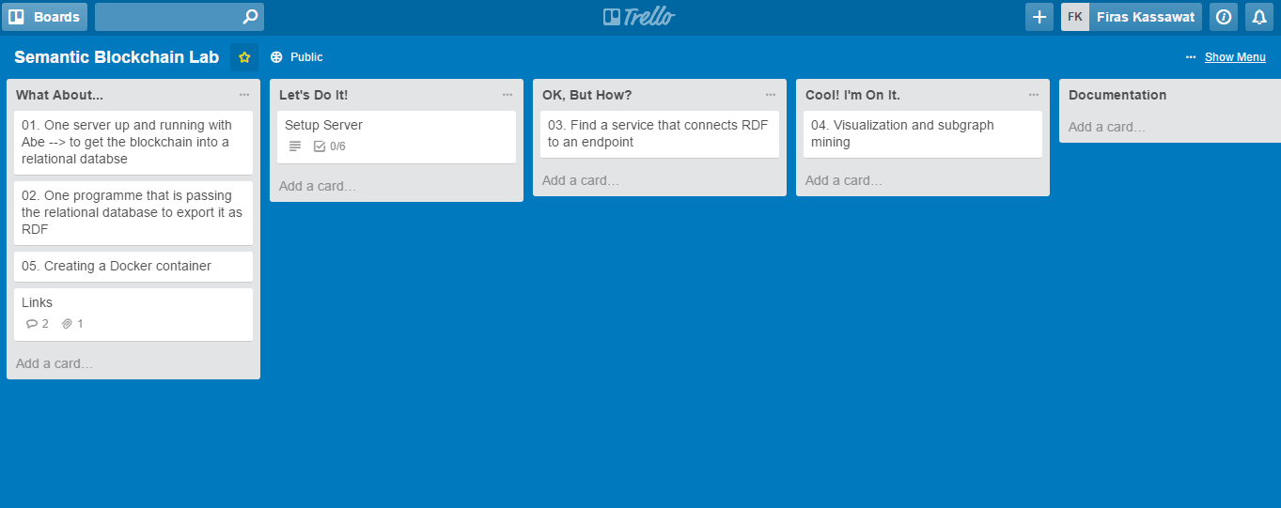

Slide 7
Code (development framework)
Section 2.

Slide 8
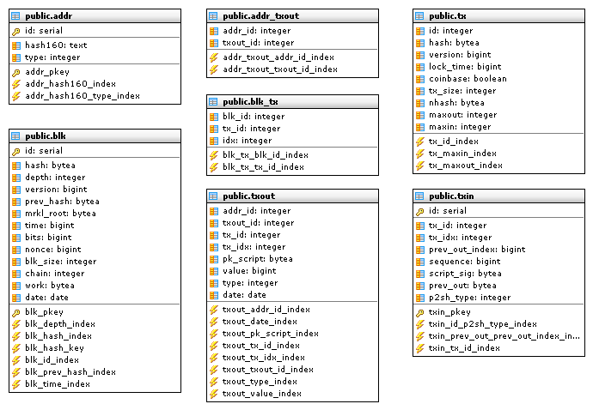
Relational Database Model

Slide 9
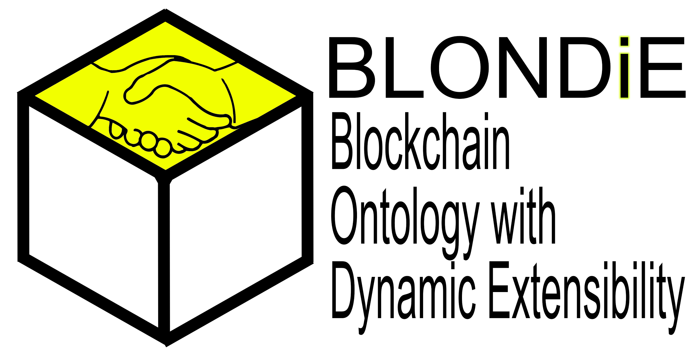

Slide 10
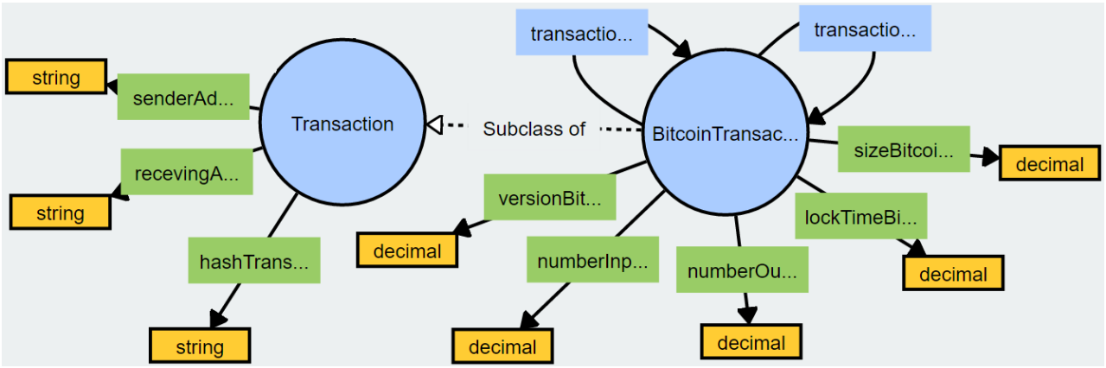

BLONDiE
Classes and properties for representing Bitcoin transactions
Notes:
classes and properties for representing Bitcoin transactions

Slide 11
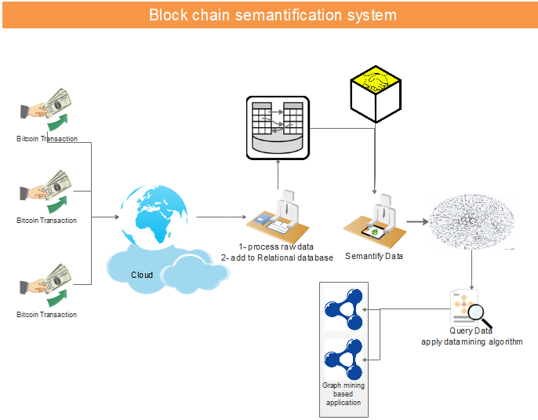
Data Processing Pipeline

Slide 12
User manual
(anticipated features)
Section 3.

Slide 13
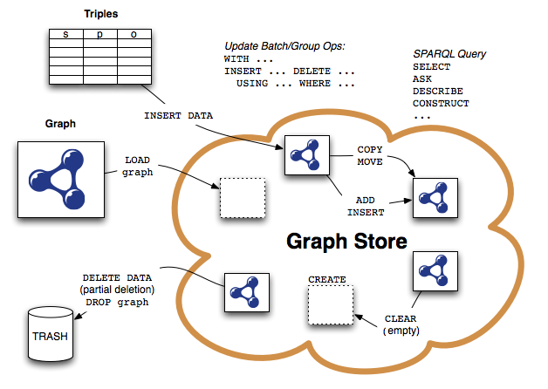
SPARQL Endpoint

Slide 14
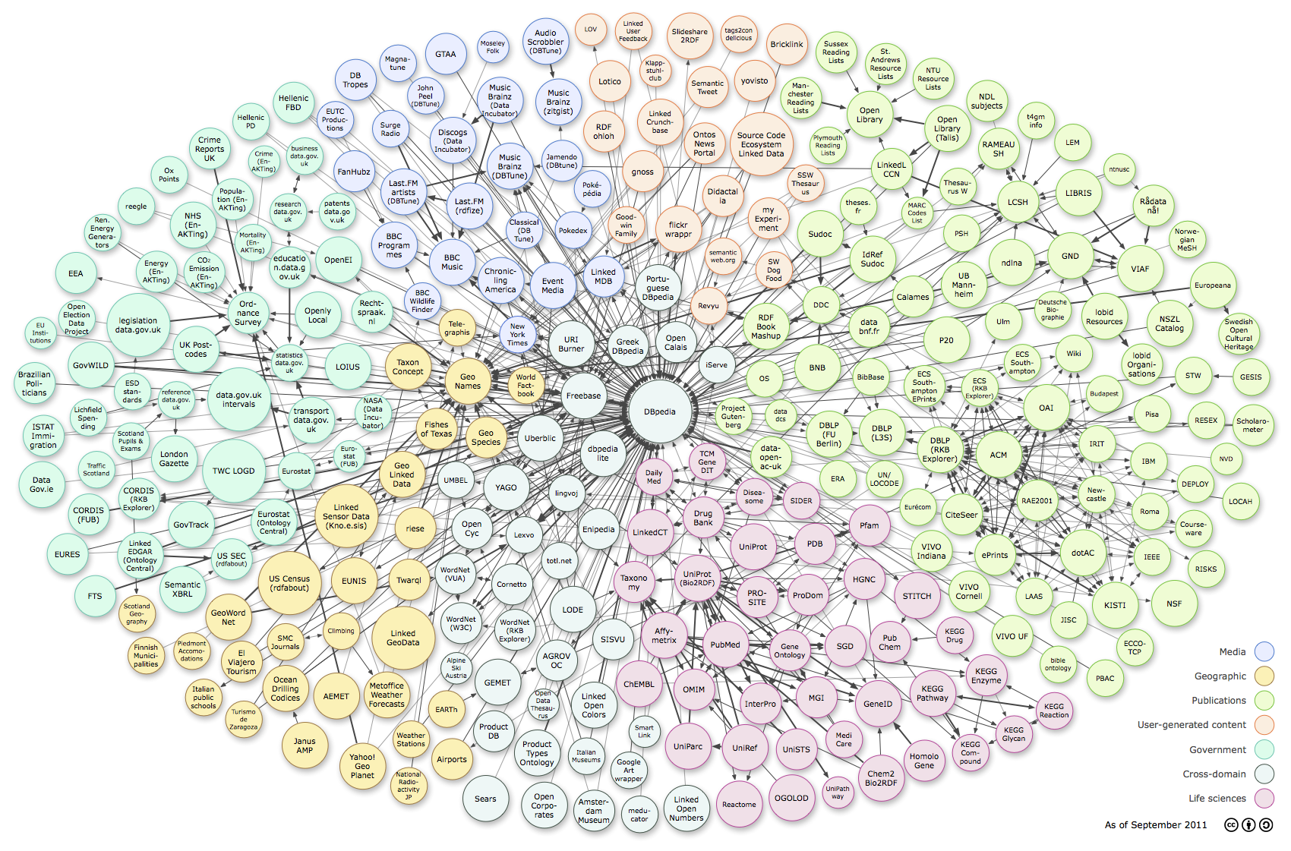
Linked Open-Data Cloud

Slide 15
Roadmap
(strategy/plan)
Section 4.

Slide 16
Plan/Strategy
July 4th - Implementation of functioning Docker testnet on server August 15th - Validate BLONDiE Ontology on sufficiently large bitcoin dataset

Slide 17
Recap
Section 1.
Architectural components
Section 2.
Code
Section 3.
User manual
Section 4.
Roadmap

