Slide 1

SaBo (Semantic Blockchain) Testing Framework
Mentor(s): Héctor, Prof. Dr. Maria-Esther Vidal Team Members: Firas, Ernane, Matthew
#SaBoFramework #SemanticBlockchain

Slide 2
Overview
Section 1.
Validating SPARQL Endpoint
Section 2.
Testing Data Model
Section 3.
Website Testing
Section 4.
Visual Analytics

Slide 3

Scientific Method
→ Propose falsifiable hypotheses(Test cases with known result)
→ Run tests to evaluate those hypotheses
→ Compare the results of the testing to real value
→ Draw conclusions and iteratively improve

Slide 4
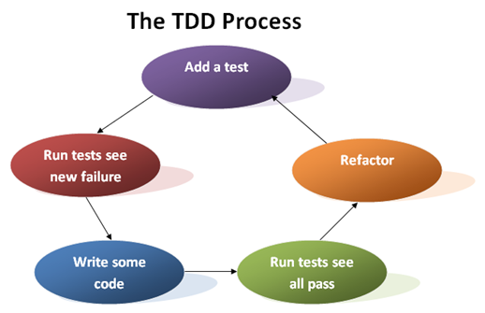
SaBo Testing Framework

Slide 5

Testnet Test Cases
Local Testnet
Define (precisely) our own data
Run queries to check our hypotheses

Slide 6
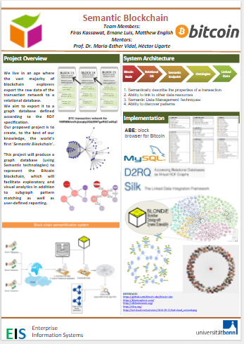
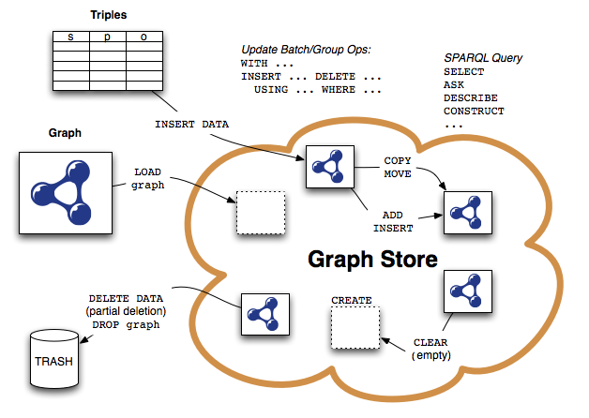
Validating SPARQL Endpoint
SPARQL Endpoint

Slide 7




Testing Data Model

Slide 8

Test-Driven Web Development
semanticblockchain.me
semantic-blockchain.me
Guard: (rubygem) Command line tool to easily handle events on file system modifications.

Slide 9
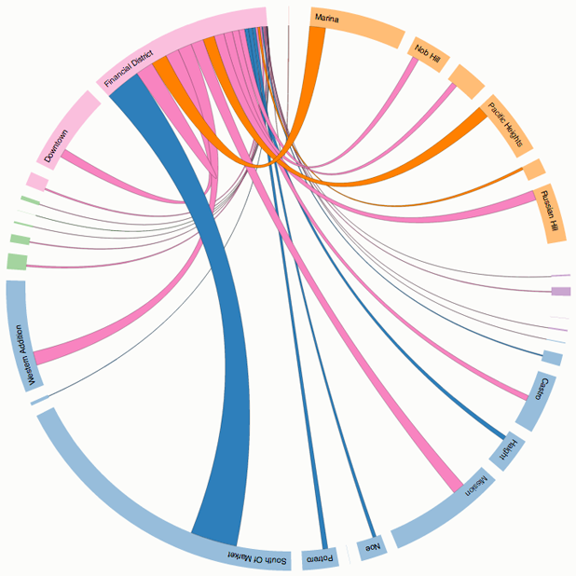

Visual Analytics: Chord Diagram

