Slide 1

SaBo (Semantic Blockchain) Development Plan
Mentor(s): Héctor, Prof. Dr. Maria-Esther Vidal Team Members: Firas, Ernane, Matthew
#SaBoFramework #SemanticBlockchain

Slide 2
Overview
Section 1.
July
Section 2.
August
Section 3.
September
Section 4.
Final Presentation

Slide 3



July
Building Wrappers

Slide 4



August
ANAPSID
Development of Knowledge Graph
adaptive query processing engine

Slide 5


August
Implementation of Use Case

Slide 6
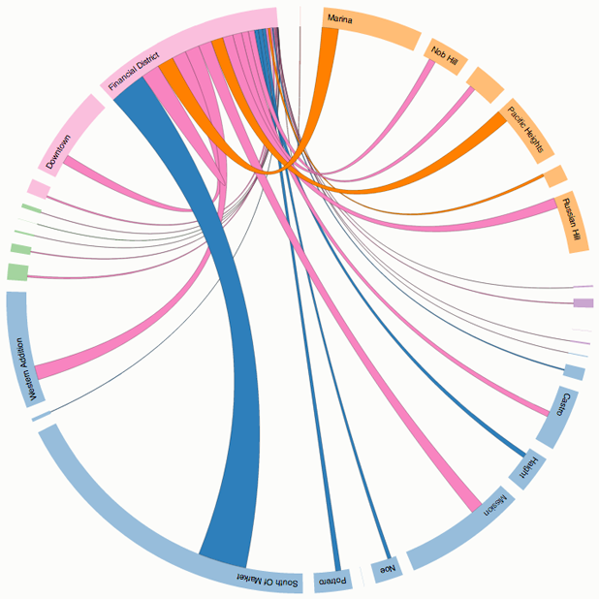
September

Slide 7

September

Slide 8
Final Presentation
ANAPSID

