Slide 1

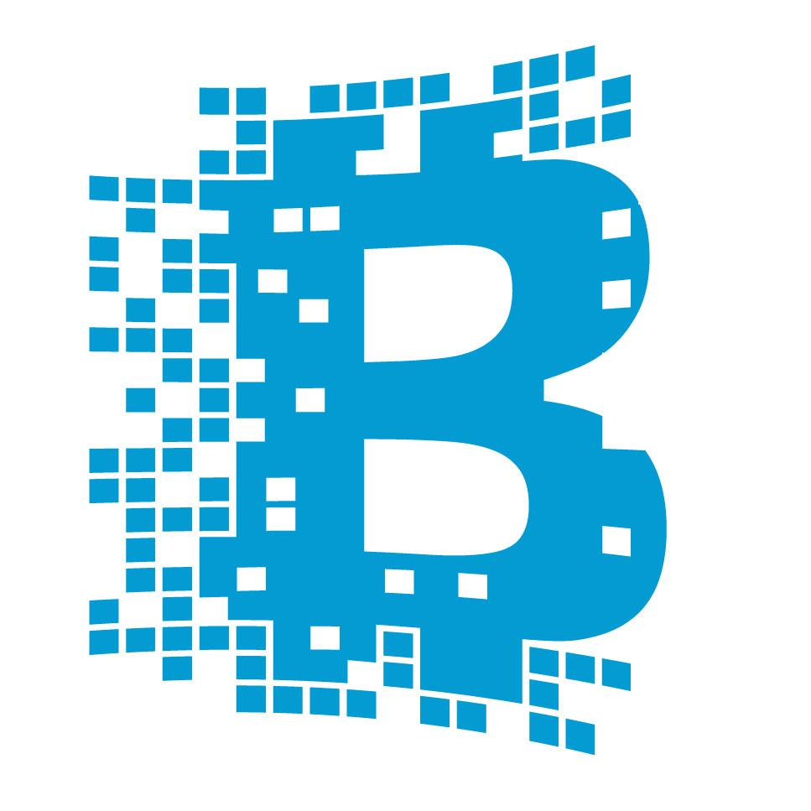

Semantic Blockchain
Mentor: Prof. Dr. Maria-Esther Vidal Team Members: Firas, Ernane, Matthew

Slide 2
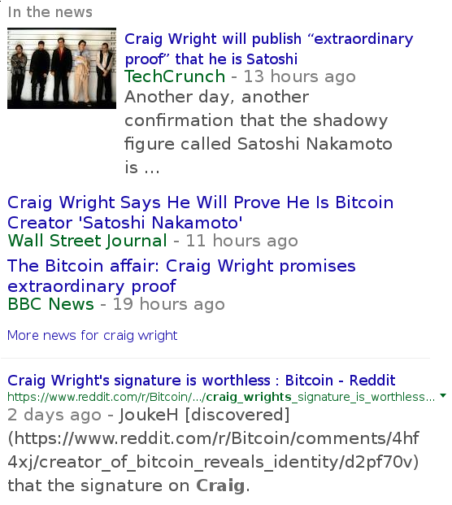

Slide 3
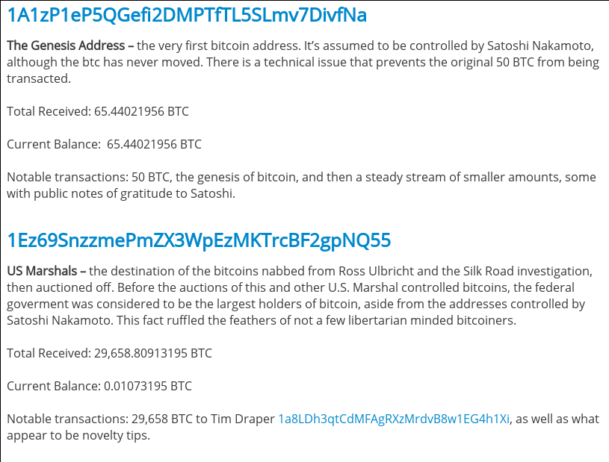
Notable Addresses

Slide 4
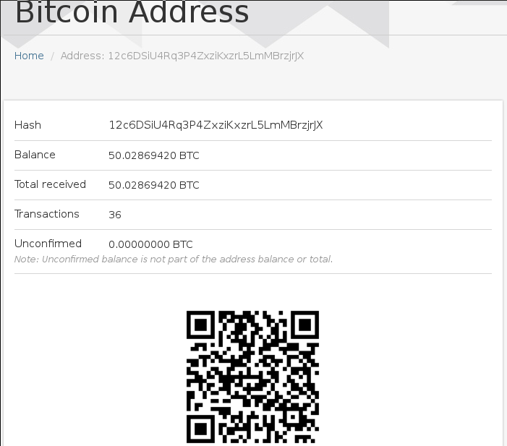
Transaction Analysis

Slide 5
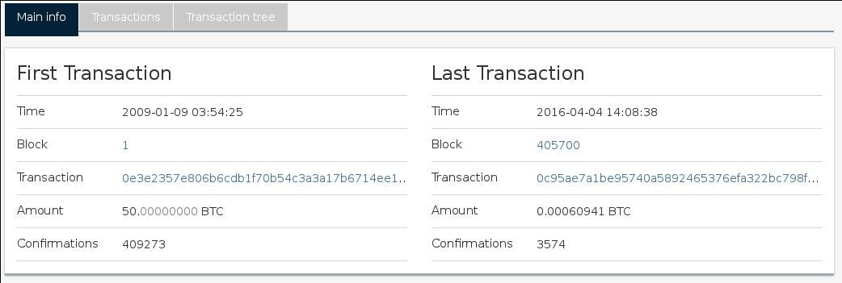
Transaction Analysis

Slide 6
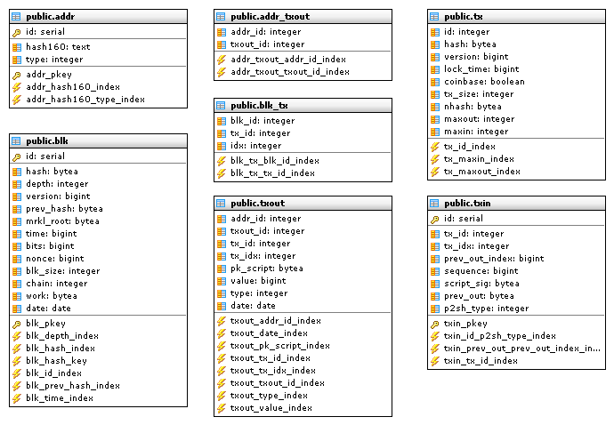
Relational Database Model
→ Bitcoin Block Explorer (BBE)
→ BlockChain.info

Slide 7
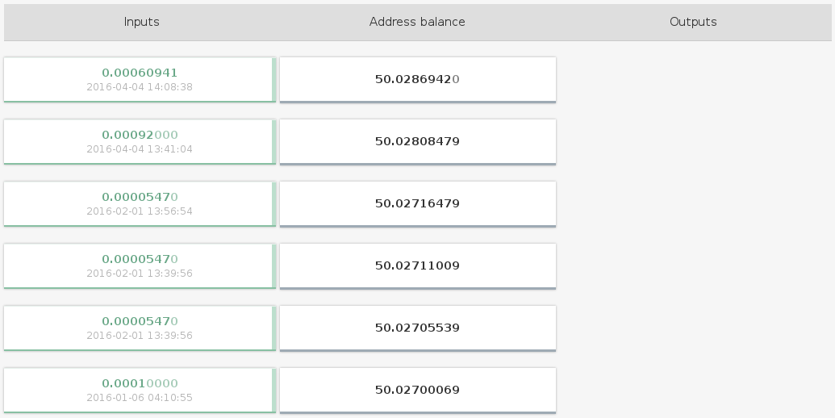
Transaction Analysis
→ Triplestore Data Model

Slide 8
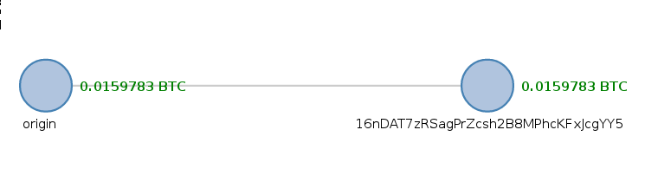
Status Quo

Slide 9
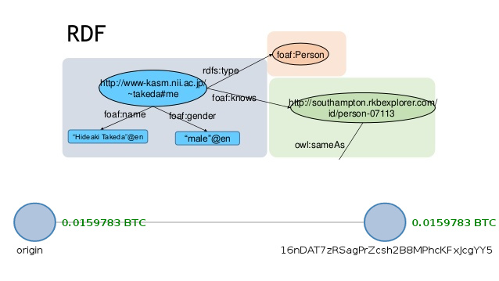
Data Enhancement

Slide 10
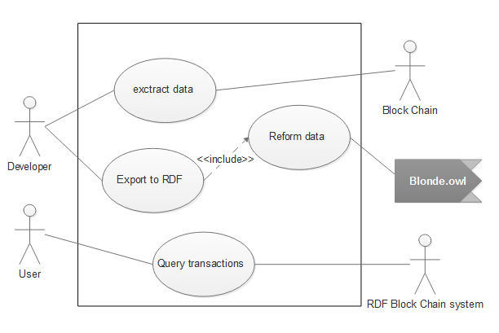
Use Case

Slide 11
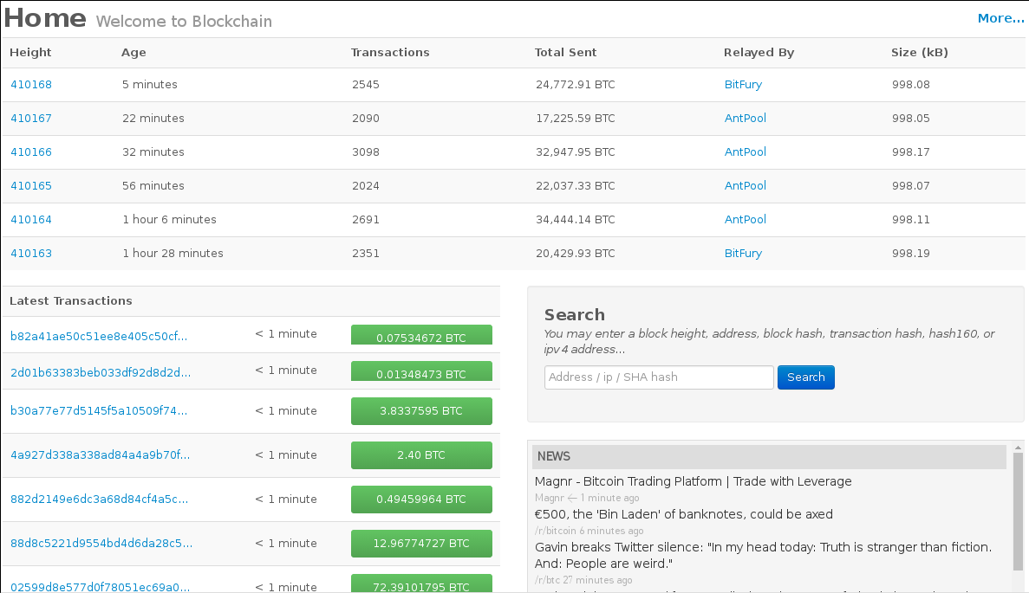
User Interface

Slide 12
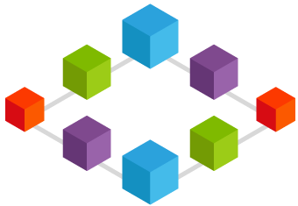
Applications and Future Aspects
Data mining (graph mining) to identify patterns.
More efficient queries.
Link to Open Data Cloud.
Facilitate Blockchain 2.0 applications.
Android Application (Semantic Wallet)
...

