Slide 1
Semantic RDF-to-Salesforce extension
Requirements

Slide 2

Perspective
Sales
Contacts
Organization
Notes:
Companies maintain and exchange data about other companies: organization structure, contact data, etc

Slide 3

Perspective
Notes:
Many of this companies already use salesforce as Cloud CRM system

Slide 4
Perspective
RDF extension
Notes:
We want to extend the Salesforce API with RDF support and make the data exchange easier

Slide 5
Perspective
Salesforce API is too big
17 separated data models
440 different objects
68 calls
Concentrate on core model: Sales Objects
Notes:
The API is very rich and we can not provide the implementation for all models. We agreed with our mentor to concentrate on Sales Objects

Slide 6
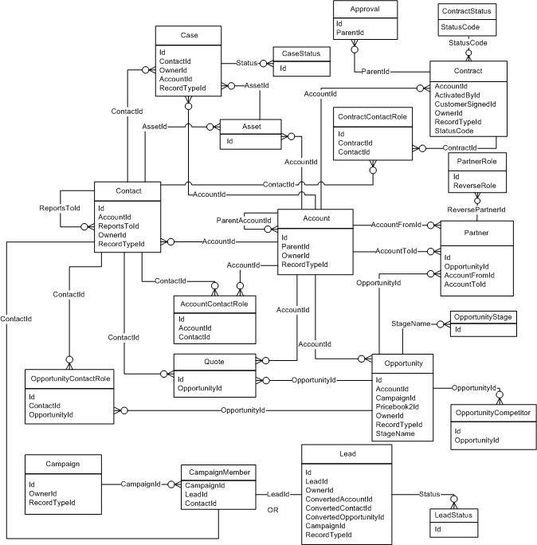
Perspective
Data Model of Sales Objects in Salesforce API

Slide 7
Functional
Export Sales Objects
Import Sales Objects
Transform Sales Objects to RDF
Transform RDF to Sales Objects

Slide 8
Nonfunctional
Performance
API limitations
Response time of requests < 5 sec
Interoperability
provided as a web service
Usability
similar to salesforce (terms and workflows)

Slide 9
Constraints
Salesforce account
Salesforce API constraints
Salesforce data structure
Library for processing RDF
Java

