Slide 1
Semantic RDF-to-Salesforce extension

Slide 2
Overview
Mentor: Niklas Petersen
Members: Mintcho Tzatzarov
Omar Rana
Alexander Melnyk
Create an semantic RDF-to-salesforce extension

Slide 3
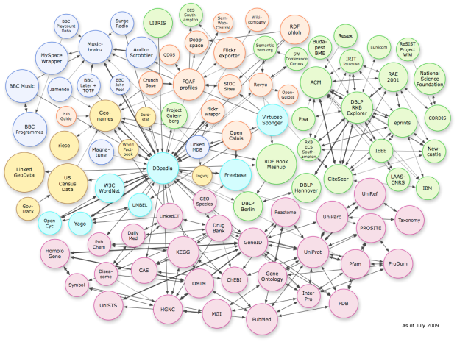

Task
RDF Graph
Cloud CRM
?

Slide 4
Task
RDF Graph
Extension
API
Cloud CRM

Slide 5
Goals
RDF vocabulary for Salesforce data
Tool to bridge between RDF and Salesforce
read Salesforce data
transfrom between RDF and Salesforce data
write Salesforce data
Smal test scenarios for validation

