Slide 1

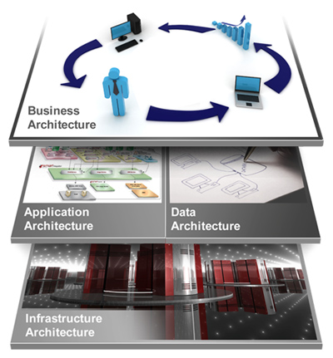
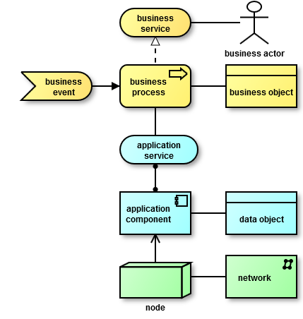
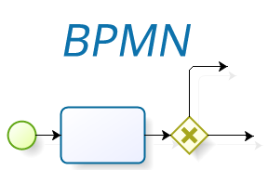

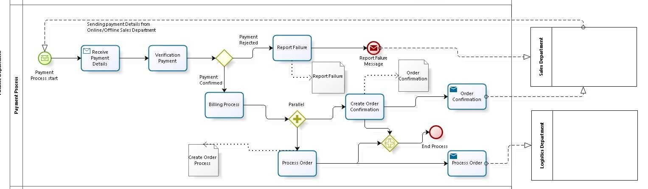






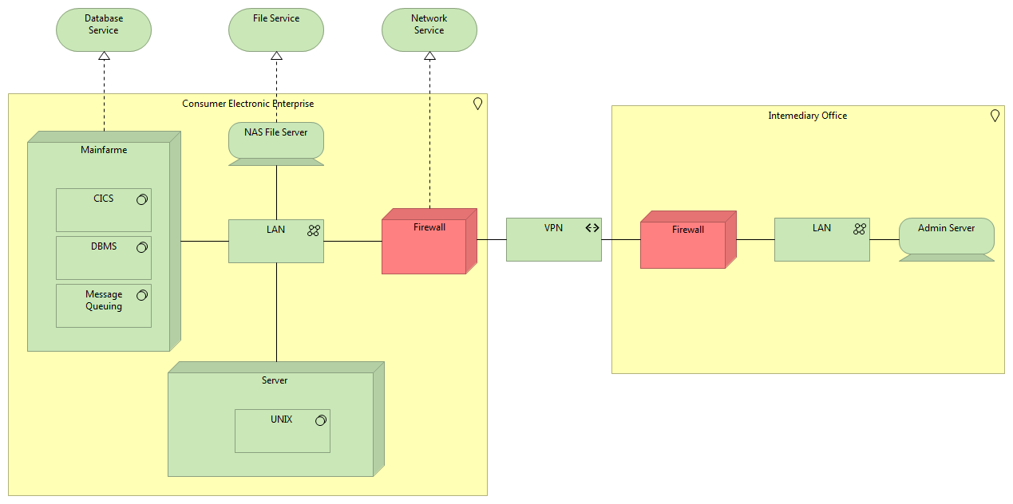




Conceptual Framework for Consumer Electronic Enterprise Architecture
Developed by: Shirin Ameri, Shiva Shokuhi, Eliza Koshtoyan, Yi Chen
Supervisor: Dr. Simon Scerri
Mentor: Michael Galkin
Overview
An enterprise architecture (EA) is a conceptual blueprint that defines the structure and operation of an organization. The intent of an enterprise architecture is to determine how an organization can most effectively achieve its current and future objectives.
Objective:
Comprehensive
Well specified, detailed model of the enterprise and its components
Consistent
Model contains consistent terminology
Unambiguous
No ambiguous situations in model and between its states
Business Architecture is usually a human activity system, with
people/actors playing roles in processes
for specifying business processes in a business process model we Use BPMN 2.0
Applications architecture focus on business apps,
And Data architecture is
concerned with data at rest, data in motion, and data qualities
For modelling the Application, Data and Technology layer , we use Archimate which is an open and independent enterprise architecture modeling language
Technology Architecture contains infrastructure or platform applications used by business applications
Figure 1: Enterprise Architecture
Figure 2:Layers of EA
Figure 3: Modeling Tools
Evaluation
Implementation
Good points:
All major enterprise components are defined
Well described business processes
Project is executed in time and requirements are met
Issues:
Differences in detail levels
Archimate diagrams less comprehensive than BPMN ones
Difficulties & Challenges
Getting information about each business domain
Modeling tool selection
Maintaining consistency of entities between different tools
Integration of all diagrams
Payment Business Process:
Verified billing information
Confirmed invoice amount
Notified customer about successful payment
Sent message to logistics department for packaging and delivery process.
Message Start Event | Exclusive Gateway
Message End Event | Parallel Event Based Gateway
End Event | Parallel Gateway
Documentation
Detailed information about EA models:
Framework , Layers, Organizational Structure
Business Process Models
Application, Data and Technology Architecture
User Manual:
BPMN and Archimate notations
Infrastructure Landscape:
The goal of modeling an infrastructure landscape:
to visualize the most important elements of the infrastructure
how these are connected to networks
what their geographical location is
<Virtual Machine Description>
Hostname: vm-EAModel
Software installed:
Installed on: EIS2
Windows 64 OS
1GB RAM
2 CPUs.
Local Access:
OS User: EA
Password: enterprise
Diagrams and Documentation:
https://github.com/EIS-Bonn/MA-INF3232-Lab-SS2015/tree/master/GroupA

