Slide 1

Salesforce RDF extension
Testing Strategy
Niklas Petersen
Omar Rana
Mintcho Tzatzarov
Alexander Melnyk

Slide 2
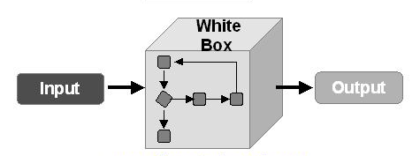
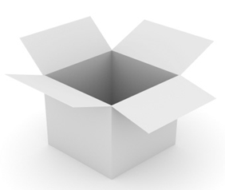
Testing method
White box testing
Common testing methods
- Unit
- Integration
- System
Notes:
is a method of testing software that tests internal structures or workings of an application, as opposed to its functionality (i.e. black-box testing)
Unit testing
Integration testing
Validation testing
System testing
Alpha/Beta testing
Recovery testing
Security testing
Stress testing

Slide 3

Testing the software
Transformation between RDF and Objects
- Unit testing
Salesforce client
- Mock Service test
Data test

Slide 4

RDF Transformer
Unit tests
Notes:
unit is often an entire interface, such as a class, but could be an individual method.^{[2]} Unit tests are short code fragments^{[3]} created by programmers or occasionally by white box testers during the development process. It forms the basis for component testing.

Slide 5
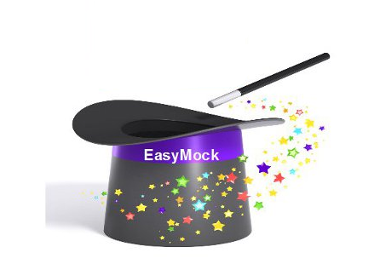
Salesforce Client
Mock Service test
Notes:
next part is the client for the salesforce, here is depend on the salesforce so we can at most mock the service and hope everything will goes well

Slide 6

Data testing
RDF Extension
Client
Notes:
last part is the test data we will get from our mentor in order to test the roundtrip from the client of the extension to salesforce

Slide 7
Thank You

