Slide 1
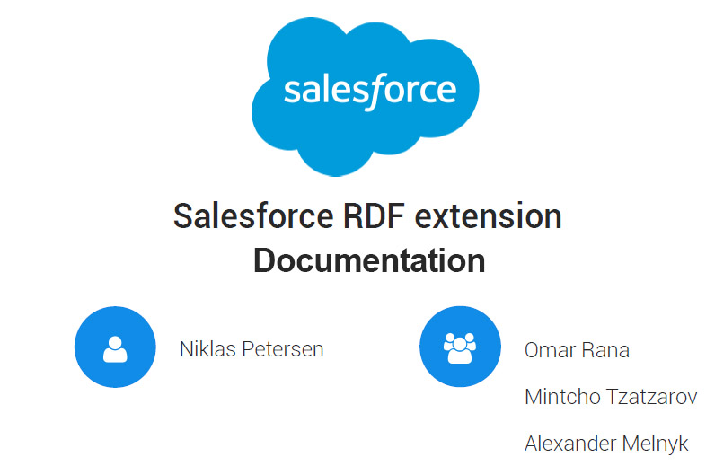

Slide 2

Requirements
Functional requirements
Non functional requirements
Notes:
Functional requirements
Export Sales Objects
Import Sales Objects
Transform Sales Objects to RDF
Transform RDF to Sales Objects
Non functional requirements
Performance
- API limitations
- Response time of requests < 5 sec
Interoperability
- provided as a web service
Usability
- similar to salesforce (terms and workflows)

Slide 3
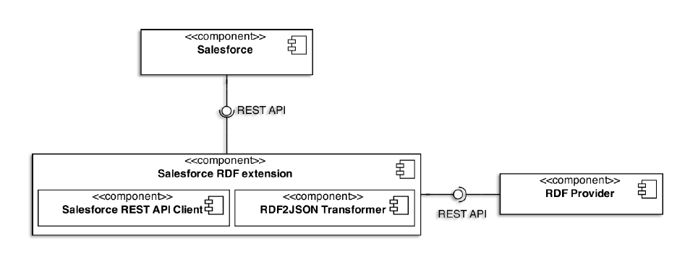
Architecture

Slide 4

Technical documentation
Documentation of code
APIs :
- Rest
- Sesame
Environment tools :
- Spring Tool Suite,
- Gradle
Notes:
Documentation on data structure
Standard Java Documentation

Slide 5

End user manual
For developers only
Environment installation guide
References for all the tools used

Slide 6
Thank you

