Slide 1
Enterprise Information Systems Lab
Linked Data Visualization and Exploration
Mentor:
Klaudia Thellmann
Group Members:
Alina Arunova (L)
Tatiana Novikova
David Ibhaluobe
Notes:
<number>
<Fußzeile>

Slide 2
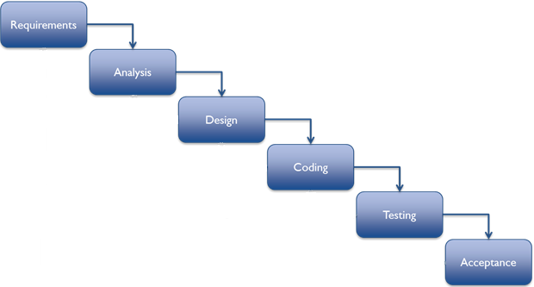
Documentation Strategy: Agile Documentation
Group D | Lab Enterprise Information Systems | 17.6.2015 | Images © google, 2013

Slide 3


Documentation Strategy: Agile Documentation
Technical
Code {Emberjs}
Functional
User Manual
Group D | Lab Enterprise Information Systems | 17.6.2015 | Images © google, 2014
<number>
Notes:
The LinkDaViz tool is a JavaScript based web application and is split into a frontend and a backend module.
It receives as input data in RDF or tabular format.
The frontend module consists of a component for data selection, the visualization widgets library and a component
The front end is implemented in Ember.js an open source client side JavaScript MVC framework.
<number>

Slide 4
Documentation strategy: Agile Documentation
Technical
Architecture
Code
Comments
Best practice: naming convention
lind_vis_fe: Data Modules, Controllers for handling user actions, views and templates, route and models
Group D | Lab Enterprise Information Systems | 17.6.2015
<number>
Notes:
* We are going to follow the already existing coding convention since we are improving the system.
* We going to comment our improvement code to enable any future developer understand our work flow.
* Ember.js uses naming conventions to wire up your objects without a lot of boilerplate. We are using these conventional names for our routes, controllers and templates.
<number>

Slide 5
Documentation Strategy: Agile Documentation
Functional
Usage scenarios of application
Tree with the components/options: filter; sort; drag&drop etc.....
Select option
Search
Consumption with the components/options: visualize, download and save options.
Group D | Lab Enterprise Information Systems | 17.6.2015
<number>
Notes:
* We are going to update the already existing document with all our proposed features
<number>

Slide 6
What we propose:
Countries:
Germany
Paging
New Analysis
Save As
Search
Filter
Spain
Portugal
Pages
1
2
3
Close
Line 1
Line 2
Line 3
Columns
Countries
Cities
Region
Export data
String
String
String
Hiding/Loading
Searching
Rows
Filtering
lll
GDP
Value
Population
Sort by
Free characteristics
GDP
Value
…
Sorting
Drag & Drop list
Scrolling
Display Overview
<number>
Group D | Lab Enterprise Information Systems | 17.6.2015
Notes:
We are adding this slide from our architecture slide to remind the audience of our propose solution to improve the LindaViz project and we are going to document how we implement all this features (well commented in the code).

Slide 7
Thank you!
Notes:
<number>
<Fußzeile>

