Slide 1
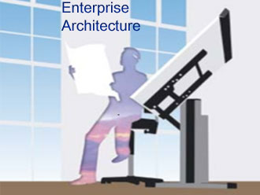

Conceptual Framework for Consumer Electronic Enterprise Architecture
Mentor: Michael Galkin
Group: Shirin Ameri
Shiva Shokuhi
Eliza Koshtoyan
Yi Chen
Notes:
Agenda:
BPM Value prop
State of BPM
Path to integrated BPM
Business
IT

Slide 2
Outline
Objectives
Key Components of EA
Business Architecture
IT Architecture
Demo
Difficulties and Challenges
Documentation Strategy
Poster

Slide 3
Objectives
Consistent
Unambiguous
Comprehensive
Well specified, detailed model of the enterprise and its components
Model contains consistent terminology
No ambiguous situations in model and between its states
The primary goal of EA is to make the organization as efficient and effective as possible!
Notes:
Design and model a
comprehensive
consistent
unambiguous
Enterprise Architecture for Consumer Electronics Enterprise.

Slide 4
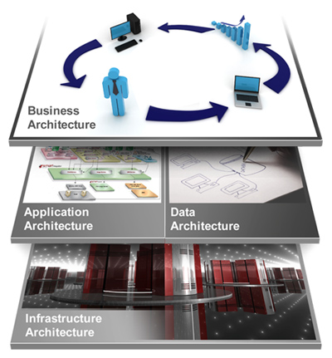
Key Components of Enterprise Architecture
Business Architecture
Application Architecture
Data Architecture
Technology Architecture
IT Strategy
Notes:
Business: Processes, strategies, organization charts, and functions.
Information: Conceptual, logical and physical data models to show what information is needed and how it relates to other information For example, a customer and an order.
Application: Portfolios, interfaces, and services.
Infrastructure: Network concept diagrams, technology reference models.)

Slide 5

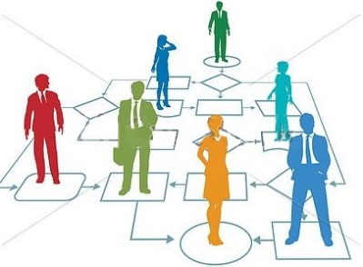

What is a Business Process
A Business Process consists of a set of activities that are performed in coordination in an organizational and technical envioroment. These activities jointly realize a business goal (service or product).
Each Business Process is enacted by a single organization, but it may interact with business processes performed by other organizations.
Business Processes
Product
Realizes
Service

Slide 6
Benefit of Process Modeling
Representation of Processes
Analysis of Processes
Continuous Improvement of Processes
A basis for IT Support
A solid basis for Process Management
Plan: Model Processes
Check: Monitor Processes
Act: Adjust Processes
Do: Perform Processes
The Deming (PCDA Circle)

Slide 7
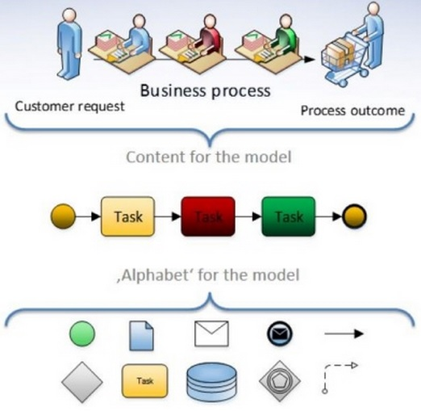
What is BPMN?
Business Process Model and Notation
Business Process
A collection of related, structured activities which
produce a specific service or product for a particular
customer
Model
A representation of a business process
Notation
A set of elements (languages) + rules used for
representing a business process in a business
process model(Diagrams)
Notes:
BPMN defines a diagram tailored for creating graphical operations , a network of graphical objects which are active and the flows controls that define their order of performance .

Slide 8
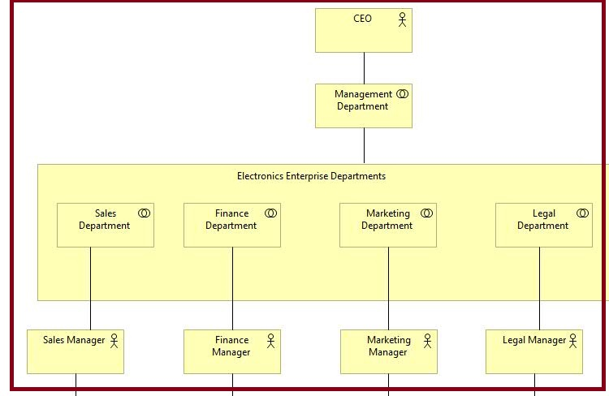
Organizational Structure
CEO = Business Actor
Management Dept. =
Business Collaboration
All Departments =
Business Collaborations
All Managers=
Business Actors
Notes:
Although the key concept is that of process, the definition of actors is considered first. This is because all processes are owned by (performed by) a particular, identifiable actor.

Slide 9
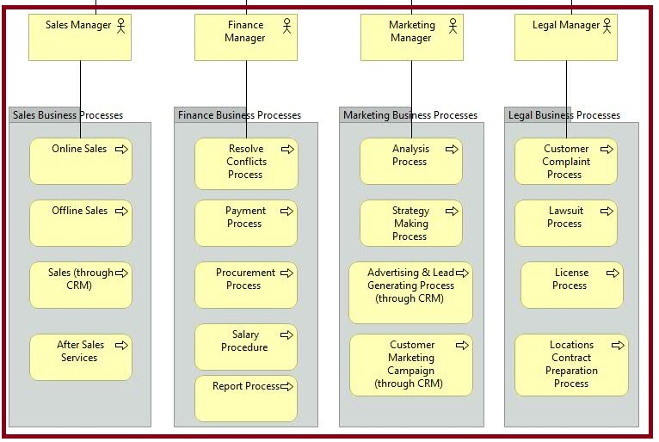
Business Processes for each Departments
All Managers =
Business Actors
BP Groups of All Departments

Slide 10
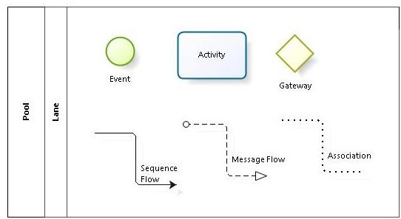
Basic BPMN Elements
Flow Objects
Events
Activities
Gateways
Connecting Objects
Sequence flows
Message flows
Assosiations
Swimlanes
Pools
Lanes
Notes:
Processes may be either ‘compound’ meaning that they can be broken down further into smaller sub-processes or ‘atomic’ meaning that further breakdown is not possible. An atomic process is termed a ‘Task’. The task is the basic unit of the BPMN notation.
An event is something that “happens” during the course of a business process. These events affect the flow of the process and usually have a cause (trigger) or an impact (result)
A Gateway is used to control the divergence and convergence of Sequence Flow. Thus, it will determine branching, forking, merging, and joining of paths
Connections are used to define the information flows that link processes. There are two main types of flow, namely sequence flow and message flow
A Pool represents a Participant in a Process. It is also acts as a graphical container for a set of processes performed by the participant that can be described in sequence.

Slide 11
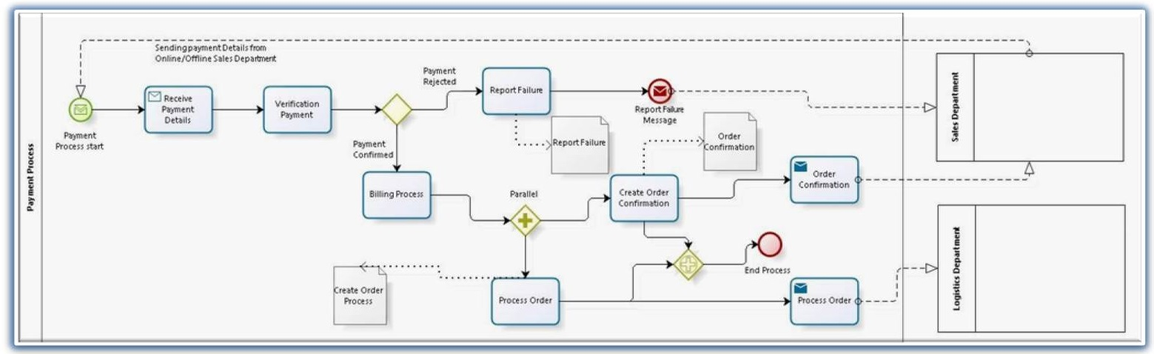
Payment Business Process
Message Start Event
Simple Activity
Exclusive Gateway
Message
Event (Failure)
Message
Flow
Pool
Association
Flow
Sequence
Flow
Received Message Activity
Parallel
Event Based Gateway
Parallel Gateway
Data Object
End Event
Forward Message Activity

Slide 12

Application Architecture
Data Architecture
Technology Architecture
IT Architecture

Slide 13
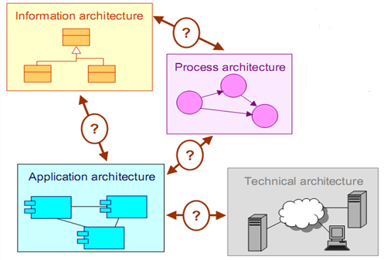
What is ArchiMate?
ArchiMate offers a common language for describing the construction and operation of business processes, organizational structures, information flows, IT systems, and technical infrastructure.
Notes:
It presents a unified way of modelling enterprise architectures,

Slide 14
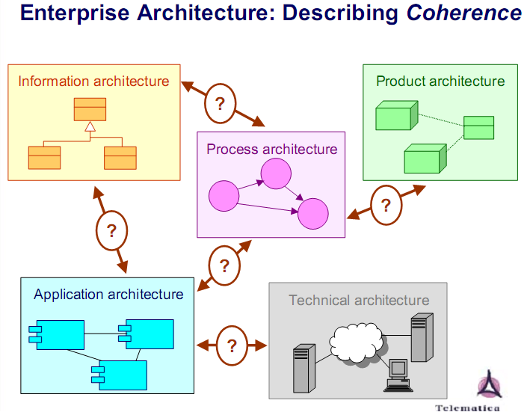
IT Architecture
Applications Architecture is the science and art of ensuring the suite of applications being used by an organization to create the composite architecture is scalable, reliable, available and manageable.
Data Architecture is composed of models, policies, rules or standards that govern which data is collected, and how it is stored, arranged, integrated, and put to use in data systems and in organizations
Notes:
that the applications architecture is about the choice of and relationships between applications in the enterprise's application portfolio, not about the internal architecture of a single application (which is often called application architecture).

Slide 15
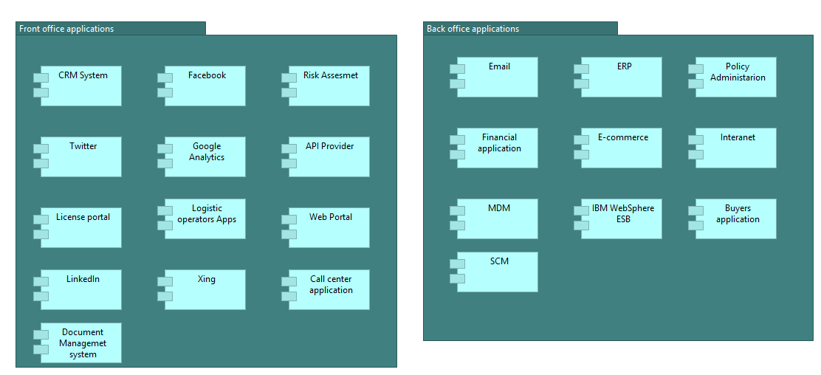
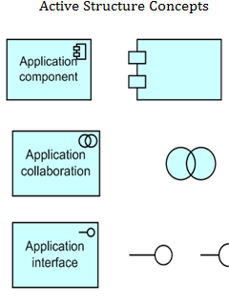
Application Architecture Demo
Application Landscape
Archimate Notation
Notes:
This viewpoint is typically used to create an overview of the application landscape of an organization. This viewpoint is also used to express the (internal) co-operation or orchestration of services that together support the execution of a business process.
Figure 13: Example of an application landscape organized along usage of front-office and back-office

Slide 16
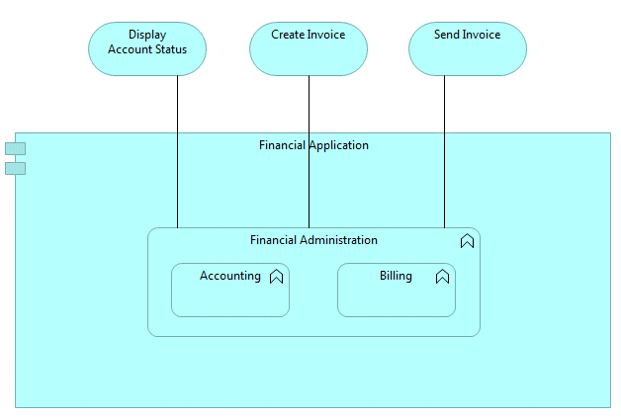
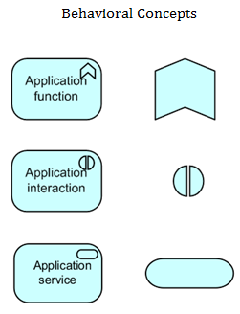
Application Architecture Demo
Application Behavior Viewpoint
Archimate Notation
Notes:
he Application Behavior viewpoint describes the internal behavior of an application; e.g., as it realizes one or more application services. This viewpoint is useful in designing the main behavior of applications, or in identifying functional overlap between different applications.
the internal behavior of the Financial application component is modeled as an application function consisting of two sub-functions. These application functions realize the application services that are made available to the users of the application.
An application service is defined as a service that exposes automated behavior.

Slide 17
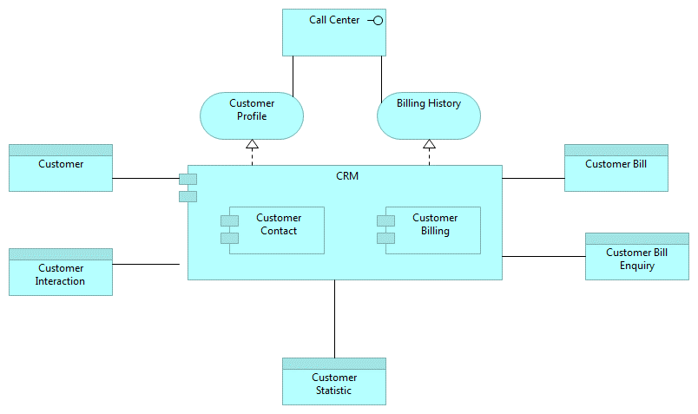
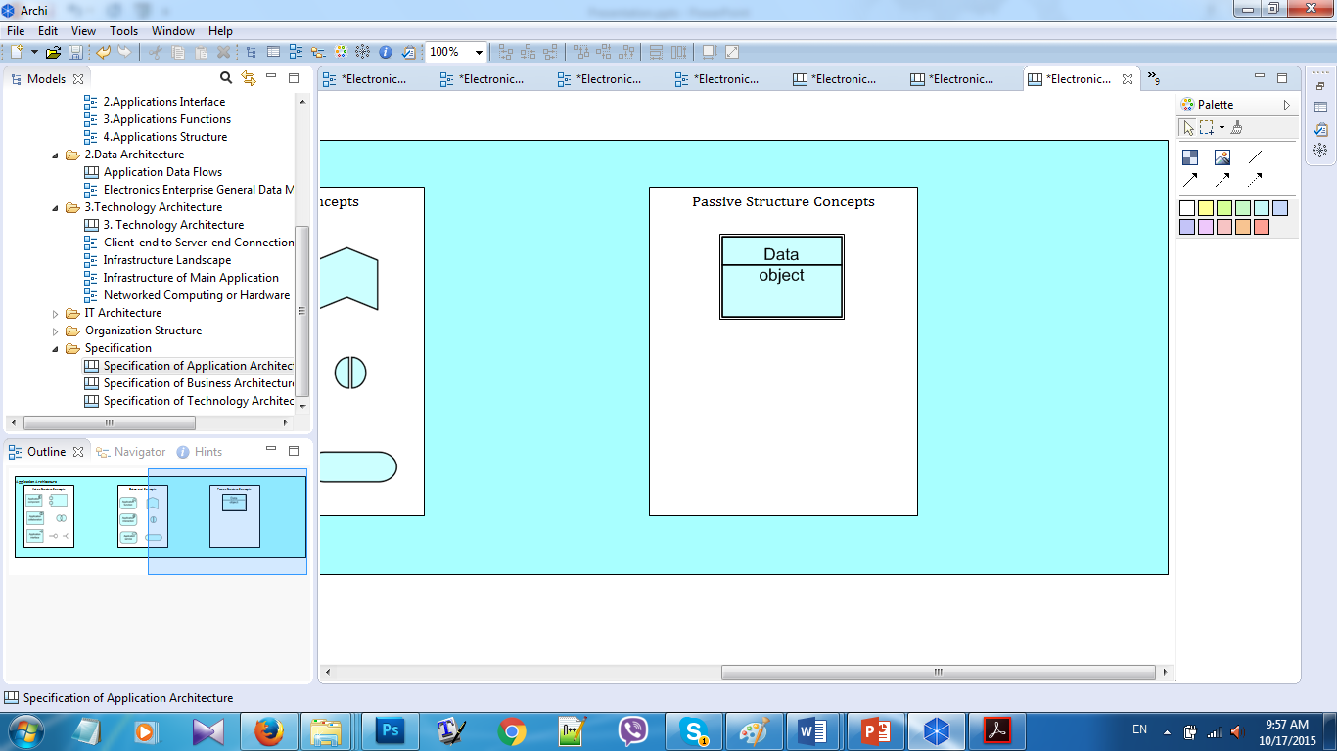
Application Architecture Demo
Application Structure Viewpoint
Archimate Notation
Notes:
The Application Structure viewpoint shows the structure of one or more applications or components. This viewpoint is useful in designing or understanding the main structure of applications or components and the associated data; e.g., to break down the structure of the system under construction, or to identify legacy application components that are suitable for migration/integration.
A data object is defined as a passive element suitable for automated processing.
a data object holding Transaction data is exchanged.

Slide 18
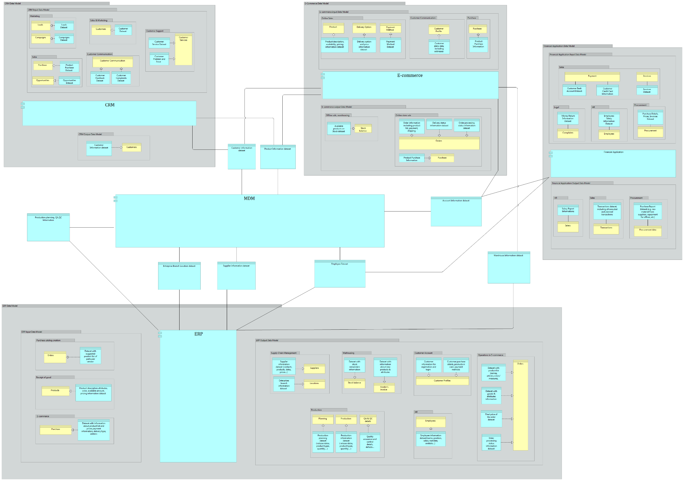
Data Architecture Demo
Notes:
In our Electronics Enterprise there are 5 main applications to automate and organize business processes. These are: Enterprise Resource Planning (ERP), Electronic Commerce (E-commerce), Financial Application, Customer Relationship Management (CRM) and Master Data Management (MDM). In the following sub-chapters we will describe each system in details including their purpose, their functionality domains and also data flow within and between these systems.

Slide 19
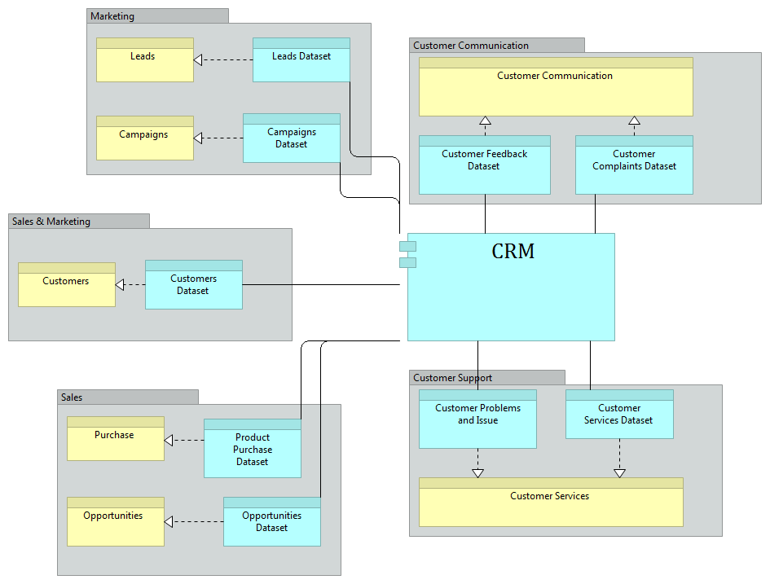
Data Architecture Demo
Notes:
In our Electronics Enterprise there are 5 main applications to automate and organize business processes. These are: Enterprise Resource Planning (ERP), Electronic Commerce (E-commerce), Financial Application, Customer Relationship Management (CRM) and Master Data Management (MDM). In the following sub-chapters we will describe each system in details including their purpose, their functionality domains and also data flow within and between these systems.

Slide 20
IT Architecture
Technical Architecture
offers infrastructural services (e.g., processing, storage and communication services) needed to run applications, realized by computer and communication hardware and system software

Slide 21
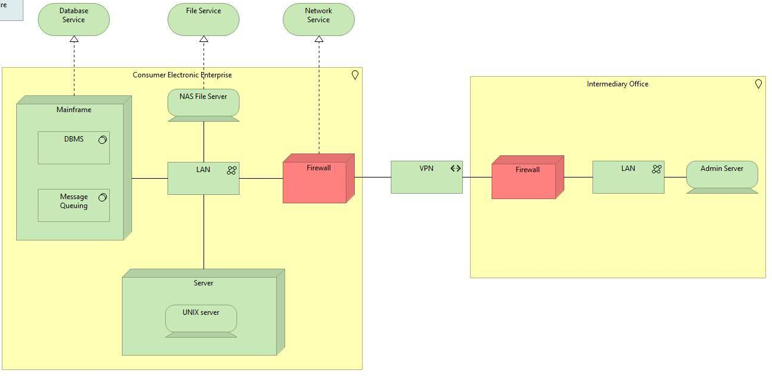
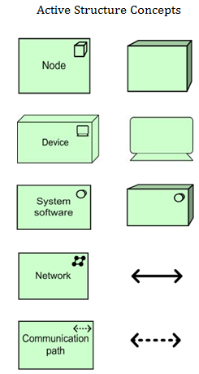
Infrastructure Architecture Demo
Infrastructure Landscape
Archimate Notation
Notes:
The Infrastructure viewpoint contains the software and hardware infrastructure elements supporting the application layer, such as physical devices, networks, or system software (e.g., operating systems, databases, and middleware).

Slide 22
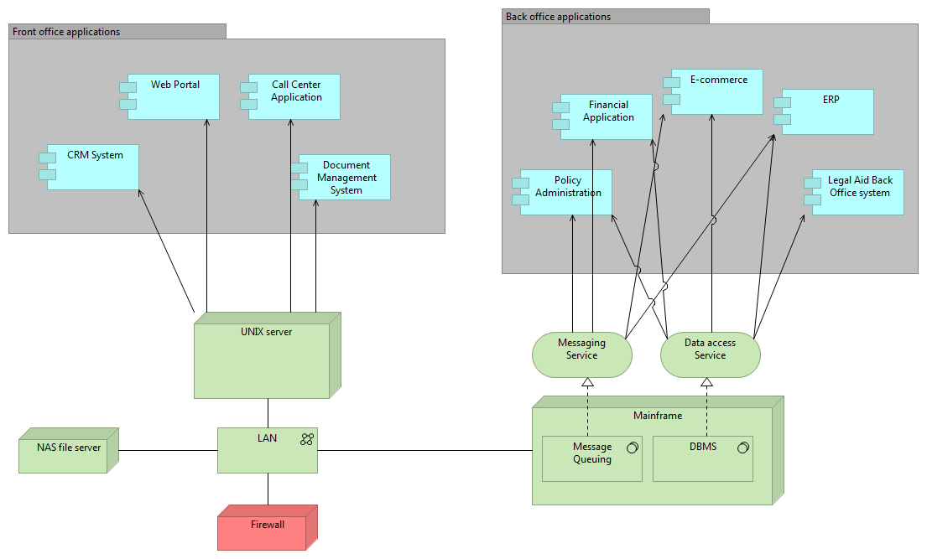
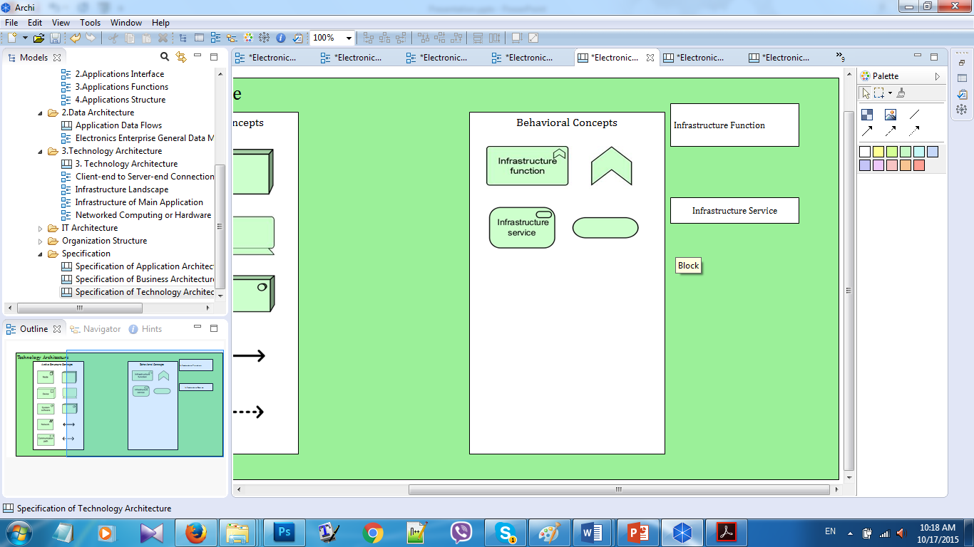
Infrastructure Architecture Demo
Infrastructure Usage Viewpoint
Archimate Notation
Notes:
The Infrastructure Usage viewpoint shows how applications are supported by the software and hardware infrastructure: the infrastructure services are delivered by the devices; system software and networks are provided to the applications. This viewpoint plays an important role in the analysis of performance and scalability, since it relates the physical infrastructure to the logical world of applications. It is very useful in determining the performance and quality requirements on the infrastructure based on the demands of the various applications that use it.

Slide 23
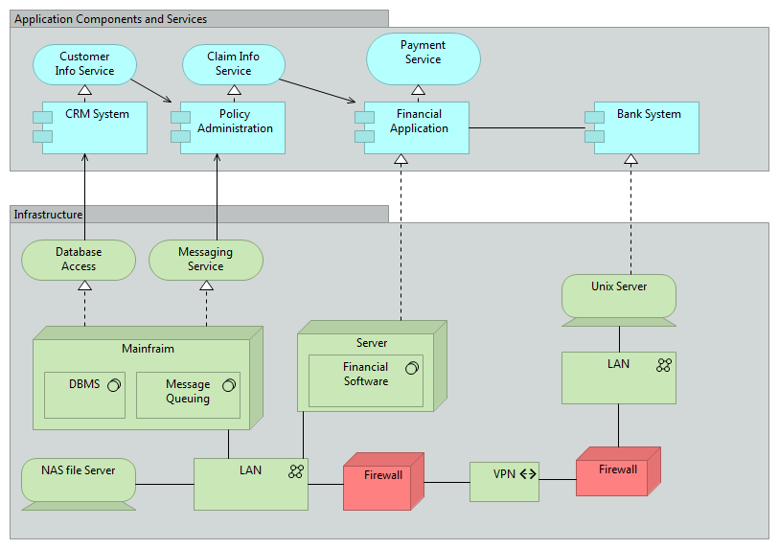
Infrastructure Deployment Viewpoint
Notes:
The Implementation and Deployment viewpoint shows how one or more applications are realized on the infrastructure. Deployment views play an important role in the analysis of performance and scalability, since they relate the physical infrastructure to the logical world of applications. In security and risk analysis, deployment views are used to identify, for example, critical dependencies and risks.

Slide 24
Difficulties and Challenges
Getting information about business processes for each domain and department
Selecting a tool (we required tool with both BPMN and Archimate notations to automatically keep diagrams and entities consistent, we found one, but was it expired in between, so we had a problem to switch to other tools and redraw all our diagrams)
Maintain consistency between two tools (later we switched to 2 different tools for BPMN and Archimate, and it was a challenge to maintain consistency for entities between them)

Slide 25
Documentation Strategy
Documentation consists of two main parts:
Technical System Documentation
Contains detailed information about implemented EA models
Components:
Framework and Architecture Layers
Organizational Structure of EA
Business Process Models
Application, Data and Technology Architecture
User Manual
­Describes BPMN and Archimate notations and helps user to understand the models.

Slide 26

Q & A

