Slide 1







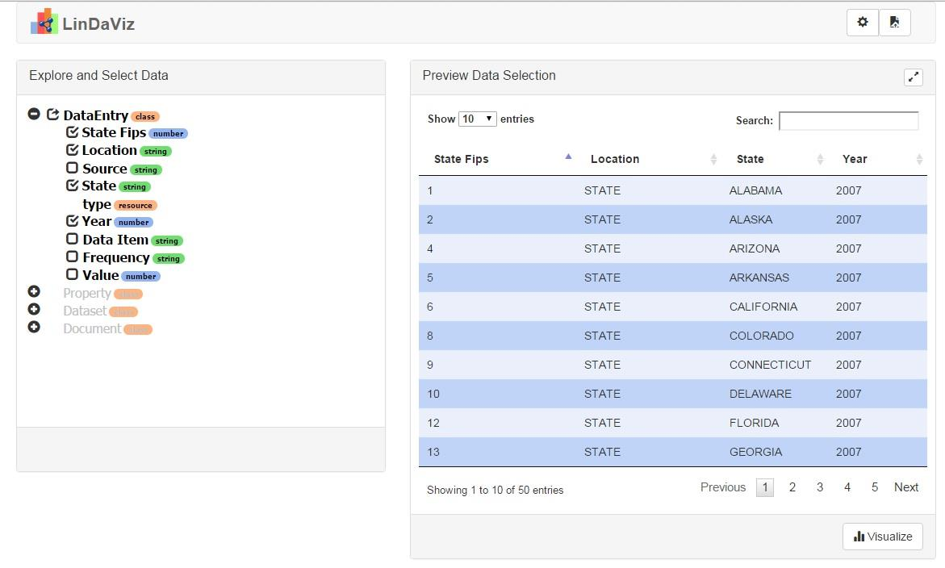
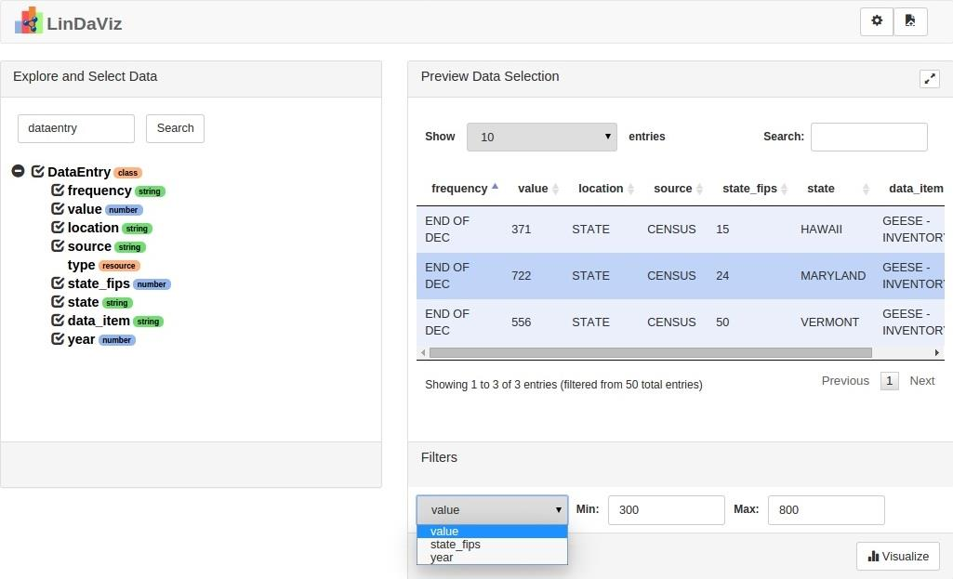
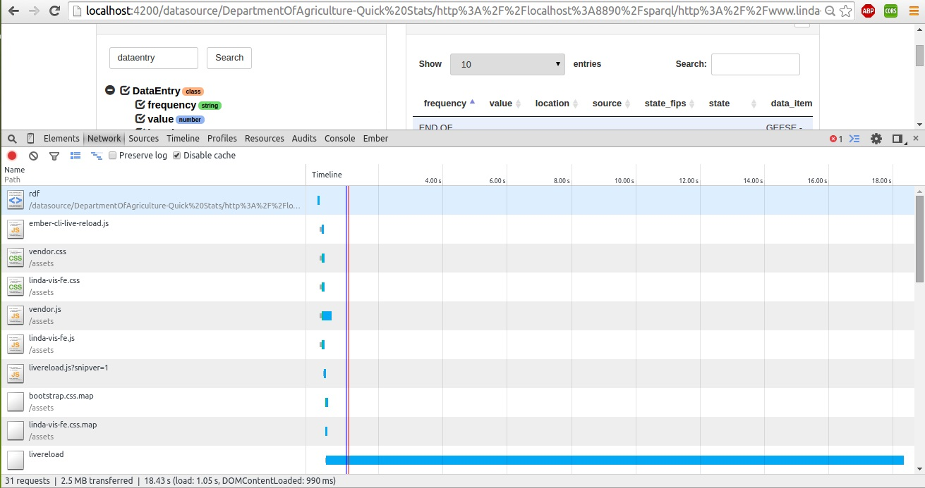
Visualizing and Exploring Linked Data
The LinkDaViz tool is a JavaScript based web application, receiving input data in RDF format.
Useful links:
Documentation: https://github.com/EIS-Bonn/MA-INF3232-Lab-SS2015/blob/master/GroupD/Presentations/GroupD_Documentation_Presentation.odp
Demo-version: http://ec2-52-88-37-178.us-west-2.compute.amazonaws.com:4200/
Components
The frontend module:
a component for data selection,
the visualization widgets library,
a component for configuring a visualization.
The backend module:
computing visualization recommendations,
a data storage for visualization metadata and saved visualizations.
Add-ons
Before
Key-based search
Values search in the tree
Non-found values
Filtering
Numerical data from the tree
Min & max values
Data table
Scrolling in the data table
Linda project
After
Objective: to make the benefits of LOD accessible to SMEs.
Functionality: Linda guides the user step by step through the process of browsing, selecting and exploring data and configuring visualizations by computing suggestions for suitable visualizations and possible configurations for this visualizations.
Major challenge: to provide means for exploring and visualizing Linked Data by hiding complexity through automation and an intuitive user interface.
Results
Workstation:
EIS02: Ubuntu2015-LDViz
TeamViewer remote access:
Login: 561 678 043
Pass: E1sldviz2015
Mentor: Klaudia Tellmann
Students: Alina Arunova, Tatiana Novikova, David Ibhaluobe

