Slide 1

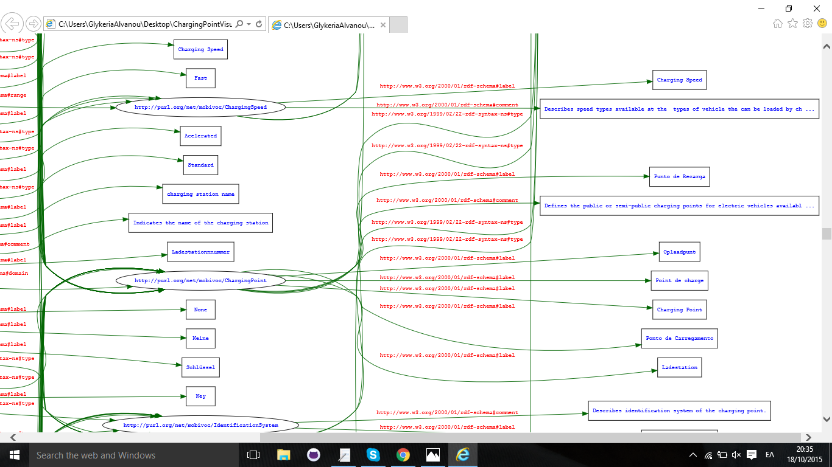
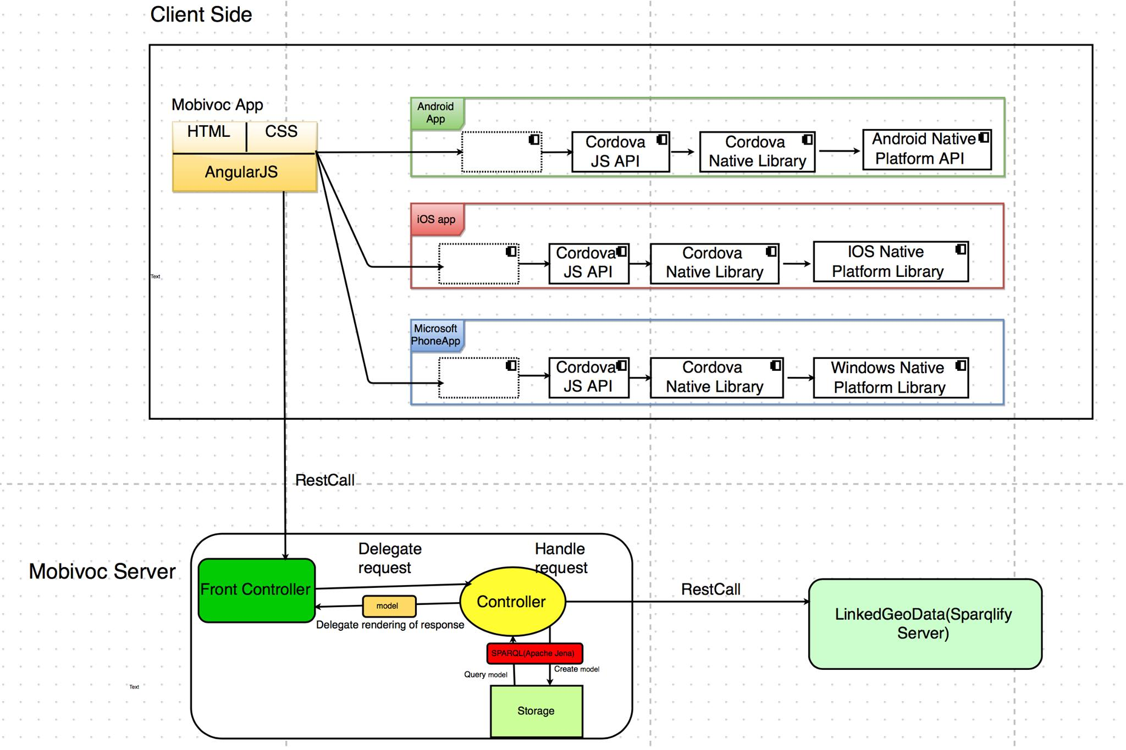
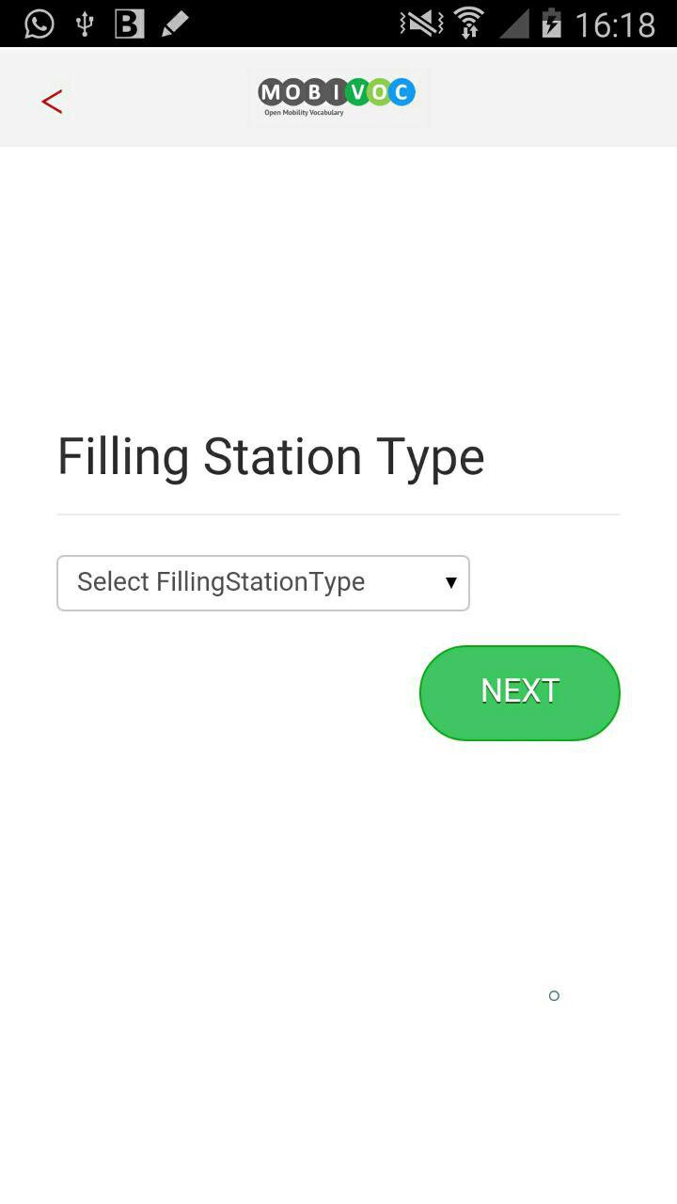
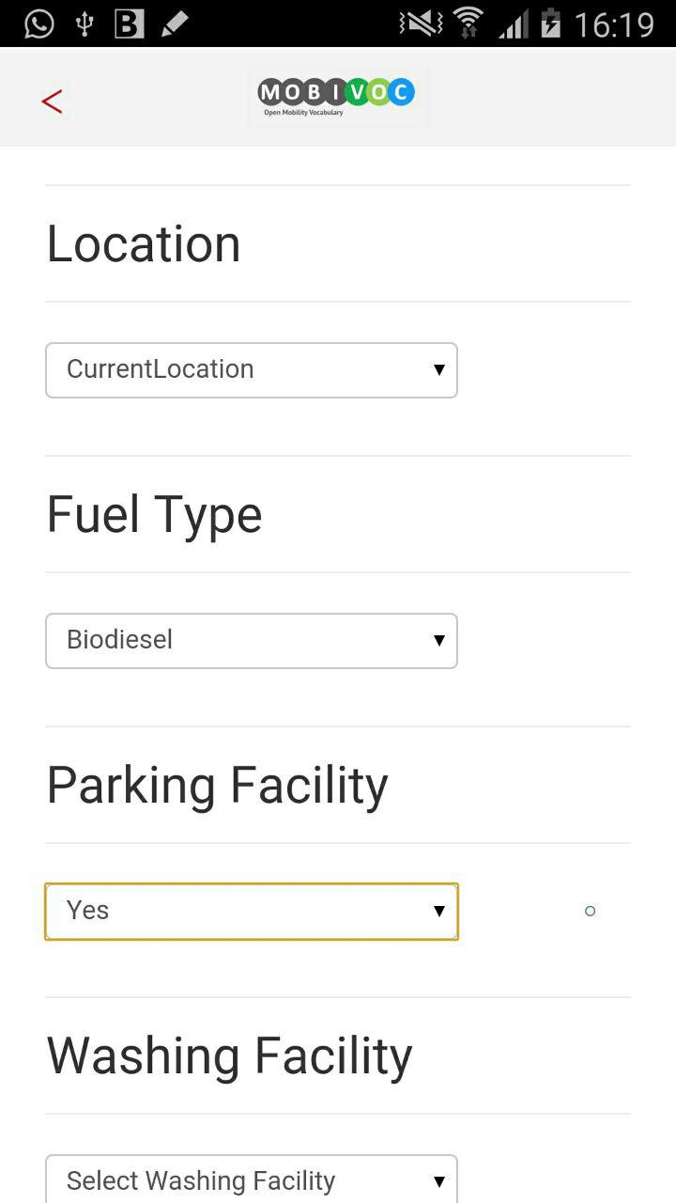
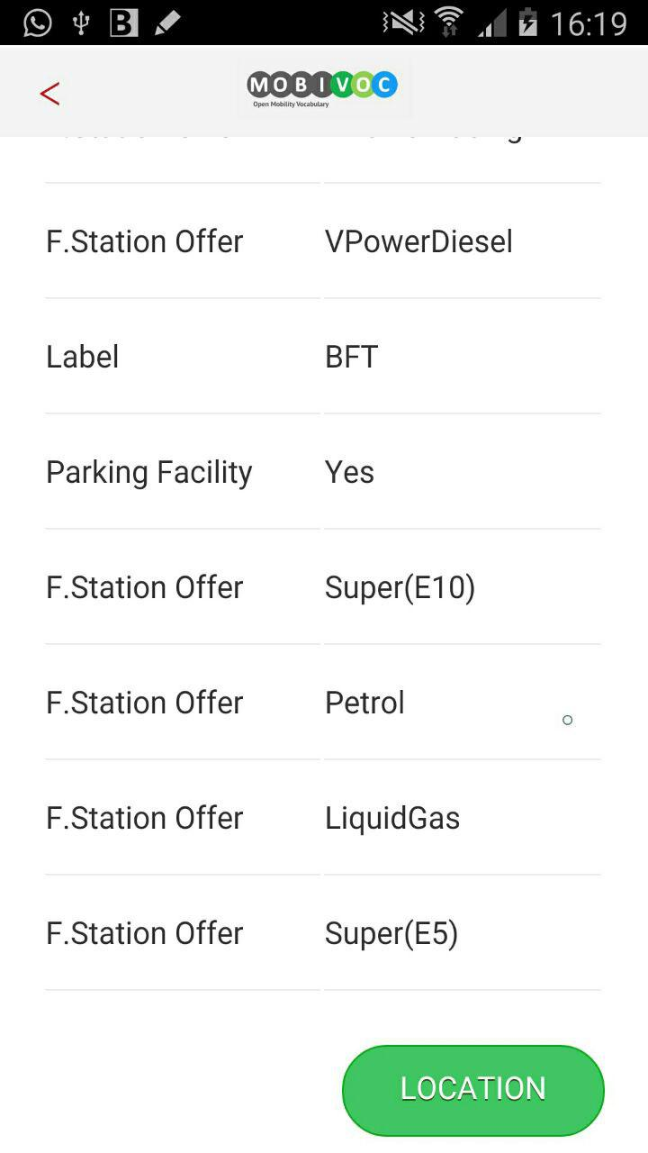
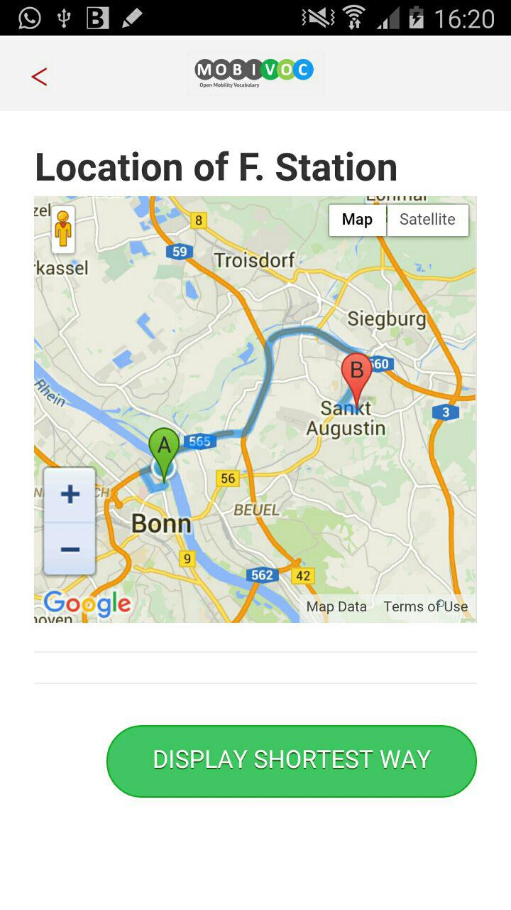



Mobility Vocabulary
Development & Showcase
Summer Semester 2015
Goal
Vocabulary Visualization
Development of a standardised vocabulary for fuel data and for electrical vehicles
Creation of an end-user application which uses the developed vocabulary
Technology
MobiVoc
RDF
SPARQL API (Apache Jena)
OWL 2.0
RDFS
Apache Cordova
Java Spring
REST
AngularJS
Apache Tomcat
Architecture
End-user Application
The system shows the functionality of the new vocabulary that is developed. It is written in Java on Eclipse, implemented in Java spring, works on mobiles as well as pads. Application uses data from GeoSparql. It queries on GeoSparql and returns the results which are stored as turtle format in the server side. Application has also client side which shows the query results within the proper format. Data exchange between client and server side is implemented with JSON.
Testing
Syntax
Rdf
Translator
Tool
Semantic
Oops
(OntolOgy
Pitfall Scanner)
End-user
Application
Test cases using
SPARQL queries
Virtual Machine Description
Hostname: Windows15-MobiVoc
Installed on: EIS02
Software installed: JDK 1.8, JavaSpring Framework, Apache Tomcat 8, Apache Cordova, Eclipse Luna
GitHub Link:
https://github.com/EIS-Bonn/MA-INF3232-Lab-SS2015/tree/master/GroupE
Local Access:
OS User: eis-user
Password: E1sdb2015
Remote Access:
Partner ID: 549 614 999 Password: E1sdb2015
EIS
Enterprise
Information Systems
Mentor: Niklas Petersen
Glykeria Alvanou
Yesim Aslan
Umut Hatipoglu

