Slide 1
_{Green Energy Mobile App}
Members:
Veronika Henk
Sarvenaz Golchin
Mahnaz Hajibaba

Slide 2
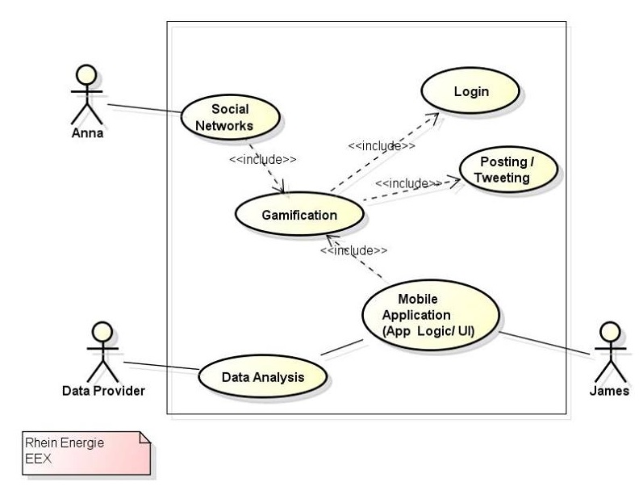
What is the goal of this project?
How is this application useful? Who benefits from this application?
How is it related to enterprise information systems?

