Slide 1
VAJRA
A closed-loop red-team / blue-team system for GenAI payment fraud
Invent the attack → live it out on the rail → catch it → feed what escaped back in
The next twenty minutes are a walk through that loop, in five stops.
A LANGUAGE for attacks, not a list
A WORLD that refuses to cheat
A DEFENCE that sees the unseen
AND OUR OWN audit of both
Mastercard Innovation Challenge 2026 · Global Fintech Fest, Mumbai
1

Slide 2
HOW THIS WALK IS LAID OUT
STOP 1 OF 5 · THE PROBLEM
Five stops
One idea per slide. The figures are the argument; the numbers are all measured.
STOP 1
The problem
Why fraud detection is hard in a way most demos never show you.
STOP 2
The attacks
How we invent them, and why there are fifteen thousand of them.
STOP 3
The machine
The three parts, walked one at a time, then closed into a loop.
STOP 4
The results
What it catches — including attacks it has never seen.
STOP 5
The honesty
The defects we found in ourselves, and what we still cannot do.
We end at honesty on purpose. Everything before it is a claim; stop 5 is the evidence that we went looking for our own mistakes before you did.
VAJRA · Mastercard Innovation Challenge 2026
2

Slide 3
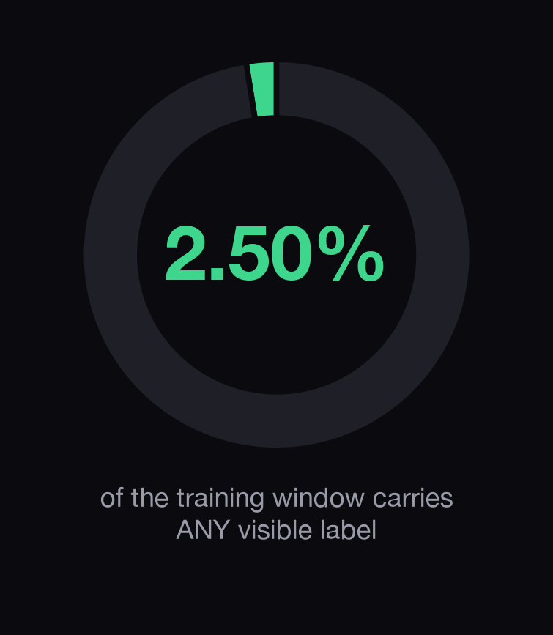
STOP 1 · THE PROBLEM
STOP 1 OF 5 · THE PROBLEM
When you have to decide, you do not know the answer
Everything about our design follows from this one picture.
A FRAUD LABEL ARRIVES LONG AFTER THE DECISION
An analyst may call it in hours. An issuer tag takes days. A chargeback or a network report takes 45 to 120 days.
SO WE NEVER PRETEND OTHERWISE
We train on the labels that actually exist at decision time, weighted by how mature they are, and we correct for the fact that the old policy already blocked some attacks and we will never learn what they would have done.
The easy alternative, call everything unlabelled "legitimate" teaches a model that no complaint means no crime.
VAJRA · Mastercard Innovation Challenge 2026
3

Slide 4
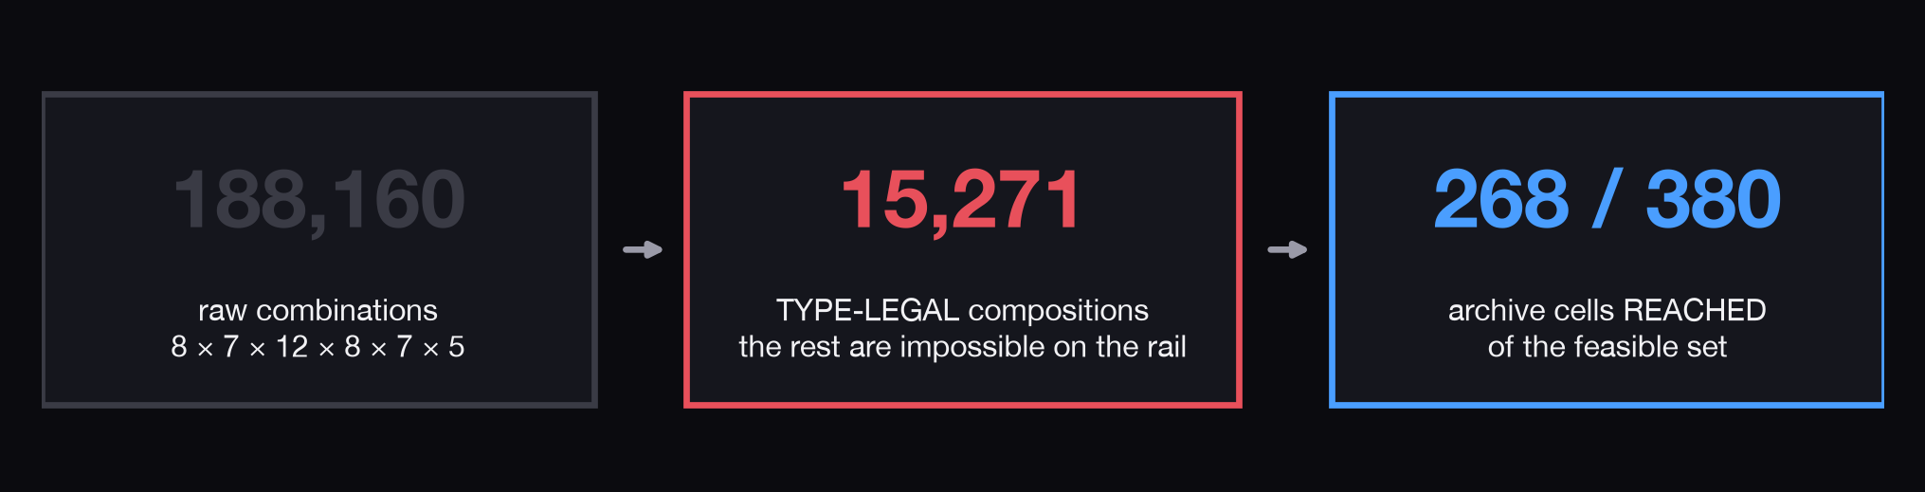
STOP 2 · THE ATTACKS
STOP 2 OF 5 · THE ATTACKS
We did not list attacks. We built a language for them.
Six slots, each a choice. Pick one from each and you have described an attack.
THE SIX CHOICES
How they get in · whose trust they borrow · which rail they ride · how they stay quiet · how the money leaves · what the victim will eventually call it.
MOST COMBINATIONS ARE IMPOSSIBLE
A rail that ends in physical cash has no beneficiary to name. We reject 172,889 such strings, and the rejection explains itself.
WE PUBLISH OUR OWN CEILING
We have reached 268 of the 380 regions this space can hold — 70.5%. We would rather show you the number than let you assume it was 100%.
VAJRA · Mastercard Innovation Challenge 2026
4

Slide 5
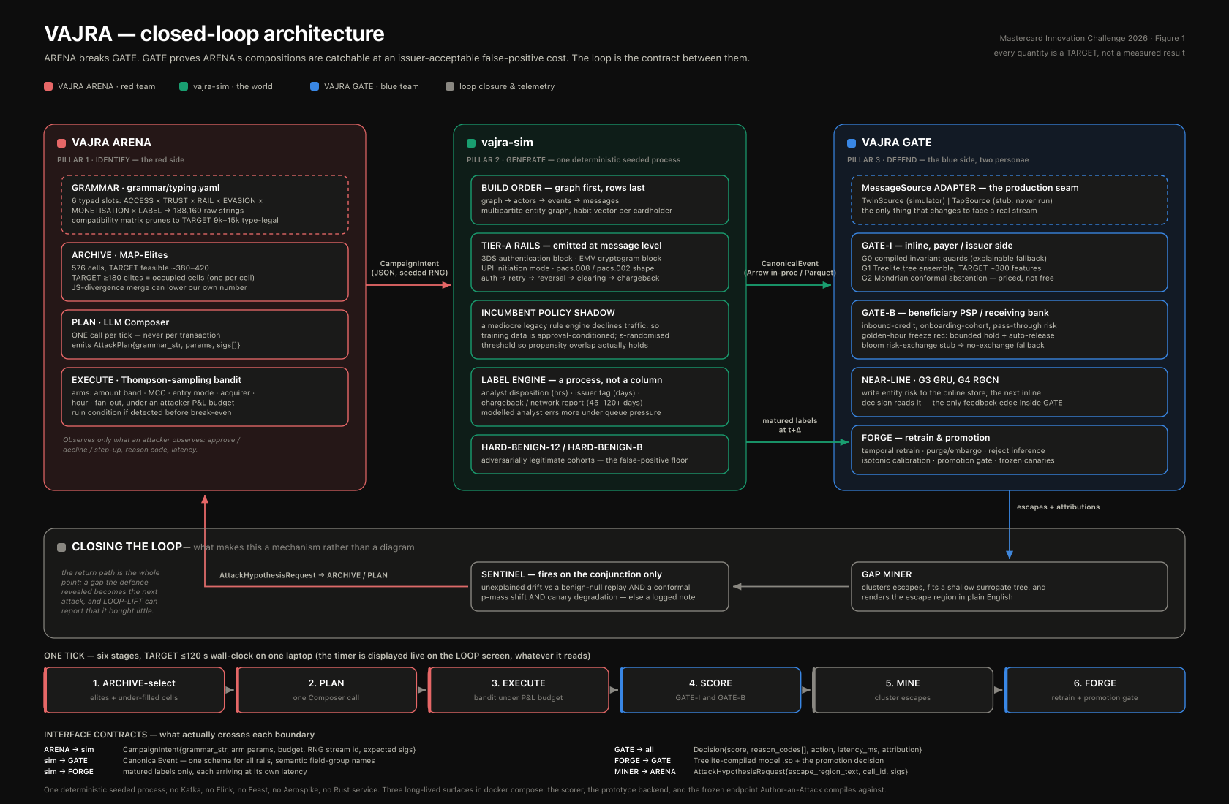
STOP 3 · THE MACHINE, ALL AT ONCE — THEN ONE PART AT A TIME
STOP 3 OF 5 · THE MACHINE
Drawn during design, so its quantities are TARGETS. Every number elsewhere in this deck is a measured result and supersedes it.
VAJRA · Mastercard Innovation Challenge 2026
5

Slide 6
STOP 3 · PART ONE OF THREE
STOP 3 OF 5 · THE MACHINE
The attacker
Its job: keep finding attacks the current defence has no answer for.
01
THE ATTACKER
It does not sample randomly. It keeps a map of the attack space and deliberately pushes into the regions where the defence is currently blind — then breeds the survivors.
A LANGUAGE MODEL, USED SPARINGLY
It proposes variations once per round, never once per transaction. The run stays seeded and reproducible.
A BUDGET, NOT A FIREHOSE
Each campaign has a profit-and-loss budget and has to earn its next move, the way a real fraud crew does.
THE MAP IS THE CURRICULUM
Regions where the defence catches nothing get sampled MORE next round. The defence's weakness sets the attacker's agenda.
VAJRA · Mastercard Innovation Challenge 2026
6

Slide 7
STOP 3 · PART TWO OF THREE
STOP 3 OF 5 · THE MACHINE
The world
Its job: make the attack actually happen, on a rail that behaves like the real one.
02
THE WORLD
Nine point nine million payment events across twelve rails, with the old fraud policy running alongside so we can see what it would have blocked, and labels that arrive late the way real ones do.
126 RULES THE BUILD WILL NOT LET US BREAK
Authorisation before presentment. Clearing spills forward, never backwards. A derived leg cannot precede the thing it derives from.
THESE ARE GATES, NOT TESTS
At one point they stopped the build 13,009 times. We fixed the generator, not the rules.
THE ATTACK RATE IS CONTROLLED, NOT ASSUMED
We aimed at 0.50% and landed at 0.69%, and the trainer uses what we actually got rather than what we asked for.
7
VAJRA · Mastercard Innovation Challenge 2026

Slide 8
STOP 3 · PART THREE OF THREE
STOP 3 OF 5 · THE MACHINE
The defence
Its job: turn a stream of events into an action a bank can actually take.
03
THE DEFENCE
Four layers. First refuse what is structurally impossible. Then score. Then ask how unusual and how confident. Then choose an action the rail actually supports.
IT IS ALLOWED TO SAY "I DO NOT KNOW"
Uncertain cases are routed to a human instead of guessed at, and we count that cost rather than treating abstention as free.
EVERY DECISION CARRIES A REASON
54 fixed reason codes. A score with no explanation is not something an issuer can act on.
THREE STRENGTHS, NOT ONE SWITCH
Add friction, send to review, or decline — fitted separately for each rail, because you cannot decline a clearing record.
8
VAJRA · Mastercard Innovation Challenge 2026

Slide 9
STOP 3 · WHAT JOINS THEM
STOP 3 OF 5 · THE MACHINE
The part that makes it a loop
A pipeline runs once. This one feeds its own failures back to the attacker.
1
PICK A TARGET
choose a region of the attack space — preferring the blind ones
2
INVENT
propose variations inside that region
3
LIVE IT OUT
run the campaign on the rail, under budget
4
DECIDE
score it from every deployment position
5
FIND WHAT ESCAPED
cluster the misses into named gaps
6
REBUILD
retrain, and only promote if it is genuinely better
AND THEN STEP 5 CHANGES STEP 1
The gaps the defence leaves raise the sampling weight of the regions that produced them. That single arrow is the difference between a system that improves and a demo that finishes. We also ran it with that arrow cut, so the contribution is compared rather than asserted.
9
VAJRA · Mastercard Innovation Challenge 2026

Slide 10
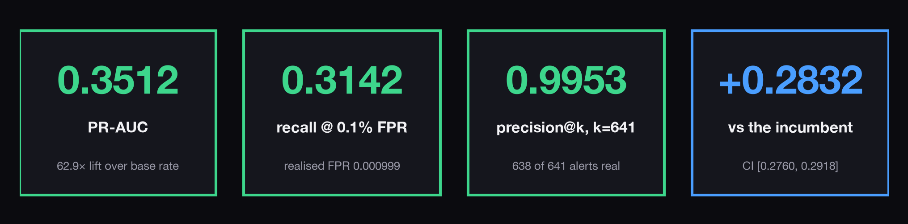
STOP 4 · THE RESULTS
STOP 4 OF 5 · THE RESULTS
What it catches
Two point six million events it has never seen · 14,918 attacks · one in every 180 events is an attack.
READ THE THIRD CARD CAREFULLY
A team can work about 641 cases in this window. Of the 641 we hand them, 638 are real attacks. That is a clean queue — not a claim that we catch everything.
SO ALWAYS SAY BOTH NUMBERS
We catch 31% of attacks at a false-positive rate of one in a thousand. Precision without recall beside it is the oldest way to mislead with a fraud metric.
10
VAJRA · Mastercard Innovation Challenge 2026

Slide 11
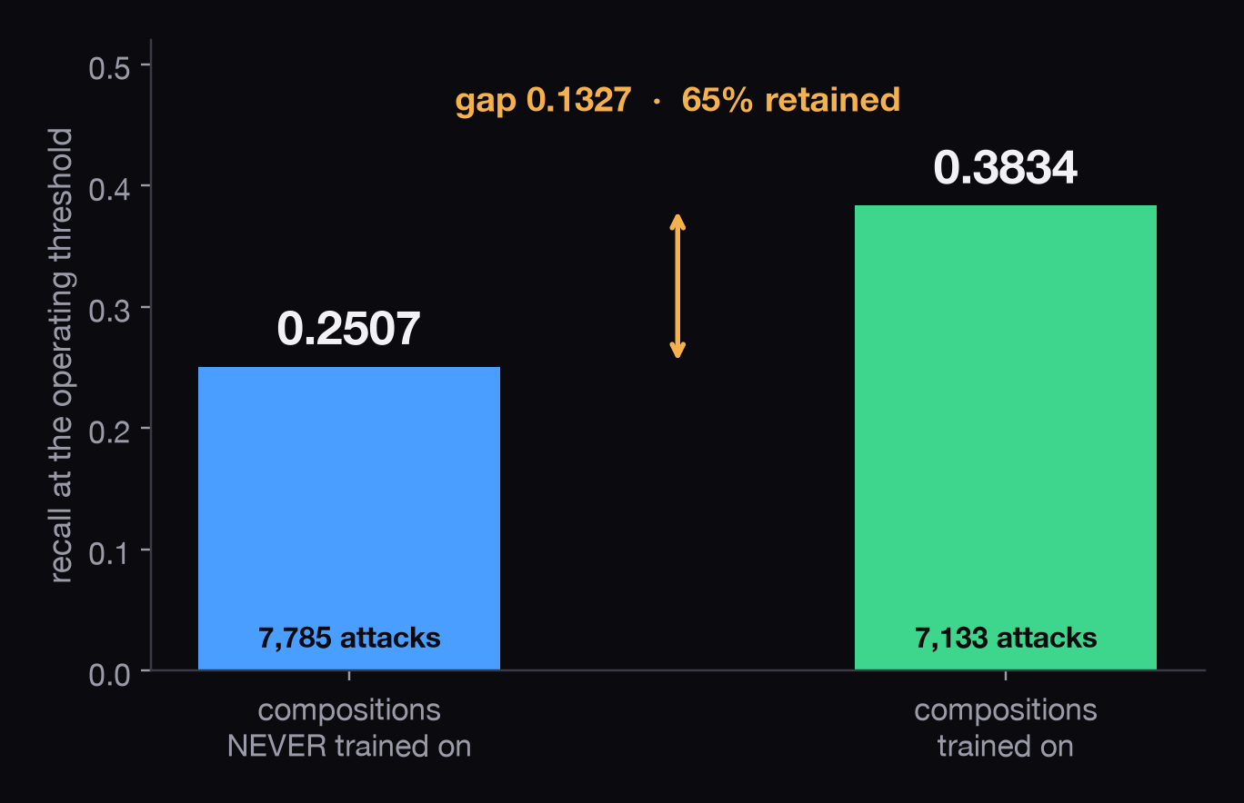
STOP 4 · THE QUESTION THAT ACTUALLY MATTERS
STOP 4 OF 5 · THE RESULTS
Can it catch an attack nobody has ever shown it?
This is what the challenge is really asking. It is the only number that answers it.
WE LOCKED AWAY THE MAJORITY
52% of the attacks in the test window are kinds the model was never trained on. We sealed twelve whole families and one entire evasion technique.
IT KEEPS TWO THIRDS OF ITS EDGE
On attacks it has never seen it retains 65% of the performance it has on ones it has.
A RANDOMLY SPLIT MODEL CANNOT ANSWER THIS
It has already seen every kind. There is no number it can put here, which is the point.
11
VAJRA · Mastercard Innovation Challenge 2026

Slide 12
STOP 4 · BEFORE YOU BELIEVE ANY OF IT
STOP 4 OF 5 · THE RESULTS
Six ways we tried to catch ourselves cheating
All six run on every build. Any one of them failing stops the build.
WE WROTE THE ANSWERS DOWN FIRST
Version-control history proves the sealed attack list was committed before a single line of detector code existed. This is a control on us, not on the model.
PASS
NO TIME TRAVEL
Training strictly precedes testing, with a five-day gap on each side of the boundary. 791,973 rows near the seam are thrown away rather than risked.
PASS
NO SHARED PEOPLE
No account, device or merchant appears both in training and in the held-out attacks. 1,791,118 rows were excluded from training to keep it that way.
PASS
NO LABEL THAT ARRIVED TOO EARLY
Every label used is checked to have arrived after its own event and inside its real window.
PASS
NO STATISTIC FITTED ON THE FUTURE
Baselines, thresholds and cold-start priors are all fitted on the training slice only.
PASS
NO ACCIDENTAL NAME LEAK
An automated check confirms no feature, rule or setting so much as mentions a held-out family.
PASS
12
VAJRA · Mastercard Innovation Challenge 2026

Slide 13
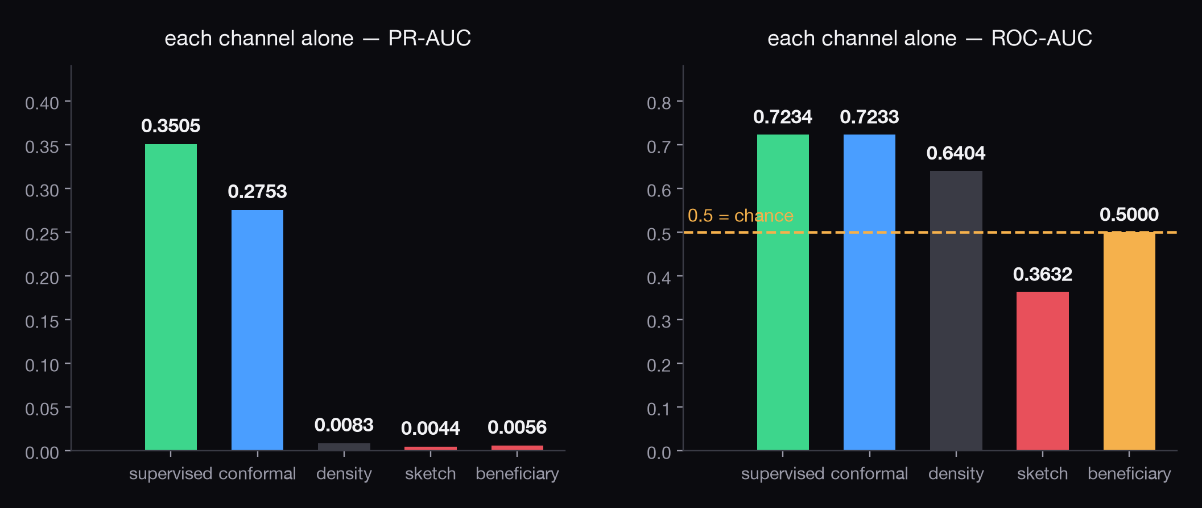
STOP 5 · THE HONESTY
STOP 5 OF 5 · THE HONESTY
We scored every part of the defense on its own: two were dead
Nobody does this, it costs almost nothing, and it is how we found the next slide.
One of them returned the SAME VALUE for all 2.6 million rows. Another was reliably WRONG — worse than a coin. Between them they carried a fifth of the final score.
13
VAJRA · Mastercard Innovation Challenge 2026

Slide 14
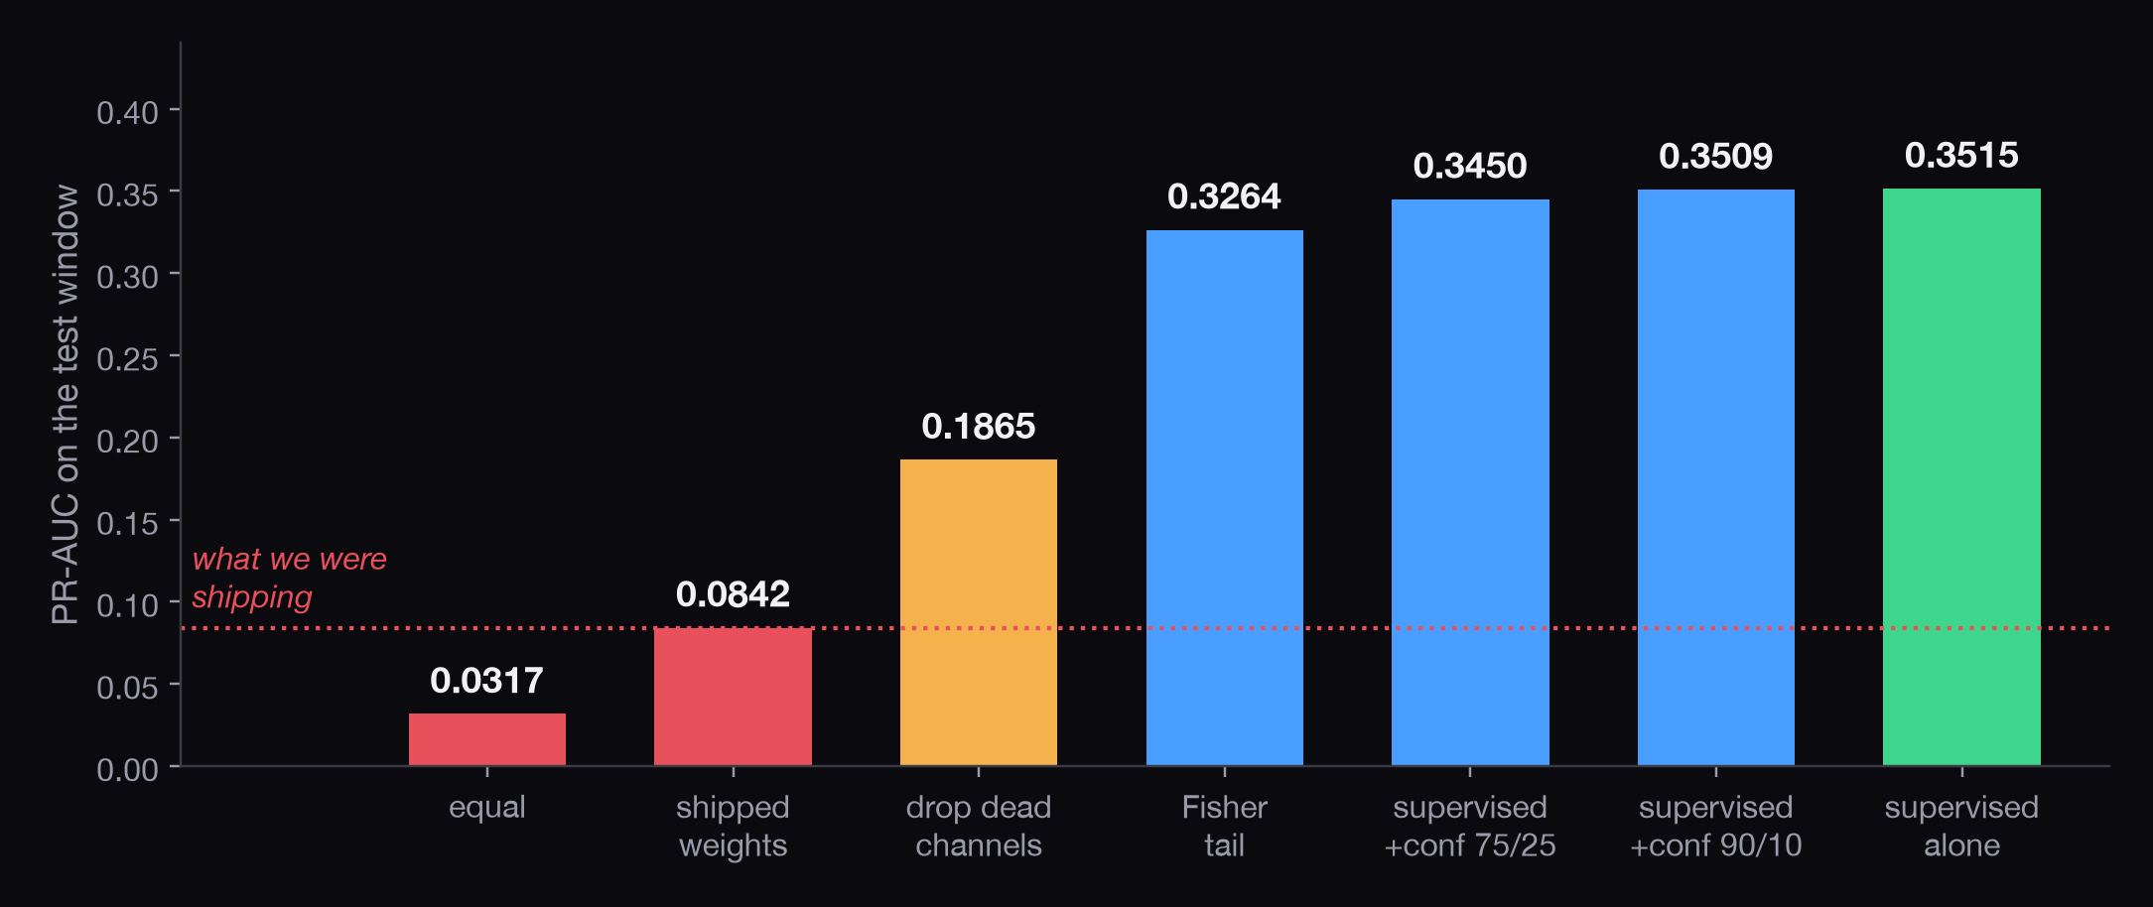
STOP 5 · WHAT THAT LED US TO
STOP 5 OF 5 · THE HONESTY
Our own combiner was throwing away a model four times better
The bar on the left is what we would have submitted. The bar on the right is the same model, combined properly.
WHY IT WAS INVISIBLE
Averaging ranks is scale-free, so a component weighted a tenth can still reorder the cases that matter — and the top of our queue is packed that tightly.
FOUR MORE WE CAUGHT THE SAME WAY
A safety cap that could escalate a whole rail into automatic declines · two features that separated attacks perfectly, deleted · an instrument reporting a fabricated zero · a guard that refused to ship a collapsed action ladder.
14
VAJRA · Mastercard Innovation Challenge 2026

Slide 15
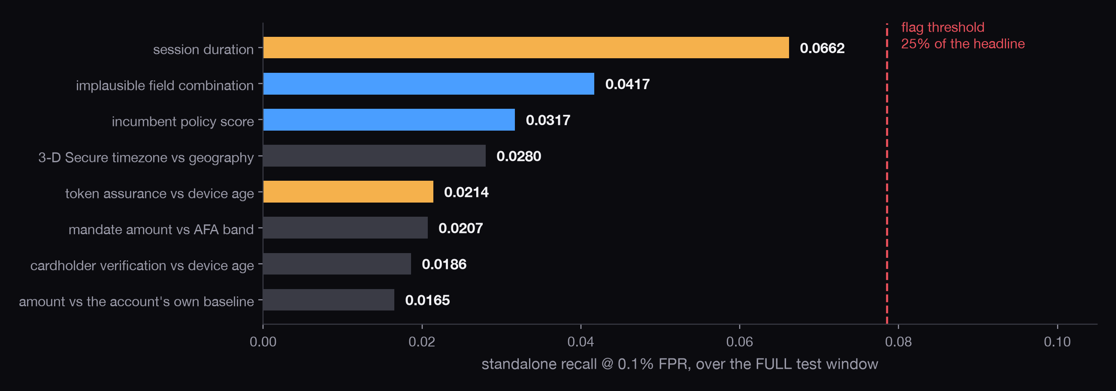
STOP 5 · WHERE WE FLATTER OURSELVES
STOP 5 OF 5 · THE HONESTY
Two of our signals are too good, and we say so first
We ranked every feature by how well it alone separates attacks, and went looking for ones that were suspiciously strong.
SESSION DURATION: REAL MECHANISM, TOO CLEAN A DRAW
Coerced victims really do sit through hour-long sessions. But our ordinary sessions are drawn too tidily, so the separation is sharper here than in production. Bounded at 21% of the headline.
AND ONE WE CHOSE NOT TO BUILD
Attack cash-outs land on exactly ₹5,000, so an amount-collision feature would have topped this chart. We left it out and recorded the decision, rather than banking a number our own generator handed us.
15
VAJRA · Mastercard Innovation Challenge 2026

Slide 16
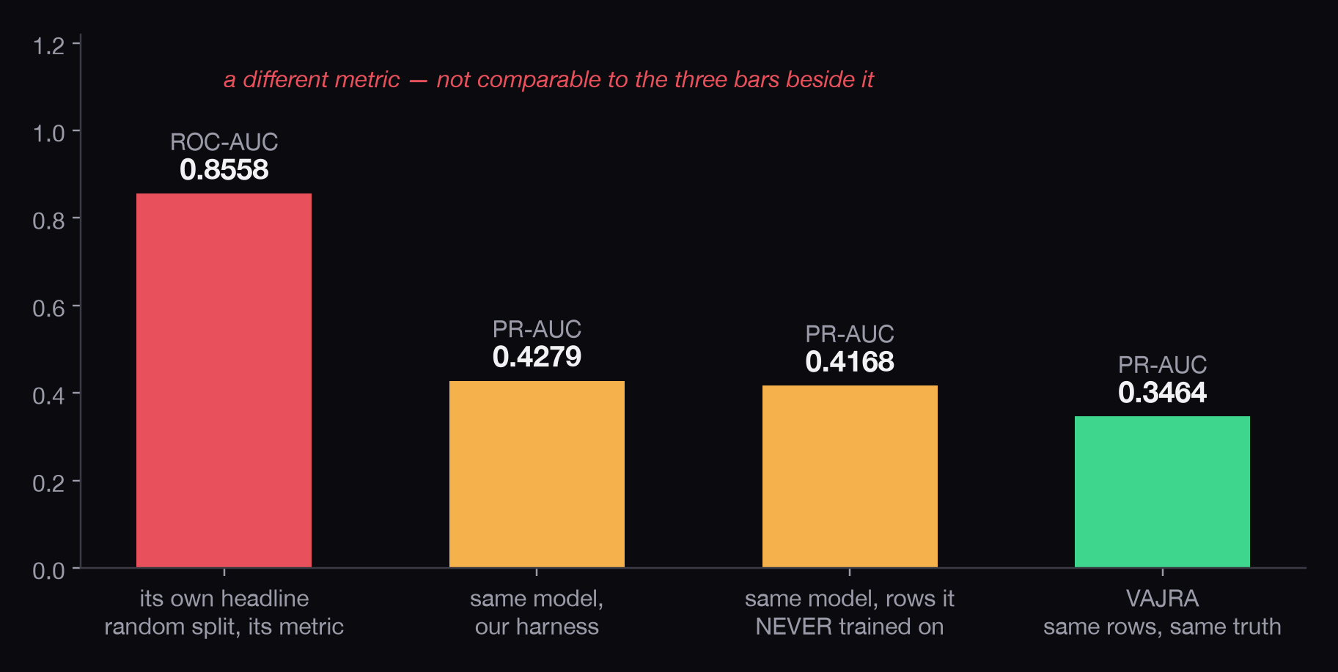
STOP 5 · THE COMPARISON WE COULD HAVE HIDDEN
STOP 5 OF 5 · THE HONESTY
A conventional model beats us, and here is why that is the point
Same features. Same library. Same settings. We changed only the methodology.
IT WINS BY 0.07: AND WE ARE SHOWING YOU
We executed the conventional approach rather than describing it.
BECAUSE IT WAS TOLD THE ANSWERS
It trains on a random slice of the whole timeline, on labels that had months to mature, counting everything unlabelled as clean. None of that is available on the day.
THE RIGHT-HAND BAR IS WHAT SURVIVES
Remove the future, and 0.3464 is what is left. That is the number an issuer could actually have had.
16
VAJRA · Mastercard Innovation Challenge 2026

Slide 17
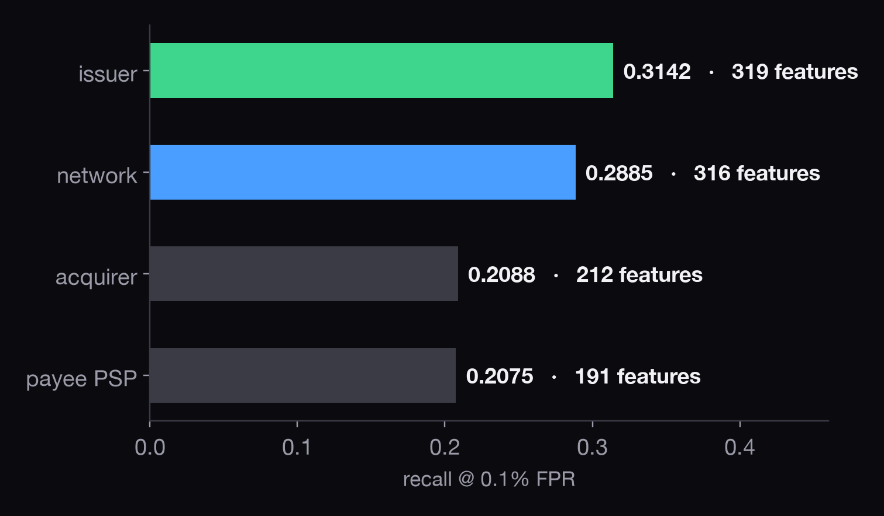
COULD THIS ACTUALLY RUN
Four places you could install it, and what each can see
We measured all four rather than assuming the network position is best.
MISSING MEANS MISSING, NOT ZERO
If an institution genuinely cannot compute something, we leave it absent. Filling in zero would assert that the account has no fan-out, a different and false claim.
THE ISSUER SEES MOST: NOT THE NETWORK
We report that even though the opposite would tell a better story at this event.
SO WHAT THE NETWORK UNIQUELY ADDS IS REACH
A privacy-preserving exchange lets one issuer receive mule risk it could never observe alone, without any personal data crossing.
17
VAJRA · Mastercard Innovation Challenge 2026

Slide 18
COULD THIS ACTUALLY RUN
The action, not the score
A score is a number. What a bank needs is the specific thing to do on that specific rail.
Three strengths, fitted per rail
A reason code on every single decision
Uncertain cases go to a human, and we count what that costs
With no model at all, it still refuses the impossible
Pinned model version · measured tail latency
Mule risk shared between issuers with no personal data
on this rail | add friction | or stop it
card, online with 3-D Secure | step-up challenge | decline
UPI payment | interstitial warning | cooling-off delay
UPI autopay mandate | refuse the mandate | refuse the mandate
account-to-account transfer | name-mismatch warning | hold the funds
card clearing and dispute | route to review | route to review
agentic commerce | refuse the mandate | refuse the mandate
LOOK AT THE LAST TWO ROWS
You cannot decline a clearing record — it has already happened. So the strength of the response is abstract, and the action is whatever that rail can actually support.
VAJRA · Mastercard Innovation Challenge 2026
18

Slide 19
WHAT WE WOULD RATHER YOU HEARD FROM US
Five things we cannot do
A limitation you find is worth more against us than one we hand you.
IT IS ALL SIMULATED
We validate that the mechanisms behave like the rails. We do not claim our distributions match any real portfolio, because that cannot be tested without the portfolio.
TWO OF OUR SIGNALS ARE TOO CLEAN
Quantified and bounded at 21% and 7% of the headline. Named on the previous stop.
TWO RAILS STAY WEAK
Assisted cash-out and offline UPI carry the right observables now, but with only 2.50% of labels visible the model cannot learn them yet — the measured gain was +0.0001. We report the null result rather than dropping it.
ONE CAPACITY CHECK MEASURES THE WRONG THING
It counts the review band, but real human workload is set by the action mapping, and one rail sends all three strengths to review. True load is about 0.54% of volume against a 0.024% staffed budget. Found by us, not yet fixed.
ONE GLOBAL THRESHOLD PENALISES SMALL-TICKET RAILS
Attacks whose entire method is to stay under the floor are exactly the ones a single cut-off handles worst.
VAJRA · Mastercard Innovation Challenge 2026
19

Slide 20
IF YOU WANT TO CHECK ANY OF IT
One command, and a demo that cannot fail
Seeded, ordered, and single-threaded where it has to be, so it comes out the same twice.
EVERY NUMBER IN THIS DECK REBUILDS FROM ONE COMMAND
Each stage writes a structured record, and there is a single index tying every claim in this deck to the record that produced it.
THE LIVE DEMO TOUCHES NO NETWORK AND NO TRAINING
It replays a committed bundle. It works on venue wifi that does not exist, because it never needed the wifi.
A SMOKE-SCALE NUMBER CANNOT BE QUOTED BY ACCIDENT
Anything produced at reduced scale is stamped NOT REPORTABLE inside the record itself, so it cannot travel into a slide.
THE HISTORY IS PART OF THE EVIDENCE
One of the six controls reads the version-control log itself, to prove the held-out attacks were written down before the detector was.
20
VAJRA · Mastercard Innovation Challenge 2026

Slide 21
WHERE THE WALK ENDS
A language that generates fifteen thousand distinct attacks. A world whose build refuses to break its own rails. A defense that catches a quarter of the attacks nobody ever showed it, hands analysts a queue that is 99.5% real, and beats the incumbent policy by 28 points of recall.
AND THE PART WE THINK MATTERS MORE
We built the instruments that found our own four-fold combiner defect, our own policy bug, and our own too-clean signals — and we walked you through all three.
15,271 distinct attacks
126 rules the build enforces
6 of 6 anti-cheating controls pass
0.2507 caught, never seen before
21
VAJRA · Mastercard Innovation Challenge 2026

