Slide 1



● EUROPEAN SECURITY STUDIES CONFERENCE · PANEL
Disruptive Machines
AI, Information Operations & Cyber Security
Chair & Discussant Dr Arthur Laudrain · ETH Zürich
● Friday, 12 June 2026 · 16:40 – 17:55 · D House, Lecture Hall 8
HOSTED BY
Stockholm University

Slide 2
PART ONE
01
The threat landscape
How automation is reshaping influence operations, and what it means for European resilience.

Slide 3

PROGRAMME · 16:40 – 17:55
Panel programme
16:40
Opening & framing remarks
A. Laudrain
16:50
Generative AI & information operations
J. Carver
17:10
Cyber resilience & strategic autonomy
S. Verschuren
17:30
Discussion & Q&A
All

Slide 4
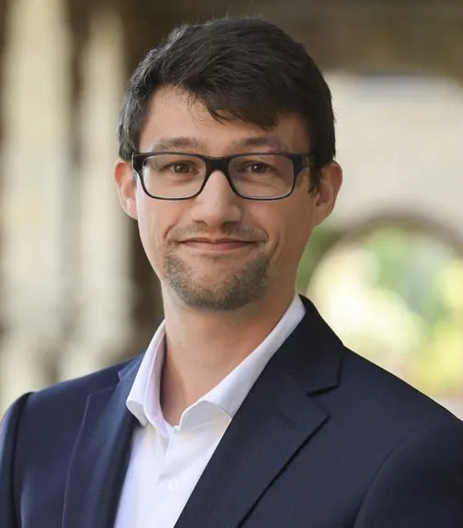
CHAIR & DISCUSSANT
Dr Arthur Laudrain
Senior Researcher · ETH Zürich
Works on cyber conflict, information security and the governance of emerging technologies, with a focus on election interference.
WG1
WG3

Slide 5
KEY ARGUMENTS
Three shifts to watch
Automation lowers the cost of influence while raising the cost of trust. The result reshapes three fronts at once.
Scale. Synthetic content makes volume cheap and provenance hard to verify.
Speed. Detection and response cycles compress from days to minutes.
Sovereignty. Capability gaps become strategic dependencies.

Slide 6
Risk versus response
THE RISK
THE RESPONSE
Fragmented defence
Networked knowledge
National responses diverge; adversaries exploit the seams between mandates and jurisdictions.
Shared methods, a common evidence base, and cross-border epistemic communities close the gaps.

Slide 7
CLOSING PLENARY
Concluding remarks & Best Paper Prize
Sanne Verschuren
Julia Carver
Moritz Weiss
Magnus Petersson
Boston University
Leiden University
LMU Munich
Stockholm University

Slide 8

Thank you, and one more thing
Add your bio in ~2 minutes
Join the NetSec Directory, the open, searchable who's-who of European security studies.
netsec-cost.eu/people

