Slide 1
EISy File Management State-of-the-Project 2020-03-26
David Hurt

Slide 2
Contents
Abstract / Status
Guide to my code style
3 “Groups” of useful tools
Tutorial descriptions
Testing methods (+ reflection)
Future work
Framework for updating
Known Bug-fixes needed
Unfinished work
Integration with other tools
Discussion of Priorities

Slide 3
ABSTRACT
The EISy File management submodule was intended to help the developers as well as the package end-user with a wide variety of file management tasks. These include file searching/uploading, error handling, data exporting, and eventual database management in SQL.
Special focus has been placed on various levels of “smart” error handling, to make the functions broadly useful whenever possible, including options for user-interactivity.
Unfortunately the submodule was not available in time to be used by the rest of the developers, and as such is not integrated with other aspects of the project.
Remaining work is mostly focused on this integration, but also aspects of the SQL output are completely unaddressed at this time.

Slide 4
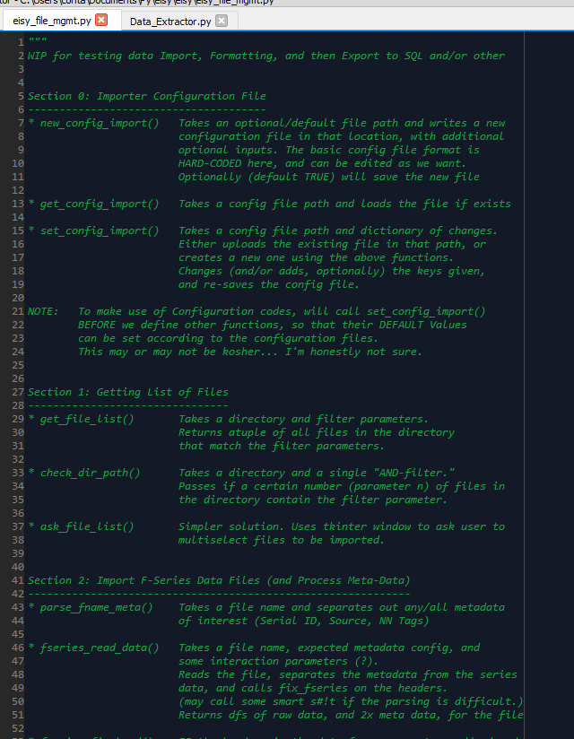
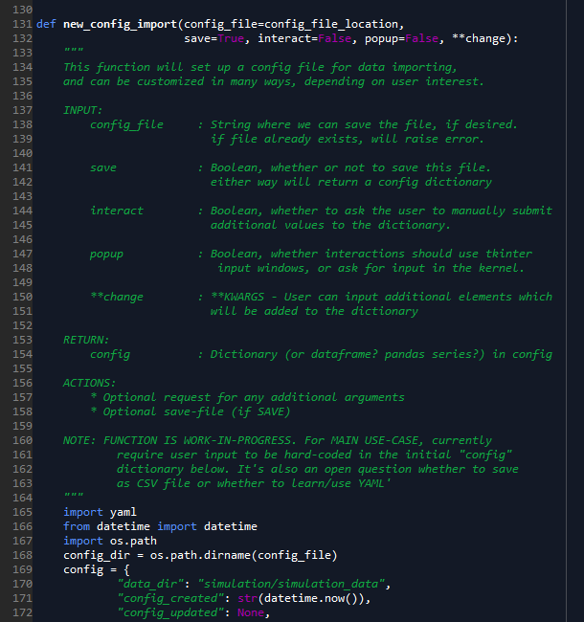
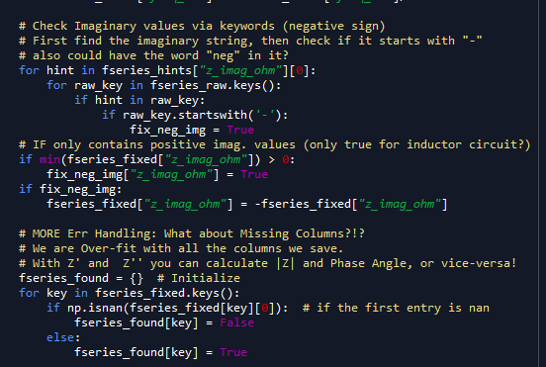
Background: David’s Code
1
2
At top of file, I tend to keep an extensive header with the verbal goals of each f(n). I also use this to pre-plan what I am going to work on.
My DocStrings are similar but not entirely in-line with our group’s designation. That could be brought in line. I do like having Actions and Dependancies listed when relevant
I try to comment Inline with descriptions of the code-flow, ESPECIALLY when the python loop/logic is not very human-readable!
When rushed, 1-3 go out the window... Sorry about that...
3

Slide 5
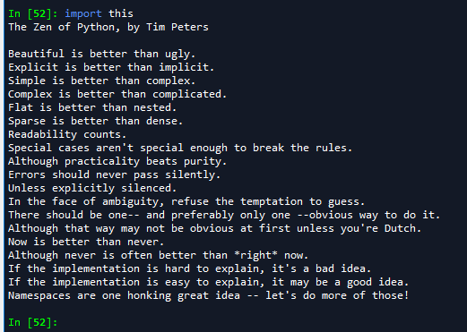
Background: Philosophhy
I have a complicated relationship with Python PEP8. Less so with the Zen...
If I was going to score my performance, Let’s give those some colors
(Green I agree with, Orange I agree but am bad at, Red I’m not so sure)
I am tremendously fond of readability, commenting, and code-flow
However there comes a time (and I am guilty too) that overcommenting, long names, or breaking apart variables can actually make code harder to read because it becomes a novel. Especially when stupid Pep8 limits chars/line
I prefer user-friendliness though, so I’m not a huge fan of only having ‘one way to do it’ (though it makes sense most of the time).
Scew the Dutch. Silly fake-german tulip-sniffing wind-milling clog-wearing asfjnvszlvmzv

Slide 6
Background: NameSpace Conventions
Data Names in/out of Functions
Boolean Logic in Functions
fseries_raw (and friends)
F Series refers to any data in the Frequency domain (most common EIS export, contains all data needed for Nyquist and/or Bode plots)
Starts as _raw, then is returned as _fixed after checking (and fixing as needed) for sign conventions, Unit consistency, and DataFrame column header names
Related data like fseries_hints identify that that dictionary is specifically to help with fseries processing
header, meta, and tags
Actually a “broken” part of our namespace (aka misleading or non-specific)...
“Header” refers to both dataframe name assignments, and also to the metadata at the top of a file!
“meta” is used both to describe ^that^ data, but also for tags midway through a file name
interact = True
Whether or not to handle errors or unexpected results via some sort of user prompt.
Note: Cannot be True for Travis (or any automated test functions)
If False will usually raise some AssertionError
popup = True
Only should matter ‘if Interact is true’
If True, will interact via Tkinter Popup dialog windows
If False, will usually interact via command line data in/out
save = True
Whether or not to save a file or keep this function’s output in local memory only

Slide 7
SECTION: Code Walkthrough “4 Groups” of functions
0. Configuration File Management
Setup, load, and edit configuration file
Define Defaults to be used in the rest of the module
File Selection
Identify a folder and select files matching input formats
Data Importing and pre-processing
In the case of Frequency-Data, Import and re-format
Attempts to be smart and broadly applicable for “any” eis data given
SQL Database Management
Using Config file (?), Initiate a SQL database with SQLite3 (native to python)
Format, store, and update database with input and processed data
Query and interact with that data
(Generally Not finished/deployable at this time)

Slide 8
DEF <function name here()>
Inputs
Description of the inputs the function needs
I’m not worrying about actual names in this ppt
Short notes will do
Actions
What is the codeflow? What is it doing?
(optionally) additional useful parts
RETURNS a description of
To-Do:
BUG Does this break sometimes? Why?
WIP Things that don’t work the way I want them to (or as definied )
IDEA some other use case that we could add in the future
Discussion of the function:
Why is this function here? What does it do, in one sentence or so?
What other functions is it used in?
When would a user call this function?
Is there anything else we should know?

Slide 10
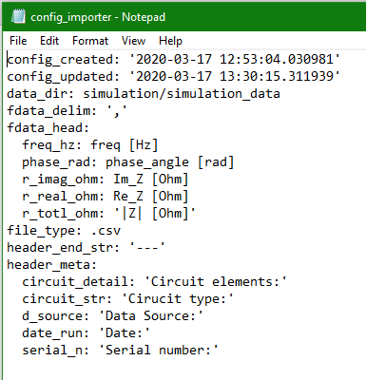
Group 0: CONFIG File Management
What’s in a Config File?
Almost anything that would be hard-coded in the module but MIGHT be different for different users should INSTEAD live in a separate file, so that users can change/update it without tinkering around in the base code.
Any Hard-coding we would do can go in the Config Setup function as the ‘default config’, but users can edit the config file in several ways (either with an edit function, or directly in the YAML with editor of their choice!)
As a user sets up (and saves interactions to) their Config, their copy of the package will “remember” so it will “learn” and get more useful for them specifically!
Getting config is the in the global package space (around line360 at time of writing), so it will load the current config file EVERY TIME you import module
Examples of what to put in the Config:
Data File Directory path to use
Data File types used (and info like delimiter, header, etc)
“Hints” ← How we identify data columns
SQL Schema to use ← Probably should be separate config? Maybe?
NOTE:
If user screws up their config, they can use the “new” function to start again!
IDEA:
Should we save backup configs? So they don’t have to start from scratch...

Slide 11
DEF new_config_import()
Inputs
File Name (default file location)
Booleans, to tell it how to behave
“change” kwargs – edits to make to the default (not implemented yet, but similar to the set_config changes{} dictionary
Actions
Makes a new config file
If Interact, has a framework for input output to edit the first config
(optionally) saves it as specified as a YAML
RETURNS the config file as you would otherwise load it
To-Do:
WIP “Change” kwargs doesn’t do anything
WIP interact-popup doesn’t do anything
The first function we have is to set up a configuration, and is only called inside other functions in case the set() or get() cannot find an existing config file.
Therefore if there is no config, this will Automatically run the first time the module is loaded (as mentioned above) – afterwhich there will be a file there.
Users can call this function to overwrite a configuration file if it isn’t working
Ideally, THIS IS THE ONLY PLACE THAT SHOULD HAVE HARD-CODED DATA!
(Edit – also in the default config location global)

Slide 12
DEF get_config_import()
Inputs
File name/path to load
Whether to interact if you can’t find it
Actions
Checks if the path is good.
(optionally) asks for a new path with tkinter dialog (askdirectory?)
RETURNS the config dictionary
To-Do:
pass
This one is pretty simple – Loads up the config file from where it should be. (defaults to the hardcoded default file)
If it’s not there, can optionally ask the user to select it.
Users probably never use this, but it gets called a lot by the set_config_import function (next page)
(sadly, it can’t update the hardcoded config file location default. I don’t think that would be possible!)

Slide 13
DEF set_config_import()
Inputs
Config file location
Changes to set (dictionary)
What to do if “changes” key isn’t found
Actions
If file is there, run get_config,
Otherwise, run new_config
For each key in both config{} and changes{} replace the old one
Re-save the config file
RETURNS the config file (duh)
To-Do:
pass
This is a wrapper that will usually call get_config or new_config, rather than users.
It gets called ~line 360 in the Global for this package! So it’s loaded the config for all other function defaults!
Users can use it to edit the config file, though you can also do that yourself since it’s a YAML.

Slide 15
Group 1: Get File-Importing List
Why have these functions?
I don’t trust that all importers will check formatting and not error out at other times, so before we do importing I want to be able to check files using our own functions
These should be broadly really useful for other developers on the project (and therefore were hoped/intended to be deployed months ago but never synced up...)
Includes a variety of logic possibilities to target which files to load, and checks that they are there before handing them to the user as a list.
Also, supports a bunch of Tkinter filedialog type options internally, because WHO LIKES DEBUGGING WITH TKINTER? NOBODY! So I did it for you!

Slide 16
DEF get_file_list():
Inputs
Directory to look in.
Str_has: “AND” filter. List of strings ALL files must have to pass
Str_inc: “OR” filter. Each file must have at least one string on the list
Ftype: the file extension string (after the period) – only return those files.
Interact=True
Actions
Checks if the path is good.
(optionally) asks for a new path with tkinter dialog (askdirectory?)
RETURNS file names that pass the filters above
To-Do:
IDEA: If we get a result from tkinter, can we (optionally) save that in the config file?! So it’ll be there when we need it next
Does what it says on the tin!
Gives you a list (actually a tuple!) of file path/names that match three filters, as discussed at left.
Checking path is done via check_dir_path() function <next slide>
By default, uses the config for the directory and file type, and meaningless filters (all files have “.” in them). Default interact is True… Should it be?
This should be super useful for both developers and users, as it is broad. We can use this to get a specific set of training data based on the file names, AKA “PNG files that all say Nyquist from any of these days”

Slide 17
DEF check_dir_path()
Inputs
Directory to check
List of required strings to look for (“AND” logic)
Number required to pass
Whether to raise error or return False
Actions
Checks if the dir exists
If so, checks each file in dir for “required” strings
To-Do:
IDEA : Could (optionally) trigger ask_file_list instead of raising errors
I initially wrote this inside of the previous function, but it was very non-pythonic and super nested!
Instead, having a separate function makes the logic flow easier, though it is still complex-ish and needs lots of coments to flow…
I only use it in the get_file_list() function, but it could be useful any time to pre-empt
When would a user call this function?
Is there anything else we should know?

Slide 18
DEF ask_file_list()
Inputs
N/A : Function is only User-Interaction
Actions
Uses Tkinter askopenfilenames to get a list of files from the user
To-Do:
WIP: Function should (maybe optionally?) run a filetype check on the files you give it to prevent user error
IDEA: window can only get files from one folder. What about a multi-folder optional loop?
I included this both for debugging and because for some use cases it makes much more sense to simply ask the user for a file
Because it’s all user- interface, you can’t write an automated test for this function... Not sure how to handle that in ‘test-driven design’ with travis.

Slide 20
Group 2: “Comprehensive” F-Series Import
Task of Function Group:
Given a file+path for Frequency-series EIS data, extract that data as well as any “Metadata” also in the datafile or filename
Special focus on allowing for unknown file structures – different programs will generate this data in different ways but we should accept and read/handle as many as possible!
Why automate? (Why not have the User do this?):
Setting up custom importers will frequently involve lots of debugging which takes time and can cause extra errors
Reassigning ambiguous data headers to “standard-for-package” names will allow us to reliably integrate with data-storage downstream.
Ideally, all of this “standardization” and Import info could/should be written into a Config file (per Group 0)

Slide 21
DEF parse_fname_meta():
Inputs
File name (may include path)
Actions
Finds the ‘actual’ filename
Separates by “_”:
Until First = Serial ID
Last until “.” = ML classification Tags
Others sep by “_” = Meta Tags for DB
Separates ML tags by “-”, makes list of those
RETURNS: ID, Meta tags, Classifications
To-Do:
Compared to other functions, this is pretty Railroad-y. Requires certain form... Put format in Config file?
Sometimes (almost always) it’s useful to have the most important info about a file in the file name
That’s not news... It’s what file names are for – Important info
Since file names have important info, we should have a function to read that info and store it!
The Serial ID should/must be unique but we don’t railroad that.
Machine-Learning classification tags are ones that will/may be fed into the ML module to classify
Meta-tags are anything else that’s important enough that it was put in the filename

Slide 22
DEF fseries_read_data():
Inputs
File name + path
Configurations about header, delimiter, and ‘expected’ format
Actions
Scans file from beginning until it reads a special “separator” string
Everything above is considered “header metadata”
Everything below is read as the raw frequency-series data
To-Do:
Does NOT work for files with no header data! (Though those files could just call read_csv with no difference)
In addition to the important metadata in the file names, important data is sometimes written at the top of a file before the data!
We separate data as such:

Slide 24
DEF <function name here()>
Inputs
Description of the inputs the function needs
I’m not worrying about actual names in this ppt
Short notes will do
Actions
What is the codeflow? What is it doing?
(optionally) additional useful parts
RETURNS a description of
To-Do:
BUG Does this break sometimes? Why?
WIP Things that don’t work the way I want them to (or as definied )
IDEA some other use case that we could add in the future
Discussion of the function:
Why is this function here? What does it do, in one sentence or so?
What other functions is it used in?
When would a user call this function?
Is there anything else we should know?

Slide 25
DEF <function name here()>
Inputs
Description of the inputs the function needs
I’m not worrying about actual names in this ppt
Short notes will do
Actions
What is the codeflow? What is it doing?
(optionally) additional useful parts
RETURNS a description of
To-Do:
BUG Does this break sometimes? Why?
WIP Things that don’t work the way I want them to (or as definied )
IDEA some other use case that we could add in the future
Discussion of the function:
Why is this function here? What does it do, in one sentence or so?
What other functions is it used in?
When would a user call this function?
Is there anything else we should know?

Slide 26
DEF <function name here()>
Inputs
Description of the inputs the function needs
I’m not worrying about actual names in this ppt
Short notes will do
Actions
What is the codeflow? What is it doing?
(optionally) additional useful parts
RETURNS a description of
To-Do:
BUG Does this break sometimes? Why?
WIP Things that don’t work the way I want them to (or as definied )
IDEA some other use case that we could add in the future
Discussion of the function:
Why is this function here? What does it do, in one sentence or so?
What other functions is it used in?
When would a user call this function?
Is there anything else we should know?

