Slide 1


EISy As Py

Slide 2

Cropping clipart (Microsoft PPT Clipart, so I presume OK to use??

Slide 3
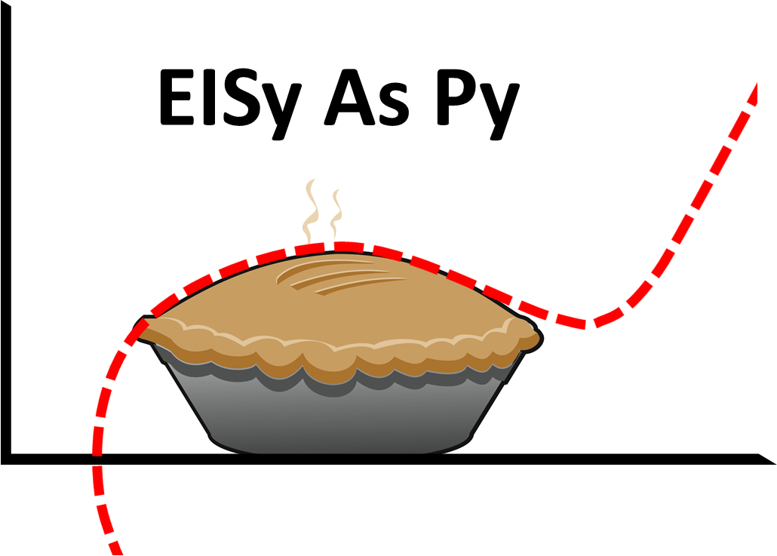
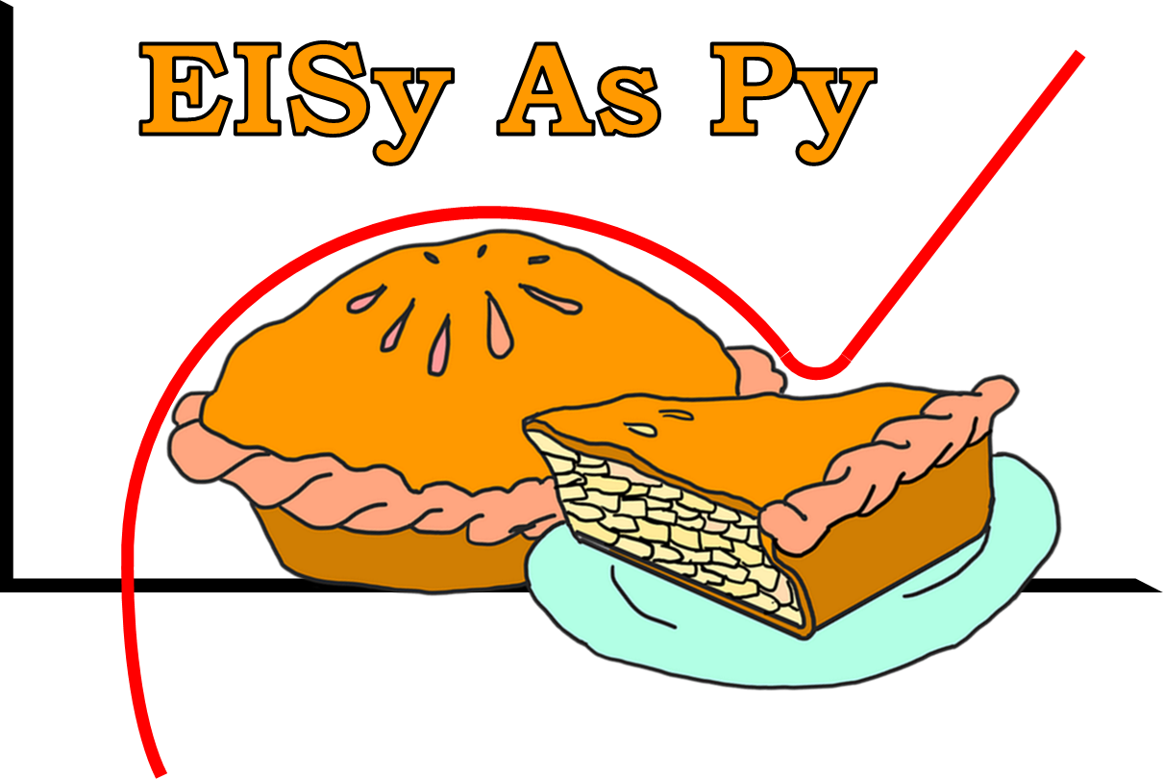

Slide 4
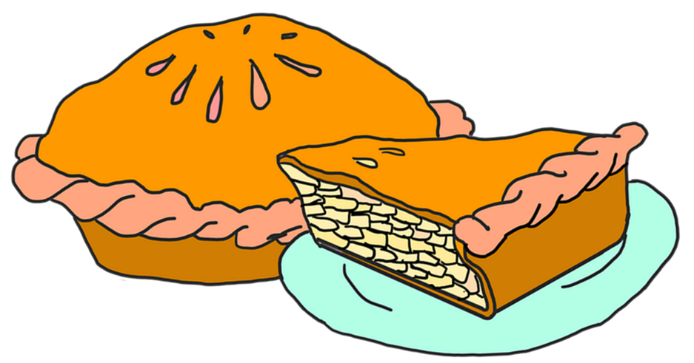
New clip art: Classified Free to Use, from https://www.needpix.com/photo/1723745/apple-pie-dessert-apple-delicious-sweet-bake-sugar-fruit-cooking:

Slide 5
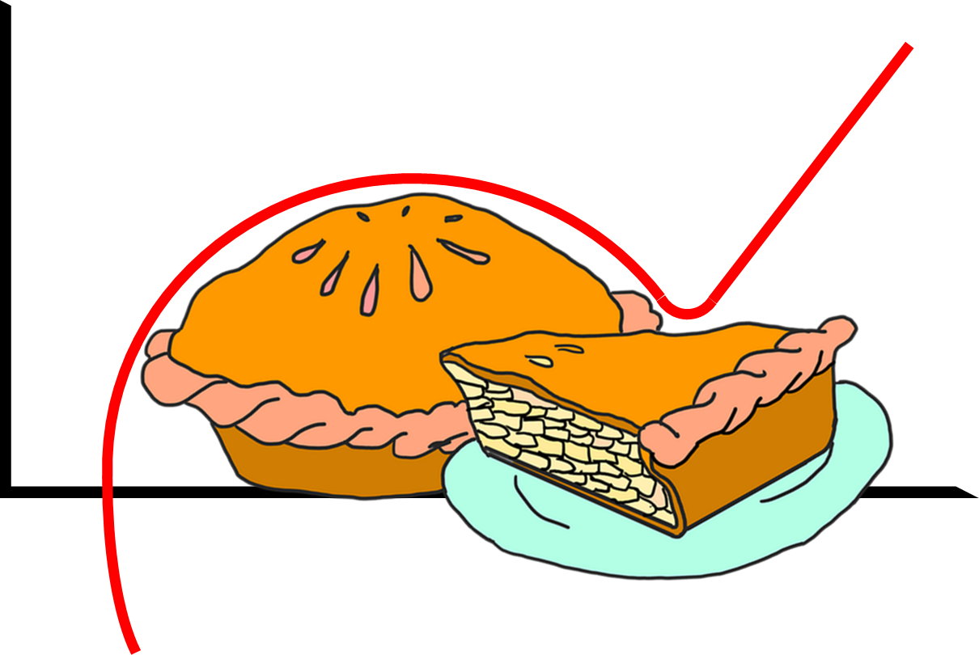
EISy As Py

Slide 6


