Slide 1
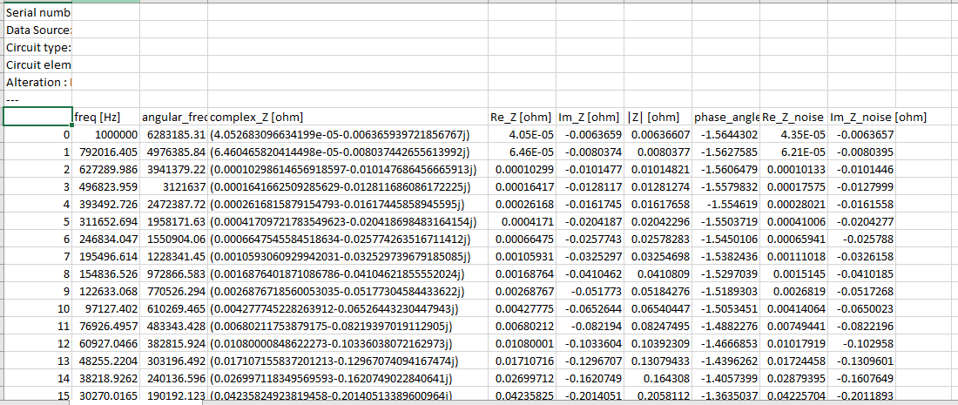
OK!
Column Numbers:
0 1 2 3 4 5 6 7
INDEX
(Strings, not
Numbers)

Slide 2
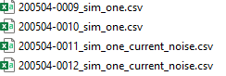

1) File Name Labels 2) Directories

Slide 3
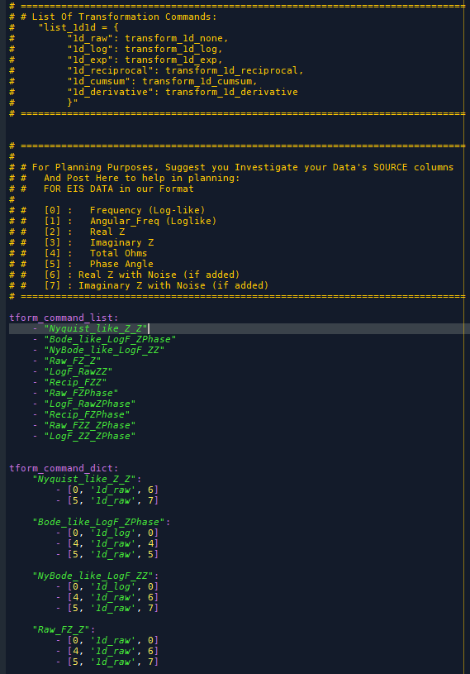

Transformation Configuration File (Typically called “tform_config.yaml”)
Instructions
ORDERED List of commands
DICTIONARY
Of Actual “Commands”
Name (string), Also in Command List
Commands: (List) of (3-part Lists)
Log of Column 0 into Plot Column 0
1/x of Column 4 into Plot Column 1
Raw of Column 7 into Plot Column 5
“Plot Columns”
Typically 0-5, formatted “RGBrgb”
0, 1, 2 are Red-Green-Blue on X-axis
3, 4, 5 are red-green-blue on Y-axis

Slide 4
Breaking Down Data Flow: (Overall)
Transform
Configuration
Tuner
Configuration
Model
Configuration
Raw Data
CSV Files
Data + Transformation
Wrapping Function
Image List-of-Tuples
Classification
Wrapping Function
Report, Analysis, and Loop to Next Transformation
Report Output

Slide 5

Breaking Down Data Flow: (Data + Transform)
Transform
Configuration
Tuner
Configuration
Model
Configuration
Raw Data
CSV Files
Data + Transformation
Wrapping Function
Tform_Command_List
Tform_Command_Dict
Transformed
List-of-Tuples
Image List-of-Tuples
Classification
Wrapping Function
FOR:
Tform
Raw Data
List-of-Tuples
“Smart Read CSV”
Transform Data()
Visualize Data()
Note: Sub-Optimal…
Re-Upload Data every Tform Loop
Optional? Handoff as
Transformed PNG Images
Report, Analysis, and Loop to Next Transformation
Report Output
Loop/apply Function to all files

Slide 6
Breaking Down Data Flow: (Overall)
Transform
Configuration
Tuner
Configuration
Model
Configuration
Raw Data
CSV Files
Data + Transformation
Wrapping Function
Image List-of-Tuples
Classification
Wrapping Function
Report, Analysis, and Loop to Next Transformation
Report Output

Slide 7

Breaking Down Data Flow: (Classifier)
Transform
Configuration
Tuner Configuration
Model Configuration
Raw Data
CSV Files
Classification
Wrapping Function
Data + Transformation
Wrapping Function
FOR:
Tuners
Setup Model
Training Data
“IF” Config:
Data from Files or List
FOR:
Epochs
Train
Model
Log
Report
Validation Data
Testing Data
Evaluate
Model
Tuner Adjust
Transformed PNG Images
Report, Analysis, and Loop to Next Transformation
Report Output

