Slide 1
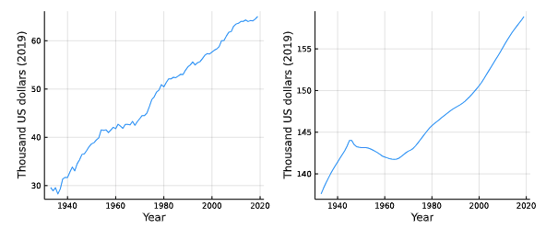
INTERNATIONAL GAINS TO ACHIEVING HEALTHY LONGEVITY
Andrew J. Scott, London Business School ∙ Julian Ashwin, London Business School ∙ Martin Ellison, University of Oxford ∙ David Sinclair, Harvard Medical School
THE KEY QUESTION
How great are the benefits of achieving healthy longevity?
HISTORICAL PERFORMANCE
Historically, improvements in healthy longevity have been at more valuable than economic growth.
Stark differences in performance across rich countries.
When accounting for health outcomes, USA became worse off from 2009 to 2018.
The value of slowing aging increases as people live longer.
WHY IS THIS IMPORTANT
We value health very highly , as the actions taken during the Covid-19 pandemic showed.
As people live longer, the incidence of age-related diseases has increased.
Value of historical increases in GDP and longevity per person (thousands of US dollars)
METHODOLOGY
We use economic tools to quantify how valuable improvements in health and life expectancy are.
Building on past work, we apply these tools internationally across a range of countries.
Modelling is based on the Value of a Statistical Life, which quantifies how much people are willing to pay to live slightly longer or be slightly healthier.
The value of slowing aging increases as the population gets older.
VALUE OF SLOWING AGING
Slowing aging has become more valuable as people live longer and fertility falls.
Improving both health and life expectancy is much more valuable than each individually.
It is therefore crucial to treat aging, not just its symptoms.
One extra year of life expectancy through slowing aging is equivalent to extra 4-5% GDP every year.
CONCLUSIONS
Health longevity is hugely valuable
There is a virtuous circle – the longer we live and the older society gets, the more valuable healthy longevity becomes.

