Slide 1
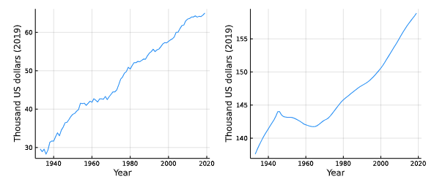
INTERNATIONAL GAINS TO ACHIEVING HEALTHY LONGEVITY
Andrew J. Scott, London Business School ∙ Julian Ashwin, London Business School ∙ Martin Ellison, University of Oxford ∙ David Sinclair, Harvard Medical School
WELFARE IMPLICATIONS
Putting a $ value on health improvements means we can add these to GDP growth to get a broader measure of welfare
Historically the value of health improvements worth more than increase in GDP
Stark differences in performance across rich countries. For instance, the USA has become worse off since 2009 due to declining health
THE KEY QUESTION
How large are the economic benefits of achieving healthy longevity?
The value of slowing aging increases as people live longer.
METHODOLOGY
We use economic tools to place a dollar value on improvements in health and life expectancy are.
Building on past work https://doi.org/10.1038/s43587-021-00080-0, we apply these tools internationally across a range of countries.
Modelling is based on the Value of a Statistical Life, which quantifies how much people are willing to pay to live slightly longer or be slightly healthier.
Value of historical increases in GDP and longevity per person (thousands of US dollars)
VALUE OF SLOWING AGING
Ageing well is incredibly valuable - an extra year of life expectancy through slowing aging is equivalent to extra 4-5% GDP every year.
Slowing aging has become more valuable as people live longer, fertility falls and there are more older people.
Improving both health and life expectancy together is very valuable as it unlocks complementarities
A health priority is to tackle the underlying causes of ageing, socio-economic as well as biological, not just deal with the symptoms.
The value of slowing aging increases as the population gets older.
CONCLUSIONS
Health longevity is hugely valuable and needs to be a priority
There is a virtuous circle – the longer we live and the older society gets, the more valuable healthy longevity becomes.
Achieving healthy longevity has never been so important and is only set to become even more important

