Slide 1


Artificial Intelligence
Unsupervised Learning
Term 2
AY 25/26
AIML CA2
Presentation
CUSTOMER SEGMENTATION & ENERGY CONSUMPTION FORECASTING
Edrin Jae Quias Magapayo
p2508302
Next Slide: Part A
Customer Segmentation

Slide 2

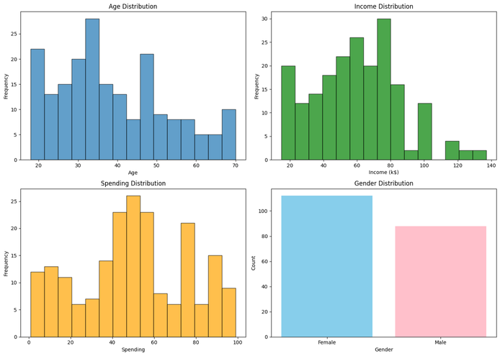
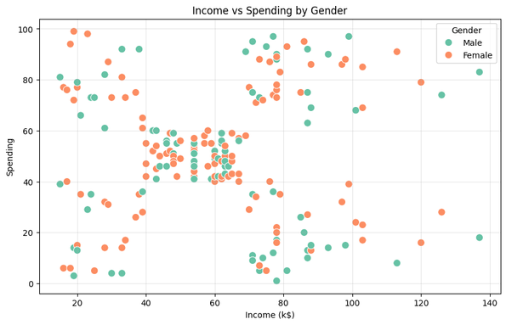

Artificial Intelligence
Unsupervised Learning
Term 2
AY 25/26
Data Exploration & Understanding
Objective:
Group customers into distinct clusters to understand spending behavior and target specific demographics.
Data Overview:
200 Customers with Age, Gender, Income, and Spending Score features.
Key Observations (EDA):
Distributions: Age and Income show fairly normal distributions, while Spending Score varies significantly.
Relationships: Scatter plots revealed potential clusters between Income and Spending.
Outliers: Box plots checked for anomalies in Income and Spending.
Next Slide: Part A - Methodology & Preprocessing

Slide 3
Artificial Intelligence
Unsupervised Learning
Term 2
AY 25/26
Feature Engineering:
Created Spending_Income_Ratio: Spending / Income. This helps identify "big spenders" relative to their earnings.
Preprocessing:
Scaling: Used StandardScaler to normalize Age, Income, and Spending. This is crucial because K-Means uses distance calculations, and different scales (e.g., Age 20 vs Income 50,000) would bias the model.
Algorithms Tested:
K-Means: Centroid-based, fast, scalable.
Hierarchical (Agglomerative): Good for visualizing hierarchy, but computationally heavier.
Part A - Methodology & Preprocessing
Next Slide: Part A
Model Selection (Finding 'k')

Slide 4
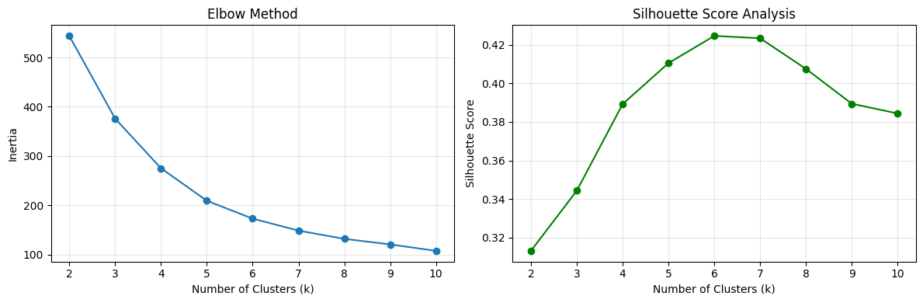

Artificial Intelligence
Unsupervised Learning
Term 2
AY 25/26
Part A - Model Selection (Finding 'k')
Determining Optimal Clusters (k):
Selection:
Elbow Method: Looked for the "elbow" point where inertia reduction slows down.
Silhouette Score:
Measured how similar an object is to its own cluster compared to other clusters.
Compared k=2 to k=10.
Result:
Chosen optimal k (e.g., k=5) based on the highest Silhouette Score and clear Elbow bend.
Model Winner:
K-Means provided slightly better separation than Hierarchical clustering in this dataset.
Next Slide: Part A
Results & Cluster Profiles

Slide 5
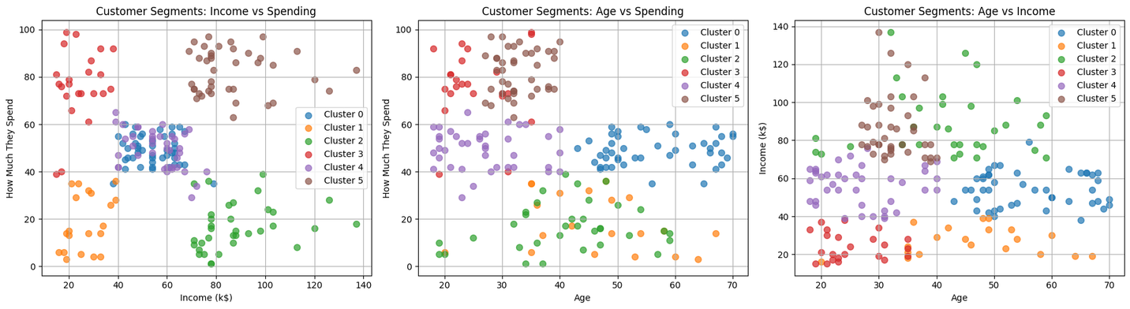
Artificial Intelligence
Unsupervised Learning
Term 2
AY 25/26
Part A - Results & Cluster Profiles
Cluster Characteristics:
Cluster 0 (Savers): High Income, Low Spending.
Cluster 1 (Standard): Average Income, Average Spending.
Cluster 2 (Target/Premium): High Income, High Spending.
Cluster 3 (Careless): Low Income, High Spending.
Cluster 4 (Sensible): Low Income, Low Spending.
Business Recommendation:
Target Group: Cluster 2 (High Income/High Spend) for luxury items.
Strategy: Marketing campaigns should focus on retention for Cluster 2 and conversion for Cluster 1.
Next Slide Part B
Data Analysis & Time Series Decomposition

Slide 6
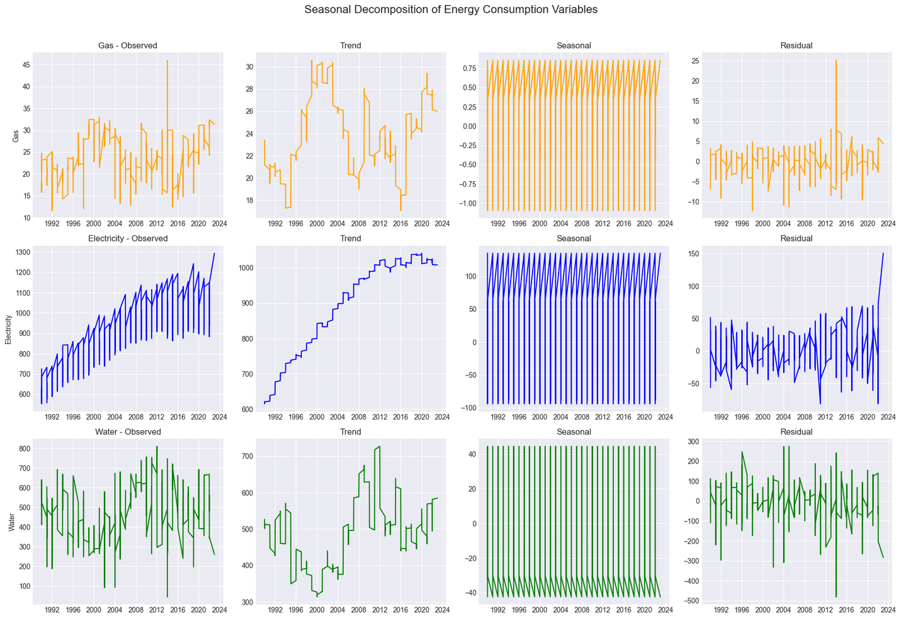

Artificial Intelligence
Unsupervised Learning
Term 2
AY 25/26
Part B - Data Analysis & Time Series Decomposition
Objective:
Forecast Gas, Electricity, and Water consumption for the next 60 months.
Data Overview: Monthly data (1990-2023).
Stationarity Check (ADF Test):
Checked if mean and variance were constant over time.
Most data was non-stationary, requiring differencing (integrated d parameter) for ARIMA models.
Decomposition:
Trend: Observed long-term usage trends.
Seasonality: Strong yearly patterns found in all three variables (e.g., Gas peaks in winter, Electricity in summer).
Next Slide: Part B
Modeling Strategy

Slide 7
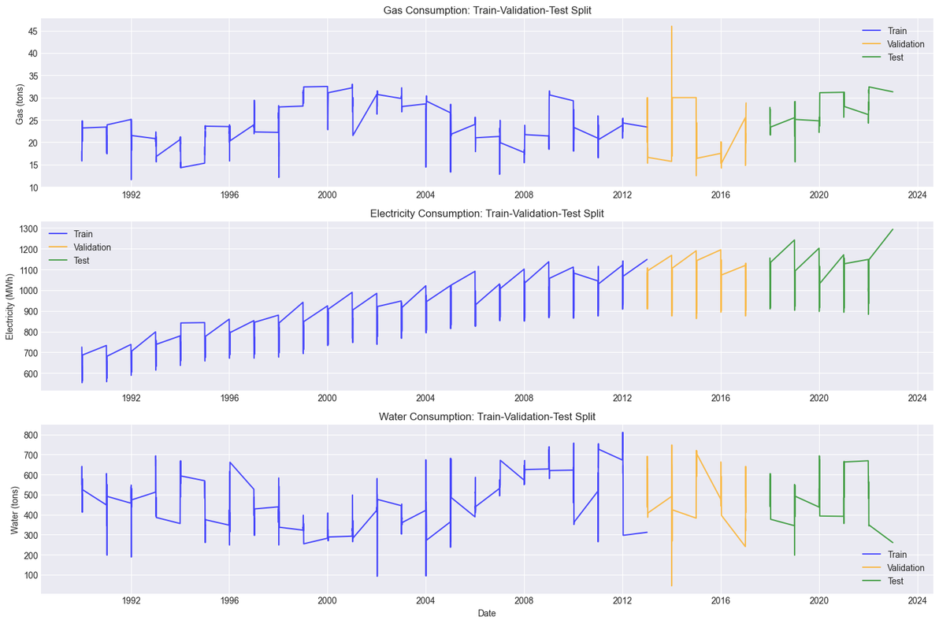
Artificial Intelligence
Unsupervised Learning
Term 2
AY 25/26
Part B - Modeling Strategy
Data Split:
Train (70%) / Validation (15%) / Test (15%).
Used temporal splitting (past vs future), not random shuffling, to preserve time order.
Models Applied:
Gas: ARIMA (Auto-Regressive Integrated Moving Average) - Best for trend/noise.
Electricity: SARIMA (Seasonal ARIMA) - Explicitly handles the strong seasonal waves observed.
Water: Holt-Winters Exponential Smoothing - Handles trend and seasonality efficiently.
Next Slide: Part B
Evaluation & Hyperparameter Tuning

Slide 8
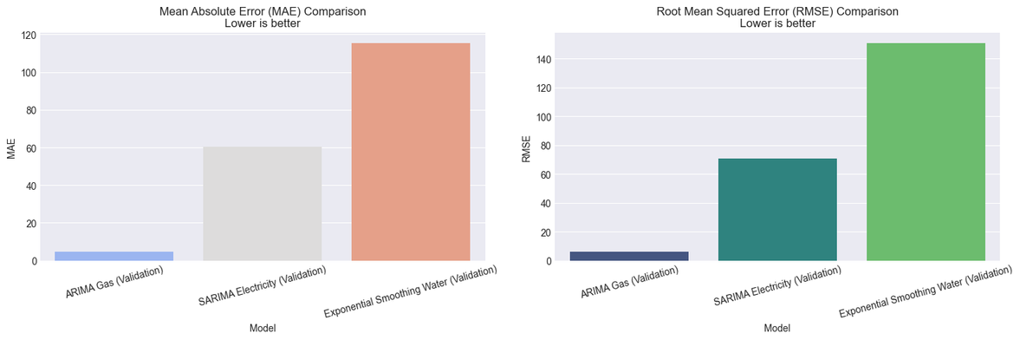
Artificial Intelligence
Unsupervised Learning
Term 2
AY 25/26
Part B - Evaluation & Hyperparameter Tuning
Tuning Process:
Grid Search: Looped through combinations of (p,d,q) parameters to find the lowest AIC (Akaike Information Criterion).
Validation: Tested models on the 15% validation set before final testing.
Performance Metrics:
MAE (Mean Absolute Error): Average magnitude of errors.
RMSE (Root Mean Squared Error): Penalizes large errors more heavily.
Results:
Gas: ARIMA provided the lowest error.
Electricity: SARIMA successfully captured the seasonal peaks.
Water: Holt-Winters was the most robust for water patterns.
Next Slide: Part B
60-Month Forecast Results

Slide 9
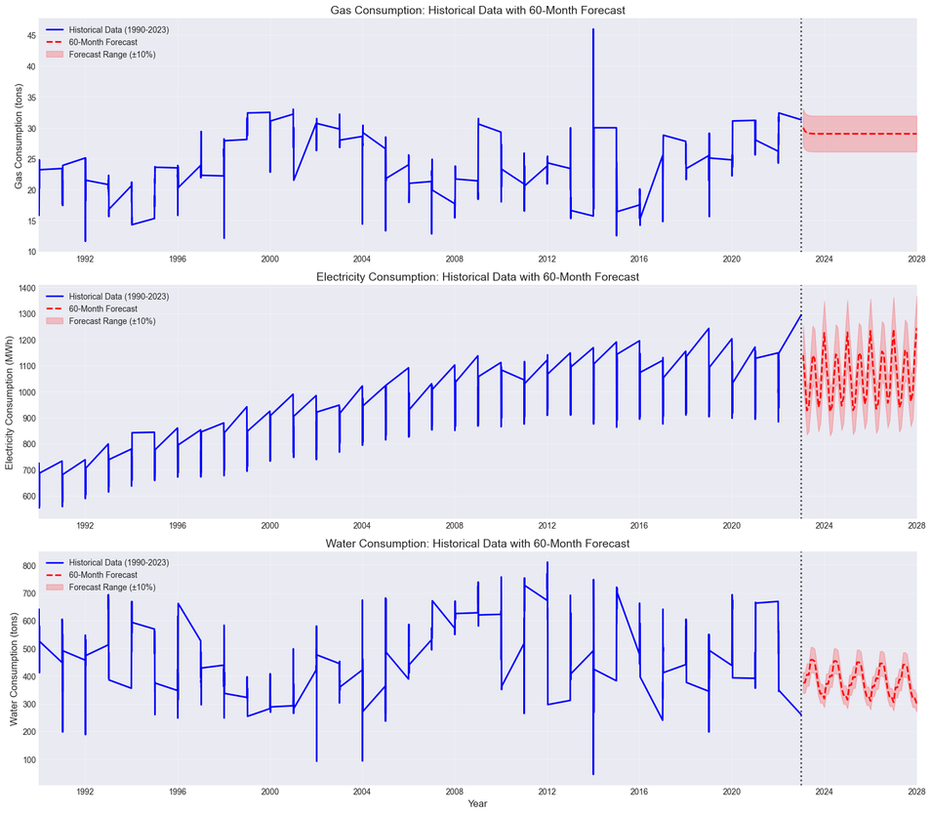
Artificial Intelligence
Unsupervised Learning
Term 2
AY 25/26
60-Month Forecast Results
Final Execution: Retrained best models on the entire dataset to maximize learning.
Forecast (Next 5 Years):
Gas: Predicted to [increase/decrease/stabilize] based on the trend line.
Electricity: Continued seasonal volatility with an upward trend.
Water: Stable seasonal patterns.
Next Slide: Conclusion & Recommendations

Slide 10
Artificial Intelligence
Unsupervised Learning
Term 2
AY 25/26
Conclusion & Recommendations
Summary:
Successfully segmented customers into 5 actionable groups using K-Means.
Generated accurate 5-year forecasts for energy resources using Time Series analysis.
Business Recommendations:
Marketing: Tailor campaigns for the "High Income/High Spend" cluster.
Operations: Plan energy inventory based on the forecasted seasonal peaks to prevent shortages.
Strategy: Use the forecasts to budget for rising electricity demand.
Next Steps:
Integrate demographic data into energy forecasting (e.g., population growth).
Test LSTM (Deep Learning) for potentially better long-term forecasting.

