Slide 1
SDLC
Maintenance
Production environment,
Implementation
Planning
User acceptance testing environment
Systems integration testing environment
Common build environment
Development environment
Design
Analysis
2017-12-14

Slide 2
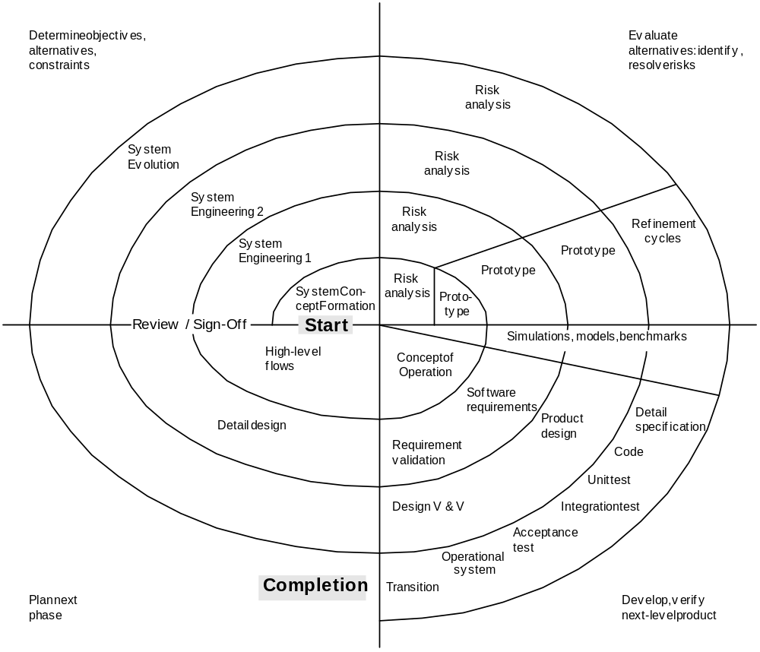

Slide 3
V-Model
Conception of Operation
Issues
User Acceptance
Test Plan
Project
Definition
System Design
System
Testing
Issues
Test Plan
Detail Design
Issues
Integration
Testing
Defect testing the failed scenarios, including defect tracking
Path testing
Data set testing
Unit testing
System testing
Integration testing
Black-box testing
White-box testing
Regression testing
Automation testing
User acceptance testing
Software performance testing
Test Plan
Project Testing
Unit / Component Design
Issues
Unit / Component Testing
Test Plan
Code
2017-12-14

