Slide 1
PCD Tracker
Storyboard
Gene Belford
16 May 2017
Notes:
Description
Enter description here
Requirements
R1
R2
R3
Business Rules
BR1
BR2
BR3
Functions
F1
Data Objects
DO1
DO2
DO3
Complexity 0
Inputs 0
Outputs 0
Inquires 0
Files/Tables 0
Ext. Files 0

Slide 2
Metadata, Audit Records And Backups
PCD revisions
Record metadata: Insert, Update, Logical Deletes, and Hidden Flags
Track inserts and updates of specific data elements
Capture the actual SQL scripts
Automated nightly backups with # days of backup retention

Slide 3
PCD Status Review
PCD Status View Options
● Not Funded ○ Funded No PCD ○ PCD Wake Up ○ All
● Compress Columns ○ Show All ○ Show PN ○ Show MAN/CLW
Yes: update the Tracker/PCD from the HMI.
Search Parameters
New PCD Task
Close
Notes:
Description
Upon entry into the PCD application the user will be shown the default view of unfunded PCD efforts. User edits to data being displayed will be made to the supporting data record. (Provide the a Excel like look and feel.)
There are 4 predefined views of the PCD data, and an option to search the PCD data using user provided parameters. Switching between options with cause the HMI to refresh automatically.
The user can select to display all the data columns or pre-defined sets of columns.
When the user selects a record the user will be able to review the associated tack information for the PCD.
When the user clicks on the “Search Parameters” button they will be taken to the “Search Parameters” HMI to set the search parameters and execute the search.
When the users clicks on the “New PCD Task” button they will be taken to the “Tracker Entry” HMI to create a new task.
Question: If the <subject> was changed in the HMI for a PCD already created, would a revised PCD be generated?
Requirements
The system will highlight data values has determined by the business rules.
The system will allow the user to view the source data record using the Tasker Data Review HMI.
The system will allow the user to add a new PCD task.
The system will allow the user to search using custom parameters.
The system will automatically provide the required scroll bars if the data exceeds the size of the display panel.
The system will allow the user to sort the data.
Business Rules
When the PCD Wakeup date before or the same as the current date the cell containing the date will be highlighted.
View Filters
Not Funded (FY: active, PCD: active, Funded: N) (Show All)
Funded No PCD (FY: active, PCD: active, Funded: Y) (Compress)
PCD Wake Up () ()
Search (user supplied search parameters) (Show All)
Functions
F1
Data Objects
PCDs
PCD Status (Draft, Submitted, Rework, Approved)
Complexity 0
Inputs 0
Outputs 0
Inquires 0
Files/Tables 0
Ext. Files 0

Slide 4

PCD Status Search Parameters
PCD:
FY:
TI:
Subject:
PCD Status:
Hull:
Contract:
Funded:
N
FEA:
NA
On Dock/Need Date:
to
PCD Required:
to
PCD Lead Time (days):
to
Del Required:
to
Del Lead Time (days):
to
Del Status:
Del O/L
MAN PR:
N
to
Next Review:
to
CLW PR:
N
to
$ Est:
to
PN:
PL Status:
DRW Status:
Rec ID:
to
Mod:
SLIN:
BOM:
Originator:
Defined Fields:
Select
Select/Enter…
Add
Select
Select/Enter…
Delete
Flags:
Select
Select/Enter…
Deleted:
N
Y
Both
Hidden:
N
Y
Both
Search
Clear Search
Task View
Notes:
Description
This HMI provides the user with the ability to define their own PCD search criteria. Once the user has completed entering the search parameters the user will click on the “Search” button to execute the actual search. If the search fails to find any matches a user message will be displayed for the user so they can alter the search parameters if they like. If the search does find matches the user will be returned to the “Status Review” HMI populated with the search results. Clicking the “Clear Search” will set the parameters back to their values.
When the search button is pressed, the user is presented with a screen where the search criteria are entered. Entering data in any of the search fields indicates that the resulting PCD's must contain that criteria. Wildcards are allowed and are specified using a "*".
Once the search has completed, a list of all resulting PCD's is displayed. Hyperlinks are available to each PCD which allow the user to work with the corresponding PCD in the same manner which is available from the Contracts/Programs option. See Section 4.1 - Contracts/Programs
Requirements
The system will require at 1 search parameter be provided by the user.
The system will retain the last successfully search parameters.
The system will re-populate the parameters using the last successfully search parameters.
The system will allow the user rest the search parameters to their default values.
Business Rules
Null search parameters will not be used in the search.
Empty strings are valid parameters. (Think about the wording.)
The “from” date is less than or equal to the “to” date.
Functions
F1
Data Objects
PCDs
Search parameters
Complexity 0
Inputs 0
Outputs 0
Inquires 0
Files/Tables 0
Ext. Files 0

Slide 5
PCD Tasker Data Review
Internal RDD:
2/1/18
Required: *
PCD:
TBD ARCI-FY-TI-SEQ#
FY:*
17
TI:*
TI16
Subject:*
Spares
PCD Status:
In-Progress
Hull:
21
Contract:
N00024-15-C-6222
Funded:
N
FEA:
NA
On Dock/Need Date:
04/13/2019
Originator:
Joe Smith
Del O/L
PCD Lead Time (days):
PCD Required:
MAN PR:
N
365
4/13/17
CLW PR:
Del Lead Time (days):
90
Del Required:
1/13/18
Del Status:
Delivered
N
PN:
N165074-1
PL Status:
Released
DRW Status:
Released
Rec ID:
00999
Mod:
P00012
SLIN:
0203AD
$ Est:
$300K
BOM:
Pre-Release
Confirm the meaning with Joe.
Next Review:
3/2/17
Remarks:
04/11/17: Not funded yet. Wait for funding to come in
Add
02/13/17: Work around is to Utilize a subset of the …
Del
Can a note be edited?
Defined
Fields:
Add
Select
Select/Enter…
Del
Tasks
Identifier
Name/Description
Pending
Attachments / Comments
BOM
Originator
Reviewer
Approver
Mullins, Jeremiyah
Myers, Janet (Pending)
Smith, Joe (Pending)
Jones, William (Approved)
Identifier
Name/Description
Status
Attachments / Comments
BOM
Originator
Reviewer
Approver
Task Maintenance
Hardware List
Copy
Save
Print
Delete
Create PCD
Status View
Notes:
Description
This is a view of a Tracker Entry that selected that was select on the “PCD Status Review” HMI. The view contains all the information found the status row. In a additional task data would be available in a scroll panel. From this HMI the user can update either the PCD data or access the tasks associated with the PCD.
ARCI-FY-TI-SEQ#
EVM requirements for the PED?
The “copy” button includes copying the tasks.
Requirements
See Tracker Entry for additional requirements.
The system will allow the user to save the data to Excel.
The system will allow the user to print the data.
Business Rules
See Tracker Entry for additional business rules.
Functions
See Tracker Entry for additional functions.
Data Objects
See Tracker Entry for additional data objects.
Complexity
See Tracker Entry for complexity values.

Slide 6
PCD Tracker Entry
Internal RDD:
2/1/18
Required: *
PCD:
Draft-001318 ARCI-FY-TI-SEQ#
FY:*
TI:*
Subject:*
Enter Subject...
PCD Status:
Select…
Hull:
Contract:
Select…
Funded:
N
FEA:
NA
On Dock/Need Date:
Originator:
Joe Smith
Del O/L
PCD Lead Time (days):
PCD Required:
MAN PR:
N
365
CLW PR:
Del Lead Time (days):
90
Del Required:
Del Status:
Select …
N
PN:
PL Status:
Select…
DRW Status:
Select…
Rec ID:
999
Mod:
SLIN:
$ Est:
BOM:
Select…
Next Review:
Remarks:
Enter Remarks…
Add
Del
Defined
Fields:
Add
Select
Select/Enter…
Del
Task
Task Maintenance
Hardware List
Copy
Save
Print
Delete
Create PCD
Status View
Notes:
Description
From this HMI the user will enter common information needed by, or status information for a related set of tasks. When the user clicks on the ‘Add Task’ button the system will switch to the <task Maintenance> page. (Can the ‘Add Task’ be merged into ‘Task Maintenance’.) When the user clicks on the ‘Copy Existing Tasker’ a new tasker will be created. (Do the tasks when copy also, or is that a option that should be proved?)
Sort/filter?
Requirements
The system will all the <users> to add, update and remove <tasks>.
The system will allow only the <authorized users> to add and/or delete <remarks>.
The system will allow the <users> to copy an existing <tasker> into a new <tasker>.
The system will allow the <users> to generate a <draft PCD> from the related <tasks>.
The system will show the status of the PCD.
The system will allow the <user> to view all the tasks the have been assigned to the <tracker>.
The system will allow only the <authorized users> to edit and/or delete a <tracker>.
Upon delete of a <remark> the system will flag the <remark> record as logically deleted.
Upon delete of a <defined field> the system will flag the <defined field> record as logically deleted.
Upon delete of a <hardware list> the system will flag the <hardware list> record as logically deleted
Business Rules
The date required can be no early than the current date.
When a new <PCD> is requested the <PCD identifier> is populated with a <draft PCD identifier>.
The <draft PCD identifier> will be updated with <PCD> identifier upon <PCD> approval.
The <PCD status> will default to ?????.
The <FY> is a required field and will default to blank.
The <FY> will be selected from the active values contained in the <FY> enumeration list.
The <TI> is a required field and will default to blank.
The <TI> will be selected from the active values contained in the <TI> enumeration list.
The <subject> is a required field and will default to “Enter Subject…”.
The <subject> will accept any string except “Enter Subject…” as valid input.
The <hull> will default to blank.
The <hull> will be selected from the active values contained in the <hull> enumeration list.
The <contract> will default to <blank>.
The <contract> will be selected from the active values contained in the <contract> enumeration list.
The <funded> will default to ‘N’ until selected by the <project manager>.
The <fea> identifier will default to ‘NA’ until selected by the <project manager>.
The <contract> is a required field and will default to <blank>.
The <originator> will default to the individual who created the <draft PCD>.
The <on dock/need date> will default to <blank> until entered by the <project manager>.
The default <PCD lead time> is 365.
Upon modification of the <PCD required date> by the user the system will recalculate the <PCD lead time>.
The <PCD lead time> will greater than 0.
The <PCD lead time> will validated against the active values contained in the <PCD lead time> enumeration list. Non-standard values will be confirmed with the user.
The <PCD required date> default value is <on dock/need date> minus <PCD lead time>.
The default <delivery lead time> is 90.
Upon modification of the <delivery required date> by the user the system will recalculate the <delivery lead time>.
The <delivery lead time> will greater than 0.
The <delivery lead time> will validated against the active values contained in the <delivery lead time> enumeration list. Non-standard values will be confirmed with the user.
The <delivery required date> default value is <on dock/need date> minus <delivery lead time>.
The <PCD Required> date cannot be later than or the same as the <internal RDD> date.
The <internal RDD> date cannot be later than or the same as the <on dock/need date> date.
The <internal rdd> identifier will default to <blank> until entered by the <project manager>.
The <man pr>
The <man del o/l>
The <clw pr>
The <clw del o/l>
The <pn> will
The <pl status> identifier will default to <blank> until selected by the <project manager>. Enumeration Type: Approval (blank, Pre-Release, Released)
The <dwg status> identifier will default to <blank> until selected by the <project manager>. Enumeration Type: Approval (blank, Pre-Release, Released)
The <mod> identifier will default to <blank> until selected by the <project manager>.
The <slin> identifier will default to <blank> until entered by the <project manager>.
The <$est> will default to <blank> until entered by the <project manager>.
The <bom> identifier will default to <blank> until selected by the <project manager>. Enumeration Type: Approval (blank, Pre-Release, Released)
The <rec id>
The <next review>
Enumeration Type: Task Type (blank, PN, DWG, DOM, PCD, PR)
Functions
Contract Selector
Enumeration Helper
Data Objects
Trackers
Contracts
Notes
Complexity 33
Inputs 18
Outputs 3
Inquires 4
Files/Tables 8
Ext. Files 0

Slide 7
PCD Task Maintenance
RecID
00999
Subject
VA Class (New Con) Delta Spares
Contract
N00024-15-C-6222
Required: *
Identifier
Name/Description *
Status *
Required By:
2/1/17 *
Task Type *
Originator *
Name
Reviewer
Name(s)
Approver *
Name(s)
Add
Delete
Add
Delete
Add
Delete
Attachments:
Directory Helper
Directory Helper
Approver Helper
LVA 790 Additional ABF Delta_HW List_790_v02.xls
Add
4/11/17: Not funded yet. Wait for funding to come in
2/13/17: Work around is to Utilize a subset of the SSN
Add
View
Del
Del
Task
Role1
Role2
Role3
Identifier
Name/Description
Status
Purch Req
Originator
Reviewers
Approvers
Mullins, Jeremiyah
Myers, Janet (Pending)
Smith, Joe (Pending)
Jones, William (Approved)
Identifier
Name/Description
Status
BOM
Originator
Reviewers
Approvers
Name(s)
Name(s) Status
Name(s) Status
Attachments:
LVA 790 Additional ABF Delta_HW List_790_v02.xls
Comments:
04/11/17: Joe Smith - Not funded yet. Wait for funding to come in
Add Task
Edit
Save
Delete
Back
Notes:
Description
The HMI will allow the authorized user to add, update, delete, and close tasks. The HMI will contain a scrolled section that displays tasks already entered for the associated tracker. When the user
Requirements
The system shall automatically assign item identifiers that are unique.
The system shall validate that all required fields are complete.
The system shall allow the <authorized user> to maintain the enumerations used in the drop-down list boxes.
The system shall use the <active directory> to assign individual tasks.
Business Rules
The <Required By> date cannot be later than or the same as the <Internal RDD> date.
Functions
Action Person Helper
Approver Person Helper
Enumeration Helper
Attachments
Notes?
Data Objects
Trackers
Tasks
Users
Enumeration Values
Notes
Attachments
Complexity

Slide 8
PCD Hardware List Entry
Yes, allow groups.
RecID:
Draft-ER-00999
FY:
17
TI:
TI16
Subject:
Spares
Current Status:*
Pending
Department:*
M7F5
Contract:
N000##-##-X-1002
N000##-##-X-1003
Group By?
Purchasing
Work Package
Whatever
Required: *
Grouping
Part
Number*
Mfg Part
Number
Nomenclature*
Qty*
Unit
Cost*
Cost
Total
Work
Package*
RDD*
Hardware
1M17ESL1N223 Hdw
1M17ESLLC223 Labor
N139894-1 Sonar Laptop 2 $800
$1600
$1600 Sub-Total
$500
$200
$700 Sub-Total
$2300 Total
Software
N139894-2 Operating System 2 $250
1M17ESL1N223 Soft
1M17ESLLC223 Soft
N139894-2 Anti- Virus 2 $100
Add
Delete
Group By
Reset
Cancel
Remarks:
04/18/2017 - LM Production is directed/authorized to generate for the Technology Part Task Trainer hardware listed below. LM Production shall notify Bill Steinbach (1511) once the kits are available for delivery.
Note: All material in the Sonar Lap top kits are required except for the Lap Tops P/N N146823-1 Item 25 on the
Add
Del
Attachments:
Attach
Select
View
Additional Columns?
Purchase Order
MAN/CLW
Contract CLIN
Save
Submit
Cancel
Back
Notes:
Description
This HMI allows the user to construct a hardware list. The basic HMI has three inputs:
Purchasing Contacts
Attachments
Comments
The four buttons on the bottom of the HMI permit the user to save a list being work, submit for approval, or cancel any changes that had been contacts, or comments.
The gray box in the center of the HMI is where the user constructs the hardware list. When the HMI opens any parts already entered would be displayed. When the user clicks on the Add button a new line will be created for the user to complete. When the Add button is clicked any changes/additions to the list will saved. If the user needs to delete a line(s), the user would line(s) and then click the Delete button. Reset? Cancel?
Requirements
If unsaved changes exist prior to closing the HMI, the system will prompt the user to save the changes.
If unsaved changes exist prior to cancel a session, the system will warn the user that changes will be lost.
Before deleting a part(s) the system will prompt the user for confirmation.
Business Rules
The Submit button will be enabled when either one part is added, or a attachment has been made.
When the Submit button is clicked the system will forwarded the to the reviewers/approvers.
When all the reviewers/approves have approved the hardware list, the list will be forwarded to the purchasing contacts.
An approved Hardware List will be locked to prevent additional part list changes.
An approved Hardware List will need approver to submit the part list for rework for changes to be made to the part list.
??? Change history
Functions
Directory Helper
Attachments
Comments
Hardware List
Data Objects
Tasks
Users (purchasing sub-list?)
Parts
Attachments
Comments
Complexity 0
Inputs 0
Outputs 0
Inquires 0
Files/Tables 0
Ext. Files 0

Slide 9
PCD Entry
Program to use in PCD number*:
Required: *
Date:
4/13/17
PCD:
Draft-001318 ARCI-FY-TI-SEQ#
FY:*
TI:*
Subject:*
Enter Subject...
PCD Required:*
4/13/17
Originator:
Joe Smith
Current Status:
New
Revision:
New
Department:*
Classification:*
In-Progress
Third Party Proprietary Information:*
Organizational Conflict of Interest (OCI):*
Work Package(s):
In-Progress
Program(s):*
In-Progress
Contract(s) / Purchase Order(s):
In-Progress
+
Approver(s):*
Select....
Add
Del
(A) = Approved; (R) = Rework; (P) = Pending; (X) = No Action Require
+
Program
Recipients:
Select....
Add
Del
(Automatically filled based on program(s) selected)
+
Action
Responsible
Persons:
Select....
Add
Del
+
Additional
Recipients:
Select....
Add
Del
+
Hardware
List:
Grouping
Part
Number*
Mfg Part
Number
Nomenclature*
Qty*
Unit
Cost*
Cost
Total
Work
Package*
+
Remarks:
04/18/2017 - LM Production is directed/authorized to generate for the Technology Part Task Trainer hardware
Add
Del
+
References:
Select
Add
Del
View
+
Attachments:
Select
Add
Del
View
Save
Submit
View
Cancel
Back
Notes:
Description
This HMI allows the user to construct a hardware list. The basic HMI has three inputs:
Purchasing Contacts
Attachments
Comments
The four buttons on the bottom of the HMI permit the user to save a list being work, submit for approval, or cancel any changes that had been contacts, or comments.
The gray box in the center of the HMI is where the user constructs the hardware list. When the HMI opens any parts already entered would be displayed. When the user clicks on the Add button a new line will be created for the user to complete. When the Add button is clicked any changes/additions to the list will saved. If the user needs to delete a line(s), the user would line(s) and then click the Delete button. Reset? Cancel?
Requirements
If unsaved changes exist prior to closing the HMI, the system will prompt the user to save the changes.
If unsaved changes exist prior to cancel a session, the system will warn the user that changes will be lost.
Before deleting a part(s) the system will prompt the user for confirmation.
Business Rules
The Submit button will be enabled when either one part is added, or a attachment has been made.
When the Submit button is clicked the system will forwarded the to the reviewers/approvers.
When all the reviewers/approves have approved the hardware list, the list will be forwarded to the purchasing contacts.
An approved Hardware List will be locked to prevent additional part list changes.
An approved Hardware List will need approver to submit the part list for rework for changes to be made to the part list.
??? Change history
Functions
Directory Helper
Attachments
Comments
Hardware List
Data Objects
Tasks
Users (purchasing sub-list?)
Parts
Attachments
Comments
Complexity 0
Inputs 0
Outputs 0
Inquires 0
Files/Tables 0
Ext. Files 0

Slide 10
Collapsed Draft PCD From Task View
ARCI-FY-TI-SEQ#
Program to use in PCD number*:
Required: *
Date:
4/13/17
PCD:
Draft-001275 ARCI-FY-TI-SEQ#
FY:*
15
TI:*
TI16
Subject:*
neration of SSN 794 Spares Hardware
PCD Required:*
4/13/17
Originator:
Joe Smith
Current Status:
Revision:
Current
Department:*
Select
Classification:*
Unrestricted
Third Party Proprietary Information:*
Organizational Conflict of Interest (OCI):*
Work Package(s):
Work Packag…
Program(s):*
ARCI FY15 Pro…
Contract(s) / Purchase Order(s):
N00024-15-C-6222
+
Approver(s):*
Jones, William (P)
Add
Del
(A) = Approved; (R) = Rework; (P) = Pending; (X) = No Action Require
+
Action
Responsible
Persons:
Mullins, Jeremiyah (Jeremiyah)
Add
Del
+
Program
Recipients:
iWAD Attachment (program name, scope of work)
Control Account
Charge IDs (Work Packages)
Period of Performance Consistent with the Schedule
Budgeted Units of Measure (dollars)
Baldwin, Kathleen; Batt, Lisa; Batz, David; Baxter, Steven; Benson, Robert; Burcin, William; Calesaric, Stev…
Add
Del
(Automatically filled based on program(s) selected)
+
Additional
Recipients:
DeRancy, Daniel G.
Add
Del
+
Hardware
List:
Grouping
Part
Number*
Mfg Part
Number
Nomenclature*
Qty*
Unit
Cost*
Cost
Total
Work
Package*
ALL comments and attachments get included in the draft PCD. The user can removed those that do not apply.
Changes made to comments and hardware list get from the draft PCD get made to the source record
+
Remarks:
10/12/2016- The purpose of this PCD is to authorize/direct LM Manassas Operations (J. Mullins) to order the S…
Add
Del
+
References:
Contract N00024-15-C-6222 UCA dated 03 Feb 2015.
Add
Del
View
+
Attachments:
Contract N00024-15-C-6222 UCA dated 03 Feb 2015.
Add
Del
View
Save
Submit
View
Cancel
Back
Notes:
Description
This HMI allows the user to construct a hardware list. The basic HMI has three inputs:
Purchasing Contacts
Attachments
Comments
The four buttons on the bottom of the HMI permit the user to save a list being work, submit for approval, or cancel any changes that had been contacts, or comments.
The gray box in the center of the HMI is where the user constructs the hardware list. When the HMI opens any parts already entered would be displayed. When the user clicks on the Add button a new line will be created for the user to complete. When the Add button is clicked any changes/additions to the list will saved. If the user needs to delete a line(s), the user would line(s) and then click the Delete button. Reset? Cancel?
Requirements
If unsaved changes exist prior to closing the HMI, the system will prompt the user to save the changes.
If unsaved changes exist prior to cancel a session, the system will warn the user that changes will be lost.
Before deleting a part(s) the system will prompt the user for confirmation.
Business Rules
The Submit button will be enabled when either one part is added, or a attachment has been made.
When the Submit button is clicked the system will forwarded the to the reviewers/approvers.
When all the reviewers/approves have approved the hardware list, the list will be forwarded to the purchasing contacts.
An approved Hardware List will be locked to prevent additional part list changes.
An approved Hardware List will need approver to submit the part list for rework for changes to be made to the part list.
??? Change history
Functions
Directory Helper
Attachments
Comments
Hardware List
Data Objects
Tasks
Users (purchasing sub-list?)
Parts
Attachments
Comments
Complexity 0
Inputs 0
Outputs 0
Inquires 0
Files/Tables 0
Ext. Files 0

Slide 11
Expanded Draft PCD From Task View
Program to use in PCD number*:
Required: *
Date:
4/13/17
PCD:
Draft-001275 ARCI-FY-TI-SEQ#
FY:*
15
TI:*
TI16
Subject:*
neration of SSN 794 Spares Hardware
PCD Required:*
4/13/17
Originator:
Joe Smith
Current Status:
Revision:
Current
Department:*
Select
Classification:*
Unrestricted
Third Party Proprietary Information:*
Organizational Conflict of Interest (OCI):*
Work Package(s):
Work Packag…
Program(s):*
ARCI FY15 Pro…
Contract(s) / Purchase Order(s):
N00024-15-C-6222
-
Approver(s):*
Jones, William (P)
Add
Del
(A) = Approved; (R) = Rework; (P) = Pending; (X) = No Action Require
-
Action
Responsible
Persons:
Mullins, Jeremiyah (Jeremiyah)
Add
Del
-
Program
Recipients:
Baldwin, Kathleen; Batt, Lisa; Batz, David; Baxter, Steven; Benson, Robert; Burcin, William; Calesaric, Steve; Cashin, Jack; Charlsen, Randolph; Colleyacme, Mark; Domergue, Juan; Eisenbaum, Jason; Eubank, Joey; Fanto, Joseph; Ferreri, Karen; Gorsuch, Wayne; Grayson, Bobbi; Griffith, Stanley; Hill, Wayne; Idris, Hind; Jones, William; Lane, John; Lemus, Nimssi; Lukasik, Jeffrey; Macdonald, Gina; Mason, Deborah; Menendez, Emanuel; Mullins, Jeremiyah; Murphy, Megan; Myers, Janet; Neckar, Adam; Oliver, Stacey; Palumbo, Dominic; Parrott, Renee; Randall, David; Scully, Keith; Spittle, Jesse; Thomas, Kenneth; Thornton, Patrick; Trump, Savannah; Underwood, Peggy; Vest, Rita; Vidrascu, Radu; Waugh, Susan; Williams, Karen; Yerkes, Paul; Zajkowski, Stephen
Add
Del
(Automatically filled based on program(s) selected)
-
Additional
Recipients:
DeRancy, Daniel G.
Add
Del
-
Hardware
List:
Grouping
Part
Number*
Mfg Part
Number
Nomenclature*
Qty*
Unit
Cost*
Cost
Total
Work
Package*
N139894-1 Sonar Laptop 1 1MT16A1…
1MT16A1…
1MT16A1…
1MT16A1…
Notes:
Description
This HMI allows the user to construct a hardware list. The basic HMI has three inputs:
Purchasing Contacts
Attachments
Comments
The four buttons on the bottom of the HMI permit the user to save a list being work, submit for approval, or cancel any changes that had been contacts, or comments.
The gray box in the center of the HMI is where the user constructs the hardware list. When the HMI opens any parts already entered would be displayed. When the user clicks on the Add button a new line will be created for the user to complete. When the Add button is clicked any changes/additions to the list will saved. If the user needs to delete a line(s), the user would line(s) and then click the Delete button. Reset? Cancel?
Requirements
If unsaved changes exist prior to closing the HMI, the system will prompt the user to save the changes.
If unsaved changes exist prior to cancel a session, the system will warn the user that changes will be lost.
Before deleting a part(s) the system will prompt the user for confirmation.
Business Rules
The Submit button will be enabled when either one part is added, or a attachment has been made.
When the Submit button is clicked the system will forwarded the to the reviewers/approvers.
When all the reviewers/approves have approved the hardware list, the list will be forwarded to the purchasing contacts.
An approved Hardware List will be locked to prevent additional part list changes.
An approved Hardware List will need approver to submit the part list for rework for changes to be made to the part list.
??? Change history
Functions
Directory Helper
Attachments
Comments
Hardware List
Data Objects
Tasks
Users (purchasing sub-list?)
Parts
Attachments
Comments
Complexity 0
Inputs 0
Outputs 0
Inquires 0
Files/Tables 0
Ext. Files 0

Slide 12
Expanded Draft PCD From Task View
Program to use in PCD number*:
Required: *
Date:
4/13/17
PCD:
Draft-001275 ARCI-FY-TI-SEQ#
FY:*
15
TI:*
TI16
Subject:*
neration of SSN 794 Spares Hardware
PCD Required:*
4/13/17
Originator:
Joe Smith
Current Status:
Revision:
Current
Department:*
Select
Classification:*
Unrestricted
Third Party Proprietary Information:*
Organizational Conflict of Interest (OCI):*
Work Package(s):
Work Packag…
Program(s):*
ARCI FY15 Pro…
Contract(s) / Purchase Order(s):
N00024-15-C-6222
-
Remarks:
3/3/2016- The purpose of this PCD revision is to direct LM Manassas Production Control & LM Clearwater to order the remainder material for SSN 794 by replacing the existing LLEOQ HPCDs created from previous PCD revisions with the full system bill of material P/N N148500-1. The work packages listed below are still valid and all existing orders are to be reassigned to the full system. There is no change to the ASRU early delivery, flow valve kit, or PCK.
Add
Del
8/19/2015 The purpose of this PCD revision is to authorize LM Manassas Production Control (J. Mullins)to procure the LL Switch (N147642-1)BOM Quantity 1.
6/29/2015 The purpose of this PCD is to authorize the procurement of TI16 New Con Server LL BOM (COTs) Hardware N147414-1.
The CTAPS N146748 Qty 2, Chin/Sphere power supply N108889 Qty 4, LASC power supply N146207 Qty 4 & N147424-1 Clw LL BOM Qty 1 shall be added to the N146651-1 TI16 LL/EOQ BOM.
2/11/2015 The purpose of this PCD is to serve as an Interim WAD, authorizing the procurement, manufacturing and labor efforts for TI-16 LL/EOQ for the (SSN 794). The Period of Performance (POP) for this effort shall be from Feb 2015 thru July 2016.
Provided as an attachment (FY15 New Con LLEOQ_BOM_v3.xls) with this PCD is the LLEOQ Required Delivery Dates to Manassas.
-
References:
Contract N00024-15-C-6222 UCA dated 03 Feb 2015.
Contract N00025-15-C-6222 Mod P000Z1 dated 30 Sept 2016.
Add
Del
View
Reference PCD00002 and all revisions
-
Attachments:
Contract N00024-15-C-6222 UCA dated 03 Feb 2015.
Add
Del
View
Save
Submit
View
Cancel
Back
Notes:
Description
This HMI allows the user to construct a hardware list. The basic HMI has three inputs:
Purchasing Contacts
Attachments
Comments
The four buttons on the bottom of the HMI permit the user to save a list being work, submit for approval, or cancel any changes that had been contacts, or comments.
The gray box in the center of the HMI is where the user constructs the hardware list. When the HMI opens any parts already entered would be displayed. When the user clicks on the Add button a new line will be created for the user to complete. When the Add button is clicked any changes/additions to the list will saved. If the user needs to delete a line(s), the user would line(s) and then click the Delete button. Reset? Cancel?
Requirements
If unsaved changes exist prior to closing the HMI, the system will prompt the user to save the changes.
If unsaved changes exist prior to cancel a session, the system will warn the user that changes will be lost.
Before deleting a part(s) the system will prompt the user for confirmation.
Business Rules
The Submit button will be enabled when either one part is added, or a attachment has been made.
When the Submit button is clicked the system will forwarded the to the reviewers/approvers.
When all the reviewers/approves have approved the hardware list, the list will be forwarded to the purchasing contacts.
An approved Hardware List will be locked to prevent additional part list changes.
An approved Hardware List will need approver to submit the part list for rework for changes to be made to the part list.
??? Change history
Functions
Directory Helper
Attachments
Comments
Hardware List
Data Objects
Tasks
Users (purchasing sub-list?)
Parts
Attachments
Comments
Complexity 0
Inputs 0
Outputs 0
Inquires 0
Files/Tables 0
Ext. Files 0

Slide 13
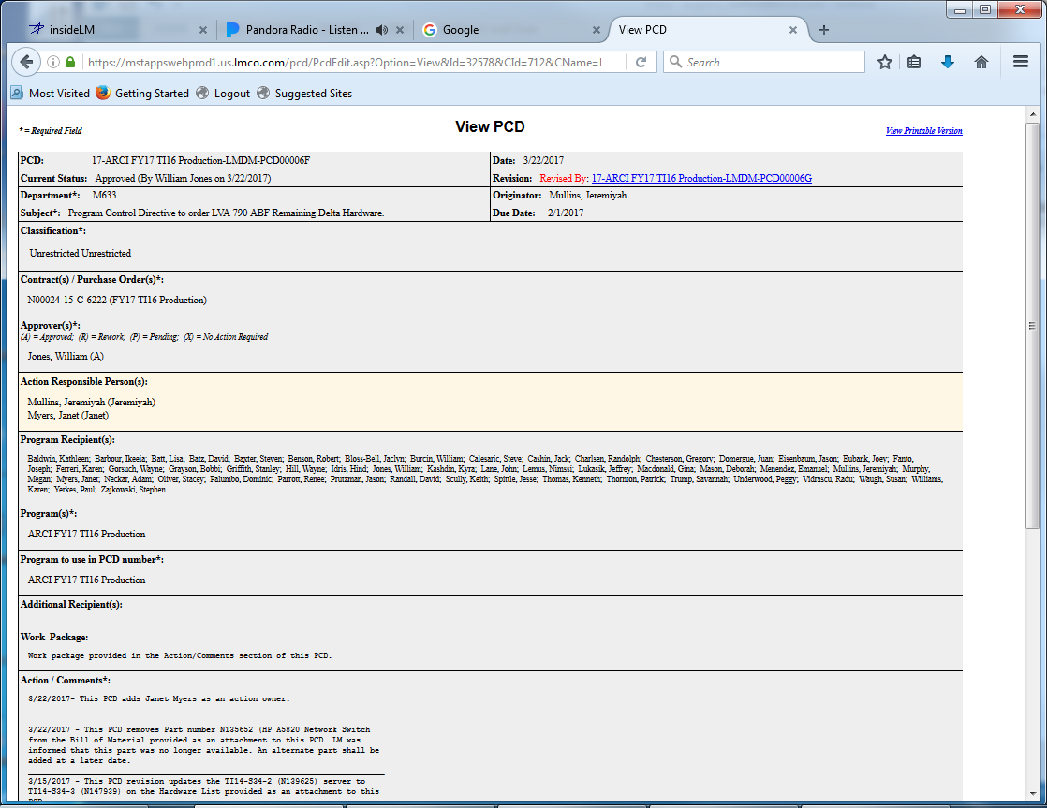
View PCD
Forward…
Cancel
Copy to another PCD
Notes:
Description
All of the PCD data may be viewed. Attachments can be retrieved, however they cannot be added, modified, or deleted from the PCD itself. The PCD state cannot be changed.
Requirements
R1
R2
R3
Functions
F1
Business Rules
BR1
BR2
BR3
Data Objects
DO1
DO1
DO1
Complexity 0
Inputs 0
Outputs 0
Inquires 0
Files/Tables 0
Ext. Files 0

Slide 14
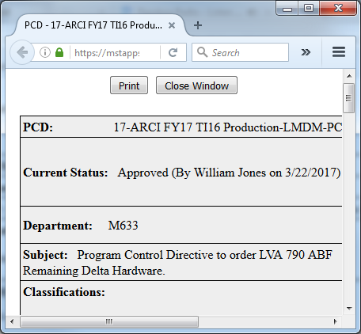
View Printable Version
Banners for printouts.
Notes:
Description
Enter description here
Requirements
R1
R2
R3
Functions
F1
Business Rules
BR1
BR2
BR3
Data Objects
DO1
DO1
DO1
Complexity 0
Inputs 0
Outputs 0
Inquires 0
Files/Tables 0
Ext. Files 0

Slide 15
Approve PCD
* = Required Field New PCD
PCD: Draft-001316
Current Status:
Department: M7F5
Subject: Sample PCD for Approval
Classification:
Unrestricted Unrestricted
Contract(s) / Purchase Order(s)*:
N00024-15-C-6222 (FY17 T116 Production)
Approver(s)*:
(A) = Approved; (R) = Rework; (P) = Pending; (X) = No Action Required
Eubank, Joey (P)
Action Responsible Person(s):
Program Recipient(s):
Baldwin, Kathleen
…
Program(s)*:
ARCI FY17 TI16 Production
Program to use in PCD number*:
ARCI FY17 TI16 Production
Additional Recipient(s):
Work Package:
Labor work package 1Mxxxxxxxxxxxxxx Material work package 1Mxxxxxxxxxxxxxx
Action / Comments*:
4/27/2017 - xxxxxxxxxxxxxxxxxxxxxxxxxxxxxxxxxxxxxxxxxxxxxxxxxxxxxxxxxxxxxxxxxxxxxx
Reference:
Rework Comments:
Attachments:
There are no attachments associated with this PCD.
Approve
Rework
Cancel
Closure
Close PCD

Slide 16
PCD Tracker Objects
tracker
recId seq
…
metadata... …
PCD Objects
pcd
recId seq
pcdId string
…
metadata... …
attachment
contract
program
hardwareList
recid seq
nameHardwareList
itemCount
totalQty
totalCost
metadata... …
hardwareListItems
recid seq
partNum
manufacture
partNumMfg
nomenclature
qty
unitCost
workPackage
poNum
metadata... …

Slide 17
PCD Tracker Functions

Slide 18
Enumeration Helper
Drop Down List Box
Modal
Assign Enumeration
Select an enumeration
Approval Status
A: Approved
R: Rework
P: Pending
X: No action required
A: Approved
R: Rework
P: Pending
X: No action required
OK
Cancel
Notes:
Description
Allows the user to select a value to populate a selection box. This could be either a separate popup, or a drop down list box depending on the standards used.
Requirements
The system shall only display active <enumeration value(s)>.
The system shall only use inactive <enumeration values(s)> for display of historical records.
The system shall use the <sort order> as the default display order.
The system shall allow the user to select many values were appropriate.
Business Rules
The code value is distinct.
The code name is distinct.
The list will only contain valid/<active> codes.
Codes that are inactive will this be displayable for historical data.
Selection/validation of enumeration values will use the <enumeration code> and <enumeration value code>.
Functions
F1
Data Objects
Enumeration Types
Enumeration Values
PCD State (Draft, Submitted, Rework, Approved)
Complexity

Slide 19
Enumeration Types
Enumeration Types
Enter filter…
Filter
# of
Values
Last modified
Date By
Type Name
Description
Action tbd 3
Approval Status Status that can be given to a task. 4
Approvers
Classification
Contract tbd
Department
Hull
Program
Role tbd 4 12/31/17 00:00:00 Smith, Joe
Task tdb 4 05/09/17 14:02:17 Smith, Joe
Technology Insert tbd
?User?
Add New Type
Notes:
Description
Enter description here
Requirements
R1
R2
R3
Business Rules
BR1
BR2
BR3
Functions
F1
Data Objects
Enumeration Types
Enumeration Values
Complexity 0
Inputs 0
Outputs 0
Inquires 0
Files/Tables 0
Ext. Files 0

Slide 20
Enumeration Values
Enumeration Values
Type Name:
Description:
Approval Status
Status that can be given to a task.
Default
Flag
Sort
Order
Active
Flag
Code
Value
Description
‘’ Select One… User prompt, not valid selection. T 0 F
A Approved Approved 1 T
P Pending Pending 3 T
R Rework Rework 2 T
X No Action Required No action required 4 T
Add New Value
Save
Reset
Types
Notes:
Description
Enter description here
Requirements
R1
R2
R3
Business Rules
BR1
BR2
BR3
Functions
F1
Data Objects
Enumeration Types
Enumeration Values
Complexity 0
Inputs 0
Outputs 0
Inquires 0
Files/Tables 0
Ext. Files 0

Slide 21
Enumeration Associated Values
Notes:
Description
Enter description here
Requirements
R1
R2
R3
Functions
F1
Business Rules
BR1
BR2
BR3
Data Objects
DO1
DO1
DO1
Complexity 0
Inputs 0
Outputs 0
Inquires 0
Files/Tables 0
Ext. Files 0

Slide 22
PCD Admin
The Administration option allows maintenance of the programs and contracts. It also allows addition/removal of system administration authorization. System administrators have access to the Administration option on the home page and are also allowed to edit any PCD in any state.

Slide 23
PCD Admin Function
Contract
Program
Need to see what already exists
Users
Add Contract
Add Program
Add User
Delete
Archive
Task View

Slide 24
Contract Entry
Notes:
Description
Enter description here
Requirements
R1
R2
R3
Functions
F1
Business Rules
BR1
BR2
BR3
Data Objects
DO1
DO1
DO1
Complexity 0
Inputs 0
Outputs 0
Inquires 0
Files/Tables 0
Ext. Files 0

Slide 25
Program Entry
Notes:
Description
Enter description here
Requirements
R1
R2
R3
Functions
F1
Business Rules
BR1
BR2
BR3
Data Objects
DO1
DO1
DO1
Complexity 0
Inputs 0
Outputs 0
Inquires 0
Files/Tables 0
Ext. Files 0

Slide 26
User Entry
Notes:
Description
Enter description here
Requirements
R1
R2
R3
Functions
F1
Business Rules
BR1
BR2
BR3
Data Objects
DO1
DO1
DO1
Complexity 0
Inputs 0
Outputs 0
Inquires 0
Files/Tables 0
Ext. Files 0

Slide 27
PCD Functions
DO1

Slide 28
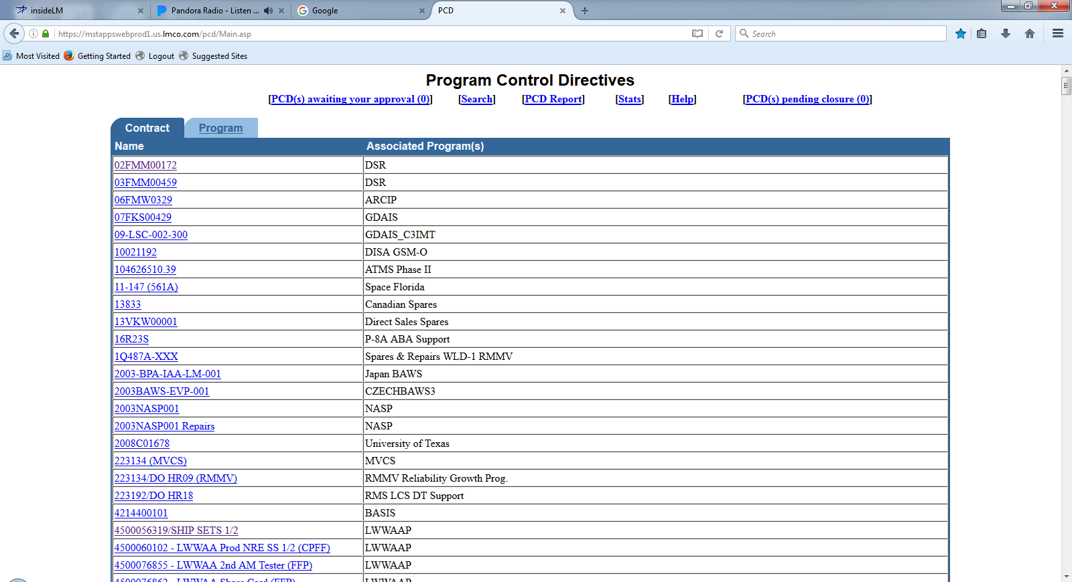
PCD Contract/Program List
Notes:
Description
Enter description here
Requirements
R1
R2
R3
Functions
F1
Business Rules
BR1
BR2
BR3
Data Objects
DO1
DO1
DO1
Complexity 0
Inputs 0
Outputs 0
Inquires 0
Files/Tables 0
Ext. Files 0

Slide 29
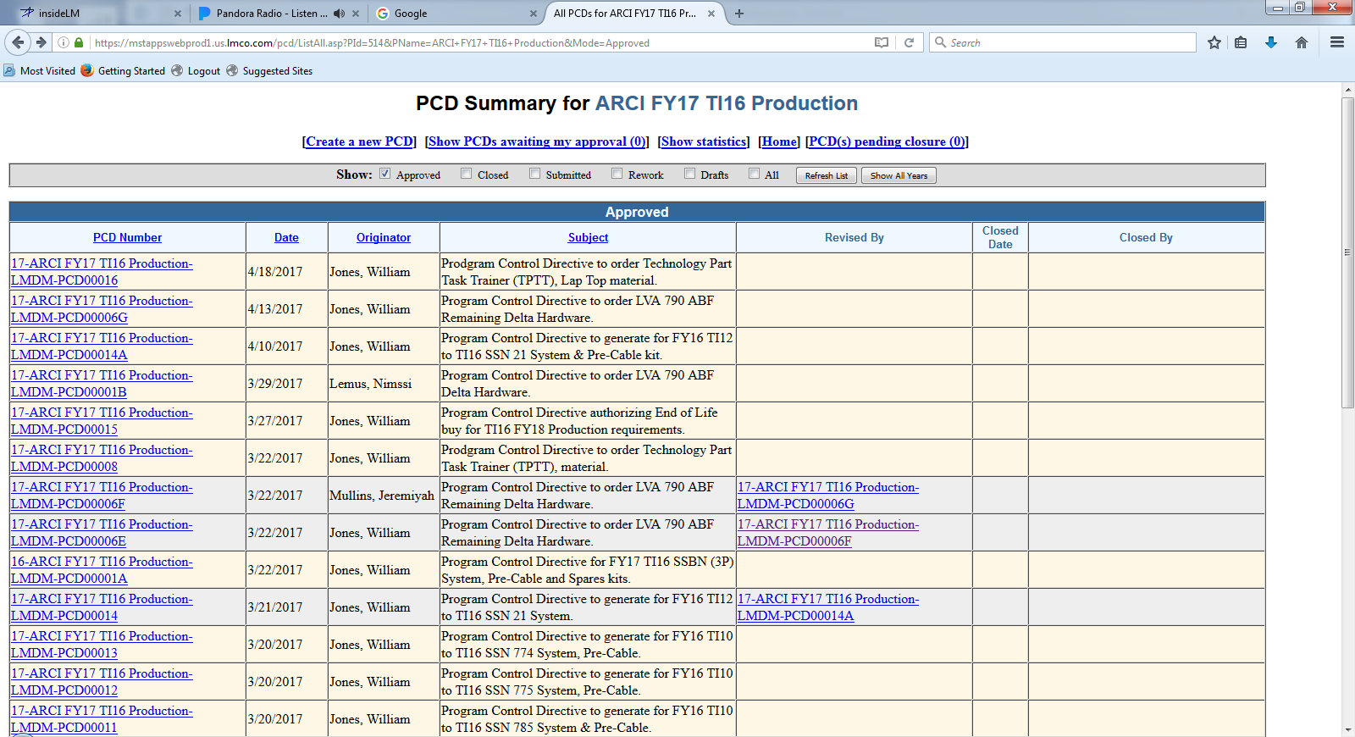
PCD Summary

Slide 30
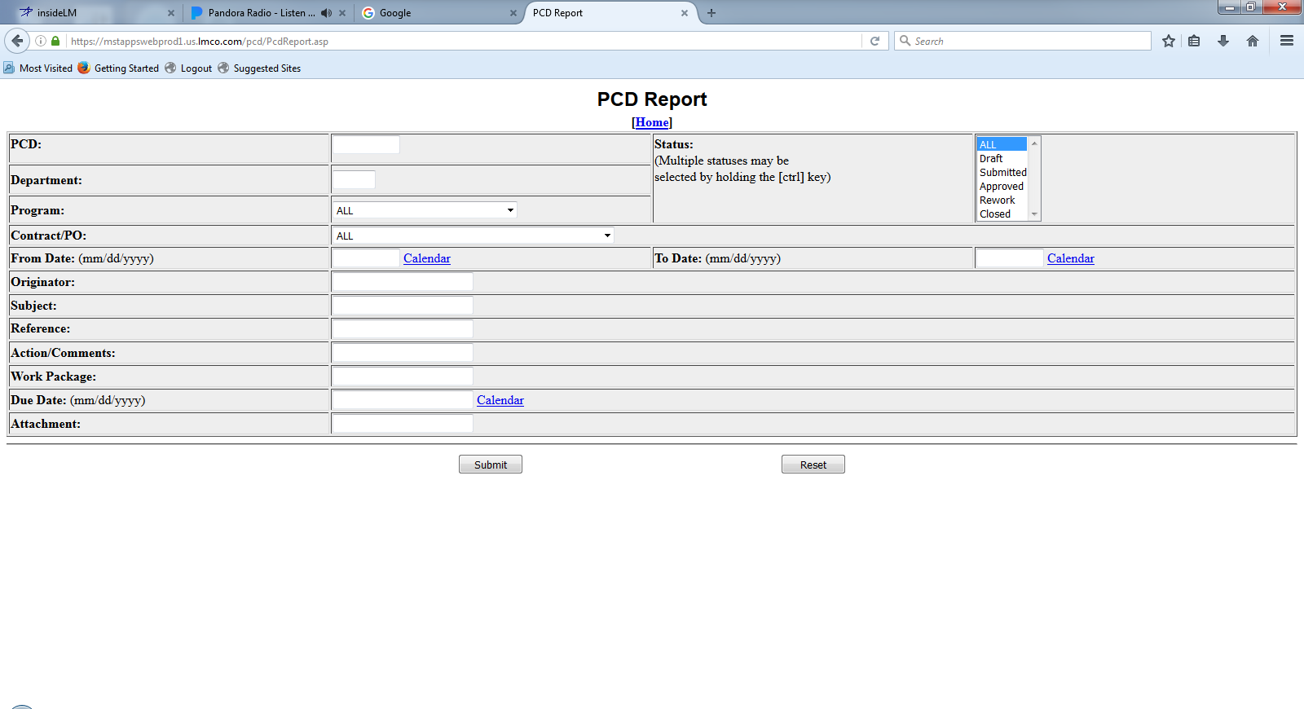
PCD Report
Notes:
Description
Enter description here
Requirements
R1
R2
R3
Functions
F1
Business Rules
BR1
BR2
BR3
Data Objects
DO1
DO1
DO1
Complexity 0
Inputs 0
Outputs 0
Inquires 0
Files/Tables 0
Ext. Files 0

Slide 31
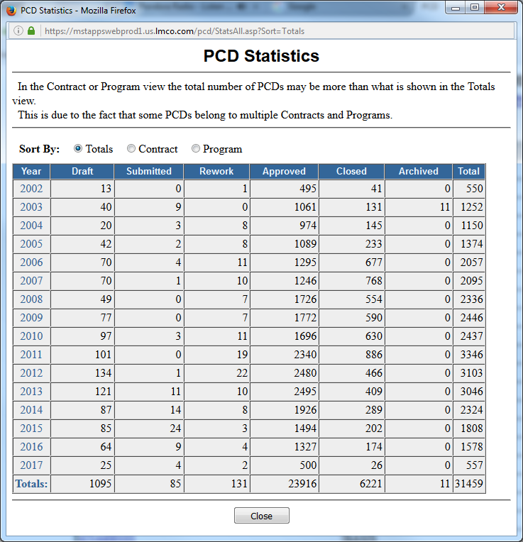
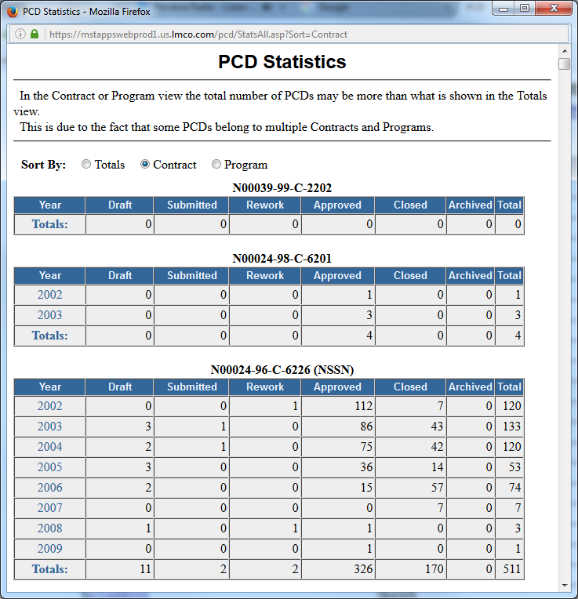
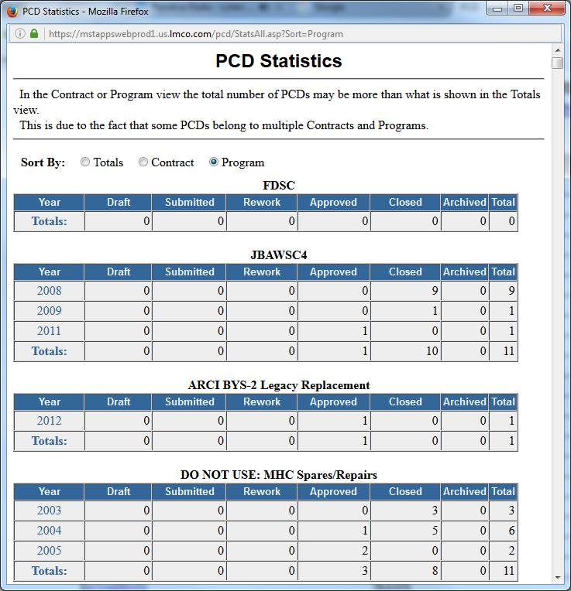
PCD Statistics
Notes:
Description
Enter description here
Requirements
R1
R2
R3
Functions
F1
Business Rules
BR1
BR2
BR3
Data Objects
DO1
DO1
DO1
Complexity 0
Inputs 0
Outputs 0
Inquires 0
Files/Tables 0
Ext. Files 0

Slide 32
PCD Auxiliary Functions

Slide 33
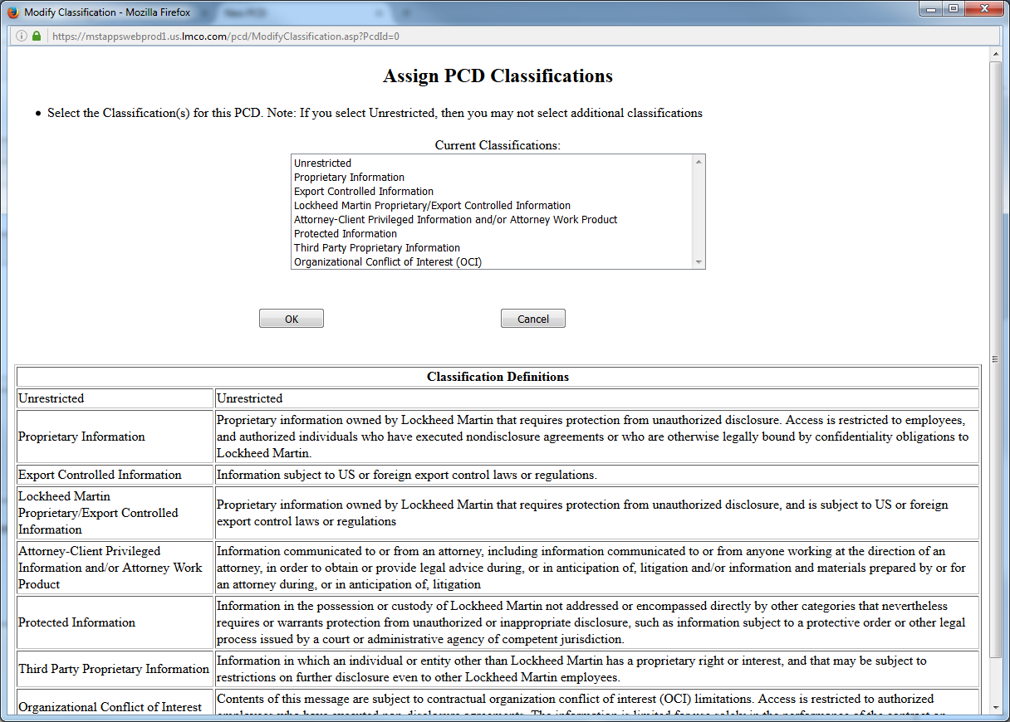
Classification
Banners for printouts.
Notes:
Description
Enter description here
Requirements
R1
R2
R3
Functions
F1
Business Rules
BR1
BR2
BR3
Data Objects
DO1
DO1
DO1
Complexity 0
Inputs 0
Outputs 0
Inquires 0
Files/Tables 0
Ext. Files 0

Slide 34
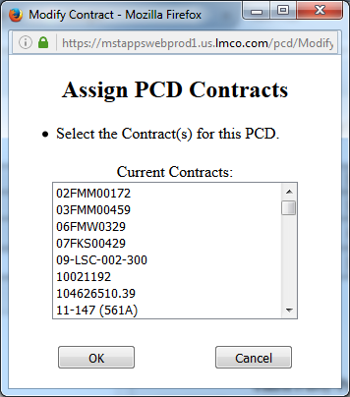
Contract(s) / Purchase Order(s)
Notes:
Description
Enter description here
Requirements
R1
R2
R3
Functions
F1
Business Rules
BR1
BR2
BR3
Data Objects
DO1
DO1
DO1
Complexity 0
Inputs 0
Outputs 0
Inquires 0
Files/Tables 0
Ext. Files 0

Slide 35
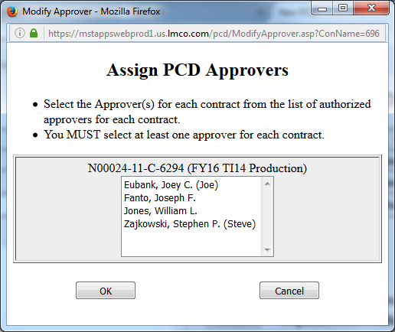
Assign Approver(s)
Notes:
Description
Enter description here
Requirements
R1
R2
R3
Functions
F1
Business Rules
BR1
BR2
BR3
Data Objects
DO1
DO1
DO1
Complexity 0
Inputs 0
Outputs 0
Inquires 0
Files/Tables 0
Ext. Files 0

Slide 36
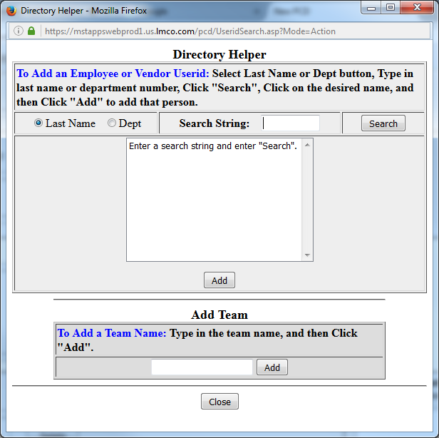
Action Responsible Person(s) / Additional Recipient(s)
Hardware List Entry
Notes:
Description
Enter description here
Requirements
R1
R2
R3
Functions
F1
Business Rules
BR1
BR2
BR3
Data Objects
DO1
DO1
DO1
Complexity 0
Inputs 0
Outputs 0
Inquires 0
Files/Tables 0
Ext. Files 0

Slide 37
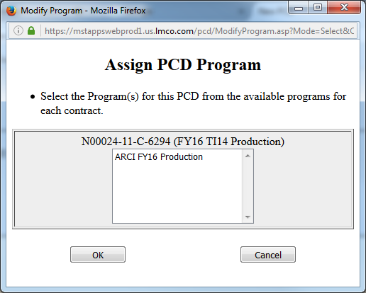
Assign Programs
Notes:
Description
Enter description here
Requirements
R1
R2
R3
Functions
F1
Business Rules
BR1
BR2
BR3
Data Objects
DO1
DO1
DO1
Complexity 0
Inputs 0
Outputs 0
Inquires 0
Files/Tables 0
Ext. Files 0

Slide 38
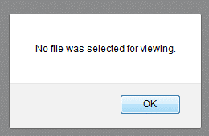
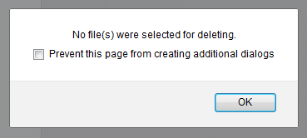
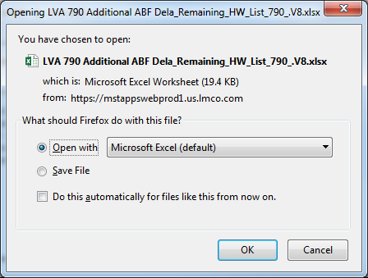
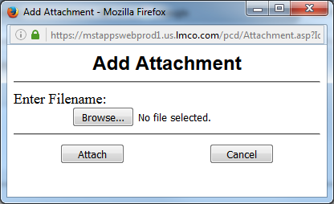
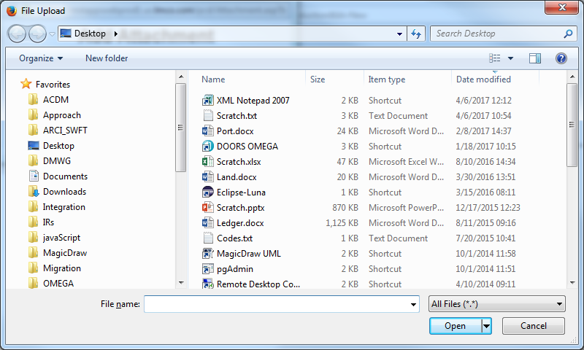
Attachments
Hardware List Entry
Task Review/Approve
Notes:
Description
Enter description here
Requirements
R1
R2
R3
Functions
F1
Business Rules
BR1
BR2
BR3
Data Objects
DO1
DO1
DO1
Complexity 0
Inputs 0
Outputs 0
Inquires 0
Files/Tables 0
Ext. Files 0

Slide 39
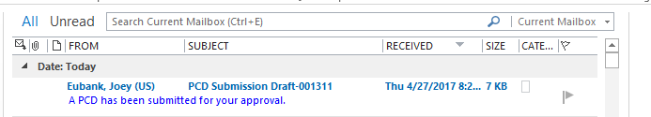
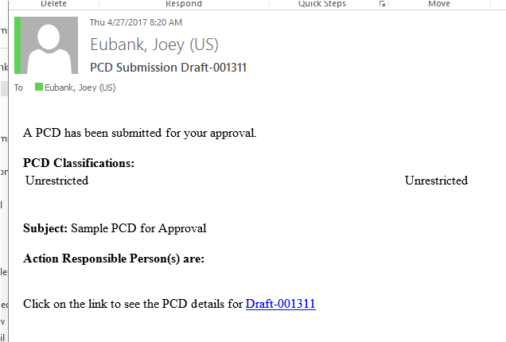
PCD Notification
The link takes you to the draft PCD.
Notes:
Description
Enter description here
Requirements
R1
R2
R3
Functions
F1
Business Rules
BR1
BR2
BR3
Data Objects
DO1
DO1
DO1
Complexity 0
Inputs 0
Outputs 0
Inquires 0
Files/Tables 0
Ext. Files 0

Slide 40
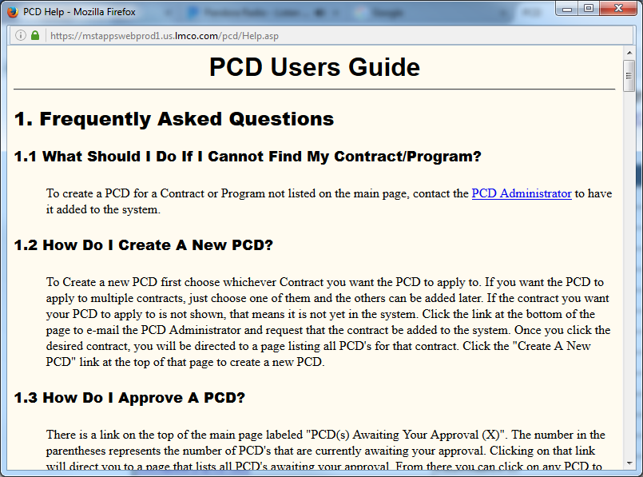
PCD Users Guide
Notes:
Description
Enter description here
Requirements
R1
R2
R3
Functions
F1
Business Rules
BR1
BR2
BR3
Data Objects
DO1
DO1
DO1
Complexity 0
Inputs 0
Outputs 0
Inquires 0
Files/Tables 0
Ext. Files 0

Slide 41
Backup/Reference

Slide 42
PCD BOM Entry
RecID:
Draft-BOM-00999
Current Status:
Pending
Department:
M7F5
Item:
Bill of Materials
Version:
2.1
Classification:
Unrestricted
Contract:
N000##-##-X-1002
N000##-##-X-1003
Source:*
Enter Here..
Required: *
Approvers:
Smith, Joe
Date Approved:
YYYY-MM-DD
BOM Id*
Description
Status*
Comments
BOM-00877 Sonar Laptop Pre-Release Ready for review MM/DD
BOM-00101 Wiring Interface Kit Released
Add
Delete
Reset
Save
Cancel
Attachments:
LVA 790 ABF Eng Dwg_790_v02.jpg
Attach
View
Comments:
04/18/2017 -
Approve
Rework
Cancel
Task View

Slide 43
PCD BOM Entry
RecID:
Draft-BOM-00999
Current Status:
Pending
Department:
M7F5
Item:
Bill of Materials
Version:
2.1
Classification:
Unrestricted
Contract:
N000##-##-X-1002
N000##-##-X-1003
Source:*
Enter Here..
Additional Columns?
Remarks
Required: *
Approvers:
Smith, Joe
Date Approved:
YYYY-MM-DD
Level*
Part
Number*
Item Description*
Group
Unit of
Measure
Qty
Req’d*
1 N139894-1 Sonar Laptop 2 Each 2
1 BOM-00101 Wiring Interface Kit 2 Kit 2
Add
Delete
Reset
Save
Cancel
Attachments:
LVA 790 ABF Eng Dwg_790_v02.jpg
Attach
View
Comments:
04/18/2017 -
Approve
Rework
Cancel
Task View

Slide 44
PCD Task View
PCD Task List
User:
Joe Smith
Show
10
entries
Role
Task
Action
Contract
Subject
Due Date
Originator
BOM
Create
N00024-15-C-6222
VA Class (New Con) Delta Spares
1/15/17
Reviewer
PCD
Review
…
…
…
Reviewer
…
Review
…
…
…
Reviewer
…
Review
…
…
…
Approver
PR
Approve
…
…
…
Approver
ER
Create
…
…
…
Go To
Add Tasker
Search
Admin
Close
Notes:
Description
Upon user initial connection, the system will display a list of tasks/actions, in descending ‘due date’ order, that the user is responsible for. The user will select a existing task and click on the “Go To” button. The system will display the appropriate HMI for the task. When the user clicks on the “Add Tasker” button the tasker HMI will be displayed to allow the user to create a new tasking.
Search
The “Admin” button will be enabled only authorized users. When enabled the user will have access to administrative tools such as:
Manage Contracts
Manage Programs
Manage Users
Manage Enumerations
The “Close” button will allow the user to exit the PCD tool.
Requirements
The system will allow the <users> to sort upon any of the data columns.
The system will allow the <users> to select a <task> to open.
The system shall allow <authorized users> with the <appropriate rights> to add new tasking.
The system shall allow <authorized users> with the <appropriate rights> to access administrative functions
Search
The system shall highlight <tasks> due with X number of days.
Functions
Business Rules
X
Y
Z
Data Objects
Users
Tasks
Complexity 7
Inputs 3
Outputs 1
Inquires 1
Files/Tables 2
Ext. Files 0

Slide 45
PCD Task Review/Approve Status
RecID:
Draft-ER-00999
Current Status:
Pending
Department:
M7F5
Task:
PCD / PR / BOM
Originator:
Smith, Joe
Subject:
Sample ER for Approval
Classification:
Unrestricted
Contract:
N000##-##-X-1002
N000##-##-X-1003
Additional elements to be determined
Attachments:
Sample_ER_File.xlsx
Sample_ER_for_Project.docu
View
Rework
Comments:
Add notes here.
Approve
Rework
Cancel
Task View
Notes:
Description
Approvers can view the PCD just as in the View mode. In addition they may add/modify their comments and select to Approve or Rework the PCD.
Requirements
R1
R2
R3
Functions
F1
Business Rules
BR1
BR2
BR3
Data Objects
DO1
DO1
DO1
Complexity 0
Inputs 0
Outputs 0
Inquires 0
Files/Tables 0
Ext. Files 0

Slide 46
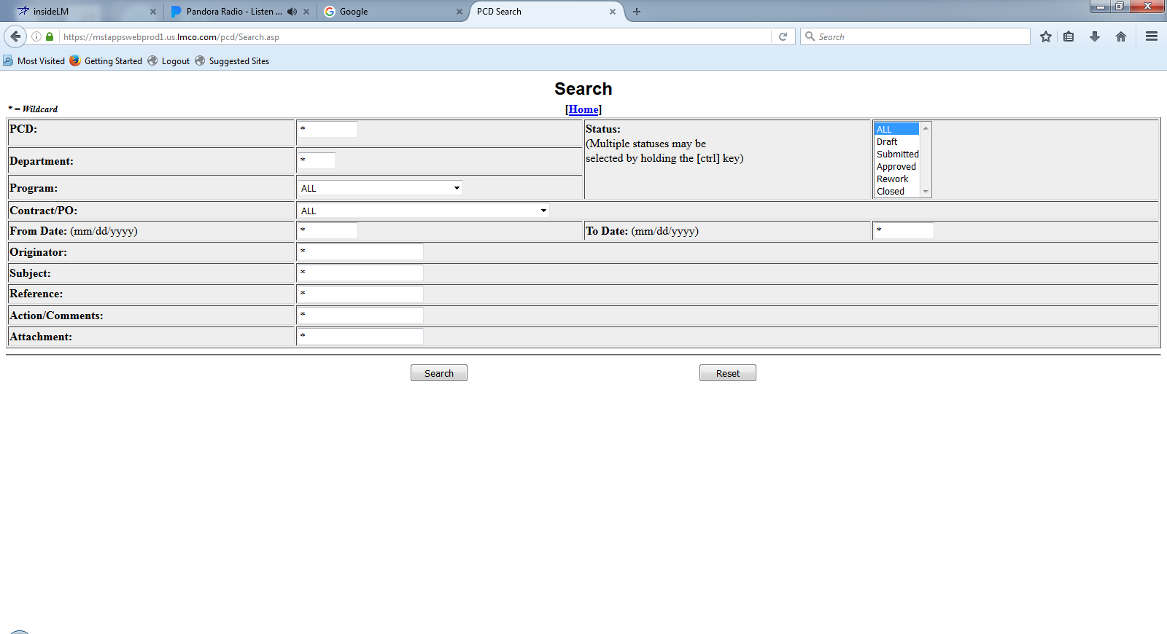
PCD Search
Notes:
Description
When the search button is pressed, the user is presented with a screen where the search criteria are entered. Entering data in any of the search fields indicates that the resulting PCD's must contain that criteria. Wildcards are allowed and are specified using a "*".
Once the search has completed, a list of all resulting PCD's is displayed. Hyperlinks are available to each PCD which allow the user to work with the corresponding PCD in the same manner which is available from the Contracts/Programs option. See Section 4.1 - Contracts/Programs
Requirements
R1
R2
R3
Functions
F1
Business Rules
BR1
BR2
BR3
Data Objects
DO1
DO1
DO1
Complexity 0
Inputs 0
Outputs 0
Inquires 0
Files/Tables 0
Ext. Files 0

Slide 47
Current PCD Entry Screen
* = Required Field New PCD
PCD: Draft-001316 Date: 4/26/2017
Current Status: New Revision: New
Department*: Originator: Belford, Eugene
Subject*: Due Date: Calendar
Classification*: Third Party Proprietary Information:
Organizational Conflict of Interest (OCI):
Contract(s) / Purchase Order(s)*:
Approver(s)*:
(A) = Approved; (R) = Rework; (P) = Pending; (X) = No Action Required
Action Responsible Person(s):
Program(s)*: Program Recipient(s):
(Automatically filled based on program(s) selected)
Program to use in PCD number*:
Additional Recipient(s):
Work Package(s):
Action(s) / Comment(s)*:
Reference(s):
Attachment(s):
Add
Delete
Add
Delete
Add
Delete
Add
View
Delete
Add
Delete
Add
Delete
View
Save
Submit
View
Cancel
Task View
Notes:
Description
The user has clicked the “Draft PCD” button on the Tasker Entry.
Requirements
The “Draft PCD” button requires that a PCD task be in the Tasker.
Business Rules
PCD*: identifier is auto generated.
Date*: defaults to current date and time.
Current Status*: defaults to “NEW”.
Revision (Status):
Department*: defaults to “Select one…”
Originator*: Individual assigned as the <originator> on the tasker.
Subject*: Text enter in the <subject> on the tasker.
Due Date: Date enter in the <pcd required> on the tasker.
Classification*:
Third Party Proprietary Information:
Organizational Conflict of Interest (OCI):
Contract(s) / Purchase Order(s): ?Purchase Requisition(s)?
Approver(s)*: New selection, or are they consolidated from associated tasks?
Approver’s approval status defaults to “P”.
Program(s)*:
Program to use in PCD number*:
Additional Recipient(s): Is there a default list?
Work Package(s): If there was a <work package> on the task, they could be consolidated here.
Action(s) / Comment(s)*: New entries, or are they consolidated from associated tasks?
Reference(s): New entries, and/or are they associated tasks?
Attachment(s): New associations, or are they consolidated from associated tasks?
Functions
F1
Data Objects
DO1
Complexity 0
Inputs 0
Outputs 0
Inquires 0
Files/Tables 0
Ext. Files 0

Slide 48
Draft PCD From Task View
* = Required Field New PCD
PCD: Draft-001316 Date: 05/09/2017
Current Status: New Revision: New
Department*: Originator:
Subject*: Due Date: Calendar
Classification*: Third Party Proprietary Information:
Organizational Conflict of Interest (OCI):
Contract(s) / Purchase Order(s)*:
Approver(s)*:
(A) = Approved; (R) = Rework; (P) = Pending; (X) = No Action Required
Action Responsible Person(s):
Program(s)*: Program Recipient(s):
(Automatically filled based on program(s) selected)
Program to use in PCD number*:
Additional Recipient(s):
Work Package(s):
Action(s) / Comment(s)*:
Reference(s):
Attachment(s):
Select One…
Mullins, Jeremiyah
VA Class (New Con) Delta Spares
02/01/17
Select One…
Add
Delete
Jones, William L. (P)
Add
Delete
Mullins, Jeremiyah
Myers, Janet
Add
Delete
Add
View
Delete
ARCI-FY-TI-SEQ#
Add
Delete
ALL comments and attachments get included in the draft PCD. The user can removed those that do not apply.
Changes made to comments and hardware list get from the draft PCD get made to the source record
Add
Delete
View
Save
Submit
View
Cancel
Task View
Notes:
Description
The user has clicked the “Draft PCD” button on the Tasker Entry. The user will be taken to the PCD Entry HMI. The entry form will be pre-populated with information captured in tasks associated with the PCD task. The amount and level of detail will depend on the associated tasks.
Yes: Question: If a associated task is updated, does the PCD get updated? Does the system need to track those changes? Can the user start the PCD before associated tasks are started/completed?
The user will then be able to work on the PCD until it is submitted for review/approval.
Question: When a PCD is submitted, can the user continue to make changes, or is it locked?
When the user clicks the “Submit” button notifications will be sent to the reviewers, action responsible persons, additional recipients, and approvers. The “View” button allows any user to view the PCD. Attachments can be retrieved, however they cannot be added, modified, or deleted from the PCD itself. The PCD state cannot be changed.
Requirements
The “Draft PCD” button requires that a PCD task be in the Tasker.
Business Rules
PCD*: identifier is auto generated.
Date*: defaults to current date and time.
Current Status*: defaults to “NEW”.
Revision (Status):
Department*: defaults to “Select one…”
Originator*: Individual assigned as the <originator> on the tasker.
Subject*: Text enter in the <subject> on the tasker.
Due Date: Date enter in the <pcd required> on the tasker.
Classification*:
Third Party Proprietary Information:
Organizational Conflict of Interest (OCI):
Contract(s) / Purchase Order(s): ?Purchase Requisition(s)?
Approver(s)*: New selection, or are they consolidated from associated tasks?
Approver’s approval status defaults to “P”.
Program(s)*:
Program to use in PCD number*:
Additional Recipient(s): Is there a default list?
Work Package(s): If there was a <work package> on the task, they could be consolidated here.
Action(s) / Comment(s)*: New entries, or are they consolidated from associated tasks?
Reference(s): New entries, and/or are they associated tasks?
Attachment(s): New associations, or are they consolidated from associated tasks?
Functions
F1
Data Objects
PCD
Tracker
Attachments
Comments
Hardware List
Enumeration Types
Enumeration Values
Complexity 19
Inputs 3
Outputs 0
Inquires 11
Files/Tables 5
Ext. Files 0

Slide 49
Hardware List Workflow
Assign the task
PM
Releases
Released
Created
Reviewer(s) Concurs?
PM Releases?
Submitted
?
Originator Drafts
Saved
Originator Submits
Review
Reviewed
Concurred
Copy?
Reworking
Rework
Rejected
Deleted
Rejected/Reopen
Deleted
Deleted

