Slide 1
PCD Tracker
Storyboard
“Keep It Simple”
Gene Belford
30 May 2017
Notes:
Description
Enter description here
Requirements
R1
Business Rules
BR1
Functions
F1
Data Objects
DO1
Complexity 0
Inputs 0
Outputs 0
Inquires 0
Files/Tables 0
Ext. Files 0

Slide 2
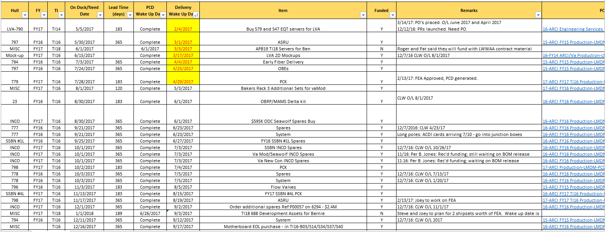
PCD Status View
PCD Status View Options
● Not Funded ○ Funded No PCD ○ PCD Wake Up ○ Delivery Wake Up ○ All Status: ○ Approved ○ Closed ○ Submitted ○ Reworking ○ Drafts
● Compress Columns ○ Show All ○ Show PN ○ Show MAN/CLW
Search Parameters
New PCD Task
New PCD
Save As
Close
Notes:
Description
Upon entry into the PCD Tracker application the user will be shown this HMI with the default PCD filter set to “Not Funded”. User changes to the data being displayed will be saved in the supporting data record. (Provide the a Excel like look and feel.) Hyperlinks are available to each PCD which allow the user to work with the corresponding PCD.
There are number predefined filters for the PCD data, and an option for the user to search the PCD data using user provided parameters. Switching between filters with cause the HMI to refresh automatically. To match the original PCD functionality the <pcd status> were added as filters. The user can select to display all the data columns or pre-defined sets of columns.
When the user clicks on the record’s hyperlink the HMI will change the to the “PCD Tracker Data View” where the user will be able to review and update the task(s) associated with the PCD.
When the user clicks on the “Search Parameters” button the system will display the “PCD Search/Report Parameters” HMI where the user can set the search parameters and either execute the search or generate a PCD report.
When the users clicks on the “New PCD Task” button the user will be taken to the “PCD Tracker Entry” HMI where the user can create a new task.
When the users clicks on the “New PCD” button the user will be taken to the “PCD Entry” HMI where the user can create a new PCD. This function allows to create a PCD that does not require the completion of tasks such as a delegation of authority.
Requirements
The system will highlight data values has determined by the business rules.
The system will allow the user to view the source data record using the “Tracker Data View” HMI by selecting a record from the “Status View”.
The system will allow the user to add a new PCD task.
The system will allow the user to search for PCD tasks using custom parameters.
The system will automatically provide the required scroll bars if the data exceeds the size of the display panel.
The system will allow the user to sort the data.
Business Rules
When the PCD Wakeup date is before or is the same as the current date, the PCD Wakeup date cell will be highlighted in yellow.
Any changes to a PCD with a “approved” status will trigger a revision.
View Filters
Not Funded (FY: active, PCD: active, Funded: N) (Show All)
Funded No PCD (FY: active, PCD: active, Funded: Y) (Compress)
PCD Wake Up () ()
Delivery Wake Up () ()
Search (user supplied search parameters) (Show All)
Approved (Status: approved) (Show All)
Closed (Status: closed) (Show All)
Submitted (Status: submitted) (Show All)
Reworking (Status: rework) (Show All)
Drafts (Status: draft) (Show All)
Functions
F1
Data Objects
PCDs
PCD Status (Draft, Submitted, Rework, Approved)
Complexity 0
Inputs 0
Outputs 0
Inquires 0
Files/Tables 0
Ext. Files 0

Slide 3

PCD Status Search / Report Parameters
PCD:
FY:
TI:
Subject:
PCD Status:
Hull:
Contract:
Funded:
N
FEA:
NA
On Dock/Need Date:
to
PCD Required:
to
PCD Lead Time (days):
to
Internal RDD:
to
Internal RDD Lead Time (days):
to
Delivery Required:
to
Delivery Lead Time (days):
to
Del Status:
Del O/L
MAN PR:
N
to
Next Review:
to
CLW PR:
N
to
$ Est:
to
PN:
PL Status:
DRW Status:
Rec ID:
to
Mod:
SLIN:
BOM:
Originator:
Defined Fields:
Select
Select/Enter…
Add
Select
Select/Enter…
Delete
Metadata Flags:
Select
Select/Enter…
Deleted:
N
Y
Both
Hidden:
N
Y
Both
Search
Report
Clear Parameters
Back
Notes:
Description
This HMI provides the user with the ability to define their own PCD search or report criteria. Once the user has completed entering the parameters the user will click on either the “Search” button to execute the search and populate the “PCD Status View”, or the “Report” button to execute the search and saves the results to a spreadsheet. If the search fails to find any matching records the system will display a message for the user that no matching records where found. If the search does find matches the system will return the user to the “Status View” HMI and refresh the view with the search results. Clicking the “Clear Search” will set the parameters back to their default values.
Requirements
The system will require at 1 search parameter be provided by the user.
The system will allow the user to perform wildcards searches.
The system will retain the last successfully search parameters.
The system will re-populate the parameters using the last successfully search parameters.
The system will allow the user rest the search parameters to their default values.
Business Rules
Null search parameters will not be used in the search.
Empty strings are valid parameters. (Think about the wording.)
The “from” date is less than or equal to the “to” date.
Functions
F1
Data Objects
PCDs
Search parameters
Complexity 0
Inputs 0
Outputs 0
Inquires 0
Files/Tables 0
Ext. Files 0

Slide 4
PCD Tracker Data View
Required: *
PCD:
TBD-ARCI-FY-TI-SEQ#
FY:*
17
TI:*
TI16
Subject:*
Spares
PCD Status:
In-Progress
Hull:
21
Contract:
N00024-15-C-6222
Funded:
N
FEA:
NA
On Dock/Need Date:
04/13/2019
Originator:
Joe Smith
Del O/L
PCD Lead Time (days):
365
PCD Required:
4/13/17
MAN PR:
N
Int RDD Lead Time (days):
0
Internal RDD:
4/13/17
CLW PR:
N
Delivery Lead Time (days):
90
Del Required:
1/13/18
Del Status:
Delivered
PN:
N165074-1
PL Status:
Released
DRW Status:
Released
Rec ID:
00999
Mod:
P00012
SLIN:
0203AD
$ Est:
$300K
BOM:
Pre-Release
Next Review:
3/2/17
Remarks:
04/11/17: Not funded yet. Wait for funding to come in
Add
02/13/17: Work around is to Utilize a subset of the …
Del
Confirm the meaning with Joe.
Defined
Fields:
Add
Select
Select/Enter…
Del
Tasks
Identifier
Name/Description
Pending
Attachments / Comments
BOM
Originator
Reviewer
Approver
Mullins, Jeremiyah
Myers, Janet (Pending)
Smith, Joe (Pending)
Jones, William (Approved)
Identifier
Name/Description
Status
Attachments / Comments
BOM
Originator
Reviewer
Approver
Task Maintenance
Hardware List
Save
Copy
Print
Delete
Cancel
Create PCD
Status View
Notes:
Description
This is the “PCD Tracker Data View” HMI. When the user clicked on the hyperlink in the “PCD Status View” HMI the system open this view for the user. The view contains all the information displayed in the status row. (See PCD Tracker Entry for more details.)
When the user edits a “remark” a audit record will be generated.
Requirements
See Tracker Entry for additional requirements.
The system will allow the user to save the data to Excel.
The system will allow the user to print the data.
Business Rules
See Tracker Entry for additional business rules.
Functions
See Tracker Entry for additional functions.
Data Objects
See Tracker Entry for additional data objects.
Complexity
See Tracker Entry for complexity values.

Slide 5
PCD Tracker Entry
Required: *
PCD:
Draft-ARCI-FY-TI-SEQ#
FY:*
TI:*
Subject:*
Enter Subject...
PCD Status:
Select…
Hull:
Contract:
Select…
Funded:
N
FEA:
NA
On Dock/Need Date:
Originator:
Joe Smith
Del O/L
PCD Lead Time (days):
365
PCD Required:
MAN PR:
N
Int RDD Lead Time (days):
0
Internal RDD:
CLW PR:
Delivery Lead Time (days):
90
Del Required:
Del Status:
Select …
N
PN:
PL Status:
Select…
DRW Status:
Select…
Rec ID:
999
Mod:
SLIN:
$ Est:
BOM:
Select…
Next Review:
Remarks:
Enter Remarks…
Add
Del
Defined
Fields:
Add
Select
Select/Enter…
Del
Task
Task Maintenance
Hardware List
Save
Copy
Print
Delete
Cancel
Create PCD
Back
Notes:
Description
This HMI allows the user to enter and/or update common information needed for a related set of tasks. The user can add and/or delete remarks regarding the activity from this HMI. These remarks will be included in the draft PCD where the user can choose to exclude the remarks from the PCD submission. The “defined fields” allows the user to add program specific terms.
The “tasks” panel provide a area where the user can view sub-tasks related to the PCD. The would tasks that require completion before the PCD can be submitted. This allows management to be able to track the PCD development a finer level of detail. The “task maintenance” button provides the user access the “PCD Tracker Maintenance” HMI. When the user exits the “task maintenance” function the system will refresh the “tasks” panel.
The “hardware list” button provides the user with the functionality need to create a hardware list for PCD from the PCD application. Changes to the hardware list would cause the system version the PCD.
Save: Allows the user to save their changes made to the tracker entry. The system will trigger the create of required audit records. “Task Maintenance” and “Hardware List” have their own save functions.
Copy: Allows the user to select an existing tracker entry and use it to pre-populate a new entry. The system will include all associated task data. (Need a save as function. The user would need to change either FY, TI or Subject to prevent a duplicate entry error.)
Print: Allows the user to view a printer ready version of the PCD, and print the PCD.
Delete: Allows the user to delete the “draft” PCD. The system will flag the entry as deleted and hide the entry from most searches, but the record will be retained by the system for audit purposes.
Cancel: Allows the user to reset the view to the values at existed upon open the HMI.
Create PCD: Allows the user to generate a PCD using the data entry into and/or associated with the tracker entry. Upon the initial generation the system will use all data associated with the entry. If the user choose the exclude tasks, remarks, attachments, etc. from the draft PCD, the system will flag those items from future re-generations of the PCD. (So we need a function to add them back in?) The system will trigger the create of required audit records. The system will open the “PCD” view upon completion.
Xxxxxx-ARCI-FY-TI-SEQ#
The “copy” button includes copying the tasks.
Sort/filter?
Requirements
The system will all the <users> to add, update and remove <tasks>.
The system will allow only the <authorized users> to add and/or delete <remarks>.
The system will allow the <users> to copy an existing <tracker> into a new <tracker>.
The system will allow the <users> to generate a <draft PCD> from the related <tasks>.
The system will show the status of the PCD.
The system will allow the <user> to view all the tasks the have been assigned to the <tracker>.
The system will allow only the <authorized users> to edit and/or delete a <tracker>.
Upon delete of a <remark> the system will flag the <remark> record as logically deleted.
Upon delete of a <defined field> the system will flag the <defined field> record as logically deleted.
Upon delete of a <hardware list> the system will flag the <hardware list> record as logically deleted
Business Rules
The date required can be no early than the current date.
When a new <PCD> is requested the <PCD identifier> is populated with a <draft PCD identifier>.
The <draft PCD identifier> will be updated with <PCD> identifier upon <PCD> approval.
The <PCD status> will default to ?????.
The <FY> is a required field and will default to blank.
The <FY> will be selected from the active values contained in the <FY> enumeration list.
The <TI> is a required field and will default to blank.
The <TI> will be selected from the active values contained in the <TI> enumeration list.
The <subject> is a required field and will default to “Enter Subject…”.
The <subject> will accept any string except “Enter Subject…” as valid input.
The <hull> will default to blank.
The <hull> will be selected from the active values contained in the <hull> enumeration list.
The <contract> will default to <blank>.
The <contract> will be selected from the active values contained in the <contract> enumeration list.
The <funded> will default to "N" until selected by the <project manager>.
The <fea> identifier will default to "NA" until selected by the <project manager>.
The <contract> is a required field and will default to <blank>.
The <originator> will default to the individual who created the <draft PCD>.
The <on dock/need date> will default to <blank> until entered by the <project manager>.
The default <PCD lead time> is 365.
Upon modification of the <PCD required date> by the user the system will recalculate the <PCD lead time>.
The <PCD lead time> will greater than 0.
The <PCD lead time> will validated against the active values contained in the <PCD lead time> enumeration list. Non-standard values will be confirmed with the user.
The <PCD required date> default value is <on dock/need date> minus <PCD lead time>.
The default <delivery lead time> is 90.
Upon modification of the <delivery required date> by the user the system will recalculate the <delivery lead time>.
The <delivery lead time> will greater than 0.
The <delivery lead time> will validated against the active values contained in the <delivery lead time> enumeration list. Non-standard values will be confirmed with the user.
The <delivery required date> default value is <on dock/need date> minus <delivery lead time>.
The <PCD Required> date cannot be later than or the same as the <internal RDD> date.
The <internal RDD> date cannot be later than or the same as the <on dock/need date> date.
The <internal rdd> identifier will default to <blank> until entered by the <project manager>.
The <man pr>
The <man del o/l>
The <clw pr>
The <clw del o/l>
The <pn> will
The <pl status> identifier will default to <blank> until selected by the <project manager>. Enumeration Type: Approval (blank, Pre-Release, Released)
The <dwg status> identifier will default to <blank> until selected by the <project manager>. Enumeration Type: Approval (blank, Pre-Release, Released)
The <mod> identifier will default to <blank> until selected by the <project manager>.
The <slin> identifier will default to <blank> until entered by the <project manager>.
The <$est> will default to <blank> until entered by the <project manager>.
The <bom> identifier will default to <blank> until selected by the <project manager>. Enumeration Type: Approval (blank, Pre-Release, Released)
The <rec id>
The <next review>
Enumeration Type: Task Type (blank, PN, DWG, DOM, PCD, PR)
Functions
Contract Selector
Enumeration Helper
Data Objects
Trackers
Contracts
Notes
Complexity 33
Inputs 18
Outputs 3
Inquires 4
Files/Tables 8
Ext. Files 0

Slide 6
PCD Tracker Maintenance
RecID
00999
Subject
VA Class (New Con) Delta Spares
Contract
N00024-15-C-6222
Required: *
Identifier
Name/Description *
Status *
Required By:
2/1/17 *
Task Type *
Originator *
Name
Reviewer
Name(s)
Approver *
Name(s)
Delete
Delete
Delete
Attachments:
Remarks:
LVA 790 Additional ABF Delta_HW List_790_v02
Add
4/11/17: Not funded yet. Wait for funding to come in
2/13/17: Work around is to Utilize a subset of the SSN
Add
View
Del
Del
Task
Role1
Role2
Role3
Identifier
Name/Description
Status
Purch Req
Originator
Reviewers
Approvers
Mullins, Jeremiyah
Myers, Janet (Pending)
Smith, Joe (Pending)
Jones, William (Approved)
Identifier
Name/Description
Status
BOM
Originator
Reviewers
Approvers
Name(s)
Name(s) Status
Name(s) Status
Attachments:
LVA 790 Additional ABF Delta_HW List_790_v02.xls
Comments:
04/11/17: Joe Smith - Not funded yet. Wait for funding to come in
Add Task
Edit
Save
Delete
Cancel
Back
Notes:
Description
The HMI will allow the authorized user to add, update, delete, and close tasks. The user will entered the required minimum for the task. information for the type of task. The user can add and/or delete attachments and remarks regarding the activity from this HMI. These remarks will be included in the draft PCD where the user can choose to exclude the remarks from the PCD submission. The HMI contains a scrolled task panel that displays tasks already entered for the associated tracker entry. When the user selects a existing tasks by checking the tack, and clicking on the “Edit” button the this will populate the entry/edit form on the top of the page.
For the originator, reviewer, and approver inputs, the system will display a list of individuals where the user can select one or more individuals to add the to role.
The user can add attachments to the task by clicking on the “Add” button. The system will open a separate window where the user will search for and select the external file from. When the user selects a attachment(s) using the check box, the “View” and “Delete” buttons will be enabled. (The check box default state is unchecked.) When the “View” button is clicked the system will open a separate window and display the document. When the “Delete” button is clicked the system will remove the attachment(s) from the task. The attachment entry will be retained by the system with a “hidden” status for audit purposes. These attachment(s) will be included in the draft PCD where the user can choose to exclude the attachment(s) from the PCD submission.
The user can add and/or delete remarks regarding the task from this HMI. When the user selects a remark(s) using the check box, “Delete” buttons will be enabled. (The check box default state is unchecked.) When the “Delete” button is clicked the system will remove the remark(s) from the task. The remark entry will be retained by the system with a “hidden” status for audit purposes. These remark(s) will be included in the draft PCD where the user can choose to exclude the remark(s) from the PCD submission.
Delete: For the originator, reviewer, and approver roles, allows the user to remove a individual from the role for the task.
Add: For the attachments it allows the user to attach a external document for the task.
View: For the attachments it allows the user to view the attachment selected
Delete: For the attachments and remarks fields, allows the user to remove elected items from the task.
Add Task: Allows the user to enter a new task under the tracker entry. The system will initialize the input panel to its default state. The system will enable the “Save” button when all the required fields are entered.
Edit: When the user selects a task from the task panel the system will enable the “Edit” button. When the user clicks the “Edit” button the system will populate the task edit panel and the allow user to update the task.
Save: Allows the user to save their changes made to the task entry. The system will trigger the create of required audit records. “Task Maintenance” and “Hardware List” have their own save functions. (Audit details)
Delete: Allows the user to delete the “draft” PCD. The system will flag the entry as deleted and hide the entry from most searches, but the record will be retained by the system for audit purposes.
Cancel: Allows the user to reset the view to the values at existed upon open the HMI.
Back: Returns the user to the HMI that the current HMI was called from.
Requirements
The system shall automatically assign item identifiers that are unique.
The system shall validate that all required fields are complete.
The system shall allow the <authorized user> to maintain the enumerations used in the drop-down list boxes.
The system shall use the <active directory> to assign individual tasks.
Business Rules
A required roles needs to have at least one individual assigned.
The <Required By> date cannot be later than or the same as the <Internal RDD> date.
Functions
Action Person Helper
Approver Person Helper
Enumeration Helper
Attachments
Notes?
Data Objects
Trackers
Tasks
Users
Enumeration Values
Notes
Attachments
Complexity 0
Inputs 0
Outputs 0
Inquires 0
Files/Tables 0
Ext. Files 0

Slide 7
PCD Hardware List Entry
RecID:
Draft-HL-00999
FY:
17
TI:
TI16
Subject:
Spares
Current Status:*
Pending
Department:*
M7F5
Contract:
N000##-##-X-1002
Required: *
Grouping
Part
Number*
Mfg Part
Number
Nomenclature*
Qty*
Unit
Cost*
Cost
Total
Work
Package*
RDD*
Hardware
1M17ESL1N223 Hdw
1M17ESLLC223 Labor
N139894-1 Sonar Laptop 2 $800
$1600
$1600 Sub-Total
$500
$200
$700 Sub-Total
$2300 Total
Software
N139894-2 Operating System 2 $250
1M17ESL1N223 Soft
1M17ESLLC223 Soft
N139894-2 Anti- Virus 2 $100
Add
Save
Delete
Group By
Cancel
Remarks:
04/18/2017 - LM Production is directed/authorized to generate for the Technology Part Task Trainer hardware listed below. LM Production shall notify Bill Steinbach (1511) once the kits are available for delivery.
Note: All material in the Sonar Lap top kits are required except for the Lap Tops P/N N146823-1 Item 25 on the
Add
Del
Attachments:
Attach
Select
View
Save
Submit
Delete
Cancel
Back
Notes:
Description
This HMI allows the user to construct a hardware list. The basic HMI has three inputs:
The hardware list
Remarks
Attachments
The four buttons on the bottom of the HMI permit the user to save a list being work, submit for approval, or cancel any changes that had been contacts, or comments.
When the user has prepared the hardware list outside the PCD, the user will import the external document as an attachment(s).
The panel in the center of the HMI is where the user constructs the hardware list. When the HMI opens any parts previously entered would be displayed. When the user clicks on the Add button a new line will be created for the user to complete. When the Add button is clicked any changes/additions to the list will saved. When a value has been entered into a new line the “Save” button will be enabled.
If the user needs to delete a line(s), the user would select the line(s) and then click the Delete button. Until user selects a hardware list entry the “Delete” button would be disabled.
The select of a hardware list entry or entries will enable the “Group By” button. The “Group By” allows the user to assigned an identifier to those entries. As shown in the HMI the user select the “sonar laptop” entry and assigned it to the “Hardware” group, and repeated the action to create a “Software” group. Does the group need a checkbox? The HMI will refresh to reflect the user grouping automatically. To remove a hardware list entry from a group the user would select the entry and assign it to the “” group which is the default group for all entries.
Reset? Cancel?
Add: The system will add a blank line item for the user to complete.
Delete: The system will delete those line item(s) the user has selected for removal. (Audit details)
Group By: The system will group line item(s) the user has selected. (How do we ungrouped items?)
Reset:
Cancel: Allows the user to reset the line items to the values at existed upon open the HMI.
Save: Allows the user to save their changes made to the task entry. The system will trigger the create of required audit records. “Task Maintenance” and “Hardware List” have their own save functions. (Audit details)
Submit:
Delete: Allows the user to delete the “draft” hardware list. The system will flag the entry as deleted and hide the entry from most searches, but the record will be retained by the system for audit purposes.
Cancel: Allows the user to reset the view to the values at existed upon open the HMI.
Back: Returns the user to the HMI that the current HMI was called from.
Requirements
Upon saving of the hardware List entry, the system will check for empty/null required fields and if found the system will prompt the user to completed entry of required fields.
If unsaved changes exist prior to closing the HMI, the system will prompt the user to save the changes.
If unsaved changes exist prior to cancel a session, the system will warn the user that changes will be lost.
Before deleting a part(s) the system will prompt the user for confirmation.
Business Rules
The Submit button will be enabled when either one part is added, or a attachment has been made.
When the Submit button is clicked the system will forwarded the to the reviewers/approvers.
When all the reviewers/approves have approved the hardware list, the list will be forwarded to the purchasing contacts.
An approved Hardware List will be locked to prevent additional part list changes.
An approved Hardware List will need approver to submit the part list for rework for changes to be made to the part list.
??? Change history
Functions
Directory Helper
Attachments
Comments
Hardware List
Data Objects
Tasks
Users (purchasing sub-list?)
Parts
Attachments
Comments
Complexity 0
Inputs 0
Outputs 0
Inquires 0
Files/Tables 0
Ext. Files 0

Slide 8
Collapsed PCD Draft From Track View
Required: *
Date:
4/13/17
PCD:
Draft-ARCI-FY-TI-SEQ#
FY:*
15
TI:*
TI16
Subject:*
neration of SSN 794 Spares Hardware
PCD Required:*
4/13/17
Originator:
Joe Smith
Current Status:
Revision:
Current
Department:*
Select
Classification:*
Unrestricted
Third Party Proprietary Information:*
Organizational Conflict of Interest (OCI):*
Work Package(s):
Work Packag…
Program(s):*
ARCI FY15 Pro…
Contract(s) / Purchase Order(s):
N00024-15-C-6222
+
Approver(s):*
Jones, William (P)
Add
Del
(A) = Approved; (R) = Rework; (P) = Pending; (X) = No Action Require
+
Action
Responsible
Persons:
Mullins, Jeremiyah (Jeremiyah)
Add
Del
+
Program
Recipients:
Baldwin, Kathleen; Batt, Lisa; Batz, David; Baxter, Steven; Benson, Robert; Burcin, William; Calesaric, Stev…
Add
Del
(Automatically filled based on program(s) selected)
+
Additional
Recipients:
DeRancy, Daniel G.
Add
Del
+
Hardware
List:
Grouping
Part
Number*
Mfg Part
Number
Nomenclature*
Qty*
Unit
Cost*
Cost
Total
Work
Package*
+
Remarks:
10/12/2016- The purpose of this PCD is to authorize/direct LM Manassas Operations (J. Mullins) to order the S…
Add
Del
Hide
+
References:
Add
Del
View
Contract N00024-15-C-6222 UCA dated 03 Feb 2015.
Hide
+
Attachments:
Add
Del
View
Contract N00024-15-C-6222 UCA dated 03 Feb 2015.
Hide
Save
Submit
View
Cancel
Back
Notes:
Description
This HMI shows the results of the user from having clicked the “Create PCD” button on the “PCD Tracker Entry” HMI. The data elements from all PCD tasks combined together in their respective sections. This the last sentence true, or is select sections? The HMI includes the functionality for the user to be able expand/collapse any given section. All the section are collapse when HMI opens. The user can click on the “+” symbol to expand a section. The section will resize the section and page to fit the data elements. The “+” symbol will change to a “-” symbol. Clicking a “-” will collapse the section and resize page. Should the user choose to add a data element to a section that is collapsed, the section will automatically expand.
The user has the functionality to edit each of the sections prior to the PCD submission. When the HMI opens only the “Add” buttons will be enabled. Depending on the section, when a data element is selected by the user using the checkbox the “Delete” and “View” are enabled. Deselecting the data element disable the buttons.
Requirements
The system will allow the user to collapse a expanded section.
The system will allow the user to expand a collapsed section.
The system will allow the user to collapse all sections with a single click.
The system will allow the user to expand all sections with a single click.
If unsaved changes exist prior to closing the HMI, the system will prompt the user to save the changes.
If unsaved changes exist prior to cancel a session, the system will warn the user that changes will be lost.
Business Rules
Upon the user adding a new data element to a section the System will associate and stored the data element with PCD.
Upon user change to an existing element in a section the System will update the source data element in the respective section and task.
Upon clicking the “Submit” button the system will change the PCD status from “Draft” to “Submitted”.
Upon clicking the “Submit” button the system will notify the reviewer(s)/approver(s) that the PCD is available for review.
Functions
Directory Helper
Attachments
Comments
Hardware List
Data Objects
Tasks
Users (purchasing sub-list?)
Parts
Attachments
Comments
Complexity 0
Inputs 0
Outputs 0
Inquires 0
Files/Tables 0
Ext. Files 0

Slide 9
Expanded PCD Draft From Track View I
Required: *
Date:
4/13/17
PCD:
Draft-ARCI-FY-TI-SEQ#
FY:*
15
TI:*
TI16
Subject:*
neration of SSN 794 Spares Hardware
PCD Required:*
4/13/17
Originator:
Joe Smith
Current Status:
Revision:
Current
Department:*
Select
Classification:*
Unrestricted
Third Party Proprietary Information:*
Organizational Conflict of Interest (OCI):*
Work Package(s):
Work Packag…
Program(s):*
ARCI FY15 Pro…
Contract(s) / Purchase Order(s):
N00024-15-C-6222
-
Approver(s):*
Jones, William (P)
Add
Del
(A) = Approved; (R) = Rework; (P) = Pending; (X) = No Action Require
-
Action
Responsible
Persons:
Mullins, Jeremiyah (Jeremiyah)
Add
Del
-
Program
Recipients:
Baldwin, Kathleen; Batt, Lisa; Batz, David; Baxter, Steven; Benson, Robert; Burcin, William; Calesaric, Steve; Cashin, Jack; Charlsen, Randolph; Colleyacme, Mark; Domergue, Juan; Eisenbaum, Jason; Eubank, Joey; Fanto, Joseph; Ferreri, Karen; Gorsuch, Wayne; Grayson, Bobbi; Griffith, Stanley; Hill, Wayne; Idris, Hind; Jones, William; Lane, John; Lemus, Nimssi; Lukasik, Jeffrey; Macdonald, Gina; Mason, Deborah; Menendez, Emanuel; Mullins, Jeremiyah; Murphy, Megan; Myers, Janet; Neckar, Adam; Oliver, Stacey; Palumbo, Dominic; Parrott, Renee; Randall, David; Scully, Keith; Spittle, Jesse; Thomas, Kenneth; Thornton, Patrick; Trump, Savannah; Underwood, Peggy; Vest, Rita; Vidrascu, Radu; Waugh, Susan; Williams, Karen; Yerkes, Paul; Zajkowski, Stephen
Add
Del
(Automatically filled based on program(s) selected)
-
Additional
Recipients:
DeRancy, Daniel G.
Add
Del
-
Hardware
List:
Grouping
Part
Number*
Mfg Part
Number
Nomenclature*
Qty*
Unit
Cost*
Cost
Total
Work
Package*
N139894-1 Sonar Laptop 1 1MT16A1…
1MT16A1…
1MT16A1…
1MT16A1…
Notes:
Description
In this view of the “Draft PCD” HMI shows all the sections expanded. The page size will automatically expand to fit the data elements.
Requirements
If unsaved changes exist prior to closing the HMI, the system will prompt the user to save the changes.
If unsaved changes exist prior to cancel a session, the system will warn the user that changes will be lost.
Business Rules
The Submit button will be enabled when either one part is added, or a attachment has been made.
When the Submit button is clicked the system will forwarded the to the reviewers/approvers.
When all the reviewers/approves have approved the hardware list, the list will be forwarded to the purchasing contacts.
An approved Hardware List will be locked to prevent additional part list changes.
An approved Hardware List will need approver to submit the part list for rework for changes to be made to the part list.
??? Change history
Functions
Directory Helper
Attachments
Comments
Hardware List
Data Objects
Tasks
Users (purchasing sub-list?)
Parts
Attachments
Comments
Complexity 0
Inputs 0
Outputs 0
Inquires 0
Files/Tables 0
Ext. Files 0

Slide 10
Expanded PCD Draft From Track View II
Required: *
Date:
4/13/17
PCD:
Draft-001275 ARCI-FY-TI-SEQ#
FY:*
15
TI:*
TI16
Subject:*
neration of SSN 794 Spares Hardware
PCD Required:*
4/13/17
Originator:
Joe Smith
Current Status:
Revision:
Current
Department:*
Select
Classification:*
Unrestricted
Third Party Proprietary Information:*
Organizational Conflict of Interest (OCI):*
Work Package(s):
Work Packag…
Program(s):*
ARCI FY15 Pro…
Contract(s) / Purchase Order(s):
N00024-15-C-6222
-
Remarks:
3/3/2016- The purpose of this PCD revision is to direct LM Manassas Production Control & LM Clearwater to order the remainder material for SSN 794 by replacing the existing LLEOQ HPCDs created from previous PCD revisions with the full system bill of material P/N N148500-1. The work packages listed below are still valid and all existing orders are to be reassigned to the full system. There is no change to the ASRU early delivery, flow valve kit, or PCK.
Add
Del
Unhide
8/19/2015 The purpose of this PCD revision is to authorize LM Manassas Production Control (J. Mullins)to procure the LL Switch (N147642-1)BOM Quantity 1.
6/29/2015 The purpose of this PCD is to authorize the procurement of TI16 New Con Server LL BOM (COTs) Hardware N147414-1.
The CTAPS N146748 Qty 2, Chin/Sphere power supply N108889 Qty 4, LASC power supply N146207 Qty 4 & N147424-1 Clw LL BOM Qty 1 shall be added to the N146651-1 TI16 LL/EOQ BOM.
2/11/2015 The purpose of this PCD is to serve as an Interim WAD, authorizing the procurement, manufacturing and labor efforts for TI-16 LL/EOQ for the (SSN 794). The Period of Performance (POP) for this effort shall be from Feb 2015 thru July 2016.
Provided as an attachment (FY15 New Con LLEOQ_BOM_v3.xls) with this PCD is the LLEOQ Required Delivery Dates to Manassas.
-
References:
Contract N00024-15-C-6222 UCA dated 03 Feb 2015.
Add
Del
View
Contract N00025-15-C-6222 Mod P000Z1 dated 30 Sept 2016.
Hide
Reference PCD00002 and all revisions
-
Attachments:
Add
Del
View
Contract N00024-15-C-6222 UCA dated 03 Feb 2015.
Hide
Save
Submit
View
Cancel
Back
Notes:
Description
This version of the Draft PCD includes the user functionality to include/exclude data elements within a section from the PCD submission. In the “Remarks” section the user has previously choose the exclude the remark dated 8/19/2015. The HMI indicates that the remark is excluded by graying out the data item display. This tells the user that the remark will excluded from the submitted PCD. Because the remark is excluded and the selection box checked the “Unhide” button is enabled to allow the user to be able to add the remark back into the PCD.
In comparison the “References” section has an item that is selected and the “Hide” button enabled. This allows the user to exclude this item from the PCD if they choose. If the wishes choose to hide the item they would do so by clicking on the “Hide” button, the item would be grayed as show above with the remarks item.
If the user were to alter a “Remark”, the alteration would trigger the creation of a audit record capturing the remark’s pre and post content.
Requirements
The system will allow the user to select data items to be include/excluded from the PCD submission.
The system will gray out excluded items.
If unsaved changes exist prior to closing the HMI, the system will prompt the user to save the changes.
If unsaved changes exist prior to cancel a session, the system will warn the user that changes will be lost.
Business Rules
The Submit button will be enabled when either one part is added, or a attachment has been made.
When the Submit button is clicked the system will forwarded the to the reviewers/approvers.
When all the reviewers/approves have approved the hardware list, the list will be forwarded to the purchasing contacts.
An approved Hardware List will be locked to prevent additional part list changes.
An approved Hardware List will need approver to submit the part list for rework for changes to be made to the part list.
??? Change history
Functions
Directory Helper
Attachments
Comments
Hardware List
Data Objects
Tasks
Users (purchasing sub-list?)
Parts
Attachments
Comments
Complexity 0
Inputs 0
Outputs 0
Inquires 0
Files/Tables 0
Ext. Files 0

Slide 11
PCD Entry
Required: *
Date:
4/13/17
PCD:
Draft-ARCI-FY-TI-SEQ#
FY:*
TI:*
Subject:*
Enter Subject...
PCD Required:*
Originator:
Joe Smith
Current Status:
New
Revision:
New
Department:*
Classification:*
Third Party Proprietary Information:*
Organizational Conflict of Interest (OCI):*
Work Package(s):
Program(s):*
Contract(s) / Purchase Order(s):
+
Approver(s):*
Add
Del
(A) = Approved; (R) = Rework; (P) = Pending; (X) = No Action Require
+
Program
Recipients:
Add
Del
(Automatically filled based on program(s) selected)
+
Action
Responsible
Persons:
Add
Del
+
Additional
Recipients:
Add
Del
+
Hardware
List:
Add
Del
+
Remarks:
Add
Del
+
References:
Add
Del
View
+
Attachments:
Add
Del
View
Save
Submit
View
Cancel
Back
Notes:
Description
This HMI is intended for the entry of a simple PCDs such as a Delegation of Authority, (DOA). The user will have selected to create a new PCD from the “PCD Status Review” HMI. The “Originator” field will be pre-filled with the id of the individual who clicked the “New PCD” button. The “Add” functions will be the only data entry functions enabled. Once the user was populated a field the “Save” button will be enabled. Once the user was populated the required fields the “Submit”, and “View” buttons will be enabled.
After adding a value to “Approver(s)” section and checking the selection box, the “Delete” function would be enabled. If the user unchecked the selection, or did delete the selection, the “Delete” function would be disabled. The same controls would apply to the sections: Program Recipients, Action Responsible Persons, Additional Recipients, Hardware List, and Remarks. In case of References and Attachments, the “View” function would work in the same fashion as the “Delete” function.
Requirements
Upon submission of the PCD the system will check for empty/null required fields and if found the system will prompt the user to completed entry of required fields.
If unsaved changes exist prior to closing the HMI, the system will prompt the user to save the changes.
If unsaved changes exist prior to cancel a session, the system will warn the user that changes will be lost.
Business Rules
The Save button will be enabled when at least one data field is filled, and disabled when no data fields are filled.
The Submit button will be enabled when the required fields are filled, and disabled when a required field(s) are empty/null.
When the Submit button is clicked the system will forwarded the to the reviewers/approvers for review.
Functions
Directory Helper
Attachments
Comments
Attachments
Data Objects
Tasks
Users (purchasing sub-list?)
Parts
Attachments
Comments
Complexity 0
Inputs 0
Outputs 0
Inquires 0
Files/Tables 0
Ext. Files 0

Slide 12
PCD Generic View
Date:
4/13/17
PCD:
Draft-001275 ARCI-FY-TI-SEQ#
FY:
15
TI:
TI16
Subject:
neration of SSN 794 Spares Hardware
PCD Required:
4/13/17
Originator:
Joe Smith
Current Status:
Revision:
Current
Department:
Select
Classification:
Unrestricted
Third Party Proprietary Information:
Organizational Conflict of Interest (OCI):
Work Package(s):
Work Packag…
Program(s):
ARCI FY15 Pro…
Contract(s) / Purchase Order(s):
N00024-15-C-6222
Approver(s):
Jones, William (P)
Action Responsible Persons:
Mullins, Jeremiyah (Jeremiyah)
Program Recipients:
Baldwin, Kathleen; Batt, Lisa; Batz, David; Baxter, Steven; Benson, Robert; Burcin, William; Calesaric, Stev…
Additional Recipients:
DeRancy, Daniel G.
Hardware List:
Grouping
Part
Number
Mfg Part
Number
Nomenclature
Qty
Unit
Cost
Cost
Total
Work
Package
Back
Notes:
Description
Requirements
R1
Business Rules
BR1
Functions
F1
Data Objects
DO1
Complexity 0
Inputs 0
Outputs 0
Inquires 0
Files/Tables 0
Ext. Files 0

Slide 13
Functions / Buttons
Contact / Program
Pending Approval
Search
PCD Report
Stats
Help
Pending Closure
PCD Summary
Pending Approval
New PCD
Stats
Home
Pending Closure
Show
Approved
Closed
Submitted
Rework
Drafts
All
Refresh
All Years
Approve PCD
Approve
Rework
Cancel
Closure PCD
Close
Cancel
View PCD
Forward
Copy to Another PCD
Cancel
Notes:
Description
These are the generic functions that would be common to the “PCD Status View” and “PCD View”.
“Pending Approval” and “Pending Approval” could be included in the pre-defined filters.
The status of the PCD would also be a good filter. (Approved, Closed, Submitted, Reworking, Drafts)
“New PCD” would be on the “PCD Status View”.
“PCD Report” uses the “Search Parameters” HMI so could it be incorporated into the “Search Parameters” HMI?
“Approve” would add functionality to the “PCD View”
“Rework” would add functionality to the “PCD View”
“Close” would add functionality to the “PCD View”
“Forward” would add functionality to the “PCD View”
“Copy to Another PCD” would add functionality to the “PCD View”
“Home” would be on every HMI, and would take the user back to the “PCD Status View”.
”Back” would be on ????? HMI, and would take the user back to the calling HMI.
Are “Cancel” and “Back” the same thing? “Cancel” would be on ????? HMI, and
“Stats” would be on the “PCD Status View”.
“Help” would be on every HMI, and would open on the help section related to the HMI.
Requirements
R1
Business Rules
BR1
Functions
F1
Data Objects
DO1
Complexity 0
Inputs 0
Outputs 0
Inquires 0
Files/Tables 0
Ext. Files 0

Slide 14
PCD Generic View
Date:
4/13/17
PCD:
Draft-001275 ARCI-FY-TI-SEQ#
FY:
15
TI:
TI16
Subject:
neration of SSN 794 Spares Hardware
PCD Required:
4/13/17
Originator:
Joe Smith
Current Status:
Revision:
Current
Department:
Select
Classification:
Unrestricted
Third Party Proprietary Information:
Organizational Conflict of Interest (OCI):
Work Package(s):
Work Packag…
Program(s):
ARCI FY15 Pro…
N00024-15-C-6222
8/19/2015 The purpose of this PCD revision is to authorize LM Manassas Production Control (J. Mullins)to procure the LL Switch (N147642-1)BOM Quantity 1.
6/29/2015 The purpose of this PCD is to authorize the procurement of TI16 New Con Server LL BOM (COTs) Hardware N147414-1.
The CTAPS N146748 Qty 2, Chin/Sphere power supply N108889 Qty 4, LASC power supply N146207 Qty 4 & N147424-1 Clw LL BOM Qty 1 shall be added to the N146651-1 TI16 LL/EOQ BOM.
2/11/2015 The purpose of this PCD is to serve as an Interim WAD, authorizing the procurement, manufacturing and labor efforts for TI-16 LL/EOQ for the (SSN 794). The Period of Performance (POP) for this effort shall be from Feb 2015 thru July 2016.
Provided as an attachment (FY15 New Con LLEOQ_BOM_v3.xls) with this PCD is the LLEOQ Required Delivery Dates to Manassas.
References:
Contract N00024-15-C-6222 UCA dated 03 Feb 2015.
Contract N00025-15-C-6222 Mod P000Z1 dated 30 Sept 2016.
Reference PCD00002 and all revisions
Attachments:
Contract N00024-15-C-6222 UCA dated 03 Feb 2015.
Back
Notes:
Description
Requirements
R1
Business Rules
BR1
Functions
F1
Data Objects
DO1
Complexity 0
Inputs 0
Outputs 0
Inquires 0
Files/Tables 0
Ext. Files 0

Slide 15
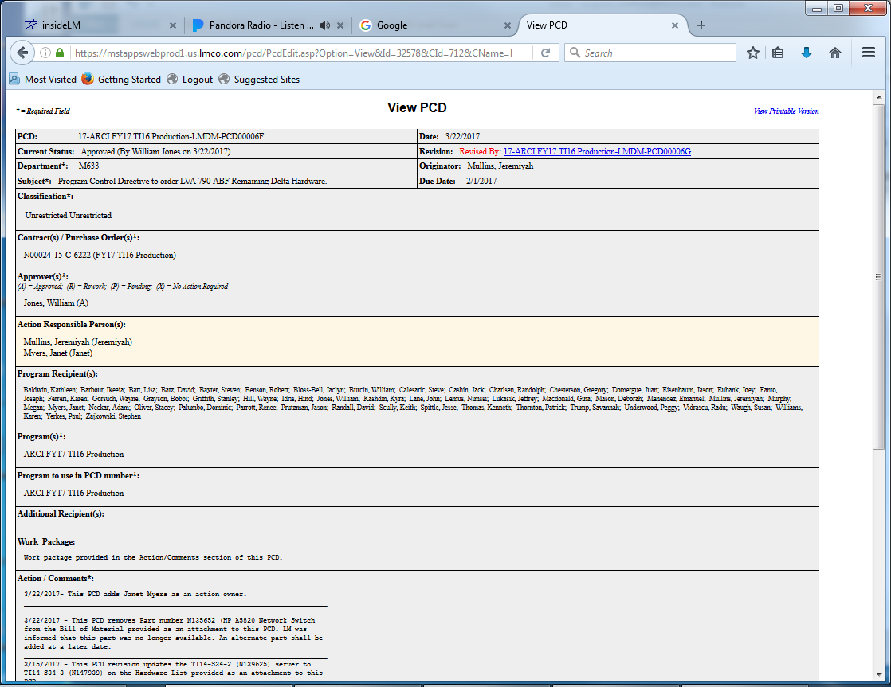
View PCD
Forward…
Cancel
Copy to another PCD
Notes:
Description
All of the PCD data may be viewed. Attachments can be retrieved, however they cannot be added, modified, or deleted from the PCD itself. The PCD state cannot be changed.
Requirements
R1
R2
R3
Functions
F1
Business Rules
BR1
BR2
BR3
Data Objects
DO1
DO1
DO1
Complexity 0
Inputs 0
Outputs 0
Inquires 0
Files/Tables 0
Ext. Files 0

Slide 16
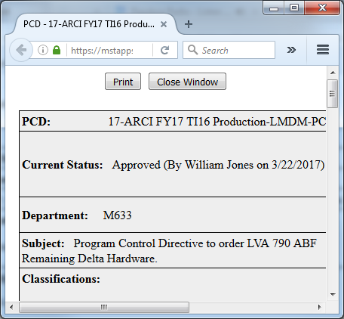
View Printable Version
Banners for printouts.
Notes:
Description
Enter description here
Requirements
R1
R2
R3
Functions
F1
Business Rules
BR1
BR2
BR3
Data Objects
DO1
DO1
DO1
Complexity 0
Inputs 0
Outputs 0
Inquires 0
Files/Tables 0
Ext. Files 0

Slide 17
Metadata, Audit Records And Backups
PCD revisions
Any change to Approved PCD triggers a revision.
Record metadata: Insert, Update, Logical Deletes, and Hidden Flags
Track inserts and updates of specific data elements
Customer Delivery Date Changes
Remarks
Automated nightly backups with # days of backup retention
Notes:
Description
Questions regarding what like of information should be automatically collected in the background.
Included data backups as another automatic function that should be performed.
Requirements
R1
Business Rules
BR1
Functions
F1
Data Objects
DO1
Complexity 0
Inputs 0
Outputs 0
Inquires 0
Files/Tables 0
Ext. Files 0

Slide 18
PCD Revision Rules
To be determined
Notes:
Description
Requirements
R1
Business Rules
BR1
Functions
F1
Data Objects
DO1
Complexity 0
Inputs 0
Outputs 0
Inquires 0
Files/Tables 0
Ext. Files 0

Slide 19
Approve PCD
* = Required Field New PCD
PCD: Draft-001316
Current Status:
Department: M7F5
Subject: Sample PCD for Approval
Classification:
Unrestricted Unrestricted
Contract(s) / Purchase Order(s)*:
N00024-15-C-6222 (FY17 T116 Production)
Approver(s)*:
(A) = Approved; (R) = Rework; (P) = Pending; (X) = No Action Required
Eubank, Joey (P)
Action Responsible Person(s):
Program Recipient(s):
Baldwin, Kathleen
…
Program(s)*:
ARCI FY17 TI16 Production
Program to use in PCD number*:
ARCI FY17 TI16 Production
Additional Recipient(s):
Work Package:
Labor work package 1Mxxxxxxxxxxxxxx Material work package 1Mxxxxxxxxxxxxxx
Action / Comments*:
4/27/2017 - xxxxxxxxxxxxxxxxxxxxxxxxxxxxxxxxxxxxxxxxxxxxxxxxxxxxxxxxxxxxxxxxxxxxxx
Reference:
Rework Comments:
Attachments:
There are no attachments associated with this PCD.
Approve
Rework
Cancel
Closure
Close PCD

Slide 20
PCD Tracker Objects
remarks
recId seq
…
metadata... …
PCD Objects
attachment
pcd
recId seq
pcdId string
…
metadata... …
trackers
recId seq
…
metadata... …
contract
program
hardwareList
recid seq
nameHardwareList
itemCount
totalQty
totalCost
metadata... …
users
recId seq
…
metadata... …
enumTypes
recId seq
…
metadata... …
hardwareListItems
recid seq
partNum
manufacture
partNumMfg
nomenclature
qty
unitCost
workPackage
poNum
metadata... …
enumValues
recId seq
…
metadata... …
tasks
recId seq
…
metadata... …
enumValueAssociations
recId seq
…
metadata... …

Slide 21
PCD Tracker Functions

Slide 22
Enumeration Helper
Drop Down List Box
Modal
Assign Enumeration
Select an enumeration
Approval Status
A: Approved
R: Rework
P: Pending
X: No action required
A: Approved
R: Rework
P: Pending
X: No action required
OK
Cancel
Notes:
Description
Allows the user to select a value to populate a selection box. This could be either a separate popup, or a drop down list box depending on the standards used.
Requirements
The system shall only display active <enumeration value(s)>.
The system shall only use inactive <enumeration values(s)> for display of historical records.
The system shall use the <sort order> as the default display order.
The system shall allow the user to select many values were appropriate.
Business Rules
The code value is distinct.
The code name is distinct.
The list will only contain valid/<active> codes.
Codes that are inactive will this be displayable for historical data.
Selection/validation of enumeration values will use the <enumeration code> and <enumeration value code>.
Functions
F1
Data Objects
Enumeration Types
Enumeration Values
PCD State (Draft, Submitted, Rework, Approved)
Complexity

Slide 23
Enumeration Types
Enumeration Types
Enter filter…
Filter
# of
Values
Last modified
Date By
Type Name
Description
Action tbd 3
Approval Status Status that can be given to a task. 4
Approvers
Classification
Contract tbd
Department
Hull
Program
Role tbd 4 12/31/17 00:00:00 Smith, Joe
Task tdb 4 05/09/17 14:02:17 Smith, Joe
Technology Insert tbd
?User?
Add New Type
Notes:
Description
Enter description here
Requirements
R1
R2
R3
Business Rules
BR1
BR2
BR3
Functions
F1
Data Objects
Enumeration Types
Enumeration Values
Complexity 0
Inputs 0
Outputs 0
Inquires 0
Files/Tables 0
Ext. Files 0

Slide 24
Enumeration Values
Enumeration Values
Type Name:
Description:
Approval Status
Status that can be given to a task.
Default
Flag
Sort
Order
Active
Flag
Code
Value
Description
"" Select One… User prompt, not valid selection. T 0 F
A Approved Approved 1 T
P Pending Pending 3 T
R Rework Rework 2 T
X No Action Required No action required 4 T
Add New Value
Save
Reset
Types
Notes:
Description
Enter description here
Requirements
R1
R2
R3
Business Rules
BR1
BR2
BR3
Functions
F1
Data Objects
Enumeration Types
Enumeration Values
Complexity 0
Inputs 0
Outputs 0
Inquires 0
Files/Tables 0
Ext. Files 0

Slide 25
Enumeration Associated Values
Notes:
Description
Enter description here
Requirements
R1
R2
R3
Functions
F1
Business Rules
BR1
BR2
BR3
Data Objects
DO1
DO1
DO1
Complexity 0
Inputs 0
Outputs 0
Inquires 0
Files/Tables 0
Ext. Files 0

Slide 26
PCD Admin
The Administration option allows maintenance of the programs and contracts. It also allows addition/removal of system administration authorization. System administrators have access to the Administration option on the home page and are also allowed to edit any PCD in any state.

Slide 27
PCD Admin Function
Contract
Program
Need to see what already exists
Users
Add Contract
Add Program
Add User
Delete
Archive
Task View

Slide 28
Contract Entry
Notes:
Description
Enter description here
Requirements
R1
R2
R3
Functions
F1
Business Rules
BR1
BR2
BR3
Data Objects
DO1
DO1
DO1
Complexity 0
Inputs 0
Outputs 0
Inquires 0
Files/Tables 0
Ext. Files 0

Slide 29
Program Entry
Notes:
Description
Enter description here
Requirements
R1
R2
R3
Functions
F1
Business Rules
BR1
BR2
BR3
Data Objects
DO1
DO1
DO1
Complexity 0
Inputs 0
Outputs 0
Inquires 0
Files/Tables 0
Ext. Files 0

Slide 30
User Entry
Notes:
Description
Enter description here
Requirements
R1
R2
R3
Functions
F1
Business Rules
BR1
BR2
BR3
Data Objects
DO1
DO1
DO1
Complexity 0
Inputs 0
Outputs 0
Inquires 0
Files/Tables 0
Ext. Files 0

Slide 31
PCD Functions

Slide 32
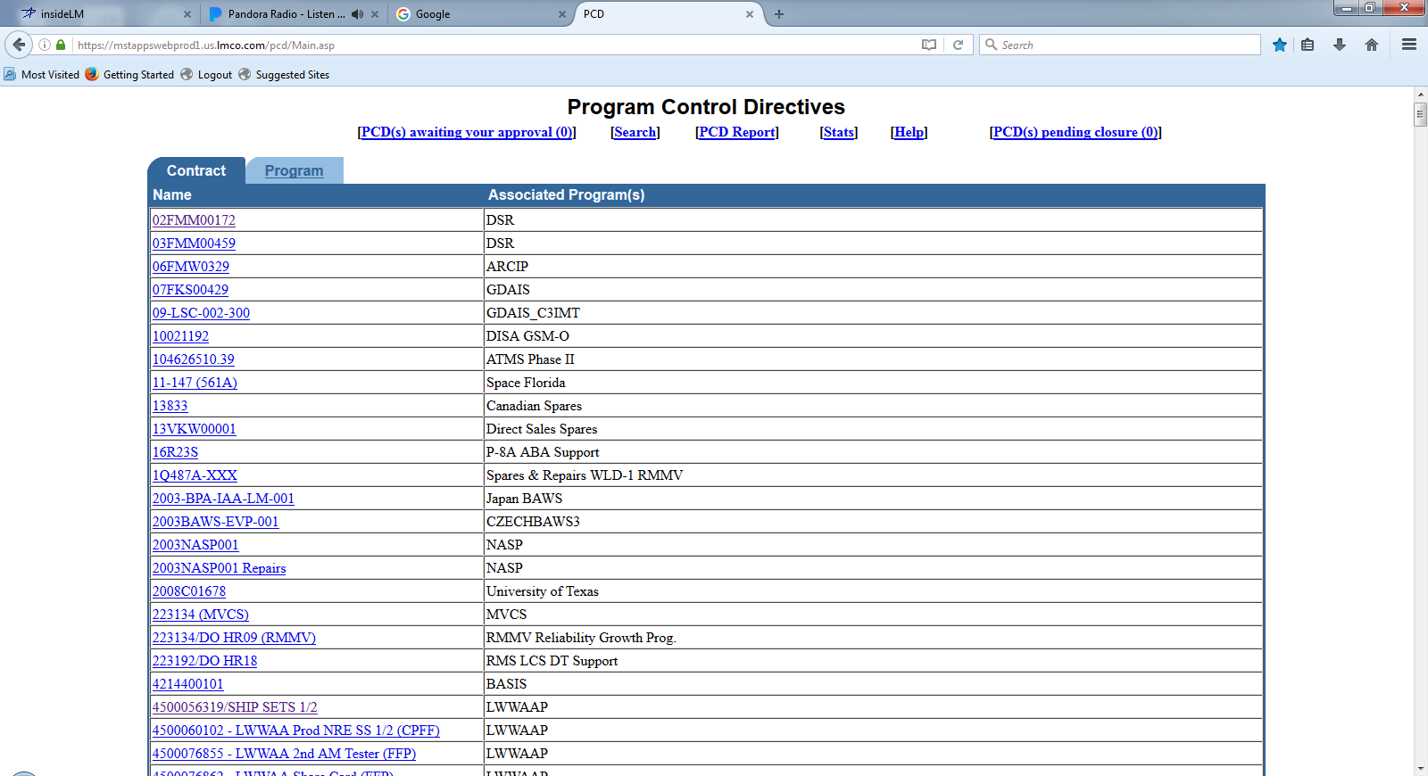
PCD Contract/Program List
Notes:
Description
Enter description here
Requirements
R1
R2
R3
Functions
F1
Business Rules
BR1
BR2
BR3
Data Objects
DO1
DO1
DO1
Complexity 0
Inputs 0
Outputs 0
Inquires 0
Files/Tables 0
Ext. Files 0

Slide 33
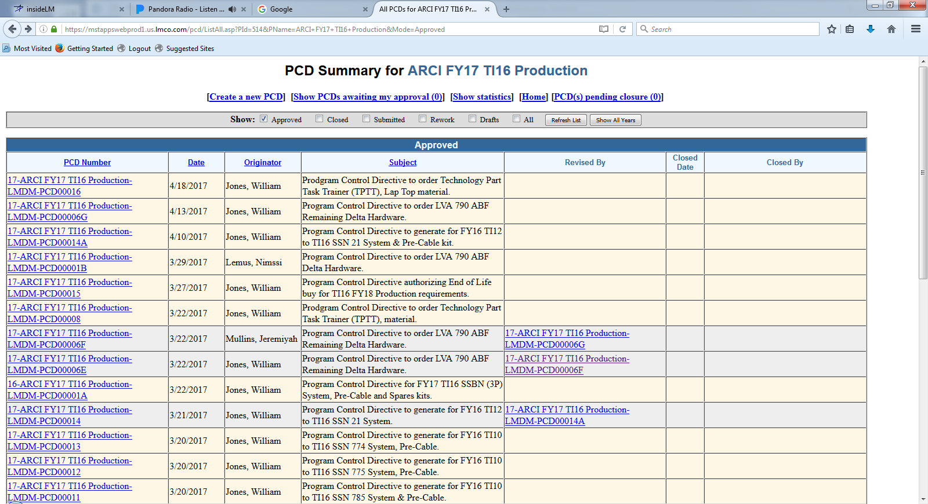
PCD Summary

Slide 34
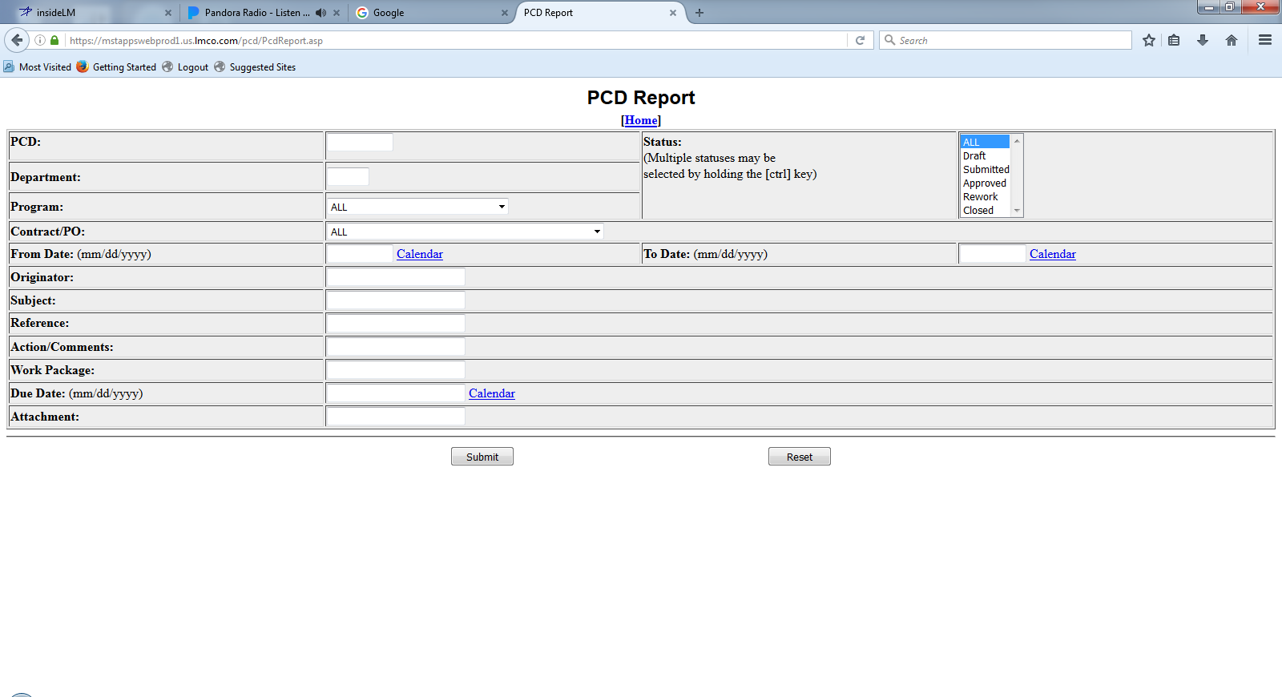
PCD Report
Notes:
Description
Enter description here
Requirements
R1
R2
R3
Functions
F1
Business Rules
BR1
BR2
BR3
Data Objects
DO1
DO1
DO1
Complexity 0
Inputs 0
Outputs 0
Inquires 0
Files/Tables 0
Ext. Files 0

Slide 35
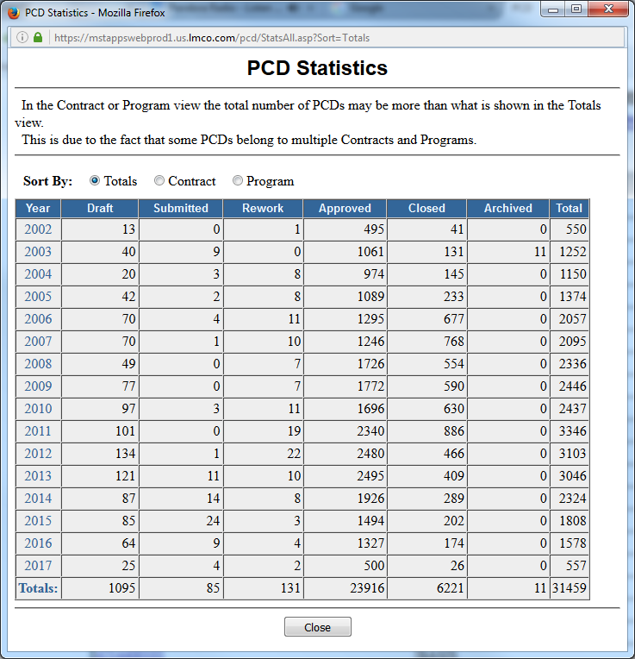
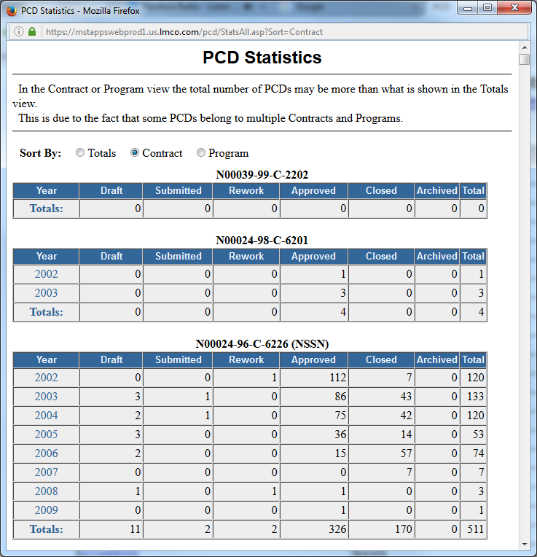
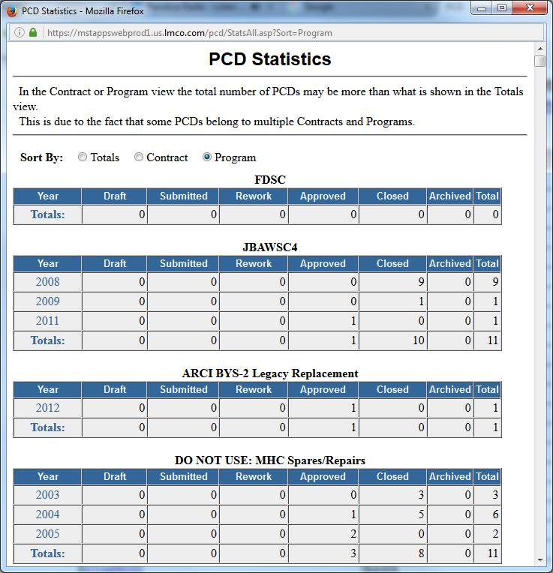
PCD Statistics
Notes:
Description
Enter description here
Requirements
R1
R2
R3
Functions
F1
Business Rules
BR1
BR2
BR3
Data Objects
DO1
DO1
DO1
Complexity 0
Inputs 0
Outputs 0
Inquires 0
Files/Tables 0
Ext. Files 0

Slide 36
PCD Auxiliary Functions

Slide 37
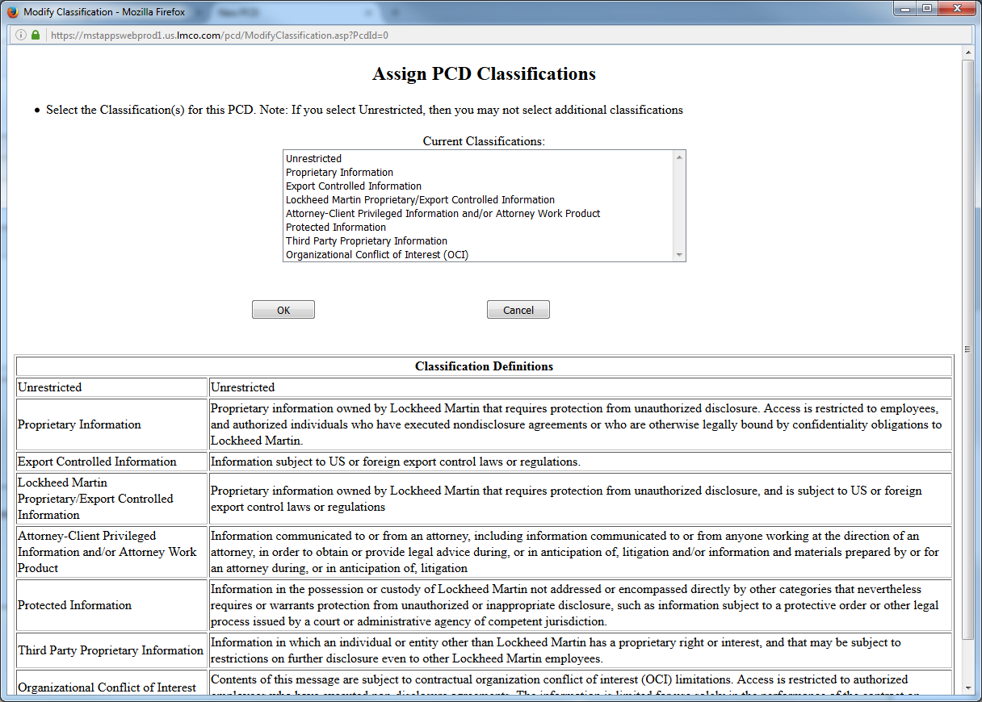
Classification
Banners for printouts.
Notes:
Description
Enter description here
Requirements
R1
R2
R3
Functions
F1
Business Rules
BR1
BR2
BR3
Data Objects
DO1
DO1
DO1
Complexity 0
Inputs 0
Outputs 0
Inquires 0
Files/Tables 0
Ext. Files 0

Slide 38
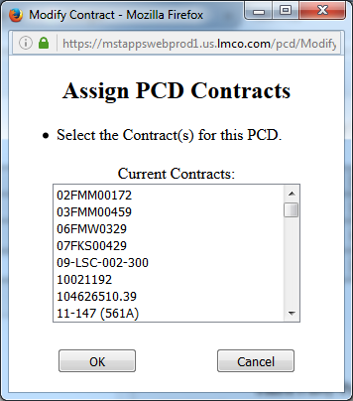
Contract(s) / Purchase Order(s)
Notes:
Description
Enter description here
Requirements
R1
R2
R3
Functions
F1
Business Rules
BR1
BR2
BR3
Data Objects
DO1
DO1
DO1
Complexity 0
Inputs 0
Outputs 0
Inquires 0
Files/Tables 0
Ext. Files 0

Slide 39
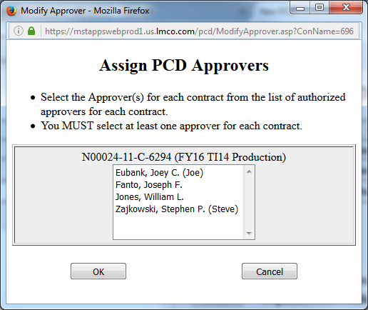
Assign Approver(s)
Notes:
Description
Enter description here
Requirements
R1
R2
R3
Functions
F1
Business Rules
BR1
BR2
BR3
Data Objects
DO1
DO1
DO1
Complexity 0
Inputs 0
Outputs 0
Inquires 0
Files/Tables 0
Ext. Files 0

Slide 40
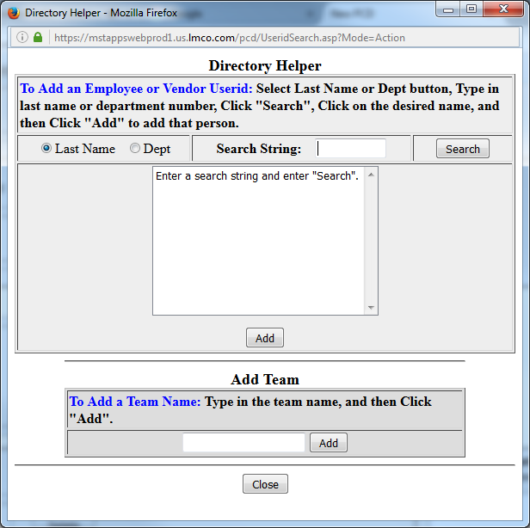
Action Responsible Person(s) / Additional Recipient(s)
Hardware List Entry
Notes:
Description
Enter description here
Requirements
R1
R2
R3
Functions
F1
Business Rules
BR1
BR2
BR3
Data Objects
DO1
DO1
DO1
Complexity 0
Inputs 0
Outputs 0
Inquires 0
Files/Tables 0
Ext. Files 0

Slide 41
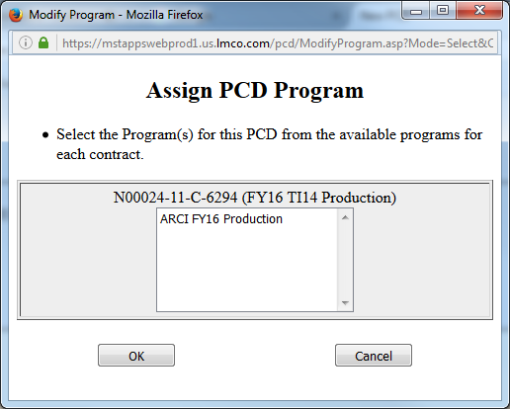
Assign Programs
Notes:
Description
Enter description here
Requirements
R1
R2
R3
Functions
F1
Business Rules
BR1
BR2
BR3
Data Objects
DO1
DO1
DO1
Complexity 0
Inputs 0
Outputs 0
Inquires 0
Files/Tables 0
Ext. Files 0

Slide 42
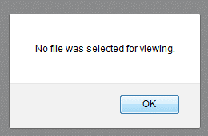
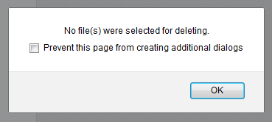
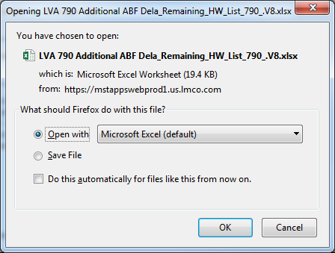
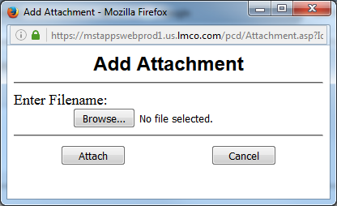
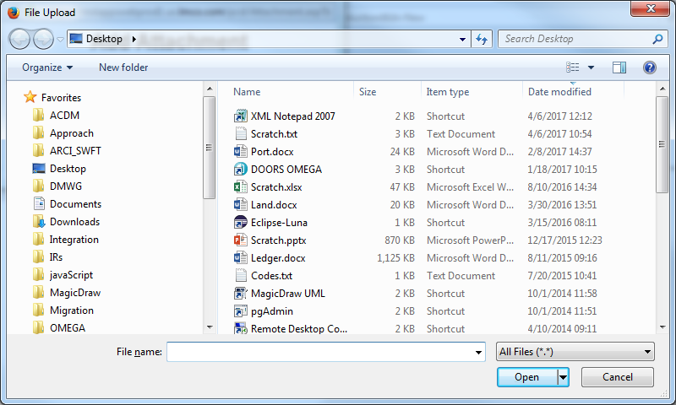
Attachments
Hardware List Entry
Approve PCD
Notes:
Description
Enter description here
Browse:
Attach:
Cancel:
OK:
Open:
Requirements
R1
R2
R3
Functions
Attachment Add Upload one file from an end user machine to a specified storage location.
Attachment Add Many Upload one or more files from an end user machine to a specified storage location.
Attachment Delete Delete one or more files from its source storage location.
Attachment View Download a file from its source storage location and open it locally on the end user machine.
Business Rules
BR1
BR2
BR3
Data Objects
DO1
DO1
DO1
Complexity 0
Inputs 0
Outputs 0
Inquires 0
Files/Tables 0
Ext. Files 0

Slide 43
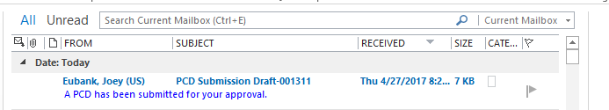
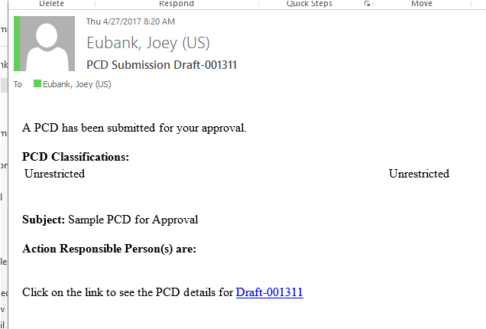
PCD Notification
The link takes you to the draft PCD.
Notes:
Description
Enter description here
Requirements
R1
R2
R3
Functions
F1
Business Rules
BR1
BR2
BR3
Data Objects
DO1
DO1
DO1
Complexity 0
Inputs 0
Outputs 0
Inquires 0
Files/Tables 0
Ext. Files 0

Slide 44
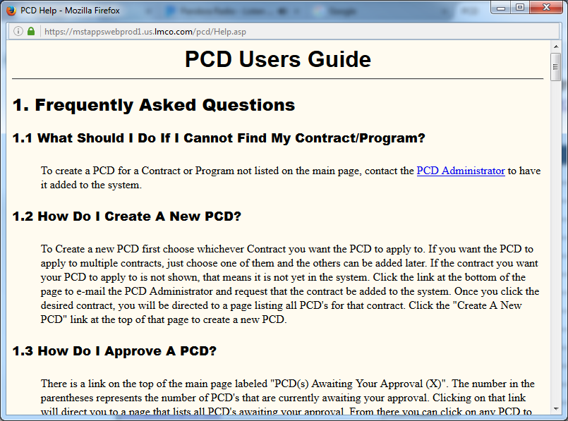
PCD Users Guide
Notes:
Description
Enter description here
Requirements
R1
R2
R3
Functions
F1
Business Rules
BR1
BR2
BR3
Data Objects
DO1
DO1
DO1
Complexity 0
Inputs 0
Outputs 0
Inquires 0
Files/Tables 0
Ext. Files 0

Slide 45
Backup/Reference

Slide 46
PCD BOM Entry
RecID:
Draft-BOM-00999
Current Status:
Pending
Department:
M7F5
Item:
Bill of Materials
Version:
2.1
Classification:
Unrestricted
Contract:
N000##-##-X-1002
N000##-##-X-1003
Source:*
Enter Here..
Required: *
Approvers:
Smith, Joe
Date Approved:
YYYY-MM-DD
BOM Id*
Description
Status*
Comments
BOM-00877 Sonar Laptop Pre-Release Ready for review MM/DD
BOM-00101 Wiring Interface Kit Released
Add
Delete
Reset
Save
Cancel
Attachments:
LVA 790 ABF Eng Dwg_790_v02.jpg
Attach
View
Comments:
04/18/2017 -
Approve
Rework
Cancel
Task View

Slide 47
PCD BOM Entry
RecID:
Draft-BOM-00999
Current Status:
Pending
Department:
M7F5
Item:
Bill of Materials
Version:
2.1
Classification:
Unrestricted
Contract:
N000##-##-X-1002
N000##-##-X-1003
Source:*
Enter Here..
Additional Columns?
Remarks
Required: *
Approvers:
Smith, Joe
Date Approved:
YYYY-MM-DD
Level*
Part
Number*
Item Description*
Group
Unit of
Measure
Qty
Req"d*
1 N139894-1 Sonar Laptop 2 Each 2
1 BOM-00101 Wiring Interface Kit 2 Kit 2
Add
Delete
Reset
Save
Cancel
Attachments:
LVA 790 ABF Eng Dwg_790_v02.jpg
Attach
View
Comments:
04/18/2017 -
Approve
Rework
Cancel
Task View

Slide 48
PCD Task View
PCD Task List
User:
Joe Smith
Show
10
entries
Role
Task
Action
Contract
Subject
Due Date
Originator
BOM
Create
N00024-15-C-6222
VA Class (New Con) Delta Spares
1/15/17
Reviewer
PCD
Review
…
…
…
Reviewer
…
Review
…
…
…
Reviewer
…
Review
…
…
…
Approver
PR
Approve
…
…
…
Approver
ER
Create
…
…
…
Go To
Add Tasker
Search
Admin
Close
Notes:
Description
Upon user initial connection, the system will display a list of tasks/actions, in descending "due date" order, that the user is responsible for. The user will select a existing task and click on the “Go To” button. The system will display the appropriate HMI for the task. When the user clicks on the “Add Tracker” button the tracker HMI will be displayed to allow the user to create a new tasking.
Search
The “Admin” button will be enabled only authorized users. When enabled the user will have access to administrative tools such as:
Manage Contracts
Manage Programs
Manage Users
Manage Enumerations
The “Close” button will allow the user to exit the PCD tool.
Requirements
The system will allow the <users> to sort upon any of the data columns.
The system will allow the <users> to select a <task> to open.
The system shall allow <authorized users> with the <appropriate rights> to add new tasking.
The system shall allow <authorized users> with the <appropriate rights> to access administrative functions
Search
The system shall highlight <tasks> due with X number of days.
Functions
Business Rules
X
Y
Z
Data Objects
Users
Tasks
Complexity 7
Inputs 3
Outputs 1
Inquires 1
Files/Tables 2
Ext. Files 0

Slide 49
PCD Task Review/Approve Status
RecID:
Draft-ER-00999
Current Status:
Pending
Department:
M7F5
Task:
PCD / PR / BOM
Originator:
Smith, Joe
Subject:
Sample ER for Approval
Classification:
Unrestricted
Contract:
N000##-##-X-1002
N000##-##-X-1003
Additional elements to be determined
Attachments:
Sample_ER_File.xlsx
Sample_ER_for_Project.docu
View
Rework
Comments:
Add notes here.
Approve
Rework
Cancel
Task View
Notes:
Description
Approvers can view the PCD just as in the View mode. In addition they may add/modify their comments and select to Approve or Rework the PCD.
Requirements
R1
R2
R3
Functions
F1
Business Rules
BR1
BR2
BR3
Data Objects
DO1
DO1
DO1
Complexity 0
Inputs 0
Outputs 0
Inquires 0
Files/Tables 0
Ext. Files 0

Slide 50
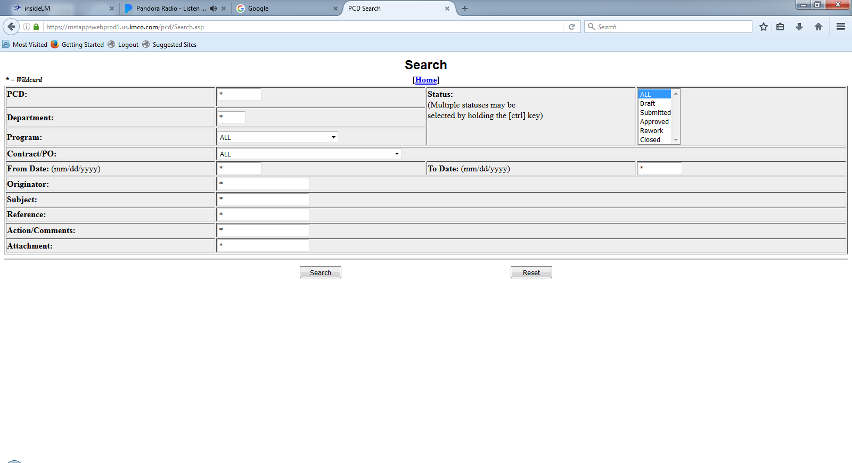
PCD Search
Notes:
Description
When the search button is pressed, the user is presented with a screen where the search criteria are entered. Entering data in any of the search fields indicates that the resulting PCD"s must contain that criteria. Wildcards are allowed and are specified using a "*".
Once the search has completed, a list of all resulting PCD"s is displayed. Hyperlinks are available to each PCD which allow the user to work with the corresponding PCD in the same manner which is available from the Contracts/Programs option. See Section 4.1 - Contracts/Programs
Requirements
R1
R2
R3
Functions
F1
Business Rules
BR1
BR2
BR3
Data Objects
DO1
DO1
DO1
Complexity 0
Inputs 0
Outputs 0
Inquires 0
Files/Tables 0
Ext. Files 0

Slide 51
Current PCD Entry Screen
* = Required Field New PCD
PCD: Draft-001316 Date: 4/26/2017
Current Status: New Revision: New
Department*: Originator: Belford, Eugene
Subject*: Due Date: Calendar
Classification*: Third Party Proprietary Information:
Organizational Conflict of Interest (OCI):
Contract(s) / Purchase Order(s)*:
Approver(s)*:
(A) = Approved; (R) = Rework; (P) = Pending; (X) = No Action Required
Action Responsible Person(s):
Program(s)*: Program Recipient(s):
(Automatically filled based on program(s) selected)
Program to use in PCD number*:
Additional Recipient(s):
Work Package(s):
Action(s) / Comment(s)*:
Reference(s):
Attachment(s):
Add
Delete
Add
Delete
Add
Delete
Add
View
Delete
Add
Delete
Add
Delete
View
Save
Submit
View
Cancel
Task View
Notes:
Description
The user has clicked the “Draft PCD” button on the Tracker Entry.
Requirements
The “Draft PCD” button requires that a PCD task be in the Tracker.
Business Rules
PCD*: identifier is auto generated.
Date*: defaults to current date and time.
Current Status*: defaults to “NEW”.
Revision (Status):
Department*: defaults to “Select one…”
Originator*: Individual assigned as the <originator> on the tracker.
Subject*: Text enter in the <subject> on the tracker.
Due Date: Date enter in the <pcd required> on the tracker.
Classification*:
Third Party Proprietary Information:
Organizational Conflict of Interest (OCI):
Contract(s) / Purchase Order(s): ?Purchase Requisition(s)?
Approver(s)*: New selection, or are they consolidated from associated tasks?
Approver"s approval status defaults to “P”.
Program(s)*:
Program to use in PCD number*:
Additional Recipient(s): Is there a default list?
Work Package(s): If there was a <work package> on the task, they could be consolidated here.
Action(s) / Comment(s)*: New entries, or are they consolidated from associated tasks?
Reference(s): New entries, and/or are they associated tasks?
Attachment(s): New associations, or are they consolidated from associated tasks?
Functions
F1
Data Objects
DO1
Complexity 0
Inputs 0
Outputs 0
Inquires 0
Files/Tables 0
Ext. Files 0

Slide 52
Draft PCD From Task View
* = Required Field New PCD
PCD: Draft-001316 Date: 05/09/2017
Current Status: New Revision: New
Department*: Originator:
Subject*: Due Date: Calendar
Classification*: Third Party Proprietary Information:
Organizational Conflict of Interest (OCI):
Contract(s) / Purchase Order(s)*:
Approver(s)*:
(A) = Approved; (R) = Rework; (P) = Pending; (X) = No Action Required
Action Responsible Person(s):
Program(s)*: Program Recipient(s):
(Automatically filled based on program(s) selected)
Program to use in PCD number*:
Additional Recipient(s):
Work Package(s):
Action(s) / Comment(s)*:
Reference(s):
Attachment(s):
Select One…
Mullins, Jeremiyah
VA Class (New Con) Delta Spares
02/01/17
Select One…
Add
Delete
Jones, William L. (P)
Add
Delete
Mullins, Jeremiyah
Myers, Janet
Add
Delete
Add
View
Delete
ARCI-FY-TI-SEQ#
Add
Delete
ALL comments and attachments get included in the draft PCD. The user can removed those that do not apply.
Changes made to comments and hardware list get from the draft PCD get made to the source record
Add
Delete
View
Save
Submit
View
Cancel
Task View
Notes:
Description
The user has clicked the “Draft PCD” button on the Tracker Entry. The user will be taken to the PCD Entry HMI. The entry form will be pre-populated with information captured in tasks associated with the PCD task. The amount and level of detail will depend on the associated tasks.
Yes: Question: If a associated task is updated, does the PCD get updated? Does the system need to track those changes? Can the user start the PCD before associated tasks are started/completed?
The user will then be able to work on the PCD until it is submitted for review/approval.
Question: When a PCD is submitted, can the user continue to make changes, or is it locked?
When the user clicks the “Submit” button notifications will be sent to the reviewers, action responsible persons, additional recipients, and approvers. The “View” button allows any user to view the PCD. Attachments can be retrieved, however they cannot be added, modified, or deleted from the PCD itself. The PCD state cannot be changed.
Requirements
The “Draft PCD” button requires that a PCD task be in the Tracker.
Business Rules
PCD*: identifier is auto generated.
Date*: defaults to current date and time.
Current Status*: defaults to “NEW”.
Revision (Status):
Department*: defaults to “Select one…”
Originator*: Individual assigned as the <originator> on the tracker.
Subject*: Text enter in the <subject> on the tracker.
Due Date: Date enter in the <pcd required> on the tracker.
Classification*:
Third Party Proprietary Information:
Organizational Conflict of Interest (OCI):
Contract(s) / Purchase Order(s): ?Purchase Requisition(s)?
Approver(s)*: New selection, or are they consolidated from associated tasks?
Approver"s approval status defaults to “P”.
Program(s)*:
Program to use in PCD number*:
Additional Recipient(s): Is there a default list?
Work Package(s): If there was a <work package> on the task, they could be consolidated here.
Action(s) / Comment(s)*: New entries, or are they consolidated from associated tasks?
Reference(s): New entries, and/or are they associated tasks?
Attachment(s): New associations, or are they consolidated from associated tasks?
Functions
F1
Data Objects
PCD
Tracker
Attachments
Comments
Hardware List
Enumeration Types
Enumeration Values
Complexity 19
Inputs 3
Outputs 0
Inquires 11
Files/Tables 5
Ext. Files 0

Slide 53
Hardware List Workflow
Assign the task
PM
Releases
Released
Created
Reviewer(s) Concurs?
PM Releases?
Submitted
?
Originator Drafts
Saved
Originator Submits
Review
Reviewed
Concurred
Copy?
Reworking
Rework
Rejected
Deleted
Rejected/Reopen
Deleted
Deleted

