Slide 1
LM Common Technology Stack for HTML/CSS/JavaScript

Slide 2
Standards / Guidelines / Tools / Frameworks
LM best practices?
Is there a style guide for webpage design at LM, (covers layout, fonts, colors, standard images)?
Are there preferred development tools and/or environments, (Eclipse, etc.)?
Are there preferred CSS frameworks, (Bootstrap, reset.css, normalize.css)?

Slide 3
PCD Screenshots

Slide 4
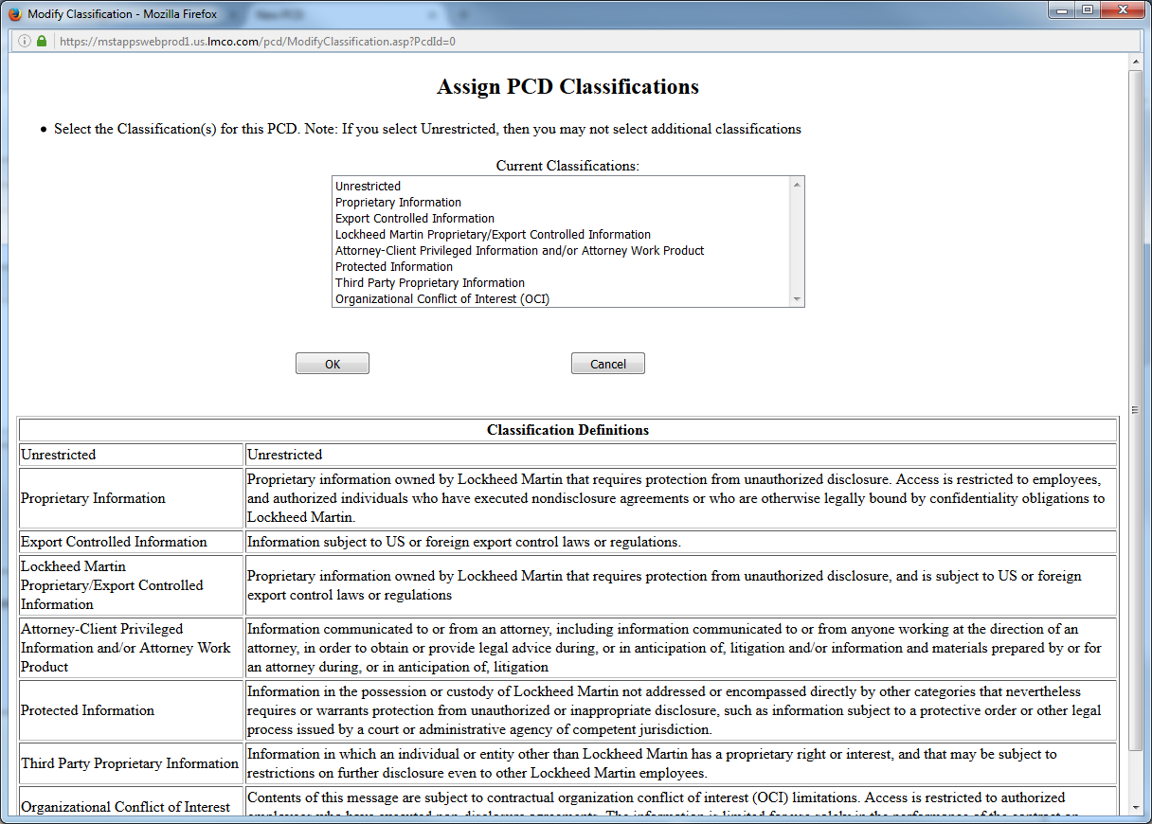
Classification

Slide 5
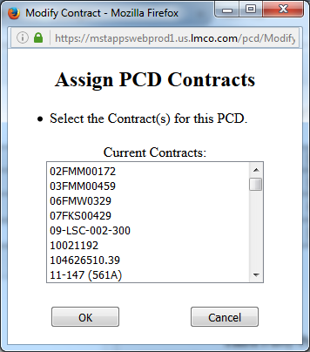
Contract(s) / Purchase Order(s)

Slide 6
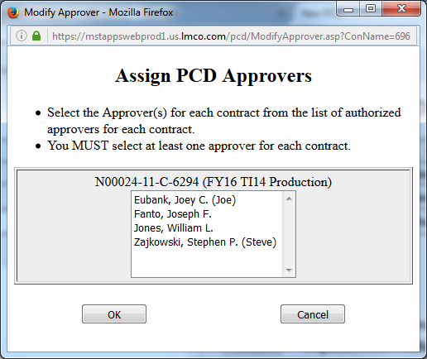
Approver(s)

Slide 7
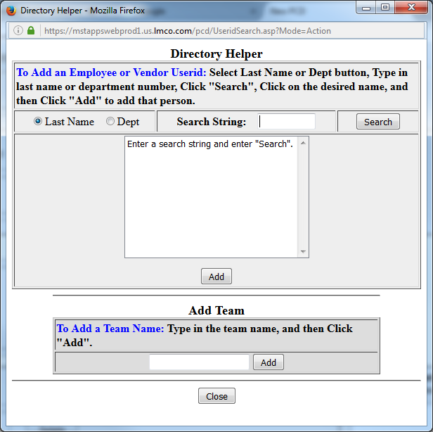
Action Responsible Person(s) / Additional Recipient(s)

Slide 8
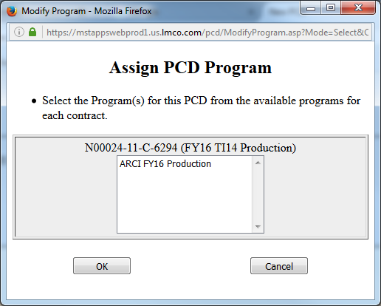
Programs

Slide 9
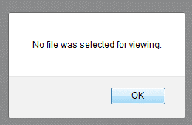
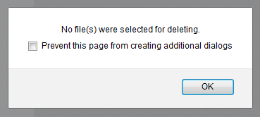
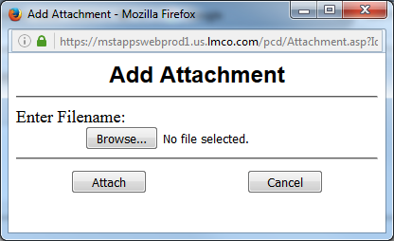
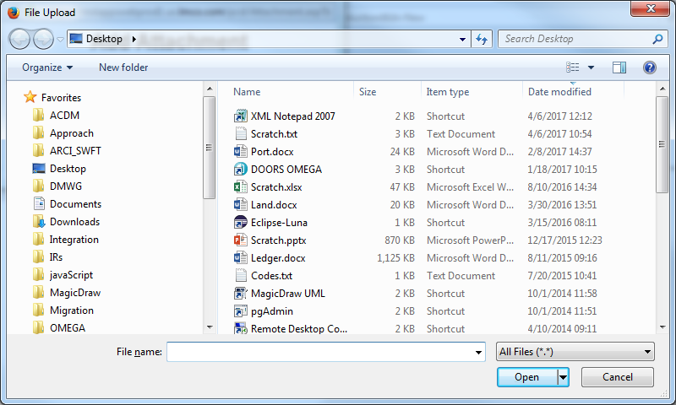
Attachments

Slide 10
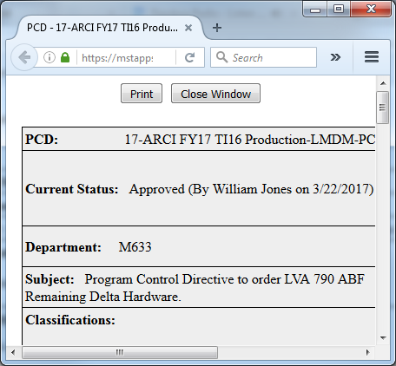
View Printable Version

