Slide 1
Program Control Directive PCD “Next”
OETRAX 324116
Gene Belford (Contractor)
April 24, 2017

Slide 2
Program Control Directive (PCD)
The Program Control Directive (PCD) application handles the generating, routing, approving and filing/archiving of Program Control Directives (PCD’s). PCD’s are used by the Program Office to direct and authorize personnel to perform actions outside normal circumstances. Common actions are to procure certain pieces of hardware, loan items to other facilities temporarily, and to stop work on a specific work package until requirements are clear. Currently the principal user is the Lockheed Martin Manassas Navy Systems Program Office.

Slide 3
PCD Existing Infrastructure
Classic ASP
HMI
Is there a DBMS in use now?
Is there a file repository?
Lists
Contract
Program
File Repository
Workflows
Approval
Closure
Where are the elements for the DDLB being maintained?
Functions
Contracts/Programs
Search (Search, Reset)
Report
Stats
Admin
Sub-Funtions
Create
?

Slide 4
Notes
Actors
Originator
Approver(s)
Recipient(s)
Action Responsible Person
Recipient(s) Additional
Administrator
PCD States
Draft
Submitted
Rework
Approved
Closed
Archived

Slide 5
PCD Rights

Slide 6
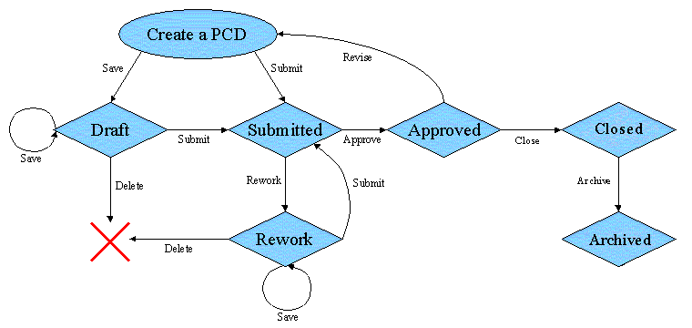
PCD State Flow Diagram

Slide 7
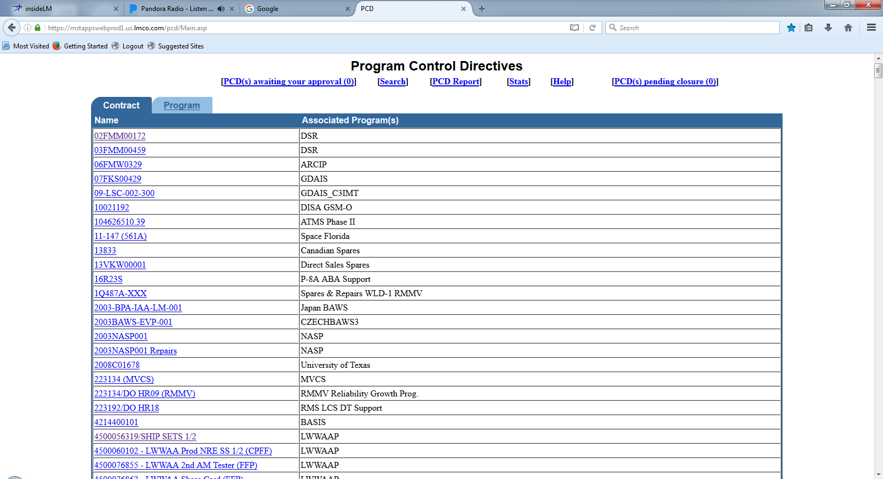
Program Control Directives

Slide 8
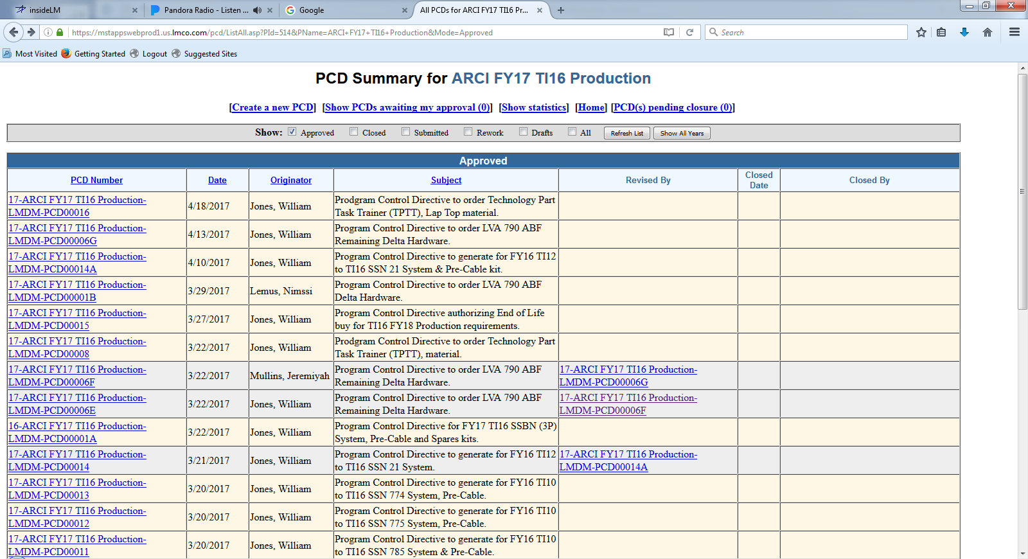
PCD Summary

Slide 9
Current PCD Entry Screen
* = Required Field New PCD
PCD: Draft-001316 Date: 4/26/2017
Current Status: New Revision: New
Department*: Originator: Belford, Eugene
Subject*: Due Date: Calendar
Classification*: Third Party Proprietary Information:
Organizational Conflict of Interest (OCI):
Contract(s) / Purchase Order(s)*:
Approver(s)*:
(A) = Approved; (R) = Rework; (P) = Pending; (X) = No Action Required
Action Responsible Person(s):
Program(s)*: Program Recipient(s):
(Automatically filled based on program(s) selected)
Program to use in PCD number*:
Additional Recipient(s):
Work Package:
Action / Comments*:
Reference:
Attachments:
Add
Delete
Add
Delete
Add
Delete
Add
View
Delete
Add
Delete
Add
View
Delete
Save
View
Cancel

Slide 10
Approve PCD
* = Required Field New PCD
PCD: Draft-001316
Current Status:
Department: M7F5
Subject: Sample PCD for Approval
Classification:
Unrestricted Unrestricted
Contract(s) / Purchase Order(s)*:
N00024-15-C-6222 (FY17 T116 Production)
Approver(s)*:
(A) = Approved; (R) = Rework; (P) = Pending; (X) = No Action Required
Eubank, Joey (P)
Action Responsible Person(s):
Program Recipient(s):
Baldwin, Kathleen
…
Program(s)*:
ARCI FY17 TI16 Production
Program to use in PCD number*:
ARCI FY17 TI16 Production
Additional Recipient(s):
Work Package:
Labor work package 1Mxxxxxxxxxxxxxx Material work package 1Mxxxxxxxxxxxxxx
Action / Comments*:
4/27/2017 - xxxxxxxxxxxxxxxxxxxxxxxxxxxxxxxxxxxxxxxxxxxxxxxxxxxxxxxxxxxxxxxxxxxxxx
Reference:
Rework Comments:
Attachments:
There are no attachments associated with this PCD.
Approve
Rework
Cancel
Closure
Close PCD

Slide 11
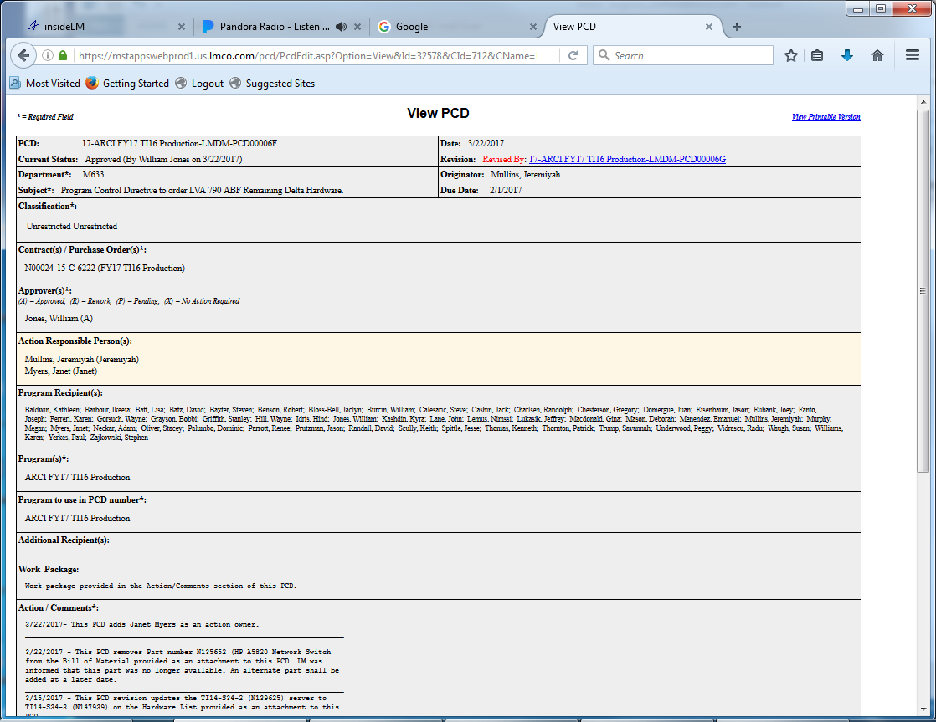
View PCD
Forward…
Cancel
Copy to another PCD

Slide 12
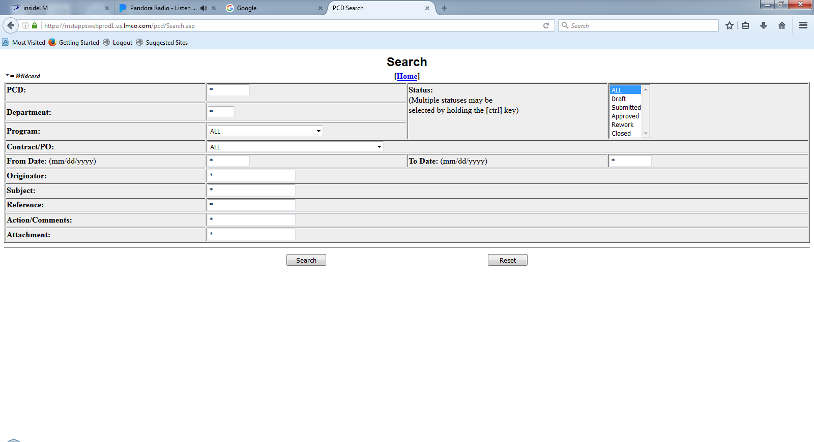
PCD Search

Slide 13
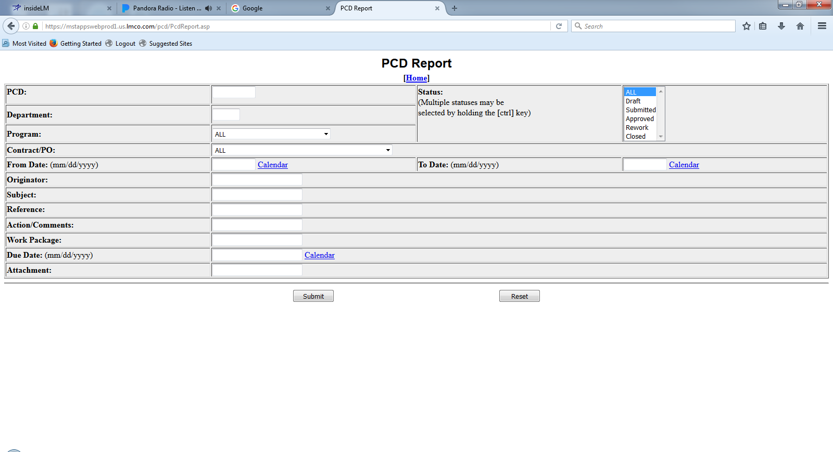
PCD Report

Slide 14
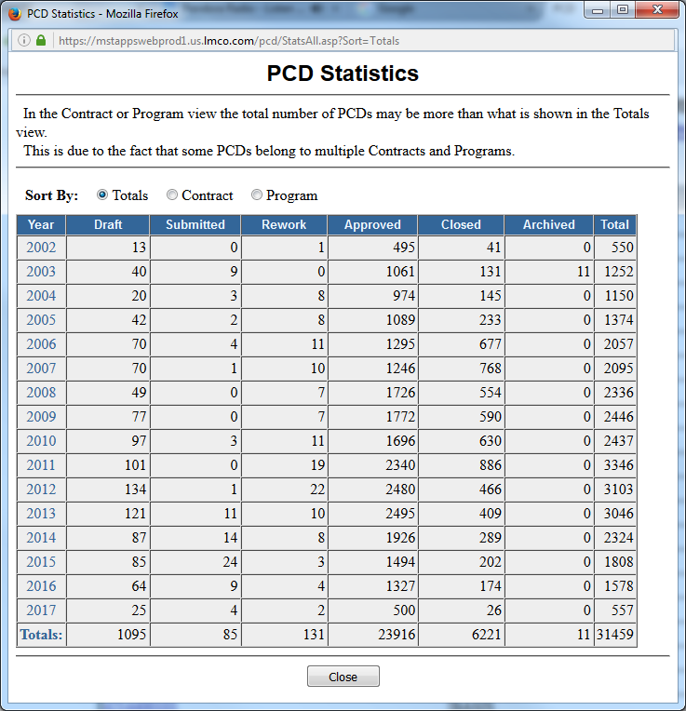
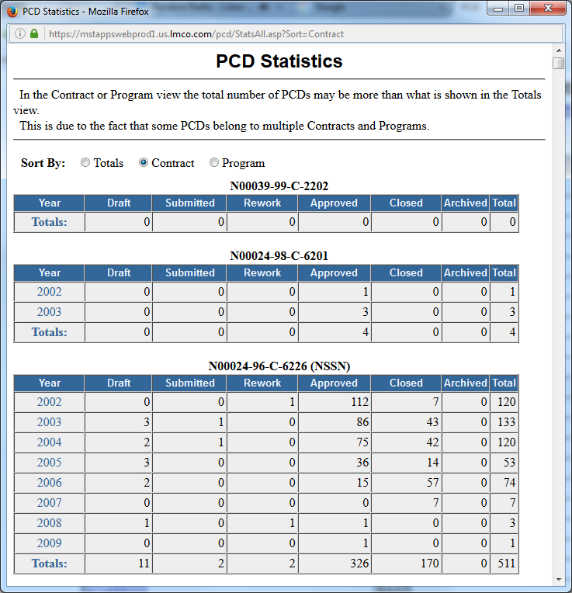
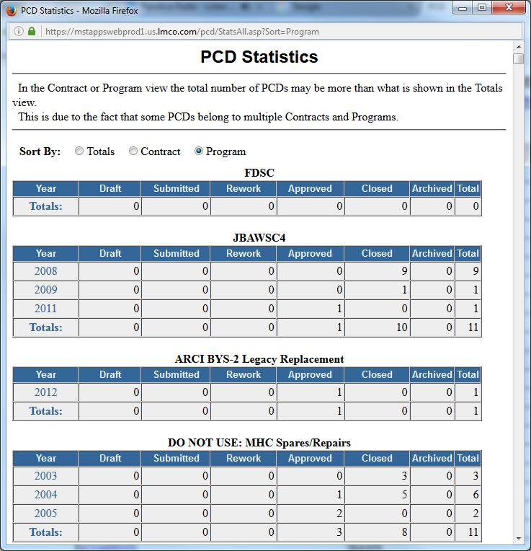
PCD Statistics

Slide 15
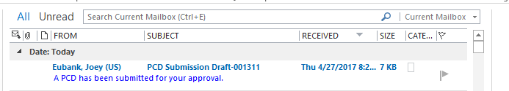
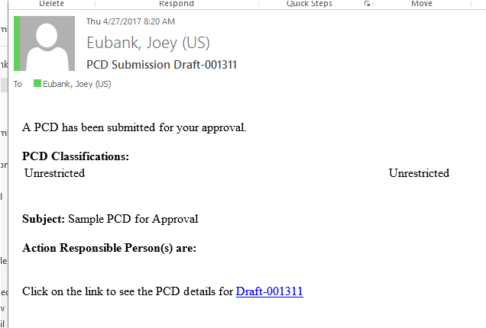
PCD Notification
The link takes you to the draft PCD.

Slide 16
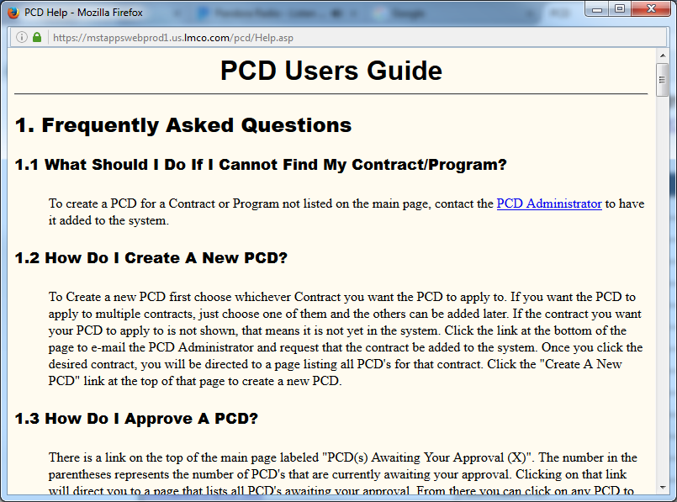
PCD Users Guide

Slide 17
Things I need to look into in PCD
Admin functions
Engineering Release
Purchase Request

Slide 18
Notes
Contract
Program is a child of Contract
PCD is a child of Program
Attachment is a child of PCD

Slide 19
PCD Objects
contract
recId seq
contractName text
program
recId seq
programName text
user
recId seq
userName
classificaton
recId seq
engineeringRelease
recid seq
engineerringRelease
dateLastModified date
dept
revision
program(s)
originator
approver(s)
statusCurrent
actionResponiblePerson(s)
subject
contract(s)
reference
action
programRecipient(s)
additionalRecipient(s)
reworkComments
programInPCDNumber
classification
workPackage
purchaseRequisition
recid seq
purchaseRequisition
dateLastModified date
dept
revision
program(s)
originator
approver(s)
statusCurrent
actionResponiblePerson(s)
subject
contract(s)
reference
action
programRecipient(s)
additionalRecipient(s)
reworkComments
programInPCDNumber
classification
workPackage
pcd
recid seq
programControlDirective
dateLastModified date
dept
revision
program(s)
originator
approver(s)
statusCurrent
actionResponiblePerson(s)
subject
contract(s)
reference
action
programRecipient(s)
additionalRecipient(s)
reworkComments
programInPCDNumber
classification
workPackage
approverList
recId seq
userName
attachment
recId seq
filename text
filePath text
purchaseOrder
recid seq
purchaseOrder
…
workPackage
Tracker I

Slide 20
PCD Fields
Field | Description
PCD | A unique identifier for each PCD. It is automatically generated. For approved PCD's the format is "Last two digits of the year approved-program-company-PCDxxxxx" eg. 01-ARCI-LMDM-PCD00010. For unapproved PCD's the number is in the format "Draft-six digit number" e.g. Draft-000010
Date | The latest modification date of the PCD
Department | Text box prefilled with department of the originator, but can be changed to any department
Revision | This is an uneditable field that shows whether this PCD has had a revision approved. If so, it will show the number of that PCD. If not, it will simply say "Current".
Programs | Author may select which program(s) this PCD applies to from a list of all programs that the chosen contract(s) apply to
Originator | Uneditable field that shows the name of the PCD's originator
Approver | Selected by author from a list of approvers for each contract that a PCD is associated with. One or more approvers must be selected from each Contract that the PCD pertains to. If the same person is an approver for multiple contracts, they may approve for both.
Current Status | Uneditable field filled with the current state of the PCD. In the case of rework, approved, or closed the name of the approver(s) who put it in that state and the date they did it will also be displayed
Action Responsible Persons | People that are responsible for the action of the PCD. Lookup select by author or a team name that the author enters
Subject | The subject of this PCD; Typed by the author
Due Date
Classification
Contracts | Shows all contracts or purchase orders that this PCD applies to.
Reference | Anything this PCD may be in reference to as entered by the author in a text area.
Action | The main content of the PCD
Program Recipients | Uneditable list of all program recipients. These are the all people on the program recipient lists of all programs associated with this PCD. They will receive a notification e-mail when the PCD is approved.
Additional Recipients | Any additional people that will get notified when the PCD is approved. The author chooses them through Lookup
Work Package
Attachments | Any files can be stored with the PCD by the author
Rework Comments | An approver can fill this field out when designating a PCD for rework. It should contain information regarding what changes are necessary
Program to Use in PCD Number | The author must select the program to have the system use when it assigns a PCD number to the PCD. To set it the author must select a program from the programs box and click the set code button.

Slide 21
Security
Classification: Inherit from parent object?

Slide 22
Click Routes
Approve PCD
Search
Statistics
Report
Help
Home
(Contract)
Program
Create PCD
Close PCD

Slide 23
Program Control Directive Tracker (PCDT)
The Program Control Directive Tracker (PCD) application handles the generating, routing, approving and filing/archiving of Program Control Directives (PCD’s). PCD’s are used by the Program Office to direct and authorize personnel to perform actions outside normal circumstances. Common actions are to procure certain pieces of hardware, loan items to other facilities temporarily, and to stop work on a specific work package until requirements are clear. Currently the principal user is the Lockheed Martin Manassas Navy Systems Program Office.

Slide 24
PCD “Tracker”
All data and attachments are ‘unclassified’? Yes, but there is a classification function which was added in the last several years.
How many of the PCD functions, (classification, directory helper, add attachment,) are available as standardized LM functions? Request has been made.
Where to host?
Can PCD Tracker have a PCD Tracker as a task?
Do entry screens need to be defined for ‘engineering releases’, and ‘purchase requisitions’? Can we use a generic entry HMI?
Are recipients also users?
Is ‘Reviewer’ a new PCD Tracker Role?
Is there only 1 ‘Originator’ for a task? In most cases.

Slide 25
Definitions (move to end)
ARCI | Acoustic Rapid Commercial-Off-The-Shelf Insertion
BOM | Bill of Materials
CAM | Control Account Manager
CLR | Clearwater
ER | Engineering Release
EVM
FEA
MAN | Manassas
MPM
PC
PCD | Program Control Directive
PM | Project Manager
PN | Part Number
PO | Purchase Order
POP | Period of Performance
PPM
PR | Purchase Requisition
RDD | Required Delivery Date
SLIN | Sub-Line Item Number
TI
iWAD | “Initial”

Slide 26
PCD Tracker Objects Level II
tracker
recId seq
…
metadata... …
task
recId seq
…
Bounding the PCD Tracker Scope
purchaseRequisition
recid seq
purchaseRequisition
dateLastModified date
statusPR
partNum
itemDescription (nomenclature)
quantityNeeded
costEach
RDD
workPackage(s)
purchaseOrder(s)
purchaseOrder
recid seq
purchaseOrder
dateLastModified date
statusPO
partNum
itemDescription
price
quantityOrdered
Shipping details
Payment terms
Discounts
billOfMaterials
recid seq
purchaseRequisition
dateLastModified date
level
partNum
itemDescription
group
unit
quanityRequired
purchaseRequisitionItems
recid seq
purchaseRequisition
dateLastModified date
partNum
itemDescription
price
quantityNeeded
Where does PCD Tracker stop and how much detail is needed/required?
The Tasker contains a BOM and a PR task. The PR requires the BOM to be completed. The PR generates 1..n PO(s).
Do we track if the PO has been created/issued?
Do we need to track the shipping dates of BOM item(s)?
Do we need to track if/when the item(s) has been received?
Do we need the details from the BOM, or is the BOM an a attachment/hyperlink to another system?
Do we need the details from the PR, or is the PR an a attachment/hyperlink to another system?
Do we simply provide a place to record the PO(s) associated with the PR?
PCD Objects
contract
pcd
PCD
Tracker I
program
attachment

Slide 27
Hardware List Examples
PART NUMBER | DESCRIPTION | Vendor | COTS BAY QTY | FAT/EQT QTY | INCO QTY | LVA Delta QTY | TOTAL QTY | Unit Cost | Extended Cost | Remark
 |  |  |  |  |  |  |  | 1M17ESM2G379
 |  |  |  |  |  |  |  | PLANNED
PN | Description | Delta Kit QTY | FAT/EQT QTY | TOTAL QTY | EST. UNIT COST | EST. TOTAL COST | CLW/MAN | MATERIAL BUDGET | LABOR BUDGET
Mfg
Part Part Total Work
Number Number Nomenclature Qty Cost Package
Part Cost
Number Nomenclature Qty Each RDD Work Package
Part Man Work
Number Description Qty RDD Package Clin 0215AA
Part Contract
Number Nomenclature Qty Clin Work Package
Part Work
Number Description Qty Package
Part Number Nomenclature Qty Cost Each Work Package
Examples where pulled from the 2017 PCDs.
Is a ‘Bill of Materials’ different from a ‘Hardware List’?
The Tasker contains a BOM and a PR task. The PR requires the BOM to be completed. The PR generates 1..n PO(s).
Are there two types of ‘hardware lists’ here?

Slide 28
PCD Tracker Objects Level III
tracker
recId seq
…
metadata... …
task
recId seq
…
Bounding the PCD Tracker Scope
constructionSchedule
recid seq
billOfMaterials
recid seq
dateLastModified date
level
partNum
itemDescription
group
unit
quanityRequired
delegationOfAuthority
recid seq
hardwareList
recid seq
nameHardwareList
itemCount
totalQty
totalCost
workPackage
recid seq
workPackage
clin
recurringSystemSupport
status
remarks
parts
recid seq
hardwareListItems
recid seq
partNum
vendor
cotsBayQty
fatEqtQty
incoQty
lvaDeltaQty
totalQty
unitCost
externalCost
hardwareListItems
recid seq
partNum
manufacture
partNumMfg
nomenclature
qty
unitCost
workPackage
poNum
PCD Objects
contract
pcd
PCD
Tracker I
program
attachment

Slide 29

Requirements PCD Tracking Data Entry/Review
Did ‘classification’ get dropped?
PCD Tracking for
ARCI Production
RecID
00999
Subject
VA Class (New Con) Delta Spares
PCD
TBD
Contract
N00024-15-C-6222
Mod
SLIN
$ Est
Funded
N
P00012
0203AD
$300K
FEA
PN
Dwg
BOM
Next Review
N
Released
Released
Pre-Rel
3/2/17
Customer RDD
1/1/19
Internal RDD
2/1/18
PCD Required
2/1/17
Process1
Role1
Role2
Role3
Add…
Delete
Add…
Delete
Add…
Delete
BOM
Originator
Name
Reviewer
Name
Approver
Name
Process2
Role1
Role2
Role3
Add…
Delete
Add…
Delete
Add…
Delete
PCD
Originator
Name
Reviewer
Name
Approver
Name
Program Defined Fields
Hull
SSN 794
MAN PR
N
0..n
TI
TI16
CLW PR
N
Notes
Create New RecID
Copy to New RecID
Edit
Save
Delete
Draft PCD

Slide 30
PCD Tracker Flow
Task View
Assign Task(s)
Create
Create
PCD Tracker
PCD
PR
Status
ER
BOM
Work
Search
Work
Draft/Submit/Rework/Delete
Review/Approve
Task
Admin
Search
Edit
Search
Execute
Search
Add
Note
Contract
Search Results
Program
Delete
Note
User
Archive

Slide 31
PCD Tracker State Flow Diagram
Create PCD Tracker
Recipients
Working
Workflows
(ER, PCD, PR)
Notify
Update
Save
Notify
Draft
Release
Released
Update
In-Progress
Close
Closed
Delete
Save
Archive
Deleted
Draft PCD
Archived

Slide 32
PCD “Next” Infrastructure
HMI
Lists
Contract
Program
File Repository
Workflows
Approval
Closure
Engineering Release
Issue PCD
Purchase Requisition
DBMS
Order Status
Change Log
Meeting Agenda
Functions
Contracts/Programs
Search (Search, Reset)
Report
Stats
Admin
Sub-Funtions
Create
?

Slide 33
PCD Tracker Objects Level I
tracker
recId seq
uuid uuid
subject text
contract text
contractModNum text
slin text
estDollars int
funded boolean
partNumStatus boolean
drawingStatus boolean
bomStatus boolean
rddCustomer date
rddInternal date
rddPCD date
dateNextReview date
metadata... …
attachment
recId seq
uuid uuid
attachmentType
enumType
enumValue
task
recId seq
uuid uuid
taskType enum
description
taskStatus enum
enumValueAssociated
userTask
taskType enum
userRole enum
user
taskStatus enum
note
recid seq
uuidParnet uuid
noteType (tracker, task, review) enum
date date
user text
note text
auditLog
PCD Objects
contract
pcd
keyWord
PCD
Tracker II
programField
programFieldType enum
programFieldValue int/text
program
attachment

Slide 34
Engineering Release Workflow
Create Engineering Request
PM
Releases
Released
Created
Reviewer(s) Concurs?
PM Releases?
Submitted
?
Originator Drafts
Saved
Originator Submits
Review
Reviewed
Concurred
Reworking
Rework
Rejected
Deleted
Rejected
Deleted
Deleted

Slide 35
PCD Workflow

Slide 36
Purchase Requisition Workflow
Create Purchase Requisition
MPM
Updates PCD
Released
Created
Submitted
Reviewer(s) Concurs?
Approver
Issues?
Originator Drafts
Saved
Originator Submits
Review
Reviewed
Concurred
Reworking
Rework
Rejected
Deleted
Rejected
Deleted
Deleted

Slide 37


Order Status
There are a number of fields not seen before
What do the macros do?
CLEAR ALL FILTERS BEFORE RUNNING MACROS
Hull |  | FY | TI | On Dock/Need Date | Lead Time (days) | PCD Wake Up Date | Delivery Wake Up Date | Item | Funded | PCD | Remarks
21 | SW | FY17 | TI16 | 2/4/2018 | 183 | 8/5/2017 | 11/6/2017 | PCK | Y | 17-ARCI FY17 TI16 Production-LMDM-PCD00014A | 3/28/2017: outlook for release is 4/7
21 | SW | FY17 | TI16 | 4/13/2018 | 365 | Complete | Delivered | System | Y | 17-ARCI FY17 TI16 Production-LMDM-PCD00014A | 11/16: Not funded 2/13/17: Work around is to Utilize a subset of the ssn23 assets
21 |  | FY17 | TI16 | 4/13/2018 | 365 | Complete | Delivered | Spares | N |  | 4/11/17: Not funded yet. Wait for funding to come in 2/13/17: Work around is to Utilize a subset of the SSN23 spares
22 |  | FY18 | TI16 | 9/15/2018 | 183 | 3/16/2018 | 6/17/2018 | PCK | N
22 |  | FY18 | TI16 | 1/16/2019 | 365 | 1/16/2018 | 10/18/2018 | Spares | N
22 |  | FY18 | TI16 | 1/16/2019 | 365 | 1/16/2018 | 10/18/2018 | System | N |  | 11/16: Not funded
23 | SW | FY16 | TI16 | 8/30/2017 | 183 | Complete | 6/1/2017 | OBRP/MAMS Delta kit | Y | 16-ARCI FY16 Production-LMDM-PCD00040B | 3/20/17:PN N148319-1 CTD PS ASSY’s sheet metal chassis 6/1/2017 to CLW. CLW O/L 8/1/2017
23 |  | FY16 | TI16 | 5/9/2018 | 183 | 11/7/2017 |  | PCK | Y |  | 4/18/17: Waiting on Michelle to release BOM 1/12/17: Need Larry's approval for GFI
23 | SW | FY16 | TI16 | 1/9/2019 | 365 | Complete | 10/11/2018 | Spares | Y | 16-ARCI FY16 Production-LMDM-PCD00020A | 12/7/17: CLW O/L APRIL THROUGH AUGUST 2017 (SYS) 7/30/2018 SPARES
23 | SW | FY16 | TI16 | 1/9/2019 | 365 | Complete | 10/11/2018 | System | Y | 16-ARCI FY16 Production-LMDM-PCD00020A | 12/7/17: CLW O/L APRIL THROUGH AUGUST 2017 (SYS) 7/30/2018 SPARES ND: Action Complete
752 |  | FY18 | TI18 | 4/1/2019 | 183 | 9/30/2018 | 1/1/2019 | PCKs | N
752 |  | FY18 | TI18 | 6/1/2019 | 365 | 6/1/2018 | 3/3/2019 | Spares | N
752 |  | FY18 | TI18 | 6/1/2019 | 365 | 6/1/2018 | 3/3/2019 | System | N
763 |  | FY18 | TI18 | 7/15/2019 | 183 | 1/13/2019 | 4/16/2019 | PCKs | N
763 |  | FY18 | TI18 | 3/15/2020 | 365 | 3/16/2019 | 12/16/2019 | Spares | N
763 |  | FY18 | TI18 | 3/15/2020 | 365 | 3/16/2019 | 12/16/2019 | System | N
764 |  | FY18 | TI18 | 8/3/2019 | 183 | 2/1/2019 | 5/5/2019 | PCKs | N
764 |  | FY18 | TI18 | 5/13/2020 | 365 | 5/14/2019 | 2/13/2020 | Spares | N

Slide 38
Change Log
Filtered and formatted version of ?
4/17/2017 | Changes from the 4/10/17 Delivery Schedule
1 | 21 (FY13) System/Spares Delivered on 4/17/17.
2 | 757 (FY15) To Config = TI14APB13 (was TI14APB15).
3 | 727 (FY19) System/Spares = 1/29/20 (was 6/7/20). PCK ODD = 11/29/19 (was 3/7/20).
4 | 775 (FY20) System/Spares = 2/13/21 (was 1/13/21). PCK ODD = 6/13/20 (was 5/13/20).
5 | 757 (FY19) System/Spares = 5/23/21 (was 6/15/21). PCK ODD = 3/23/21 (was 4/15/21).
6 | Availability Dates were updated for 758 (FY14), 23 (FY16), 771 (FY18), 752 (FY18), 770 (FY18), 727 (FY19), 775 (FY20), and 757 (FY19).
4/10/2017 | Changes from the 3/31/17 Delivery Schedule
1 | 797 (FY16) PCK Delivered on 4/4/17.
2 | SSBN #1L (FY16) Spares ODD = 9/25/17 (was 4/24/17).
3 | Updated SLINs and SLIN $ from 6222 P00014 Contract Mod (FY17).
3/31/2017 | Changes from the 3/27/17 Delivery Schedule
1 | SSBN #3P (FY17) PCK Delivered on 3/31/17.
2 | 757 (FY15) System/Spares ODD = 8/7/17 (was 8/1/17).
3 | 721 (FY16) System/Spares ODD = 2/26/18 (was 2/14/18). PCK ODD = 7/15/17 (was 7/5/17).
4 | 762 (FY16) System/Spares ODD = 6/16/18 (was 7/30/18). PCK ODD = 10/16/17 (was 7/30/17).
5 | 782 (FY17) System/Spares ODD = 5/15/18 (was 5/1/18).
6 | 22 (FY18) System/Spares ODD = 1/16/19 (was 11/15/18).
7 | 764 (FY18) System/Spares ODD = 5/13/20 (was 7/15/19).
8 | 781 (FY18) System/Spares ODD = 9/15/19 (was 10/15/19). PCK ODD = 1/15/19 (was 2/15/19).
9 | 752 (FY18) System/Spares ODD = 6/1/19 (was 5/31/19). PCK ODD = 4/1/19 (was 3/31/19).
10 | 775 (FY20) System/Spares ODD = 1/13/21 (was 2/13/21). PCK ODD = 5/13/20 (was 6/13/20).
11 | 760 (FY20) System/Spares ODD = 11/27/20 (was 1/19/21). PCK ODD = 9/27/20 (was 11/19/20).
12 | 773 FY18) System/Spares ODD = 2/6/22 (was 7/22/20). PCK ODD = 6/6/21 (was 1/22/19).
13 | Availability Dates were updated for 721 (FY16), 762 (FY16), SSBN #5P (FY17), 782 (FY17), 781 (FY18), 752 (FY18), 775 (FY20), 760 (FY20), 773 (FY18), and 790 (FY24).
3/20/2017 | Changes from the 3/13/17 Delivery Schedule
1 | SSBN #2L (FY16) System/Spares ODD = TBD (was 10/12/17). Deferred per 3/16/17 PMS401IM Installation Schedule.
2 | SSBN #3P (FY17) PCK ODD = 3/31/17 (was 7/1/17).
3 | SSBN #4L (FY17) PCK ODD = 11/13/17 (was 12/9/17).
4 | SSBN #5P (FY17) System/Spares ODD = 8/15/18 (was 6/16/18). PCK ODD = 3/1/18 (was 12/20/17).
2/27/2017 | Changes from the 2/17/17 Delivery Schedule
1 | SSBN #2L PCK ODD = TBD (was 3/1/17).
2 | Added 782 (FY17) - replacement for 784.
3 | 780 moved to FY17 from FY18.
4 | 21 moved to FY17 from FY18.
5 | 22 moved to FY18 from FY17.

Slide 39
PCD Screenshots

Slide 40
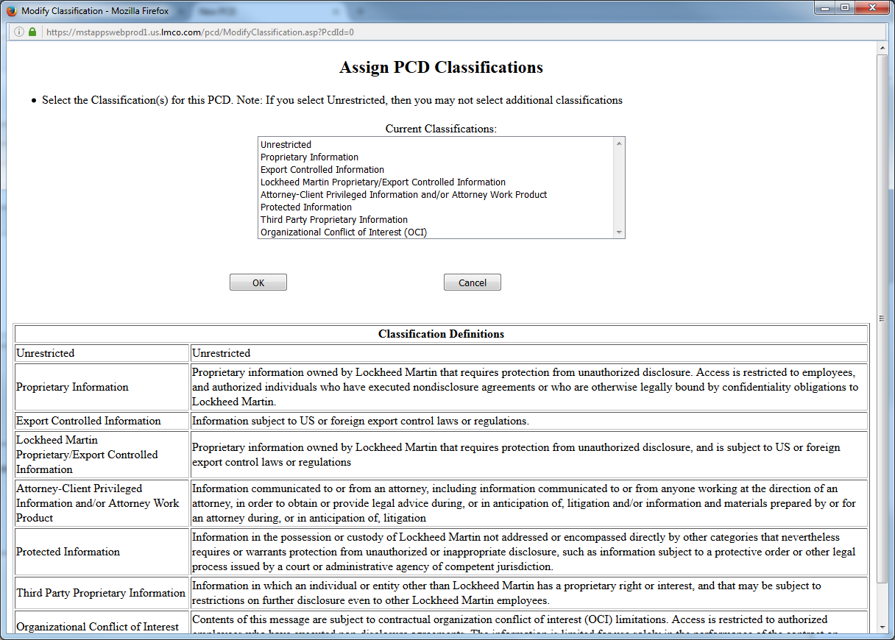
Classification

Slide 41
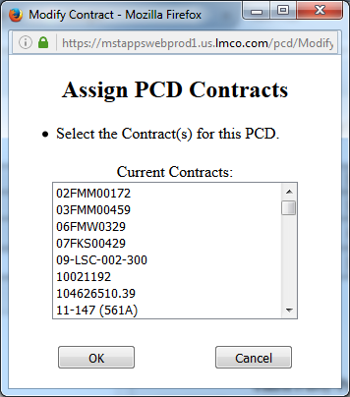
Contract(s) / Purchase Order(s)

Slide 42
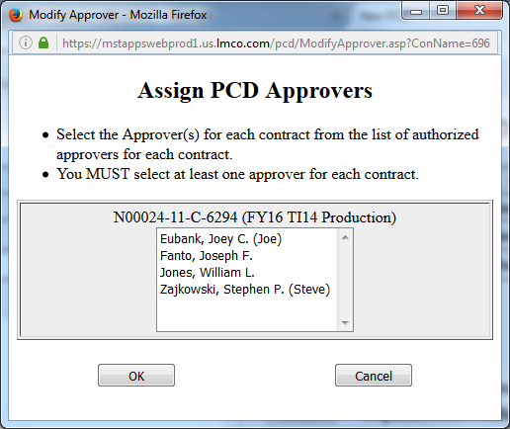
Approver(s)

Slide 43
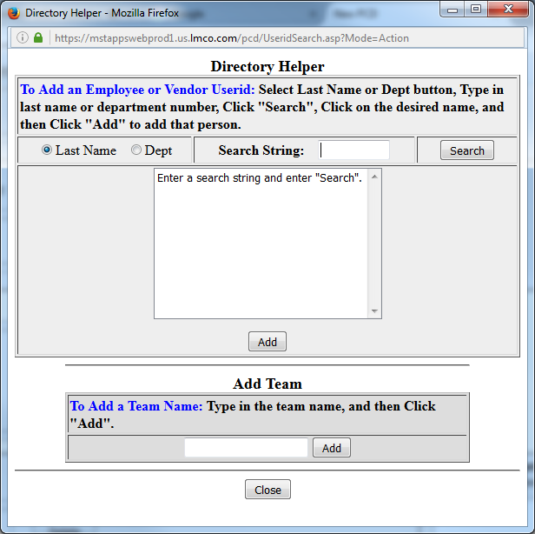
Action Responsible Person(s) / Additional Recipient(s)

Slide 44
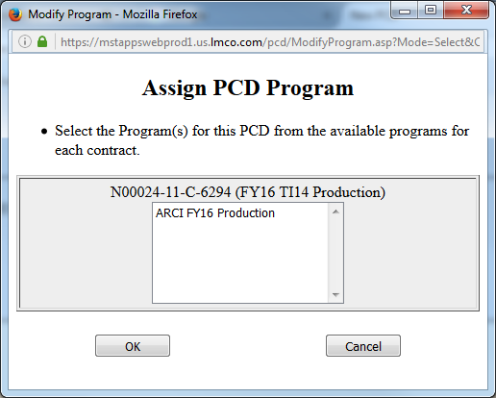
Programs

Slide 45
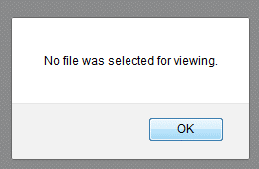
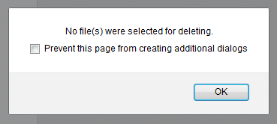
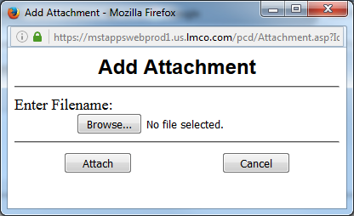
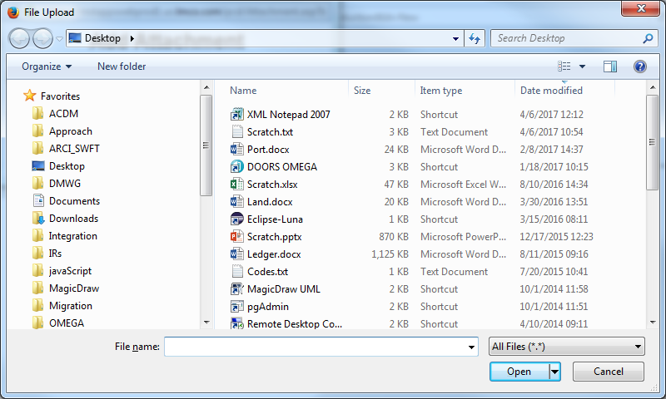
Attachments

Slide 46
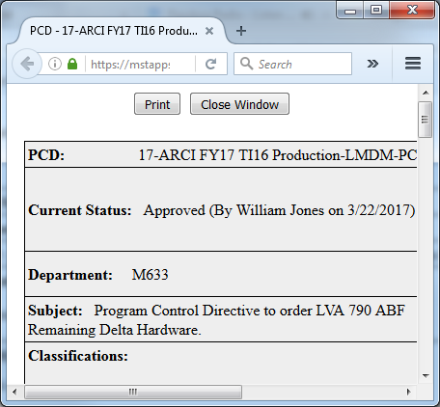
View Printable Version

Slide 47
PCD Report Elements
PCD
Date
Current Status
Closed By
Date Closed
Approved By
Date Approved
Rework By
Date Sent for Rework
Revised By
Dept
Originator
Subject
Due Date
Contract(s) / Purchase Order(s)
Action Responsible Person(s)
Program Recipients
Program(s)
Program to use in PCD number
Additional Recipient(s)
Work Package
Action / Comments
Reference
Closure Comments
Rework Comments
Attachments

Slide 48
Misc.

Slide 49
Speed
Efficiency
Learnability
Memorability
User Preference

Slide 50
Simple and natural dialogue.
Speaking the users' language, which means not using technical jargon if you have users who won't understand it.
Minimizing the users' memory load, so they don't have to remember too much.
Being consistent, and that means consistent within your own application, but also consistent with what users are used to interacting with.
Giving good feedback.
Providing clearly marked exits so if the user doesn't know what they want to do, they can get out.
Having shortcuts for expert users.
Preventing errors.
Giving good error messages,
Providing help in documentation.

