Slide 1
PCD Tracker
Storyboard
Gene Belford
09 May 2017
Notes:
Description
Enter description here
Requirements
R1
R2
R3
Business Rules
BR1
BR2
BR3
Functions
F1
Data Objects
DO1
DO2
DO3
Complexity 0
Inputs 0
Outputs 0
Inquires 0
Files/Tables 0
Ext. Files 0

Slide 2
PCD Task View
PCD Task List
User:
Joe Smith
Show
10
entries
Role
Task
Action
Contract
Subject
Due Date
Originator
BOM
Create
N00024-15-C-6222
VA Class (New Con) Delta Spares
1/15/17
Reviewer
PCD
Review
…
…
…
Reviewer
…
Review
…
…
…
Reviewer
…
Review
…
…
…
Approver
PR
Approve
…
…
…
Approver
ER
Create
…
…
…
Go To
Add Tasker
Search
Admin
Close
Notes:
Description
Upon user initial connection, the system will display a list of tasks/actions, in descending ‘due date’ order, that the user is responsible for.
Requirements
The system will allow the <users> to sort upon any of the data columns.
The system will allow the <users> to select a <task> to open.
The system shall allow <authorized users> with the <appropriate rights> to add new tasking.
The system shall allow <authorized users> with the <appropriate rights> to access administrative functions
Search
The system shall highlight <tasks> due with X number of days.
Functions
Business Rules
X
Y
Z
Data Objects
Users
Tasks
Complexity 7
Inputs 3
Outputs 1
Inquires 1
Files/Tables 2
Ext. Files 0

Slide 3

PCD Tracker Entry
Change this to a count and the lowest status of the BOMs
(non-editable)
RecID:
00999
Subject:*
Enter Subject...
PCD:
TBD
Contract:*
Select Contract…
Mod
SLIN
$ Est
Funded:
N
Enter…
Enter…
$0
FEA:
PN
Dwg
BOM
Next Review:
NA
Select…
Select…
Select…
3/2/17
Customer RDD:
1/1/19
Internal RDD:
2/1/18
PCD Required:
2/1/17
Originator:
Joe Smith
Status:
In-Progress
Required: *
Task
Metadata?
Pre-defined lead times?
Overall status of the PCD?
Task Maintenance
Program Defined Fields:
Notes:
Add
More details?
(date and author on each note)
Hull
794
TI
16
Delete
Select
Select/Enter…
Can a note be edited?
Add Task
Copy Existing Tasker
Edit
Save
Delete
Draft PCD
Task View
Notes:
Description
From this HMI the user will enter common information needed by, or status information for a related set of tasks. When the user clicks on the ‘Add Task’ button the system will switch to the <task Maintenance> page. (Can the ‘Add Task’ be merged into ‘Task Maintenance’.) When the user clicks on the ‘Copy Existing Tasker’ a new tasker will be created. (Do the tasks when copy also, or is that a option that should be proved?)
Sort/filter?
Requirements
The system will all the <users> to add, update and remove <tasks>.
The system will allow the <users> to copy an existing <tasker> into a new <tasker>.
The system will allow the <users> to generate a <draft PCD> from the related <tasks>.
The system will show the lowest status of a reportable item.
The system will allow the <user> to all the tasks the have been assigned to the <tracker>.
The system will allow only <authorized users> to edit and/or delete a <tracker>.
Business Rules
Required dates can be no early than the current date.
The <PCD Required> date cannot be later than or the same as the <Internal RDD> date.
The <Internal RDD> date cannot be later than or the same as the <Customer RDD> date.
The <PCD> identifier will default to ‘TBD’ upon <tracker> creation.
The <PCD> identifier will be updated with <draft PCD> identifier upon generation.
The <draft PCD> will have the identifier of the individual who clicked the button assigned as the <originator>.
The <PCD> identifier will be updated with <PCD> identifier upon approval.
The <contract> identifier will default to <blank>.
The <mod> identifier will default to <blank> until selected by the <project manager>.
The <slin> identifier will default to <blank> until entered by the <project manager>.
The <$est> will default to <blank> until entered by the <project manager>.
The <funded> will default to ‘N’ until selected by the <project manager>.
The <fea> identifier will default to ‘NA’ until selected by the <project manager>.
The <pn> identifier will default to <blank> until selected by the <project manager>. Enumeration Type: Approval (blank, Pre-Release, Released)
The <dwg> identifier will default to <blank> until selected by the <project manager>. Enumeration Type: Approval (blank, Pre-Release, Released)
The <bom> identifier will default to <blank> until selected by the <project manager>. Enumeration Type: Approval (blank, Pre-Release, Released)
The <customer rdd> identifier will default to <blank> until entered by the <project manager>.
The <internal rdd> identifier will default to <blank> until entered by the <project manager>.
The <pcd required> identifier will default to “<internal rdd> less the <pre-defined lead time>”.
Enumeration Type: Task Type (blank, PN, DWG, DOM, PCD, PR)
Functions
Contract Selector
Enumeration Helper
Data Objects
Trackers
Contracts
Notes
Complexity

Slide 4
PCD Task Maintenance
RecID
00999
Subject
VA Class (New Con) Delta Spares
Contract
N00024-15-C-6222
Task
Role1
Role2
Role3
Identifier
Name/Description
Status
Attachment…
Purch Req
Originator
Reviewer
Approver
Mullins, Jeremiyah
Myers, Janet (Pending)
Smith, Joe (Pending)
Jones, William (Approved)
Identifier
Name/Description
Status
LVA 790 Additional ABF Delta_HW …
BOM
Originator
Reviewer
Approver
Name(s)
Name(s) Status
Name(s) Status
Identifier
Name/Description
Status
LVA 790 Additional ABF Delta_HW …
Required: *
References to hold PR, etc?
Identifier
Name/Description *
Status *
Required By:
2/1/17 *
Task Type *
Originator *
Name
Reviewer
Name(s)
Approver *
Name(s)
Task comments?
Add
Delete
Add
Delete
Add
Delete
Directory Helper
Directory Helper
Approver Helper
Attachments:
LVA 790 Additional ABF Delta_HW List_790_v02.xls
Attach
Add Task
Copy
Edit
Save
Delete
Task View
Notes:
Description
The HMI will allow the authorized user to add, update, delete, and close tasks. The HMI will contain a scrolled section that displays tasks already entered for the associated tracker. When the user
Requirements
The system shall automatically assign item identifiers that are unique.
The system shall validate that all required fields are complete.
The system shall allow the <authorized user> to maintain the enumerations used in the drop-down list boxes.
The system shall use the <active directory> to assign individual tasks.
Business Rules
The <Required By> date cannot be later than or the same as the <Internal RDD> date.
Functions
Action Person Helper
Approver Person Helper
Enumeration Helper
Attachments
Notes?
Data Objects
Trackers
Tasks
Users
Enumeration Values
Notes
Attachments
Complexity

Slide 5
PCD Tasker Data Review
RecID
00999
Subject:*
VA Class (New Con) Delta Spares
PCD
TBD
Contract:*
N00024-15-C-6222
Mod
SLIN
$ Est
Funded
N
P00012
0203AD
$300K
FEA
PN
Dwg
BOM
Next Review
N
Released
Released
Pre-Rel
3/2/17
Customer RDD
1/1/19
Internal RDD
2/1/18
PCD Required
2/1/17
Originator:
Joe Smith
Status:
In-Progress
Required: *
Task
Identifier
Name/Description
Pending
Attachment(s)
BOM
Originator
Reviewer
Approver
Mullins, Jeremiyah
Myers, Janet (Pending)
Smith, Joe (Pending)
Jones, William (Approved)
Identifier
Name/Description
Status
Attachment(s)
BOM
Originator
Reviewer
Approver
Task Maintenance
Program Defined Fields:
Notes:
Hull
794
Add
TI
16
Delete
Select
Select/Enter…
Add Tracker
Copy Existing Tracker
Edit
Save
Delete
Draft PCD
Task View
Notes:
Description
This is a completed PCD Tracker Entry shown with tasks assigned. This HMI would be displayed if the user select a PCD from the Task View.
Requirements
See Tracker Entry requirements
Functions
See Tracker Entry functions
Business Rules
See Tracker Entry business rules
Data Objects
See Tracker Entry data objects
Complexity
See Tracker Entry complexity

Slide 6
PCD Hardware List Entry
Would this be better with the part, or parts group?
RecID:
Draft-ER-00999
Current Status:
Pending
Department:
M7F5
Subject:
Hardware List
Classification:
Unrestricted
Additional Columns?
Purchase Order
MAN/CLW
Contract CLIN
Contract:
N000##-##-X-1002
N000##-##-X-1003
Purchasing Contacts:*
Name
Add
Delete
Required: *
Directory Helper
Part
Number*
Mfg Part
Number
Nomenclature*
Qty*
Unit
Cost*
Cost
Total
Work
Package*
RDD*
N139894-1 Sonar Laptop 2 $800
$1600
$1600 Total
1M17ESL1N223 Hdw
1M17ESLLC223 Labor
Can the list be copied from an existing list?
Is the volume worth the effort to add copy function?
Add
Delete
Reset
Cancel
Attachments:
Attach
View
Group By?
Purchasing
Work Package
Whatever
Comments:
04/18/2017 - LM Production is directed/authorized to generate for the Technology Part Task Trainer hardware listed below. LM Production shall notify Bill Steinbach (1511) once the kits are available for delivery.
Note: All material in the Sonar Lap top kits are required except for the Lap Tops P/N N146823-1 Item 25 on the N139894-1 BOM. We already have the Laptops (N146823-1) for the kits but need two sets of the remaining items.
Save
Submit
Cancel
Task View
Notes:
Description
This HMI allows the user to construct a hardware list. The basic HMI has three inputs:
Purchasing Contacts
Attachments
Comments
The four buttons on the bottom of the HMI permit the user to save a list being work, submit for approval, or cancel any changes that had been contacts, or comments.
The gray box in the center of the HMI is where the user constructs the hardware list. When the HMI opens any parts already entered would be displayed. When the user clicks on the Add button a new line will be created for the user to complete. When the Add button is clicked any changes/additions to the list will saved. If the user needs to delete a line(s), the user would line(s) and then click the Delete button. Reset? Cancel?
Requirements
If unsaved changes exist prior to closing the HMI, the system will prompt the user to save the changes.
If unsaved changes exist prior to cancel a session, the system will warn the user that changes will be lost.
Before deleting a part(s) the system will prompt the user for confirmation.
Business Rules
The Submit button will be enabled when either one part is added, or a attachment has been made.
When the Submit button is clicked the system will forwarded the to the reviewers/approvers.
When all the reviewers/approves have approved the hardware list, the list will be forwarded to the purchasing contacts.
An approved Hardware List will be locked to prevent additional part list changes.
An approved Hardware List will need approver to submit the part list for rework for changes to be made to the part list.
??? Change history
Functions
Directory Helper
Attachments
Comments
Hardware List
Data Objects
Tasks
Users (purchasing sub-list?)
Parts
Attachments
Comments
Complexity 0
Inputs 0
Outputs 0
Inquires 0
Files/Tables 0
Ext. Files 0

Slide 7
Hardware List Workflow
Assign the task
PM
Releases
Released
Created
Reviewer(s) Concurs?
PM Releases?
Submitted
?
Originator Drafts
Saved
Originator Submits
Review
Reviewed
Concurred
Copy?
Reworking
Rework
Rejected
Deleted
Rejected/Reopen
Deleted
Deleted

Slide 8
Current PCD Entry Screen
* = Required Field New PCD
PCD: Draft-001316 Date: 4/26/2017
Current Status: New Revision: New
Department*: Originator: Belford, Eugene
Subject*: Due Date: Calendar
Classification*: Third Party Proprietary Information:
Organizational Conflict of Interest (OCI):
Contract(s) / Purchase Order(s)*:
Approver(s)*:
(A) = Approved; (R) = Rework; (P) = Pending; (X) = No Action Required
Action Responsible Person(s):
Program(s)*: Program Recipient(s):
(Automatically filled based on program(s) selected)
Program to use in PCD number*:
Additional Recipient(s):
Work Package(s):
Action(s) / Comment(s)*:
Reference(s):
Attachment(s):
Add
Delete
Add
Delete
Add
Delete
Add
View
Delete
ARCI?
17-ARCI FY17 TI16 Production-LMDM-PCD00016
Add
Delete
Add
Delete
View
Save
View
Cancel
Task View
Notes:
Description
The user has clicked the “Draft PCD” button on the Tasker Entry.
Requirements
The “Draft PCD” button requires that a PCD task be in the Tasker.
Business Rules
PCD*: identifier is auto generated.
Date*: defaults to current date and time.
Current Status*: defaults to “NEW”.
Revision (Status):
Department*: defaults to “Select one…”
Originator*: Individual assigned as the <originator> on the tasker.
Subject*: Text enter in the <subject> on the tasker.
Due Date: Date enter in the <pcd required> on the tasker.
Classification*:
Third Party Proprietary Information:
Organizational Conflict of Interest (OCI):
Contract(s) / Purchase Order(s): ?Purchase Requisition(s)?
Approver(s)*: New selection, or are they consolidated from associated tasks?
Approver’s approval status defaults to “P”.
Program(s)*:
Program to use in PCD number*:
Additional Recipient(s): Is there a default list?
Work Package(s): If there was a <work package> on the task, they could be consolidated here.
Action(s) / Comment(s)*: New entries, or are they consolidated from associated tasks?
Reference(s): New entries, and/or are they associated tasks?
Attachment(s): New associations, or are they consolidated from associated tasks?
Functions
F1
Data Objects
DO1
Complexity 0
Inputs 0
Outputs 0
Inquires 0
Files/Tables 0
Ext. Files 0

Slide 9
Draft From PCD Tracker
* = Required Field New PCD
PCD: Draft-001316 Date: 05/09/2017
Current Status: New Revision: New
Department*: Originator:
Subject*: Due Date: Calendar
Classification*: Third Party Proprietary Information:
Organizational Conflict of Interest (OCI):
Contract(s) / Purchase Order(s)*:
Approver(s)*:
(A) = Approved; (R) = Rework; (P) = Pending; (X) = No Action Required
Action Responsible Person(s):
Program(s)*: Program Recipient(s):
(Automatically filled based on program(s) selected)
Program to use in PCD number*:
Additional Recipient(s):
Work Package(s):
Action(s) / Comment(s)*:
Reference(s):
Attachment(s):
Select One…
Mullins, Jeremiyah
VA Class (New Con) Delta Spares
02/01/17
Select One…
Add
Delete
Jones, William L. (P)
Add
Delete
Add the task they are responsible for?
BOM, hardware List, etc.
Mullins, Jeremiyah
Myers, Janet
Add
Delete
Add
View
Delete
ARCI?
17-ARCI FY17 TI16 Production-LMDM-PCD00016
Add
Delete
Add
Delete
View
Save
View
Cancel
Task View
Notes:
Description
The user has clicked the “Draft PCD” button on the Tasker Entry.
Requirements
The “Draft PCD” button requires that a PCD task be in the Tasker.
Business Rules
PCD*: identifier is auto generated.
Date*: defaults to current date and time.
Current Status*: defaults to “NEW”.
Revision (Status):
Department*: defaults to “Select one…”
Originator*: Individual assigned as the <originator> on the tasker.
Subject*: Text enter in the <subject> on the tasker.
Due Date: Date enter in the <pcd required> on the tasker.
Classification*:
Third Party Proprietary Information:
Organizational Conflict of Interest (OCI):
Contract(s) / Purchase Order(s): ?Purchase Requisition(s)?
Approver(s)*: New selection, or are they consolidated from associated tasks?
Approver’s approval status defaults to “P”.
Program(s)*:
Program to use in PCD number*:
Additional Recipient(s): Is there a default list?
Work Package(s): If there was a <work package> on the task, they could be consolidated here.
Action(s) / Comment(s)*: New entries, or are they consolidated from associated tasks?
Reference(s): New entries, and/or are they associated tasks?
Attachment(s): New associations, or are they consolidated from associated tasks?
Functions
F1
Data Objects
DO1
Complexity 0
Inputs 0
Outputs 0
Inquires 0
Files/Tables 0
Ext. Files 0

Slide 10
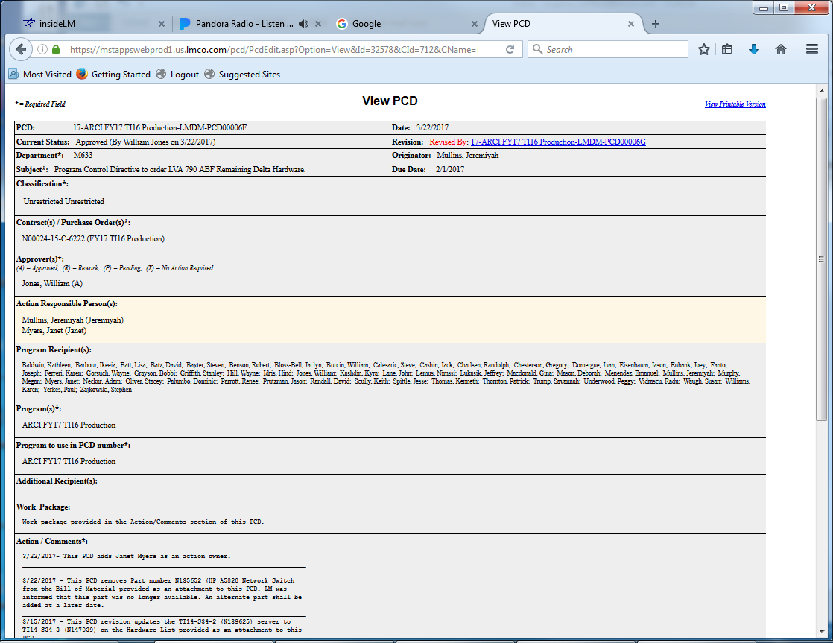
View PCD
Forward…
Cancel
Copy to another PCD
Notes:
Description
Enter description here
Requirements
R1
R2
R3
Functions
F1
Business Rules
BR1
BR2
BR3
Data Objects
DO1
DO1
DO1
Complexity 0
Inputs 0
Outputs 0
Inquires 0
Files/Tables 0
Ext. Files 0

Slide 11
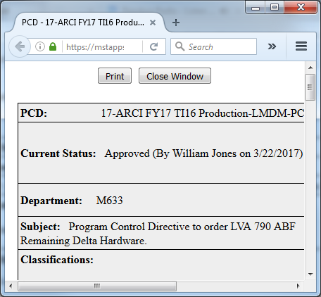
View Printable Version
Notes:
Description
Enter description here
Requirements
R1
R2
R3
Functions
F1
Business Rules
BR1
BR2
BR3
Data Objects
DO1
DO1
DO1
Complexity 0
Inputs 0
Outputs 0
Inquires 0
Files/Tables 0
Ext. Files 0

Slide 12
PCD Task Review/Approve Status
RecID:
Draft-ER-00999
Current Status:
Pending
Department:
M7F5
Task:
PCD / PR / BOM
Originator:
Smith, Joe
Subject:
Sample ER for Approval
Classification:
Unrestricted
Contract:
N000##-##-X-1002
N000##-##-X-1003
Additional elements to be determined
Attachments:
Sample_ER_File.xlsx
Sample_ER_for_Project.docu
View
Rework
Comments:
Add notes here.
Approve
Rework
Cancel
Task View
Notes:
Description
Enter description here
Requirements
R1
R2
R3
Functions
F1
Business Rules
BR1
BR2
BR3
Data Objects
DO1
DO1
DO1
Complexity 0
Inputs 0
Outputs 0
Inquires 0
Files/Tables 0
Ext. Files 0

Slide 13
Approve PCD
* = Required Field New PCD
PCD: Draft-001316
Current Status:
Department: M7F5
Subject: Sample PCD for Approval
Classification:
Unrestricted Unrestricted
Contract(s) / Purchase Order(s)*:
N00024-15-C-6222 (FY17 T116 Production)
Approver(s)*:
(A) = Approved; (R) = Rework; (P) = Pending; (X) = No Action Required
Eubank, Joey (P)
Action Responsible Person(s):
Program Recipient(s):
Baldwin, Kathleen
…
Program(s)*:
ARCI FY17 TI16 Production
Program to use in PCD number*:
ARCI FY17 TI16 Production
Additional Recipient(s):
Work Package:
Labor work package 1Mxxxxxxxxxxxxxx Material work package 1Mxxxxxxxxxxxxxx
Action / Comments*:
4/27/2017 - xxxxxxxxxxxxxxxxxxxxxxxxxxxxxxxxxxxxxxxxxxxxxxxxxxxxxxxxxxxxxxxxxxxxxx
Reference:
Rework Comments:
Attachments:
There are no attachments associated with this PCD.
Approve
Rework
Cancel
Closure
Close PCD

Slide 14
PCD Admin Function
Contract
Program
Need to see what already exists
Users
Add Contract
Add Program
Add User
Delete
Archive
Task View

Slide 15
PCD Tasker Search Parameters
Man PR and Clw PR were program defined fields?
Where do keywords get entered?
And/Or?
RecID
Keyword(s)
PCD
TBD
Contract
N00024-15-C-6222
Mod
SLIN
Funded
Y
FEA
PN
Dwg
BOM
Man PR
Clw PR
N
Customer RDD
1/1/17
to
12/31/19
PCD Required
to
Internal RDD
to
Next Review
to
Program Defined Fields:
Hull
794
Add
TI
16
Delete
Select
Select/Enter…
Distinct list from all Projects for DDLB?
Use value from column 1 to filter for select values?
Search
Clear Search
Task View
Notes:
Description
Enter description here
Requirements
R1
R2
R3
Business Rules
BR1
BR2
BR3
Functions
F1
Data Objects
DO1
DO2
DO3
Complexity 0
Inputs 0
Outputs 0
Inquires 0
Files/Tables 0
Ext. Files 0

Slide 16
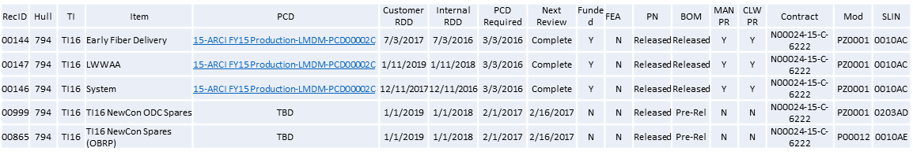

PCD Tasker Search Results
Suggest splitting into a status and next review fields
Restricted to PCD tasks only
Edit Search
Select
Task View
Notes:
Description
Enter description here
Requirements
R1
R2
R3
Functions
F1
Business Rules
BR1
BR2
BR3
Data Objects
DO1
DO1
DO1
Complexity 0
Inputs 0
Outputs 0
Inquires 0
Files/Tables 0
Ext. Files 0

Slide 17
PCD Tracker Functions
DO1

Slide 18
Enumeration Helper
Drop Down List Box
Modal
Assign Enumeration
Select an enumeration
Approval Status
A: Approved
R: Rework
P: Pending
X: No action required
A: Approved
R: Rework
P: Pending
X: No action required
OK
Cancel
Notes:
Description
Allows the user to select a value to populate a selection box. This could be either a separate popup, or a drop down list box depending on the standards used.
Requirements
The system shall only display active <enumeration value(s)>.
The system shall only use inactive <enumeration values(s)> for display of historical records.
The system shall use the <sort order> as the default display order.
The system shall allow the user to select many values were appropriate.
Business Rules
The code value is distinct.
The code name is distinct.
The list will only contain valid/<active> codes.
Codes that are inactive will this be displayable for historical data.
Selection/validation of enumeration values will use the <enumeration code> and <enumeration value code>.
Functions
F1
Data Objects
Enumeration Types
Enumeration Values
Complexity

Slide 19
Enumeration Types
Enumeration Types
Enter filter…
Filter
# of
Values
Last modified
Date By
Type Name
Description
Action tbd 3
Approval Status Status that can be given to a task. 4
Approvers
Classification
Contract tbd
Department
Hull
Program
Role tbd 4 12/31/17 00:00:00 Smith, Joe
Task tdb 4 05/09/17 14:02:17 Smith, Joe
Technology Insert tbd
?User?
Add New Type
Notes:
Description
Enter description here
Requirements
R1
R2
R3
Business Rules
BR1
BR2
BR3
Functions
F1
Data Objects
DO1
DO2
DO3
Complexity 0
Inputs 0
Outputs 0
Inquires 0
Files/Tables 0
Ext. Files 0

Slide 20
Enumeration Values
Enumeration Values
Type Name:
Description:
Approval Status
Status that can be given to a task.
Default
Flag
Sort
Order
Active
Flag
Code
Value
Description
‘’ Select One… User prompt, not valid selection. T 0 F
A Approved Approved 1 T
P Pending Pending 3 T
R Rework Rework 2 T
X No Action Required No action required 4 T
Add New Value
Save
Reset
Types
Notes:
Description
Enter description here
Requirements
R1
R2
R3
Business Rules
BR1
BR2
BR3
Functions
F1
Data Objects
Enumeration Types
Enumeration Values
Complexity 0
Inputs 0
Outputs 0
Inquires 0
Files/Tables 0
Ext. Files 0

Slide 21
Enumeration Associated Values
Notes:
Description
Enter description here
Requirements
R1
R2
R3
Functions
F1
Business Rules
BR1
BR2
BR3
Data Objects
DO1
DO1
DO1
Complexity 0
Inputs 0
Outputs 0
Inquires 0
Files/Tables 0
Ext. Files 0

Slide 22
PCD Admin

Slide 23
Contract Entry
Notes:
Description
Enter description here
Requirements
R1
R2
R3
Functions
F1
Business Rules
BR1
BR2
BR3
Data Objects
DO1
DO1
DO1
Complexity 0
Inputs 0
Outputs 0
Inquires 0
Files/Tables 0
Ext. Files 0

Slide 24
Program Entry
Notes:
Description
Enter description here
Requirements
R1
R2
R3
Functions
F1
Business Rules
BR1
BR2
BR3
Data Objects
DO1
DO1
DO1
Complexity 0
Inputs 0
Outputs 0
Inquires 0
Files/Tables 0
Ext. Files 0

Slide 25
User Entry
Notes:
Description
Enter description here
Requirements
R1
R2
R3
Functions
F1
Business Rules
BR1
BR2
BR3
Data Objects
DO1
DO1
DO1
Complexity 0
Inputs 0
Outputs 0
Inquires 0
Files/Tables 0
Ext. Files 0

Slide 26
PCD Functions
DO1

Slide 27
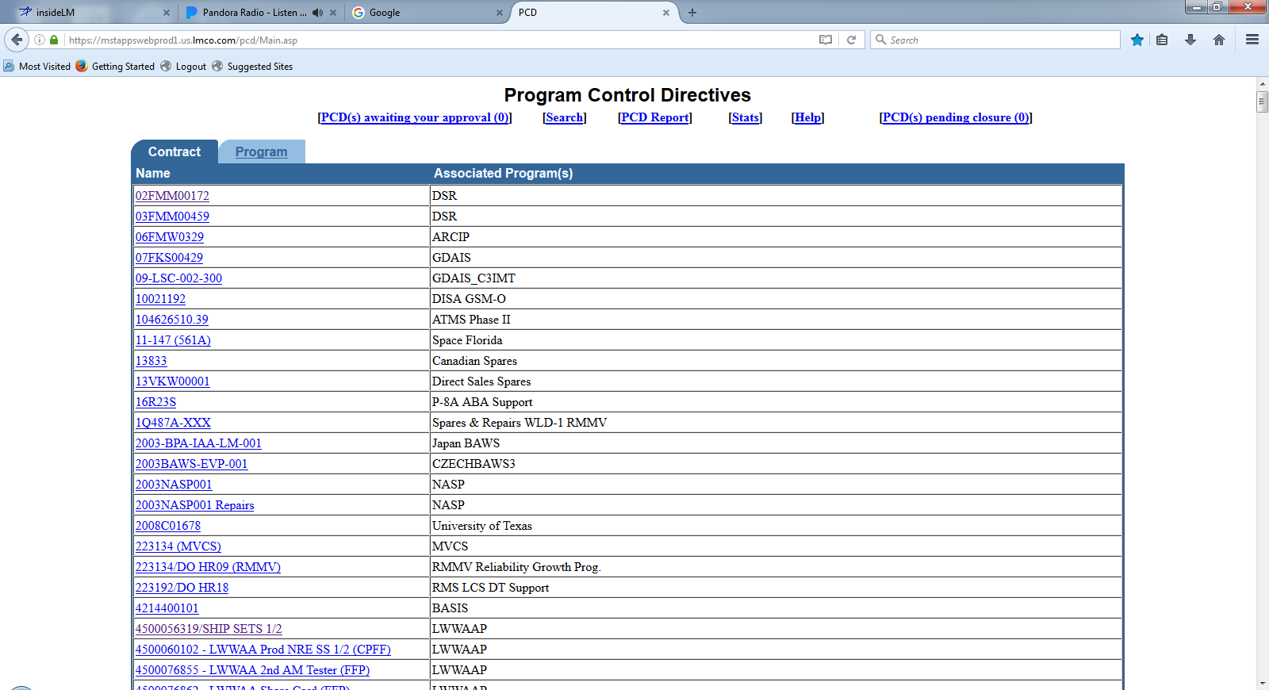
PCD Contract/Program List
Notes:
Description
Enter description here
Requirements
R1
R2
R3
Functions
F1
Business Rules
BR1
BR2
BR3
Data Objects
DO1
DO1
DO1
Complexity 0
Inputs 0
Outputs 0
Inquires 0
Files/Tables 0
Ext. Files 0

Slide 28
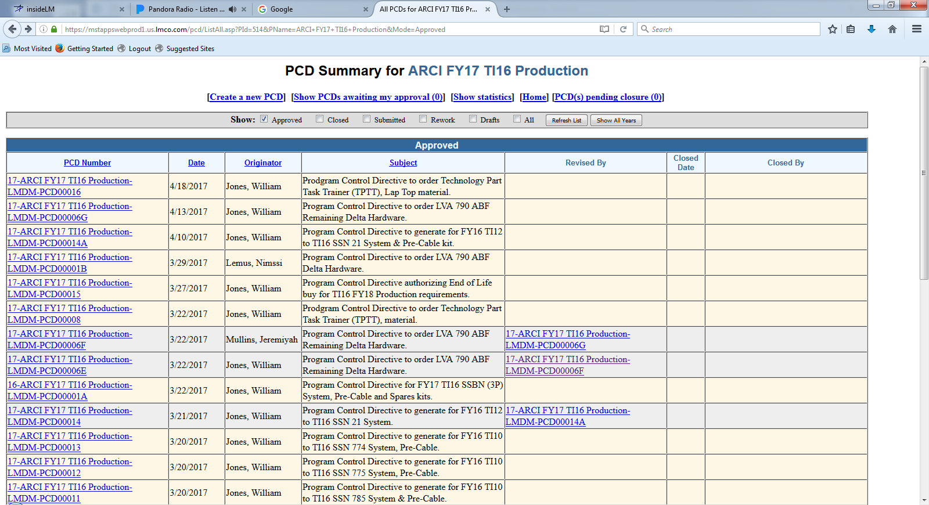
PCD Summary

Slide 29
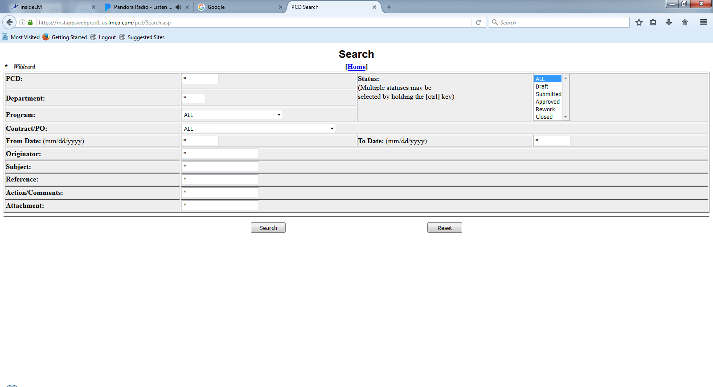
PCD Search
Notes:
Description
Enter description here
Requirements
R1
R2
R3
Functions
F1
Business Rules
BR1
BR2
BR3
Data Objects
DO1
DO1
DO1
Complexity 0
Inputs 0
Outputs 0
Inquires 0
Files/Tables 0
Ext. Files 0

Slide 30
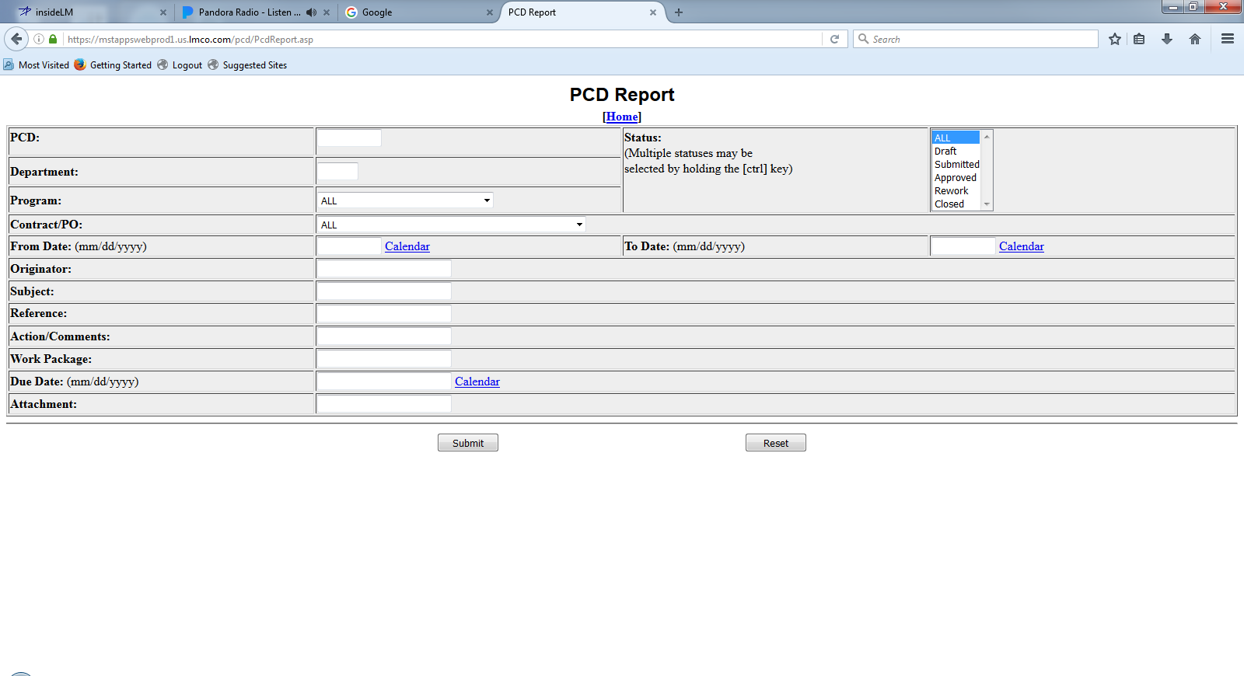
PCD Report
Notes:
Description
Enter description here
Requirements
R1
R2
R3
Functions
F1
Business Rules
BR1
BR2
BR3
Data Objects
DO1
DO1
DO1
Complexity 0
Inputs 0
Outputs 0
Inquires 0
Files/Tables 0
Ext. Files 0

Slide 31
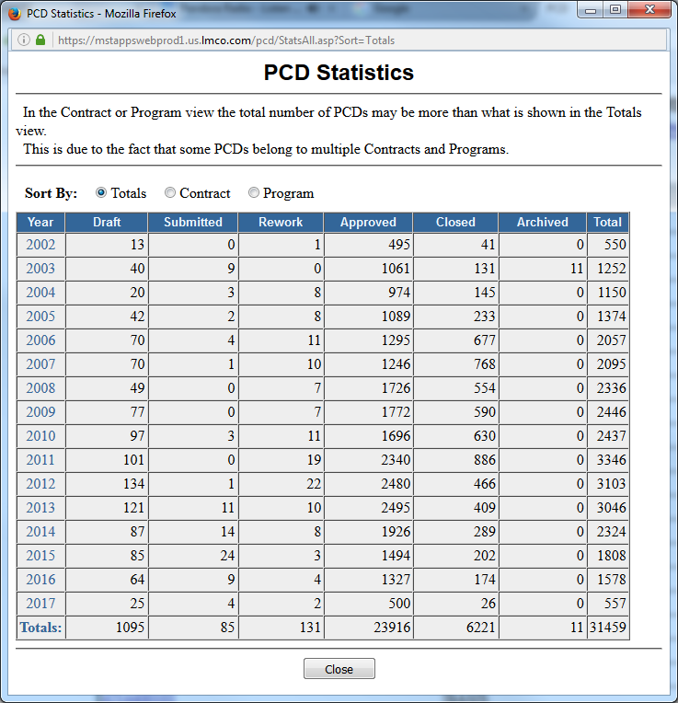
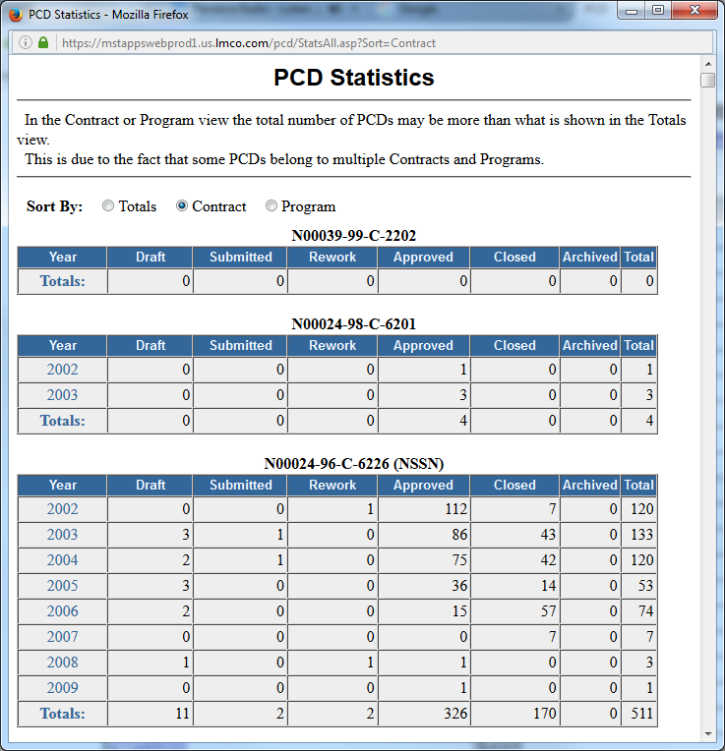
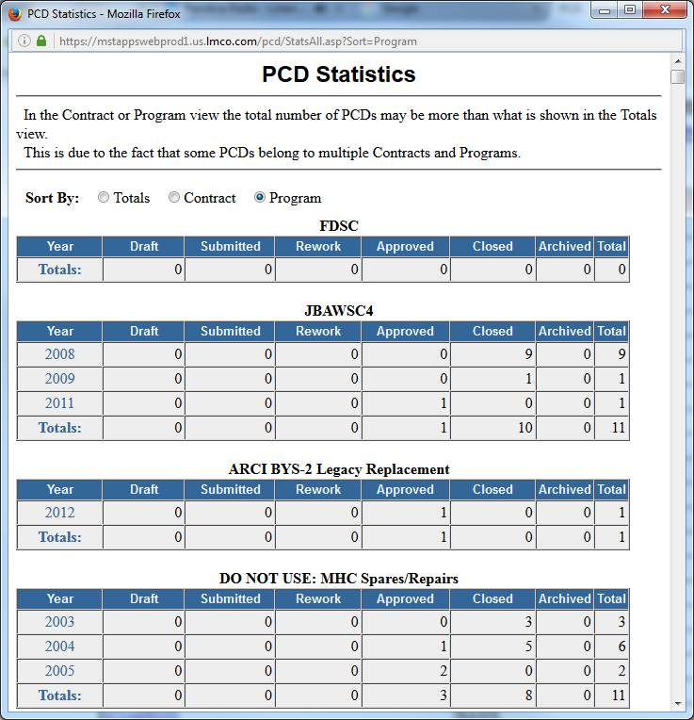
PCD Statistics
Notes:
Description
Enter description here
Requirements
R1
R2
R3
Functions
F1
Business Rules
BR1
BR2
BR3
Data Objects
DO1
DO1
DO1
Complexity 0
Inputs 0
Outputs 0
Inquires 0
Files/Tables 0
Ext. Files 0

Slide 32
PCD Auxiliary Functions

Slide 33
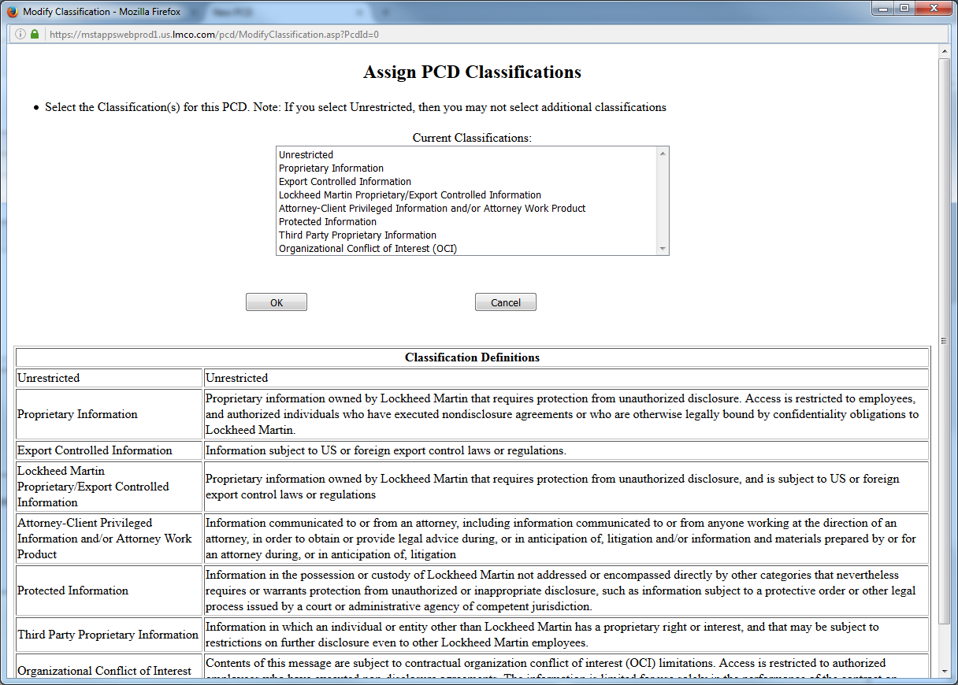
Classification
Notes:
Description
Enter description here
Requirements
R1
R2
R3
Functions
F1
Business Rules
BR1
BR2
BR3
Data Objects
DO1
DO1
DO1
Complexity 0
Inputs 0
Outputs 0
Inquires 0
Files/Tables 0
Ext. Files 0

Slide 34
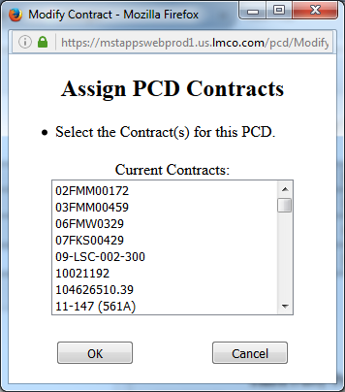
Contract(s) / Purchase Order(s)
Notes:
Description
Enter description here
Requirements
R1
R2
R3
Functions
F1
Business Rules
BR1
BR2
BR3
Data Objects
DO1
DO1
DO1
Complexity 0
Inputs 0
Outputs 0
Inquires 0
Files/Tables 0
Ext. Files 0

Slide 35
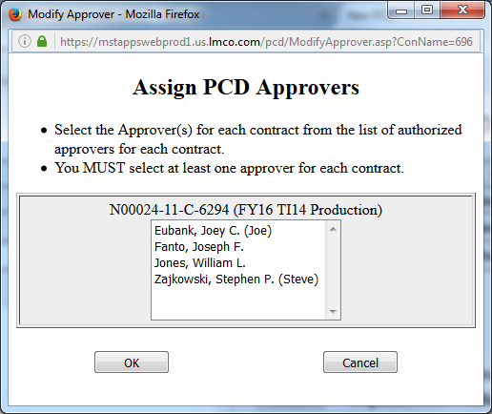
Assign Approver(s)
Notes:
Description
Enter description here
Requirements
R1
R2
R3
Functions
F1
Business Rules
BR1
BR2
BR3
Data Objects
DO1
DO1
DO1
Complexity 0
Inputs 0
Outputs 0
Inquires 0
Files/Tables 0
Ext. Files 0

Slide 36
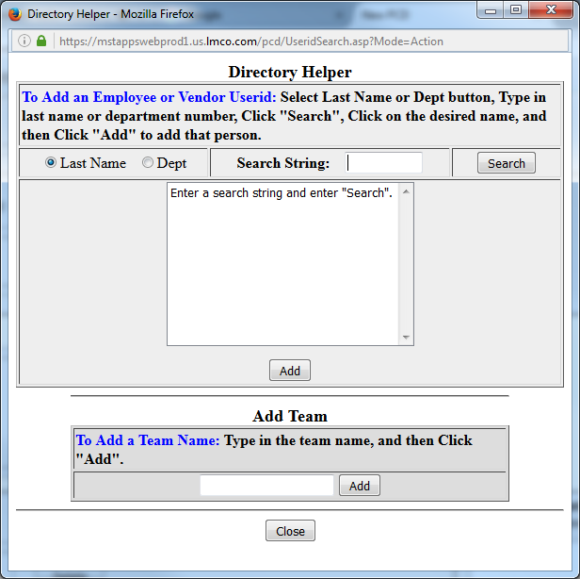
Action Responsible Person(s) / Additional Recipient(s)
Hardware List Entry
Notes:
Description
Enter description here
Requirements
R1
R2
R3
Functions
F1
Business Rules
BR1
BR2
BR3
Data Objects
DO1
DO1
DO1
Complexity 0
Inputs 0
Outputs 0
Inquires 0
Files/Tables 0
Ext. Files 0

Slide 37
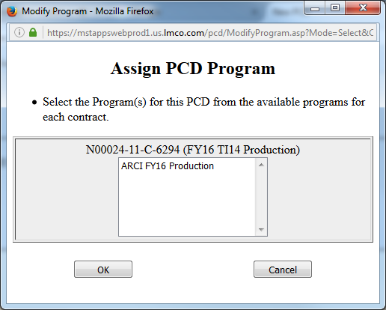
Assign Programs
Notes:
Description
Enter description here
Requirements
R1
R2
R3
Functions
F1
Business Rules
BR1
BR2
BR3
Data Objects
DO1
DO1
DO1
Complexity 0
Inputs 0
Outputs 0
Inquires 0
Files/Tables 0
Ext. Files 0

Slide 38
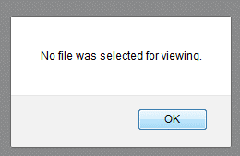
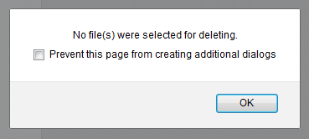
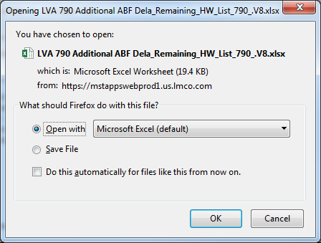
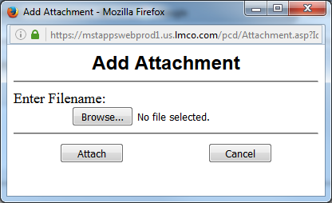
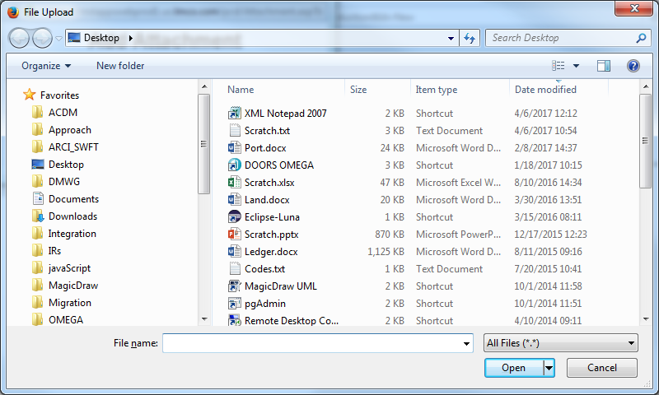
Attachments
Hardware List Entry
Task Review/Approve
Notes:
Description
Enter description here
Requirements
R1
R2
R3
Functions
F1
Business Rules
BR1
BR2
BR3
Data Objects
DO1
DO1
DO1
Complexity 0
Inputs 0
Outputs 0
Inquires 0
Files/Tables 0
Ext. Files 0

Slide 39
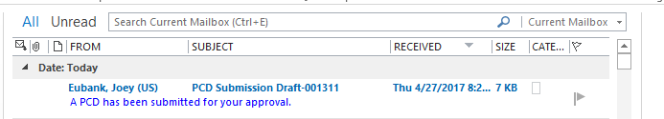
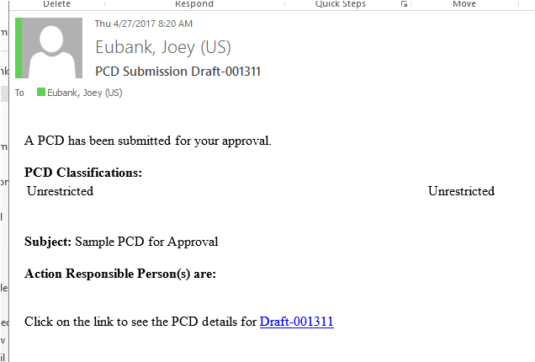
PCD Notification
The link takes you to the draft PCD.

Slide 40
PCD Notification
The link takes you to the draft PCD.
Notes:
Description
Enter description here
Requirements
R1
R2
R3
Functions
F1
Business Rules
BR1
BR2
BR3
Data Objects
DO1
DO1
DO1
Complexity 0
Inputs 0
Outputs 0
Inquires 0
Files/Tables 0
Ext. Files 0

Slide 41
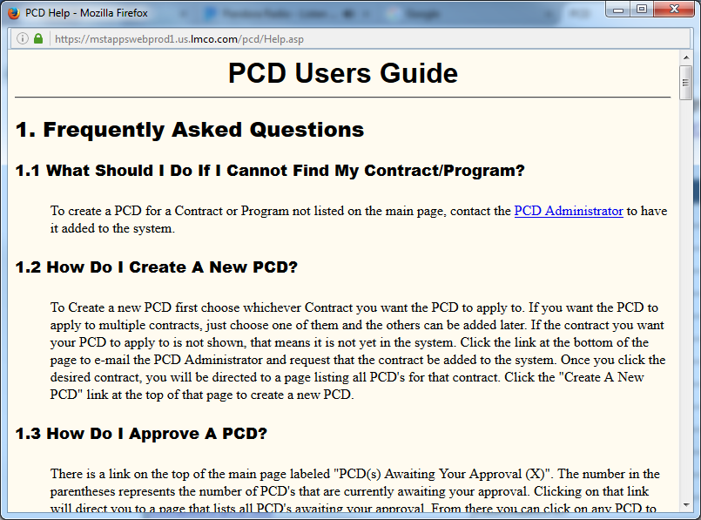
PCD Users Guide
Notes:
Description
Enter description here
Requirements
R1
R2
R3
Functions
F1
Business Rules
BR1
BR2
BR3
Data Objects
DO1
DO1
DO1
Complexity 0
Inputs 0
Outputs 0
Inquires 0
Files/Tables 0
Ext. Files 0

Slide 42
Backup/Reference

Slide 43
PCD BOM Entry
RecID:
Draft-BOM-00999
Current Status:
Pending
Department:
M7F5
Item:
Bill of Materials
Version:
2.1
Classification:
Unrestricted
Contract:
N000##-##-X-1002
N000##-##-X-1003
Source:*
Enter Here..
Required: *
Approvers:
Smith, Joe
Date Approved:
YYYY-MM-DD
BOM Id*
Description
Status*
Comments
BOM-00877 Sonar Laptop Pre-Release Ready for review MM/DD
BOM-00101 Wiring Interface Kit Released
Add
Delete
Reset
Save
Cancel
Attachments:
LVA 790 ABF Eng Dwg_790_v02.jpg
Attach
View
Comments:
04/18/2017 -
Approve
Rework
Cancel
Task View

Slide 44
PCD BOM Entry
RecID:
Draft-BOM-00999
Current Status:
Pending
Department:
M7F5
Item:
Bill of Materials
Version:
2.1
Classification:
Unrestricted
Contract:
N000##-##-X-1002
N000##-##-X-1003
Source:*
Enter Here..
Additional Columns?
Remarks
Required: *
Approvers:
Smith, Joe
Date Approved:
YYYY-MM-DD
Level*
Part
Number*
Item Description*
Group
Unit of
Measure
Qty
Req’d*
1 N139894-1 Sonar Laptop 2 Each 2
1 BOM-00101 Wiring Interface Kit 2 Kit 2
Add
Delete
Reset
Save
Cancel
Attachments:
LVA 790 ABF Eng Dwg_790_v02.jpg
Attach
View
Comments:
04/18/2017 -
Approve
Rework
Cancel
Task View

