Slide 1
A local and global approach to the minimum vertex cover optimisation problem
Ethan Leet 22/05/2022

Slide 2
Overview
Minimum Vertex Cover is a NP-hard optimisation problem
Two local search algorithms and one global stochastic algorithm were implemented in polynomial time and provide a naive solution
All testing conducted with stage four compile optimisations
Promising results for the global approach should further research be invested

Slide 3
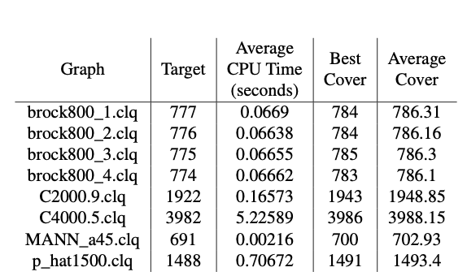
Local Approach 1
Next-Best Greedy
Ranks each node based of its degree
Chooses next node to add to the cover based off highest rank
No node will be chosen twice in the same cover
Hash-map randomness ensures a new variation of ‘next-best’ every trial

Slide 4
Local Approach 2
Randomised Local Search
Chooses next node based off a normally distributed random choice
Each node has the same chance of being picked
No node will be chosen twice in the same cover
Identical local minima compared to next-best greedy

Slide 5
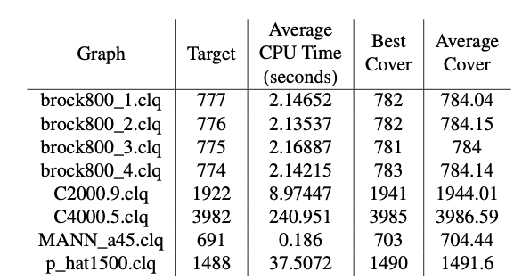
Global Approach
Simulated Annealing
Outperforms both local search algorithms
Cooled at a rate of 0.8 for temperature = 100,000
Iteratively improves its solution at every temperature
Probability of choosing a worse solution decreases as temperature lowers
Algorithm approaches better minima as it cools

Slide 6
Conclusions
Local Search algorithms should be avoided for the anti-greedy Brock collection of graphs
If close enough is good enough an extension to Simulated Annealing should be chosen
If benchmark results are required further research is required into different types of algorithms

