Slide 1
Capstone Project
The battle Of Neighborhoods
By: Evert Johannes Woudstra

Slide 2
Introduction: IBM certificate
Final assignment of the IBM Professional Data science Certificate
Series of 9 Courses
Data science skills studied and applied under which:
Data Science Methodology
Data mining
Analysis and visualization with python
Artificial intelligence, Machine learning
Learning objectives
Leverage location data provided by Foursquare and the Data of Amsterdam website
Applying data science skills in machine learning and data visualization

Slide 3
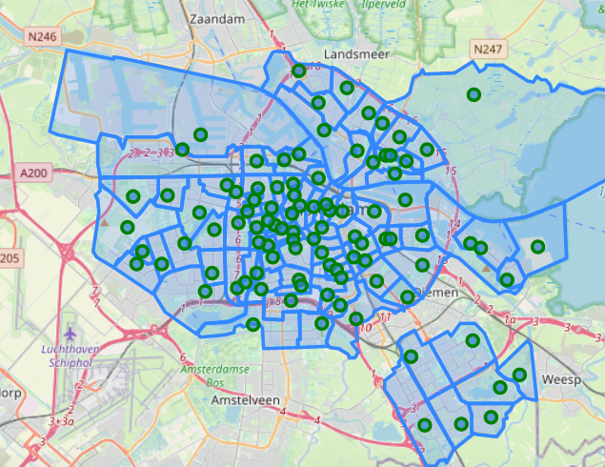
Introduction: Context of the project
Amsterdam, What a city!
872.922 inhabitants from 177 different nationalities
Most bars and pubs of any city in the Netherlands
Trend since 2010: number of restaurants increasing
Amsterdam increasingly popular among tourists
Business problem
Where to open a new restaurant
Stakeholder \ audience
Entrepreneurs
Brokers for properties
Data Analysts interested in Geo Pandas

Slide 4
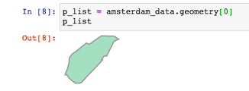
Data Description: Data sources
Location data neighborhoods
The Amsterdam data website (https://maps.amsterdam.nl)
Data format in GeoJson
Polygon objects describing the borders of each neighborhood
Venue Data: The Foursquare database
Foursquare (https://foursquare.com) build and maintains a massive dataset of accurate location data
Foursquare uses the RESTful API
Search can only be made using radius or squared region which will present difficulties finding venues in he above example of neighborhoods

Slide 5
Data Description: feature selection
Foursquare queries will be made using the following categories
Food: Find all venues for venues to assess the indirect competition
Italian Restaurants: Find all venues for venues to assess the direct competition
Arts and Entertainment: attractive venues for tourists \ possible business partner
Nightlife: indicated for popularity for locals and tourists
Travel and Transport: indication how reachable a potential neighborhood is
The query results will be cleaned preprocessed and ordered to achieve a dataset ready to be analysed using machine learnings

Slide 6
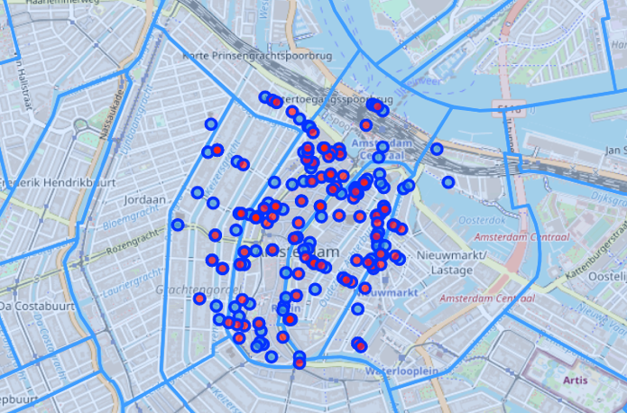
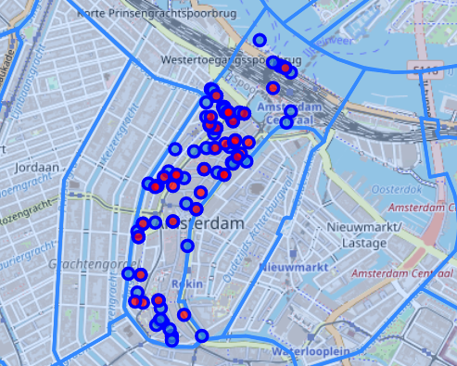
Methodology: assiging venues
Venue assignment by foursquare using a search radius of 500 m results in:
Presence of duplicates
Wrongly assigned venues
Venue assignment done by GeoPandas
delivers a much more precise result
all venues are located within the defined neighbourhood borders

Slide 7
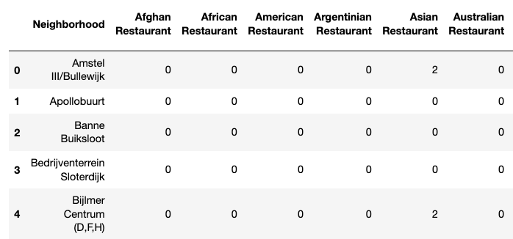
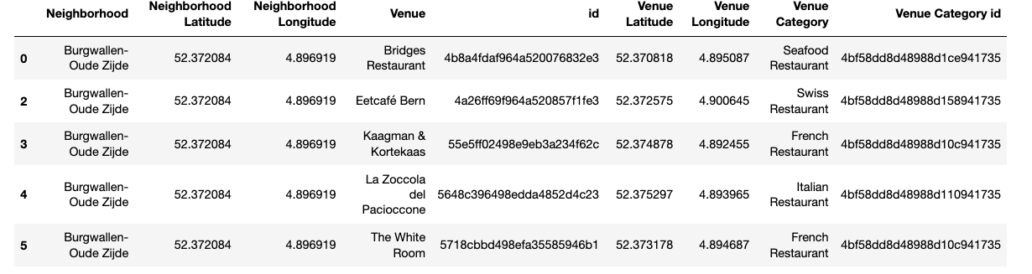
Methodology: One hot encoding
Why we need one hot encoding
Machine learning algorithms won’t work nicely with categorical values
Conversion of categorical values to numerical ones

Slide 8
Machine learning: k-means clustering
What is k-means
technique for calculating the similarity and dissimilarity of points in a given dataset
unsupervised machine learning being capable to handle unlabeled data
Why we want to use it
separate the neighborhood based on unlabeled features
finding and those similar neighborhoods which will have the ideal feature values for starting a restaurant
Those ideal feature values are:
Total number of restaurants: low, meaning less indirect competition
Total number of Italian restaurants: low, meaning less direct competition
Arts\entertainment venues: high, opportunities to form business partners and attractive for tourists
Nightlife: High, opportunities to form business partners attractive for the target customer being in the area.
Transport venues: high, for a restaurant to become a success the neighborhood needs to be reachable.

Slide 9
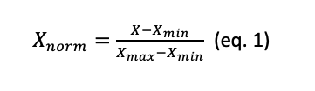
Methodology: Normalization
Why do we need to normalize?
The K-Means algorithm is sensitive for unscaled data.
Assure all features will have an equal impact on the clustering
Which method ?
The most commonly used normalization method is Min\Max scaling (eq 1).
Applying the eq. 1 on the feature data will result in a scaling between 0 and 1 where:
0 = min value
1 = max value

Slide 10
Methodology: parameter selection
K-means clustering most powerful parameter: value for K
Which K is optimal? IT will be between two extremes:
K= 1: there will be only one cluster containing all datapoints.
Cluster distance is maximized (no other cluster available)
No separation of data points.
K= max (99 neighborhoods)
Inter cluster separation minimised (one datapoint per cluster
No clustering at all; every cluster contains one data point just like the dataframe
Optimal K? Iterate over a range of possible K’s and determine the ‘clusering quality using Elbow method and Silhouette score

Slide 11
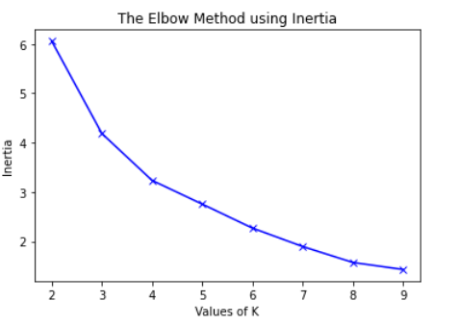
Statistical testing: Elbow method
elbow method: multiple runs of the K -means algorithm over a range of values for K = 1-10
Calculate inertial
Inertial is the sum of the distances of data points to their closest cluster center
Find the elbow point in the graph
Elobow point is where the graph suddenly change in steepness

Slide 12
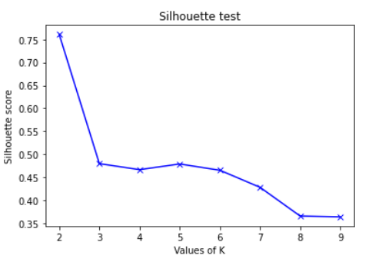
Statistical testing: Silhouette test
The Silhouette method:
measures how similar a datapoint is to:
own cluster (cohesion)
other clusters (separation)
Optimal value?
Find local maximum in graph
Values will be between -1 and 1
Which value of k? 5 could be a good choice based on both methods

Slide 13
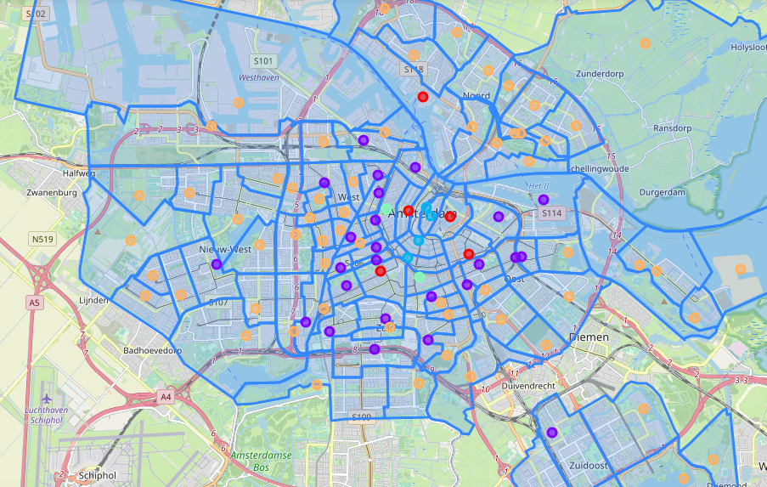
Results: clustering the neighbordhoods
Clusters are assigned by following colors:
Purple: Cluster 1, containing 25 neighborhoods
Dark blue: Cluster 2, containing 4 neighborhoods
Light blue: Cluster 3, containing 2 neighborhoods
Orange: Cluster 4, containing 62 neighborhoods
Red: cluster 5, containing 6 neighborhoods

Slide 14
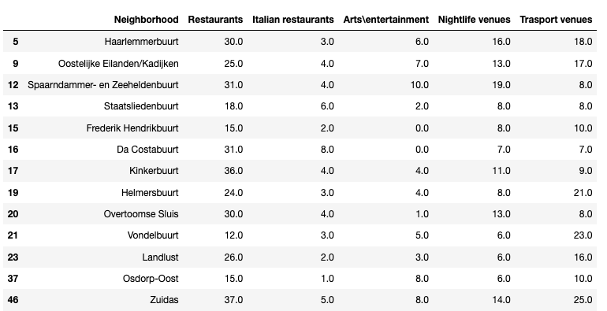
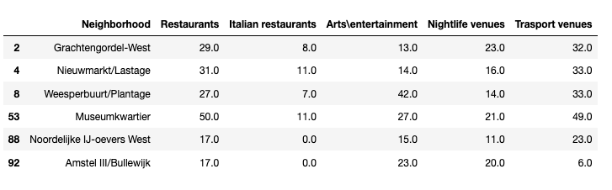
Results: promising clusters
Cluster 1: These are neighborhoods
mainly located outside of the touristic citycenter
less interesting to starting a restaurant for tourist and dayvisitors.
have relatively good transport possibilities
low number of italian restaurants.
‘Vondelbuurt’ and ‘Zuidas’ to be considered
Cluster 5: All is in balance
located close to city center
many options for public transport
many venues in the category’s arts\entertainment and nightlife.
‘Museum kwartier ‘and ‘Weesper buurt’ to be considered

Slide 15
Discussion: observations Foursquare
Foursquare API: Retrieving data using the Foursquare database might seem straight forward at first use.
Observations and Pitfalls
Using categories can focus your search but still allow other unwanted categories
Duplicate venues have to be deleted
venues need to be reassigned which greatly improves accuracy.
The free account : limited possibilities to perform queries,
Overall database is rich of valuable data and Foursquare has proven to be reliable

Slide 16
Discussion: K-means clustering
Clustering with K-Means: A popular way to cluster data and the used library Sklearn works very well. Some Observations can be mentioned.
value for K is still one of the hardest parameters to
Other parameters might be investigated on their effect on clustering
Evaluate independence of features is still an area to be considered for future development

Slide 17
Discussion: recommandations
The following recommendations can be made in further addressing the business question.
review specific venues inside the targeted neighborhood on ratings and popularity during traffic hours
Profile potential customers in the neighborhood; what could be their spending budged?
Review of menus \ concepts of most popular competition
Diversify
Find gaps in portfolio

Slide 18
Conclusion
Mlearning has proven to be an effective tool for discovering insights from large amounts of data.
The Foursquare database
interesting data source but has its limitations when it comes to data precision
This precision can be enhanced by using Geopandas
Using K-means clustering we have been able to cluster the neighborhoods based on their common features.
The following neighborhoods have been highlighted:
Vondelbuurt and Zuidas (cluster 1)
Museum kwartier and Weesper buurt (Cluster 5).

Slide 19
Thank you all for your attention

