Slide 1

COMP3011 Web Services and Web Data Presentation Slides
COMP3011 Web Services and Web Data
Yuankun Zhou 201690952
School of Computing University of Leeds

Slide 2
Project Theme & Use Cases
COMP3011 Web Services and Web Data Project Theme & Use Cases
Theme: Smart Productivity Analytics Platform
Application Scenarios:
▶ Personal task management and tracking
▶ Productivity data analysis and insights
▶ AI assistant integration (Claude, ChatGPT) for automated operations
Core Features:
Feature
Description
Task Management Categories & Tags Analytics
MCP Integration
Create, categorize, prioritize, track status Hierarchical categories + flexible tagging Completion rates, trends, dashboard insights AI agent tool discovery and execution

Slide 3
Project Overview
COMP3011 Web Services and Web Data Project Overview
RESTful API for Task Management & Productivity Analytics
Technology Stack:
▶ Django 5.2
▶ Django REST Framework 3.15
▶ Simple JWT Authentication
▶ drf-spectacular (OpenAPI 3.0)
▶ pytest-django
Key Metrics:
▶ 4 database models
▶ 6 endpoint categories
▶ 36 API endpoints
▶ Comprehensive test suite
▶ Full OpenAPI documentation

Slide 4
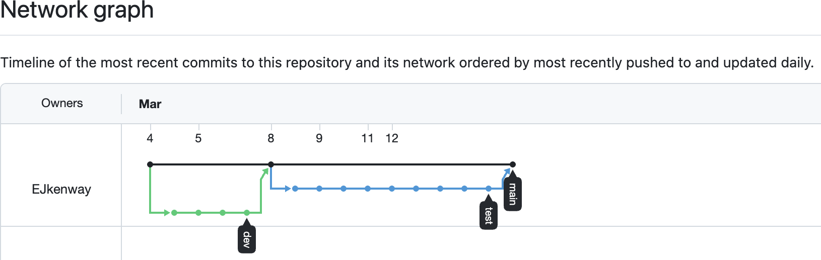
Version Control Practices
COMP3011 Web Services and Web Data Version Control
Branching Strategy:
▶ main – Production-ready code, stable releases
▶ dev – Feature development and integration
▶ test – Testing and validation before merge to main
Workflow:
Develop features on dev branch
Merge to test for validation
Final merge to main after testing

Slide 5
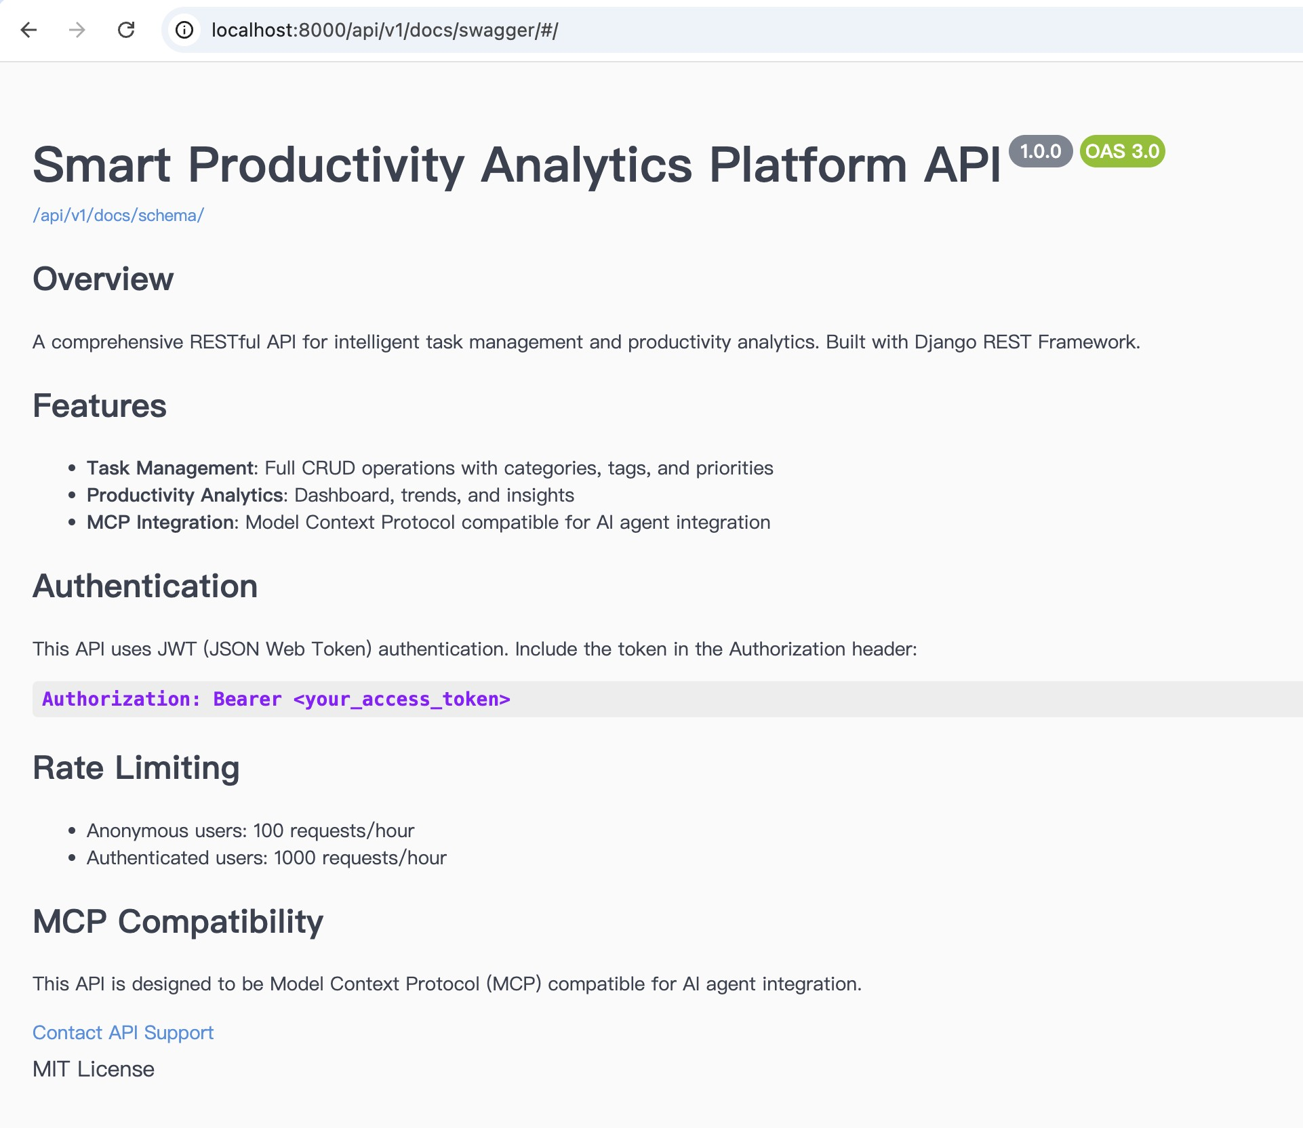
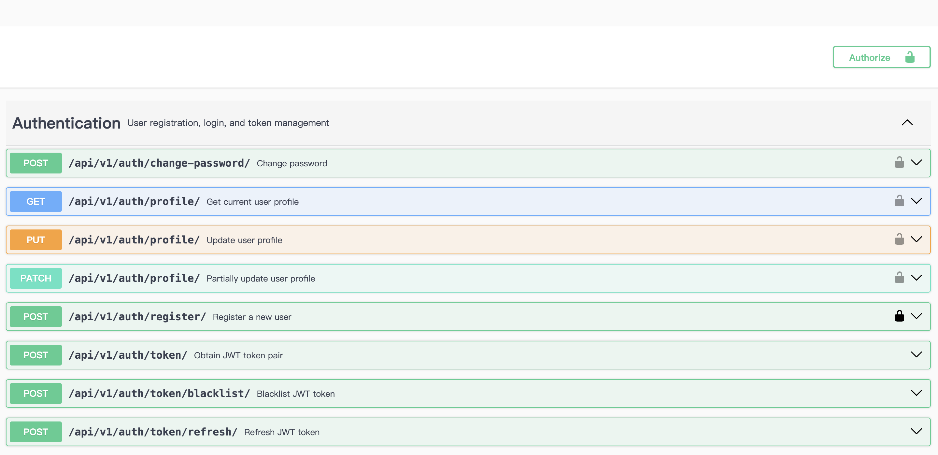
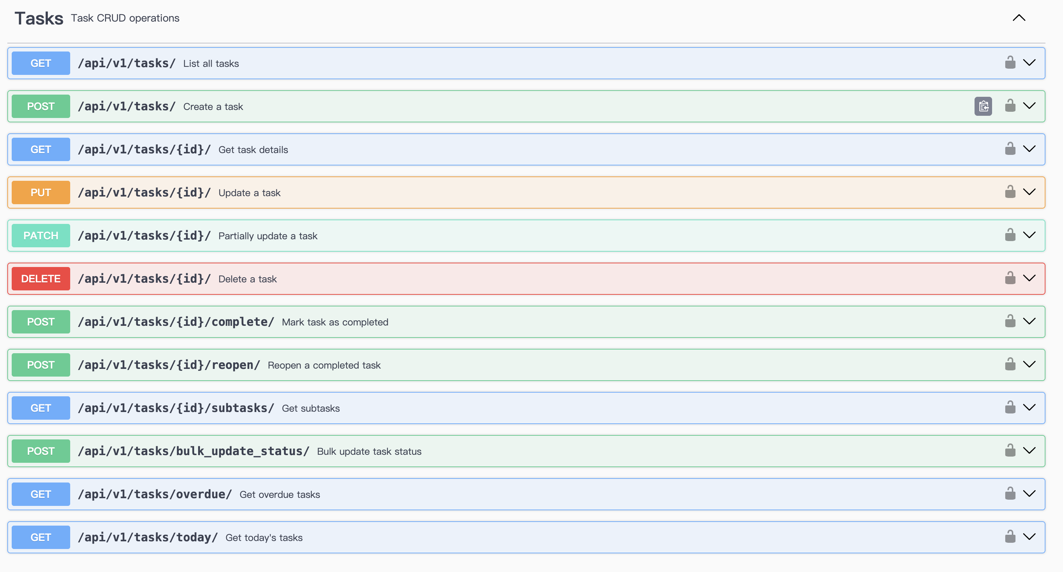
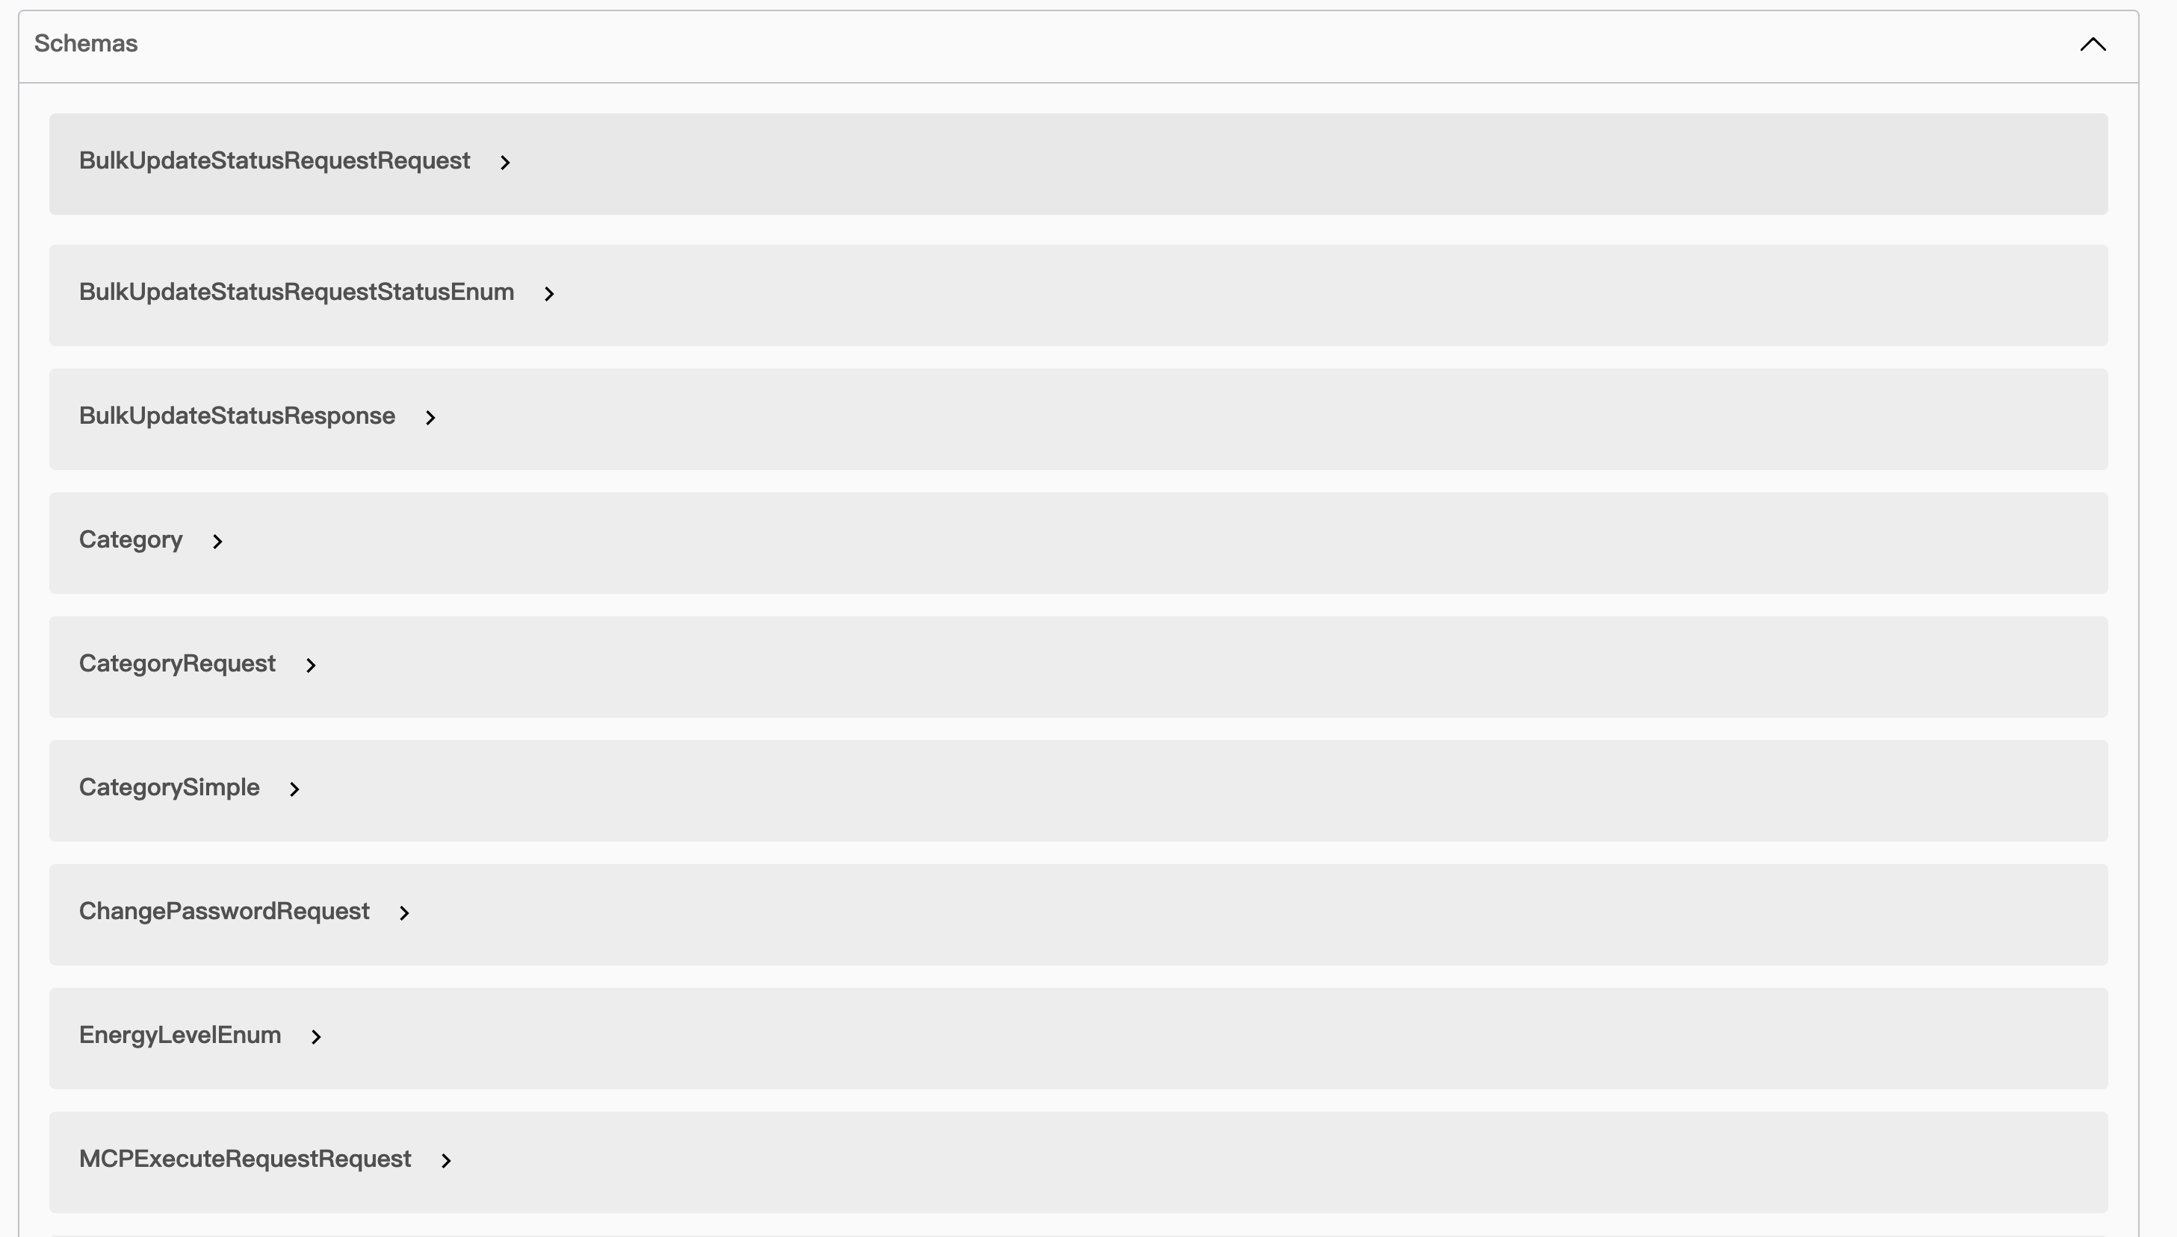
API Documentation Overview
COMP3011 Web Services and Web Data API Documentation
Interactive Documentation:
▶ Swagger UI:
/api/v1/docs/swagger/
▶ ReDoc:
/api/v1/docs/redoc/
▶ OpenAPI Schema:
/api/v1/docs/schema/
Documentation Files:
▶ openapi.yaml
▶
api documentation.pdf

Slide 6
API Endpoints by Category
COMP3011 Web Services and Web Data API Endpoints
Category | Count | Key Endpoints
Authentication | 6 | register, token, refresh, profile
Tasks | 11 | CRUD, complete, reopen, today,
 |  | overdue
Categories | 7 | CRUD, statistics
Tags | 6 | CRUD
Analytics | 3 | dashboard, tasks, trends
MCP | 3 | capabilities, tools, execute
Total | 36
HTTP Methods: GET, POST, PUT, PATCH, DELETE
API Versioning: /api/v1/ prefix for backward compatibility

Slide 7
Technical Report Highlights
COMP3011 Web Services and Web Data Technical Highlights
Architecture:
▶ Layered design
▶ Views → Serializers →
Models
▶ Clear separation of concerns
Database Design:
▶ UUID primary keys
▶ Optimized indexes
▶ Self-referential FK (subtasks)
Security:
▶ JWT authentication (60min access)
▶ Token refresh & blacklisting
▶ Rate limiting (100/1000 per hour)
▶ User data isolation
Testing:
▶ pytest-django framework
▶ Reusable fixtures
▶ Integration testing
▶ Authentication flow tests

Slide 8
AI Integration & MCP
COMP3011 Web Services and Web Data AI Integration & MCP
Model Context Protocol (MCP):
▶ Emerging standard for AI agent integration
▶ Enables AI assistants to discover and execute API tools
MCP Endpoints:
Endpoint Description
/mcp/capabilities/
/mcp/tools/
/mcp/execute/
Public system capability description Returns available tools with JSON Schema Execute specified tool with arguments
Available Tools:
▶ create task
▶ list tasks
▶ complete task
▶ get today tasks
▶ get overdue tasks
▶ suggest next task
▶ get productivity summary
▶ create category

Slide 9
All Deliverables
COMP3011 Web Services and Web Data Deliverables
Deliverable
Location
Code Repository API Documentation OpenAPI Schema Technical Report Presentation
github.com/Ejkenway/COMP3011-CW1 api documentation.pdf openapi.yaml
technical report.pdf presentation.pdf
Repository Structure:
▶ api/ – API views, serializers, URLs
▶ core/ – Models and admin configuration
▶ tests/ – Test suite
▶ todo api/ – Django project settings

Slide 10
COMP3011 Web Services and Web Data END & Q&A
END & Q&A
Thanks
Questions?

