Slide 1
STORYBOARD
Blueprint for the Dashboard

Slide 2
CONTENTS
01
Technology Utilized
Tableau
02
Visualizations Utilized
Map, Scatter Plot and Dual-Line Chart
03
Visualizations Explained
Map and Scatter Plot: visualizes a country’s total medals won by its total GDP, in a participating Games year
Dual-Line Chart: visualizes trends by season (summer vs. winter), across all years and highlights the total number of athletes, events and disciplines in each respective Games year
04
Interactive Elements
Universal filters across multiple charts that are adjusted upon selecting a specific Olympic year or range of years
Click-to-filter to utilize the dimensions of the dashboard’s charts and graphs, as temporary filter values
Adjustable zoom feature on the map chart
05
Additional Visualizations to Explore
Analyze GDP per Capita instead of total GDP
Medal Distribution by Country
Filter by summer vs. winter Games

Slide 3
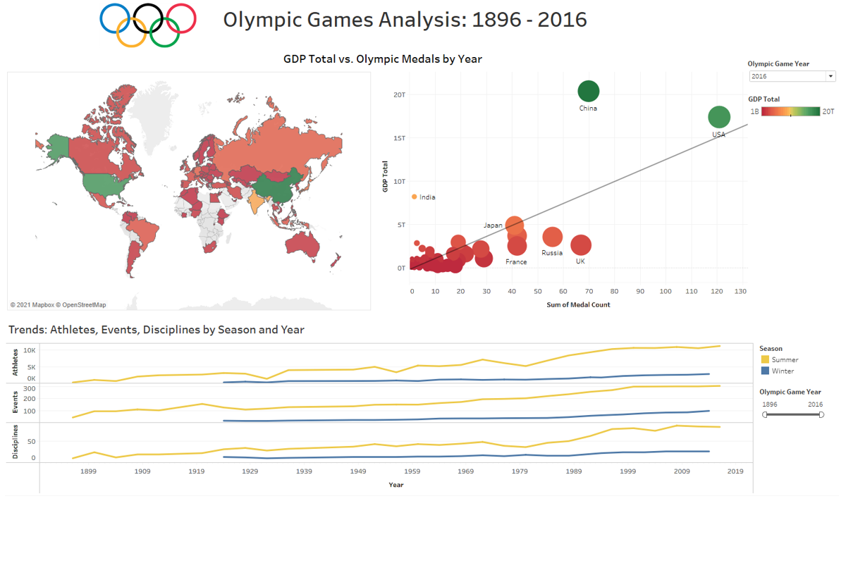
Tableau Dashboard

