Slide 1
Machine Labor – Angrist & Frandsen JoLE 2022
Minsuk Kim

Slide 2
Initial ML methodology introduction
Much better at predicting values
“Human Decision and Predictions ” by Kleinberg, Lakkaraju, Leskovec, Ludwig, and Mullainathan (QJE 2018)
Trains an algorithm to predict whether pre-trial release should be granted
Judges make systematic prediction errors/heuristical decision making/racial bias
Reduces incarceration cost/crime cost trade off
Key idea: In an age of data, we need to take advantage of it by selecting the right ones

Slide 3

Why use ML in Economics?
Regression of Y on X provies the best linear approximation of the CEF
The key difference in ML agenda is it tries to make the best prediction model, not causal inference
Although, a classic regression model such as the one below will showcase causal effects, R² values of regression analysis is pathetic in predicting the future earning. i.e in ML, predicting Yi is more important than the coefficient.

Slide 4
Why use ML in Economics?
Ultimately, we want conditional random assignment
Want to prevent data mining and overfitting
Possible with lots of controls or instruments
In 2SLS, heavily overidentified models are biased
Let’s pick which are the best controls to implement in the regression
Post-double-lasso estimator (PDS) – Belloni,Chernozhukov, Hansen
1. Used for variable selection in OLS (sample size protection from controls)
2. Used for instrument selection to get a good first stage (many instruments)

Slide 5


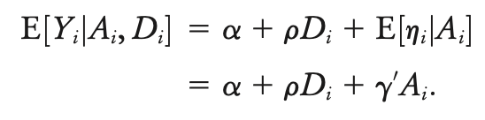
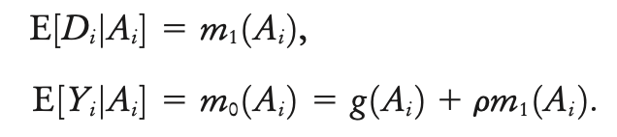

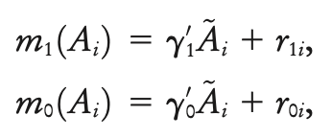

Post Double Lasso Framework
PDS Approximation
Simple causal linear model
Sparsity Condition : a few control variables should explain the outcome variable
Condition I: s²log²(max{p,n})/n converges to 0
Condtion II: approximation error no more than C√s/n
“Double” because it uses both post-lasso-chosen controls and propensity score to treatment
Notes:
C

Slide 6
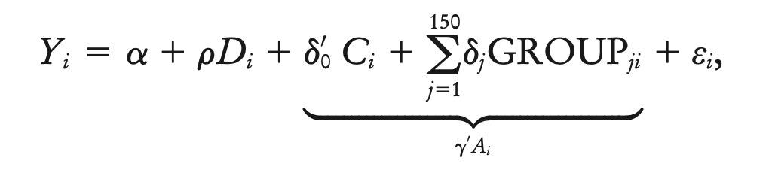
Example 1 – Private vs Public College education
Dale and Kreuger (QJE 2002): “Estimating the payoff to attending a more selective college”
Setting: Data with what colleges a student applied to, their SAT score, parental income, what colleges rejected, admitted.
Try to see if going to a private university is worth the additional fees it entails through additional income in the future
Main identification:
Notes:
24 151 58

Slide 7
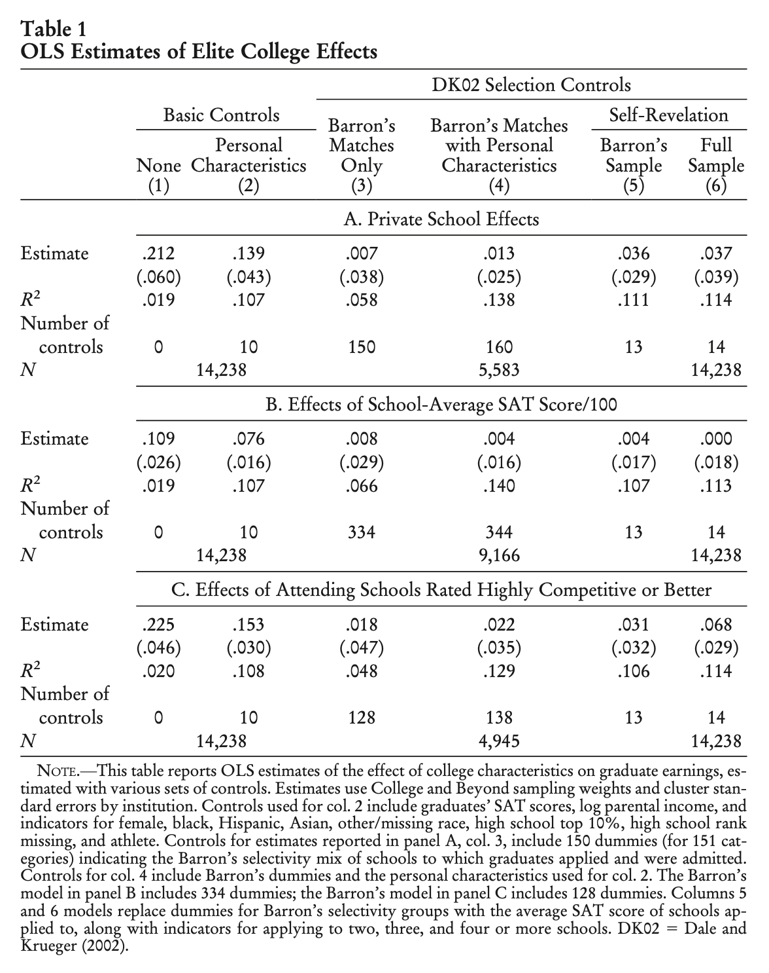
Example 1 – Private vs Public College education

Slide 8
ML Advantages
Baron’s selectivity group matching leads to sample loss due to selectivity groups not being marginal – many groups are simply all 0s or 1s = no variation to compare “apples to apples”
Self-revelation model is limited in taking into account other factors such as geography and finances (hence doesn’t perform very well for binary interest of private schools)

Slide 9
Different Lasso methods
Method | How It Works | Number of Controls Selected | Advantages | Disadvantages
Plug-in Penalty | Uses a formula from Belloni et al. (2014) to calculate an optimal lambda based on theoretical sparsity conditions. | 18, 24, 17 | Less overfitting | May underfit if lambda is too large
Cross-Validation (CV) | Uses 10-fold CV to select lambda by minimizing out-of-sample prediction error. | 100, 151, 185 | Less risk of omitting relevant controls | Can select too many variables
CV-Lasso (Cvlasso in Stata 15) | Similar to standard CV, but with an alternative tuning strategy (implemented in Lassopack). | 112, 58, 106 | May better capture nonlinear relationships | Increased variance in final estimates

Slide 10
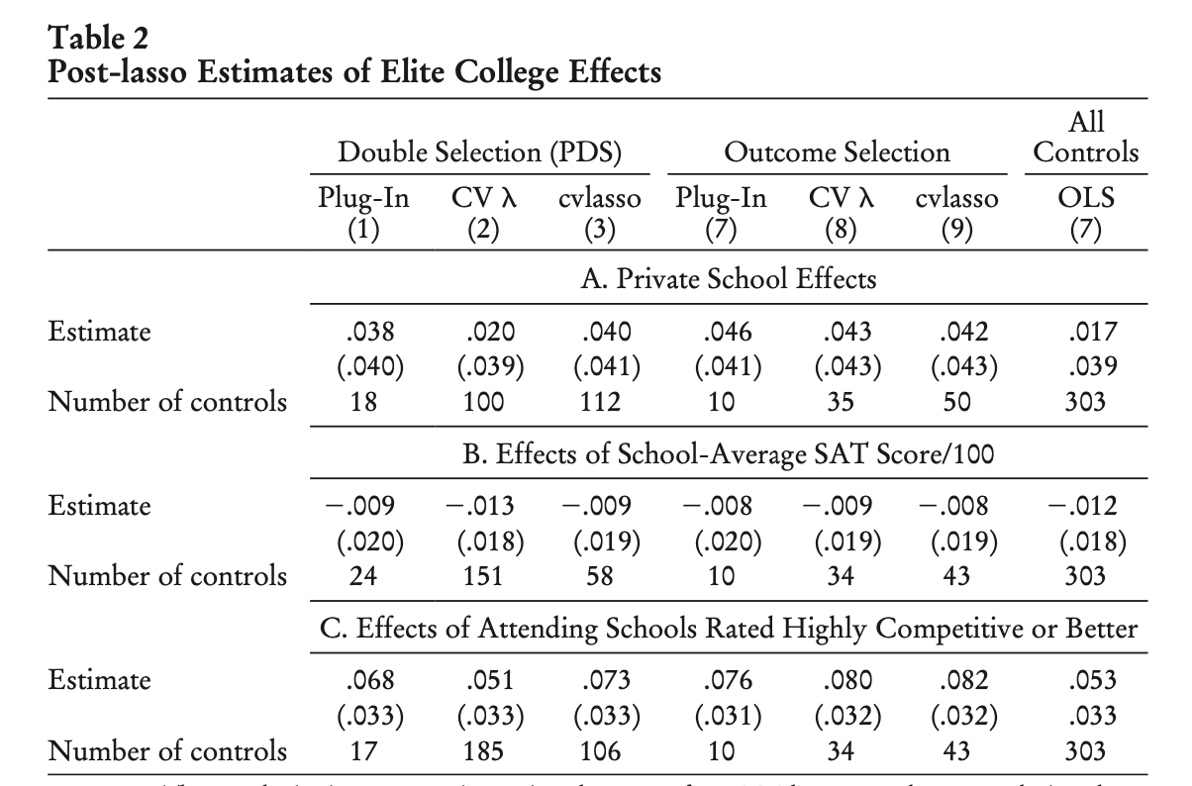
Example 1 – Private vs Public College education
Notes:
Reduced form. Outcome selection. Although un biased in practice In practice, the reduced form is unknown, and the post-lasso approximation to it is inherently imperfect.

Slide 11
“It is worth emphasizing that a causal interpretation of the ML estimates in table 2 turns on a maintained conditional independence assumption. ML methods do not create quasi-experimental variation. Rather, ML uses data to pick from among a large set of modeling options founded on a common identifying assumption. This facilitates estimation in high-dimensional control scenarios and may increase precision (although that is not the finding here). We have also noted considerable sensitivity to implementation details, specifically to software choice and lasso penalty determination.”

Slide 12
Applying it on Angrist & Kreuger
Angirst & Kreuger: Does compulsory schoolattendance affect schooling and earnings? (QJE 1991)
Use quarter of birth dummies as instruments to estimate the economic returns to schooling.
Children who start school at an older age attain the minimum school dropout age after having completed less schooling
QOB -> highest education attained -> log weekly wage
In 2-SLS using QOB only, F-statistic 36 = no weak instruments
QOB, YOB, POB first stage has 1530 instruments -> finite sample bias . F statistic falls below 2. Bias even larger

Slide 13
Applying it on Angrist & Kreuger
Simulated to build a new data set through bootstrapping and the conditional expectation function derived from 180 instruments 2 sls regression
This gives a OVB by design, and how each estimation method performs in regards to bias and deviation.
Simulated 999 times to provide how well it performs on average.

Slide 14
Alternatives | Method | Strengths | Weaknesses
LIML (Limited infomration ML) | Shrinks 2SLS estimator based on instrument strength | Works well with many weak instruments | Higher Variance
SSIV (Split sample) | Splits the sample for first and second stage to avoid first-stage overfitting | Less bias than 2SLS | Reduces eefficiency due to sample split
JIVE (Jackknife) | Uses a leave-one-out first-stage estimate (each observation’s fitted value is computed using all other observations) | Reduces small-sample bias without splitting the sample | Can still be biased if instruments are very weak

Slide 15
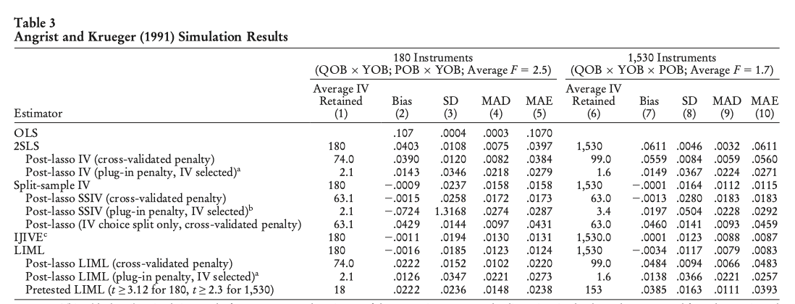
Maybe we can try it on IV
Notes:
the median absolute deviation (MAD, de ned
as the median of the absolute value of the difference between simulated esti-
mates and the median simulation estimate) of the 2SLS estimates is somewhat
below the corresponding standard deviation. The Monte Carlo median ab-
solute error (MAE, reported in columns 5 and 10 and de ned as the median
of the absolute value of the difference between simulated estimates and 0.1)

Slide 16
3. Random Forest
Context – Angrist & Evans: Parental labour supply
First stage: same sex child -> one more child
Additional child -> changes in parental labour supply
Just-identified model with controls
Each leaf of the random forest represents the final decision node
E.g 800 leaves do not represent 800 control variables but 800 unique partitions of the data

Slide 17
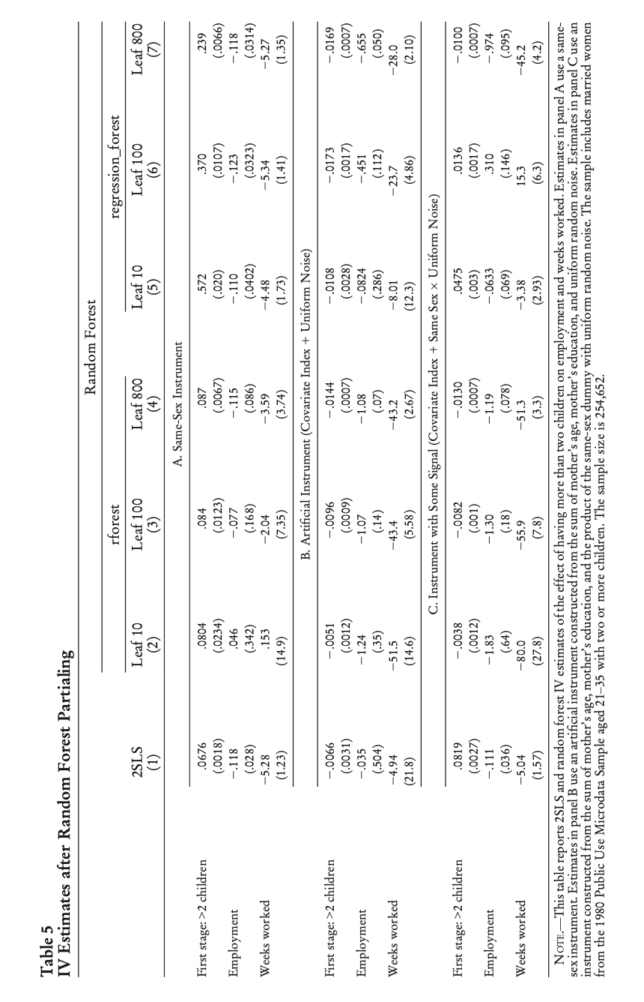
Testing to see if it is any good
Notes:
일부러 exclusion restriction 이 안돼는 어떤 변수를 만들었는데 그것도 괜찮다고 해버렸다.

Slide 18
Randomly excluded
Although less efficient than 2-SLS models, it seems to point in the right direction
However, it is important to note that random forest is not a regression – residuals may be correlated with the covariates
Artificial instrument constructed to test: age of mother + education of mother

Slide 19
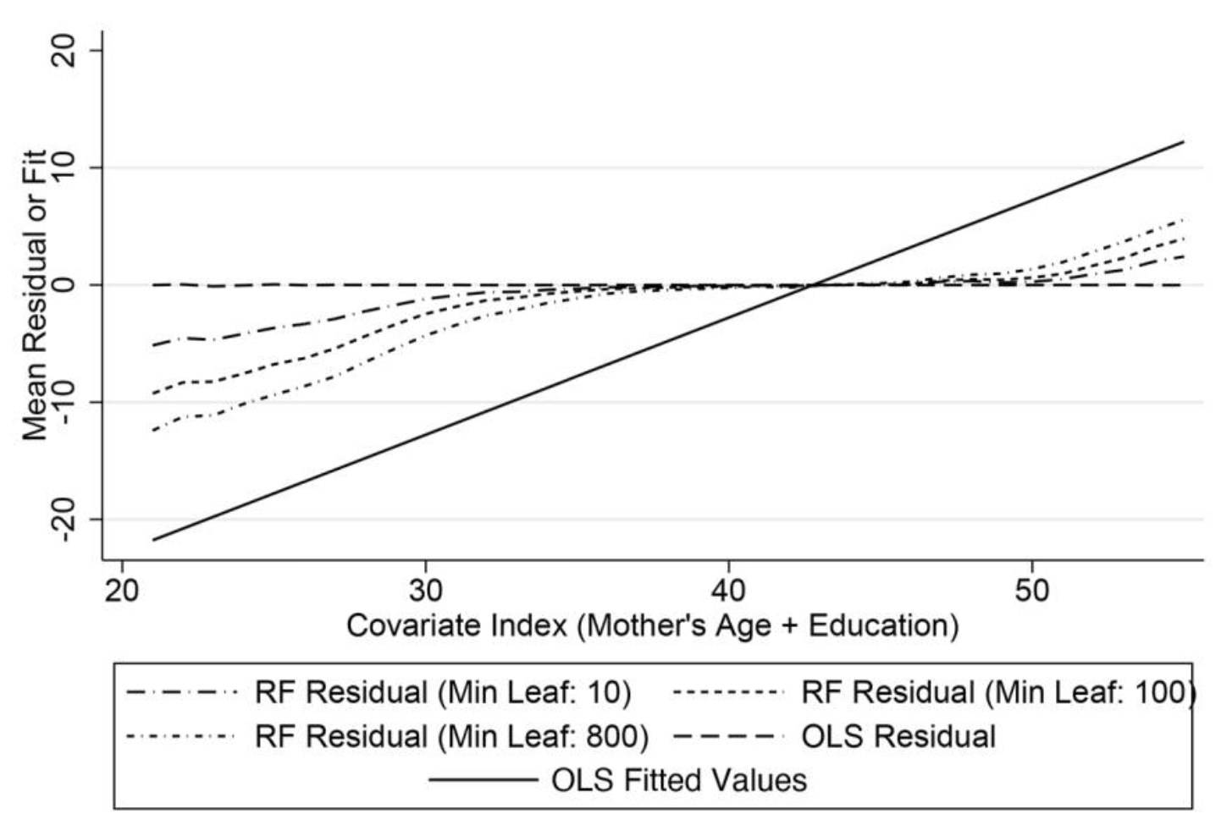

Slide 20
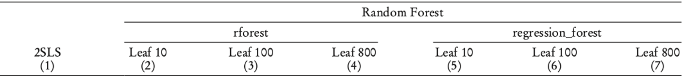
Testing to see if it is any good

Slide 21
Why did ML yield worse results?
Causality has nothing to do with goodness of fit
Although in applications such as PDS, it is less efficient, non-linear ML such as random forest can lead to misleading outcomes
Perhaps due to data being not high-dimension “enough”
Labour data typically does not have number of controls > number of observations

