Slide 1
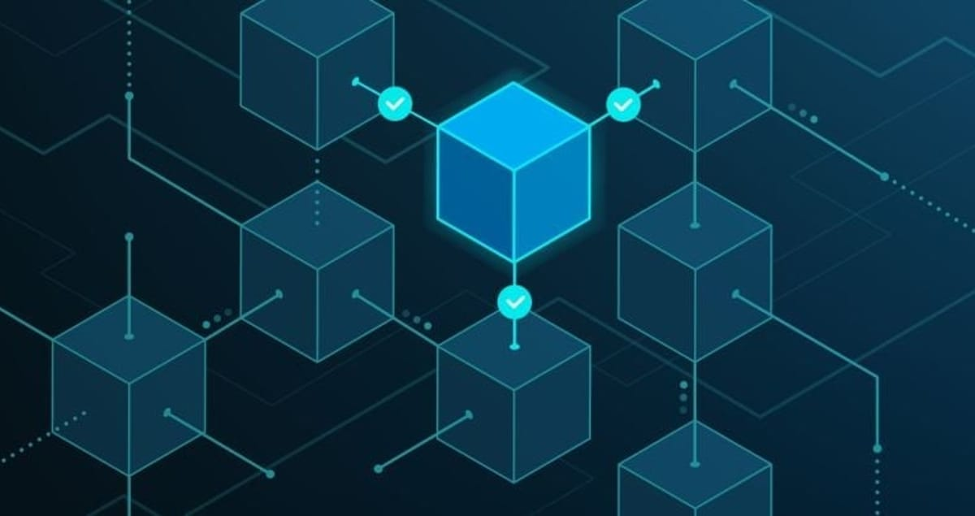
Blockchain Technology
Easton Kite
April 21st, 2025

Slide 2
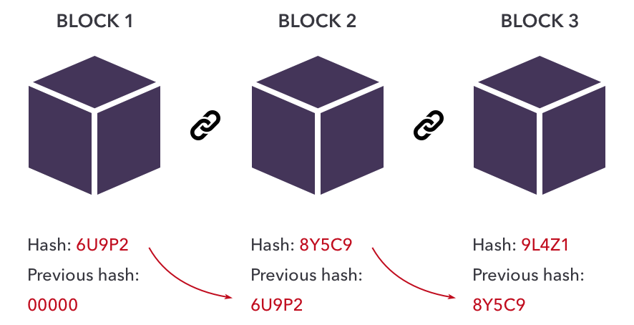
What is Blockchain?
A digital ledger of records (blocks) linked together
Decentralized and tamper-resistant
Verified using cryptographic methods
First used in Bitcoin, now much more

Slide 3

How Blockchain Supports Cybersecurity
Ensures data integrity and authenticity
Makes it hard to alter information
Prevents identity theft and fraud
Enables trust without a central authority

Slide 4



Real World Applications
Voting systems
Secure communication
Intellectual property protection
Medical and financial recordkeeping

Slide 5

Challenges and Ethics
Scalability and speed issues
Energy consumption
Especially with mining
Regulation and misuse
Criminal activity
Ethical concerns in data storage

Slide 6
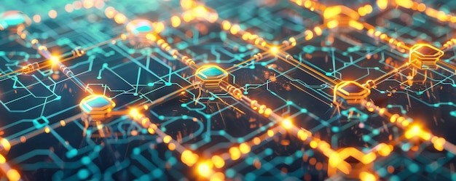
Conclusion
Blockchain boosts cybersecurity through decentralization
Strong potential in many industries
Challenges must be addressed for broader use
A key player in the future of secure computing

Slide 7
References
[1] S. Nakamoto, “Bitcoin: A Peer-to-Peer Electronic Cash System,” 2008. [Online]. Available: https://bitcoin.org/bitcoin.pdf. Accessed: Apr. 20, 2025.
[2] M. Crosby, P. Pattanayak, S. Verma, and V. Kalyanaraman, “Blockchain technology: Beyond bitcoin,” Applied Innovation Review, vol. 2, pp. 6–10, Jun. 2016.
[3] Z. Zheng, S. Xie, H. Dai, X. Chen, and H. Wang, “An overview of blockchain technology: Architecture, consensus, and future trends,” in Proc. IEEE Int. Congr. Big Data, 2017, pp. 557–564.
[4] “What Is Blockchain Technology?,” BuiltIn. [Online]. Available: https://builtin.com/blockchain. Accessed: Apr. 20, 2025.
[5] “Blockchain Cybersecurity Applications,” Colocation America, Jun. 16, 2020. [Online]. Available: https://www.colocationamerica.com/blog/blockchain-cybersecurity. Accessed: Apr. 20, 2025.
[6] Dreamstime, “Ballot Box Symbol Cartoon Illustration.” [Online]. Available: https://thumbs.dreamstime.com/b/ballot-box-symbol-cartoon-illustration-53635350.jpg. Accessed: Apr. 20, 2025.
[7] iStock, “Medical White Cross.” [Online]. Available: https://media.istockphoto.com/id/922551734/vector/medical-white-cross.jpg. Accessed: Apr. 20, 2025.
[8] Vecteezy, “Illustration of Shield Vector.” [Online]. Available: https://static.vecteezy.com/system/resources/previews/051/829/448/non_2x/illustration-of-shield-vector.jpg. Accessed: Apr. 20, 2025.
[9] Shutterstock, “Blockchain Warning Icon Flat Style.” [Online]. Available: https://www.shutterstock.com/image-vector/blockchain-warning-icon-flat-style-260nw-1879326169.jpg. Accessed: Apr. 20, 2025.
[10] Freepik, “Abstract Representation of Blockchain Technology.” [Online]. Available: https://img.freepik.com/premium-photo/abstract-representation-blockchain-technology-with-interconnected-blocks-glowing-pathways_220770-43557.jpg. Accessed: Apr. 20, 2025.
[11] Webflow Assets, “Blockchain Network Nodes Graphic.” [Online]. Available: https://cdn.prod.website-files.com/5d2dd7e1b4a76d8b803ac1aa/5e81c66dd4cabdcc1674a08d_0nt8_YaCOJ_ED51A163rrtjq4mA4Qp1MsIXdDUR4iUAVBYYM5thrRmXCJsZHNa95-yQ3poZep9S8hkUffFkdqbIt9EXmk0bUbLfV0TJWOTH2dwUp6sSsCtnPx8esAE_DROgkKAAT.png. Accessed: Apr. 20, 2025.

