Slide 1

DESIGN OF SMART CITY | BCSE316L
LumiPath
Adaptive Pedestrian-Safety Streetlight System
Team Members
Rohan Mishra
Ekant Aman
Anurag Pareek
23BCT0130
23BCT0180
23BCT0173

Slide 2



The Problem with Conventional Streetlights
Wasted energy
Lights burn at full power all night, even when no one is on the road.
Pedestrian risk
Crossings are not lit up at the moment someone actually needs to cross.
No quick alert
A person in trouble has no simple way to raise an alarm on the spot.

Slide 3



Our Solution: Light Only When Needed
THE CORE IDEA
Night + Motion
Day / night sensing
Pedestrian detection
LDR with a stable threshold gap
Two IR sensors at the crossing
LEDs switch ON only when it is dark AND a pedestrian is detected, and switch OFF instantly when the person leaves.
Distance and speed
Manual SOS alarm
Ultrasonic sensor measurements
Push button toggles the buzzer

Slide 4


Hardware Components and Pin Map
Arduino UNO
LDR sensor
2 x IR sensors
Main controller
Pin A0
Pins 5 and 6
Runs all logic
Ambient light level
Detect pedestrians
Ultrasonic
Green, Yellow, Red LEDs
Buzzer + SOS button
Trig 9, Echo 10
Pins 13, 12, 4
Pins 8 and 7
Distance and speed
Streetlight output
Emergency alarm

Slide 5

System Architecture
INPUTS
OUTPUTS
LDR light sensor
Green LED
IR sensor 1
Yellow LED
IR sensor 2
Arduino UNO
Red LED
Ultrasonic sensor
Reads sensors, applies day/night and motion logic, drives outputs
Buzzer (SOS)
SOS push button
Serial Monitor

Slide 6
Stable Day / Night Detection
A wide gap between two thresholds stops the system from flickering between day and night.
850
900
DAY MODE (below 850)
NIGHT
0
1023
Above 900
Below 850
850 to 900
Switch to Night mode
Switch back to Day mode
Keep the previous state

Slide 7
LED Control Logic
Read LDR
Read IR 1 + IR 2
Motion = IR1 or IR2 is LOW
Night and motion?
Mode | Motion | LED result
Day | Yes | OFF
Day | No | OFF
Night | No | OFF
Night | Yes | ON (all three)
LDR is re-checked only when no motion is active, so the LEDs' own glow cannot fake a daytime reading.

Slide 8
SOS Alarm and Speed Measurement
Toggle SOS Buzzer
Ultrasonic Speed
Press once: buzzer ON
Press again: buzzer OFF
Works independently of day/night and motion
Internal pull-up on pin 7, 200 ms debounce
d = duration x 0.034 / 2 (cm)
v = |d2 - d1| / dt (cm/s)
Distance and speed are printed to the Serial Monitor every loop.

Slide 9
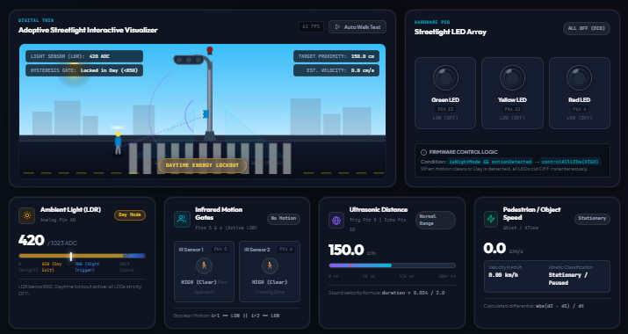
Digital Twin Dashboard
Live visual of the streetlight, crossing and pedestrian
Real-time LDR, IR, distance and speed cards
LED array shows the exact firmware output
Can connect to a real Arduino or run in simulator mode
Screenshot of the LumiPath web dashboard (daytime standby state)

Slide 10
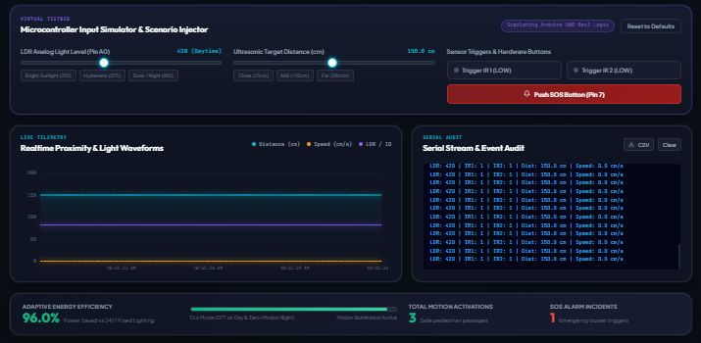
Virtual Testbed and Telemetry
Sliders inject light level and object distance
Buttons trigger IR sensors and SOS
Live waveform graph of distance, speed and LDR
Serial log can be exported as CSV

Slide 11


Results and Benefits
96%
3
200 ms
energy saved vs 24/7 lighting (dashboard estimate)
input types: light, motion, distance
control loop delay
Lower power use and carbon footprint
Better visibility for pedestrians at night
Quick manual alarm in emergencies
Energy figure comes from the simulator dashboard, not a field measurement.

Slide 12


Smart City Fit and Future Scope
Smart city relevance
Future scope
Smart, energy-efficient public lighting
Safer streets and road crossings
Supports SDG 7 (clean energy) and SDG 11 (sustainable cities)
PWM dimming instead of full ON/OFF
IoT cloud monitoring (ESP32 / MQTT)
Solar-powered streetlight units
Vehicle detection and speed warnings

Slide 13
Thank You
LumiPath: Adaptive Pedestrian-Safety Streetlight System
Rohan Mishra | Ekant Aman | Anurag Pareek

