Slide 1
StrikeX BY: Asif Meghani, Elaine Kellerman and Jaqueline McGinley

Slide 2
About Strike X
We create a foreign exchange token (STRX) that locks in the value at the time of transaction.

Slide 3
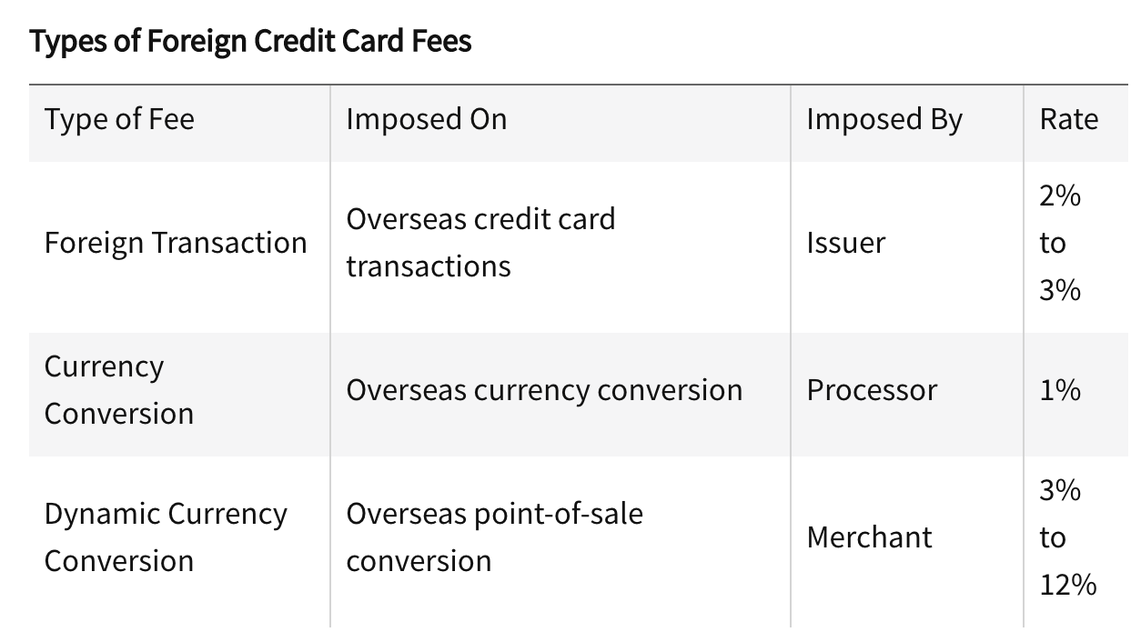
Behind the Idea of StrikeX Token
To avoid exchange rates frustrations like fluctuating exchange rates and high foreign transaction fees and conversion fees.
Fig Source: https://www.investopedia.com/foreign-transaction-fee-vs-currency-conversion-fee-know-the-difference-4768955

Slide 4
How It Works
The customer buys a StrikeX token that holds the value at the time of transaction.
This token allows the customer to redeem the token without having to worry about the exchange rates in the future.
The customer knows exactly how much the transfer is worth at the time of transaction.

Slide 5
The Process
Step 1: You buy the token
Step 2: You can either hold it, transfer or sell the token.
Step 3: If you change your plans you can request the refund.

Slide 6
REMIX DEMO

Slide 7
The Future of StrikeX
Make API calls for exchange rates
Create a dApp for the contract
Expand currencies

Slide 8
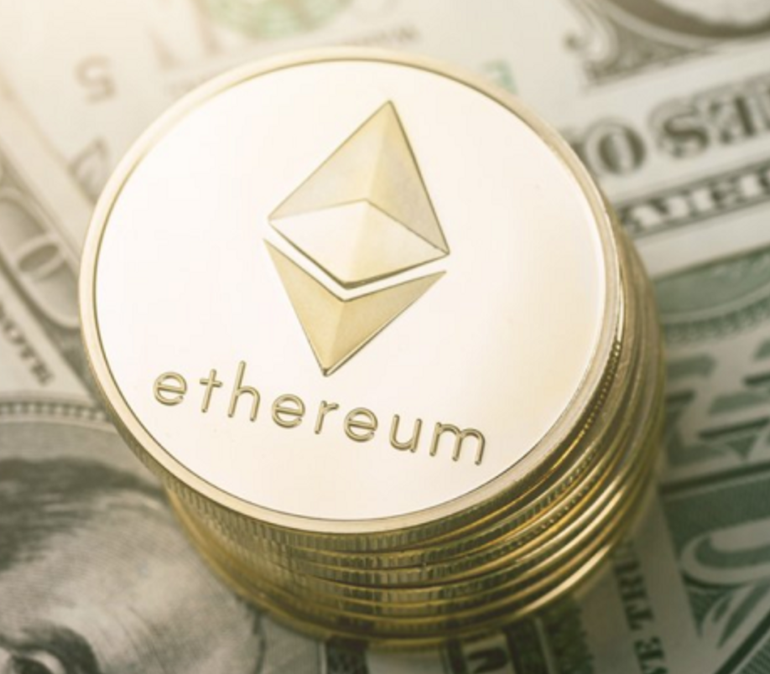
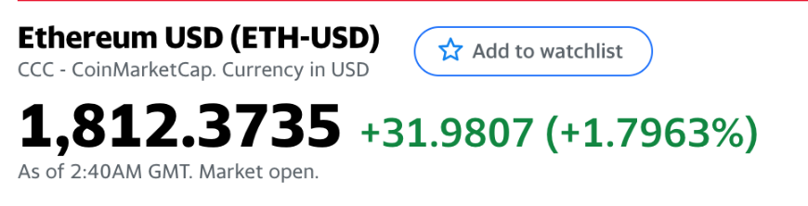
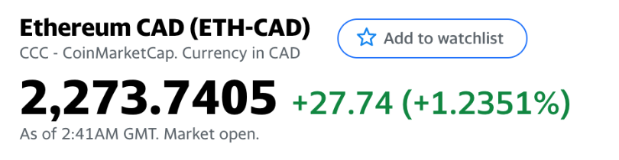
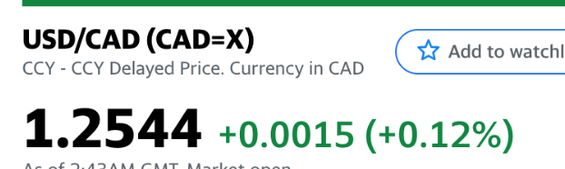
Conversion Process

Slide 9
THANK YOU!

