Slide 1

Cross Over Network
E 232
Section A
Group 4
By Carlos Arce Sanchez,
Eugene Kozlakov,
and Sophia Turci

Slide 2
Table of Contents
Title…………………………………..Slide 1
Table of Contents…………………...Slide 2
Problem Statement………………....Slide 3
Quality Functional Deployment…....Slide 4
Hypothesis…………………………...Slide 5
Butterworth HP Analysis…………....Slide 6
Butterworth LP Analysis…………….Slide 7
Chebyshev HP Analysis……………..Slide 8
Chebyshev LP Analysis……………...Slide 9
Chebyshev-Amplifier Setup………...Slide 10
Butterworth-Amplifier Setup……….Slide 11
Biasing Resistor Load Choices……...Slide 12
Test Results……………………..Slides 13-18
Test Summary Data………………….Slide 19
Final Conclusion……………………..Slide 20

Slide 3
Problem Statement
This Project Entails:
The design and simulation of filter/amplifier circuits that optimize and equalize the performance of a speaker system consisting of a Woofer and Mid-Range.
Crossover frequency: 100-125Hz
Filter Slope: -12dB/octave minimum.
Quality Functional Deployment: Cost not a priority.
Woofer Resistance: 3.35 Ohms.
Mid-Range Resistance: 4 Ohms.

Slide 4
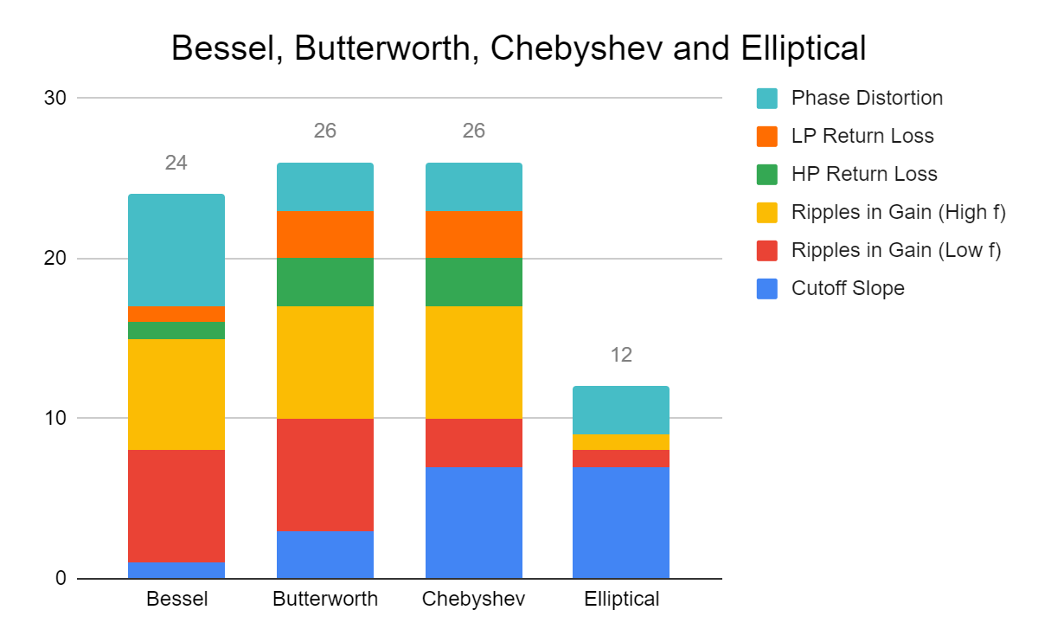
Quality Functional Deployment (QFD)

Slide 5
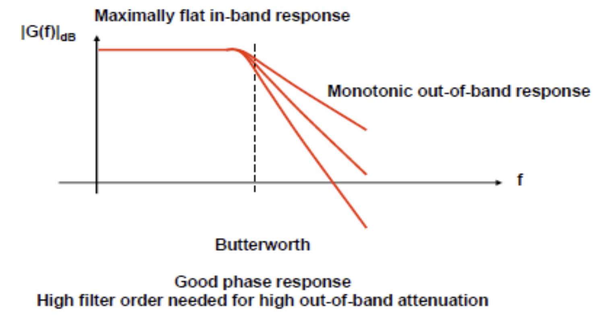
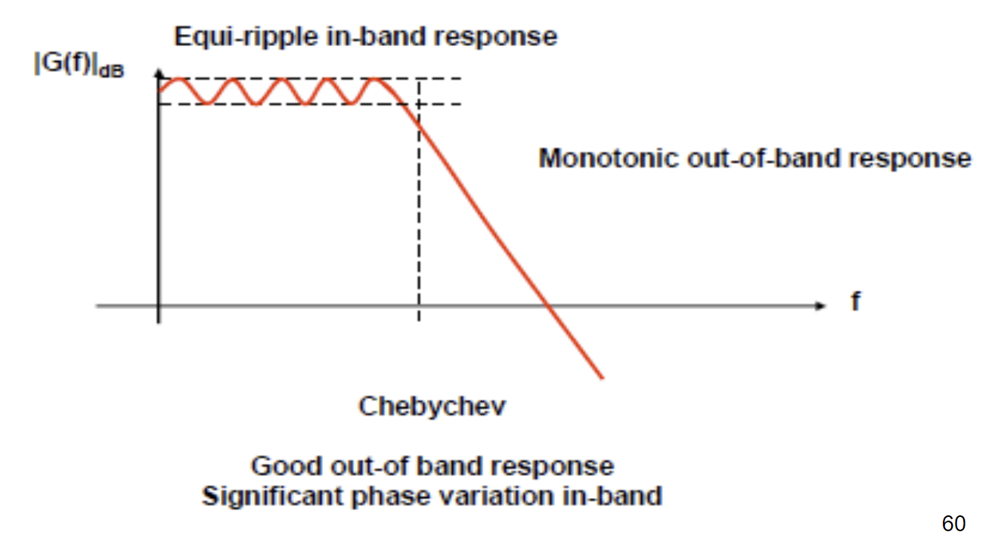
Hypothesis
Based on theory: Butterworth is well rounded to meet design needs
Chebyshev is a strong second contender.
Images Src.: Dr. Kevin Ryan’s Design IV Lecture Slides, Chapter 3, Slides 58 & 60.

Slide 6
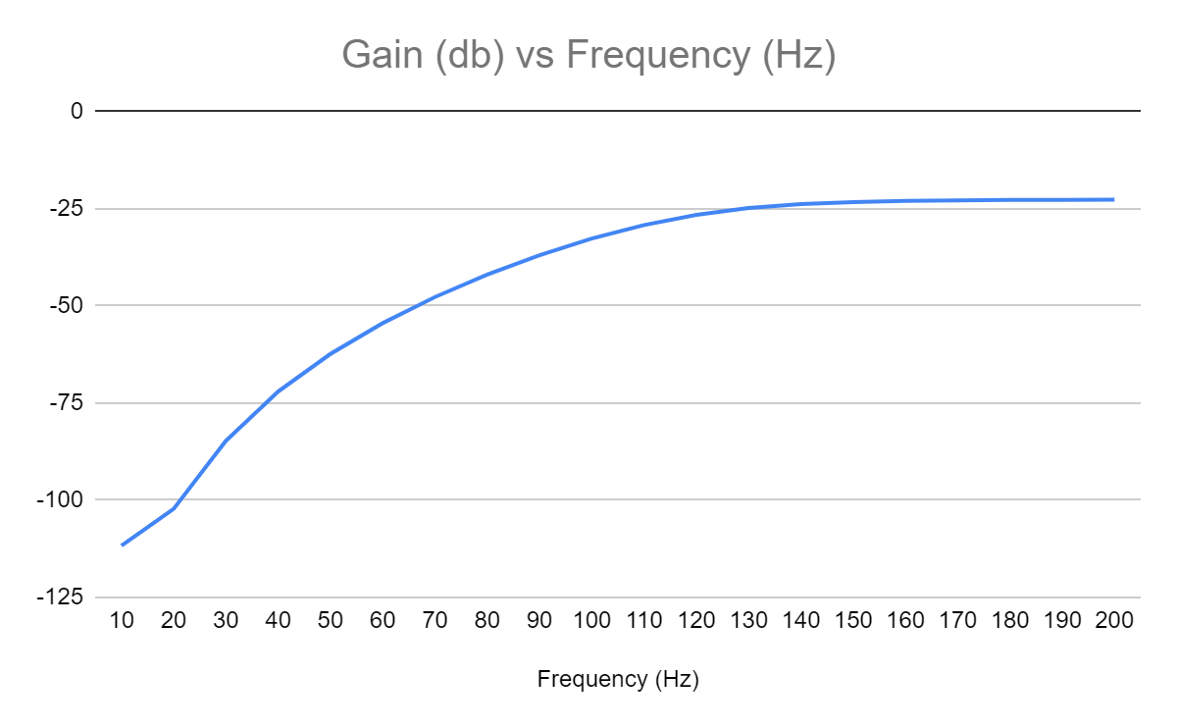
Butterworth Highpass Filter Analysis (5th Order)
The Gain vs. Frequency graph above has a slope of approximately: 10.1 dB/Octave in the stopband.

Slide 7
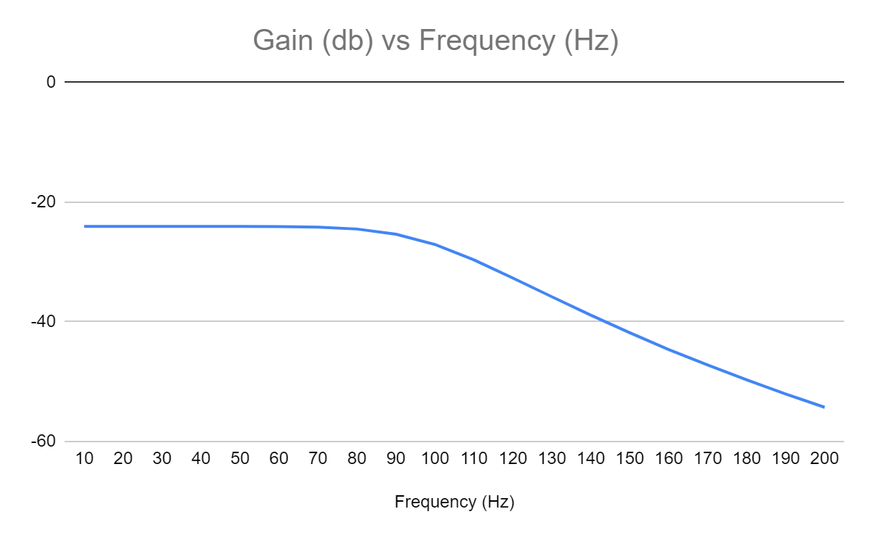
Butterworth Lowpass Filter Analysis (5th Order)
The Gain vs. Frequency graph above has a slope of approximately: -27.2 dB/Octave in the stopband.

Slide 8
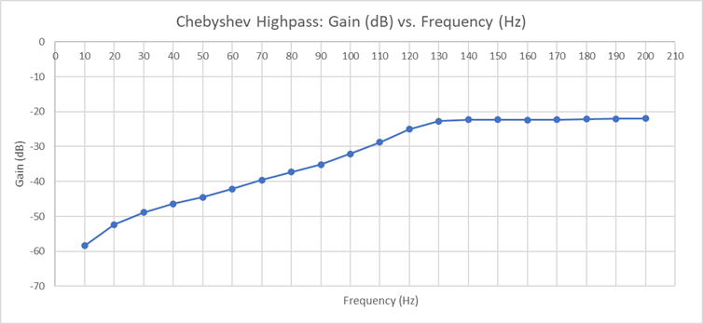
Chebyshev Highpass Filter Analysis (5th Order)
The Gain vs. Frequency graph above has a slope of approximately: 17.93 dB/Octave in the stopband.
Notes:
This slope is representative of the sharp cutoff Chebyshev filters are known for.

Slide 9
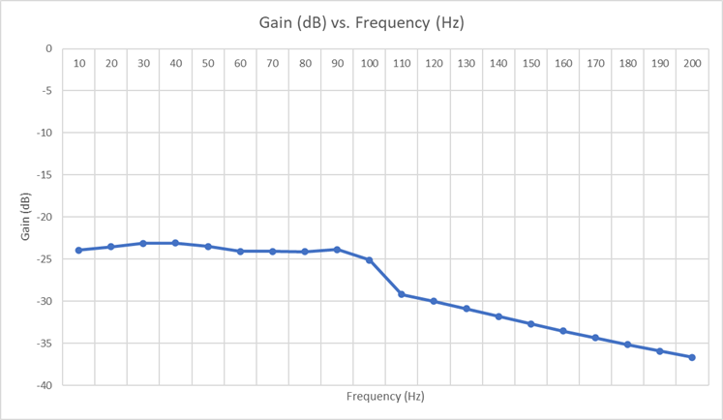
Chebyshev Lowpass Filter Analysis (5th Order)
The Gain vs. Frequency graph above has a slope of approximately: -11.54 dB/Octave in the stopband.
Notes:
This smaller slope in the stopband made us consider using a combinations of filters for the highpass and lowpass, in order to get better efficiency in the stopband and prevent woofer signals from crossing into the mid, and vice versa.

Slide 10
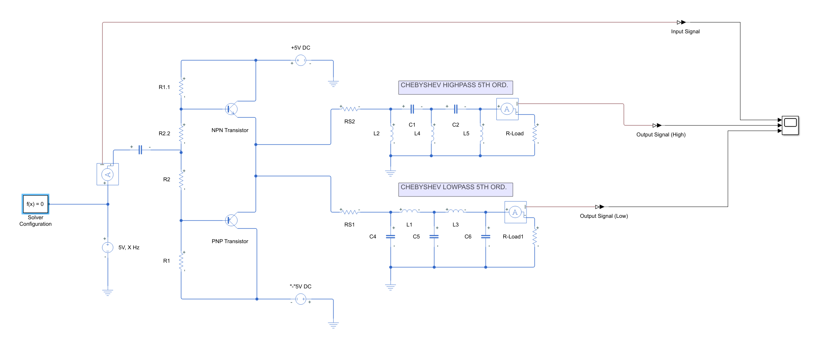
Chebyshev-Amplifier Setup

Slide 11
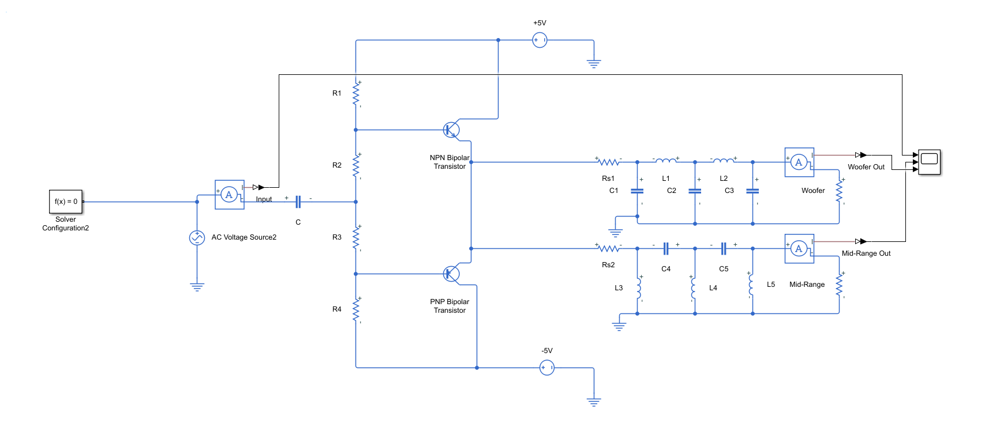
Butterworth-Amplifier Setup

Slide 12
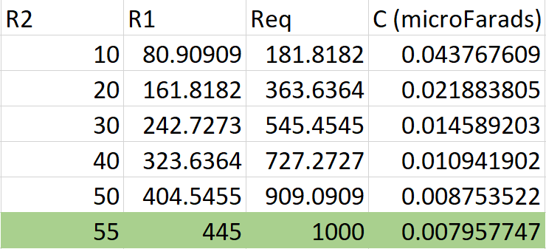
Biasing Resistor Load Choices
Notes:
We chose to work with 55 Ohm R2 and a 445 Ohm R1 because it was the pairing that gave us the best amplification while meeting the 1 kilo-ohm limit exactly.

Slide 13
Test Results

Slide 14
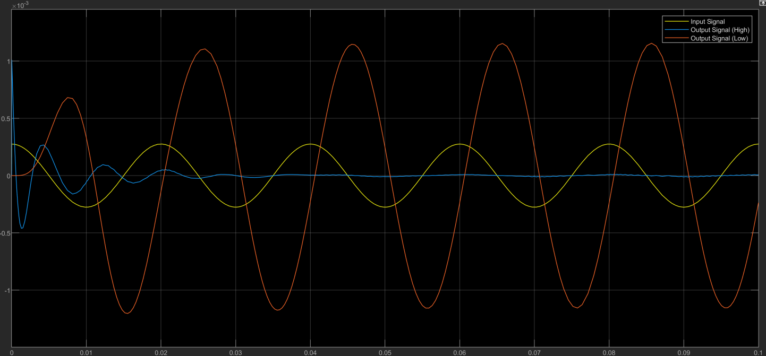
Chebyshev-Amplifier setup, 50 Hz
Notes:
50 Hz

Slide 15
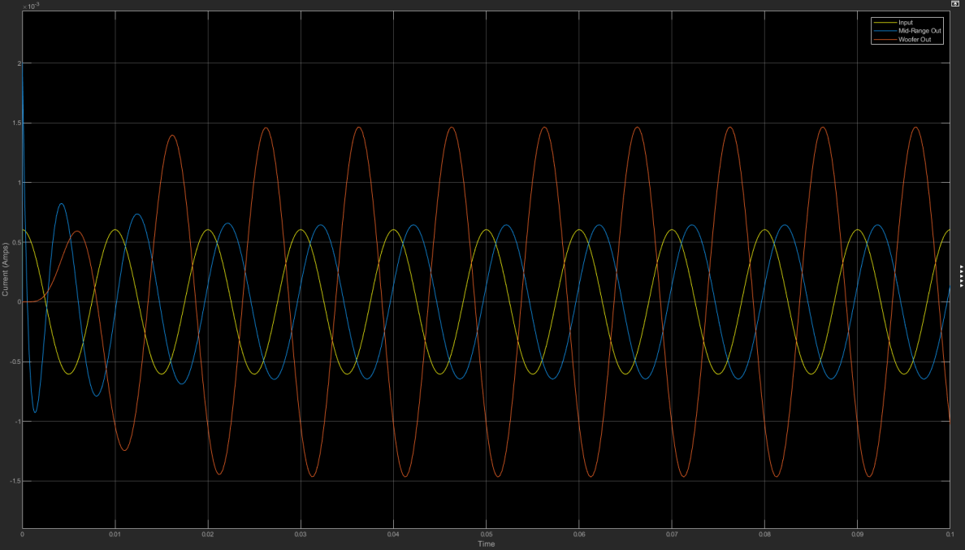
Chebyshev-Amplifier setup, 100 Hz
Notes:
100Hz

Slide 16
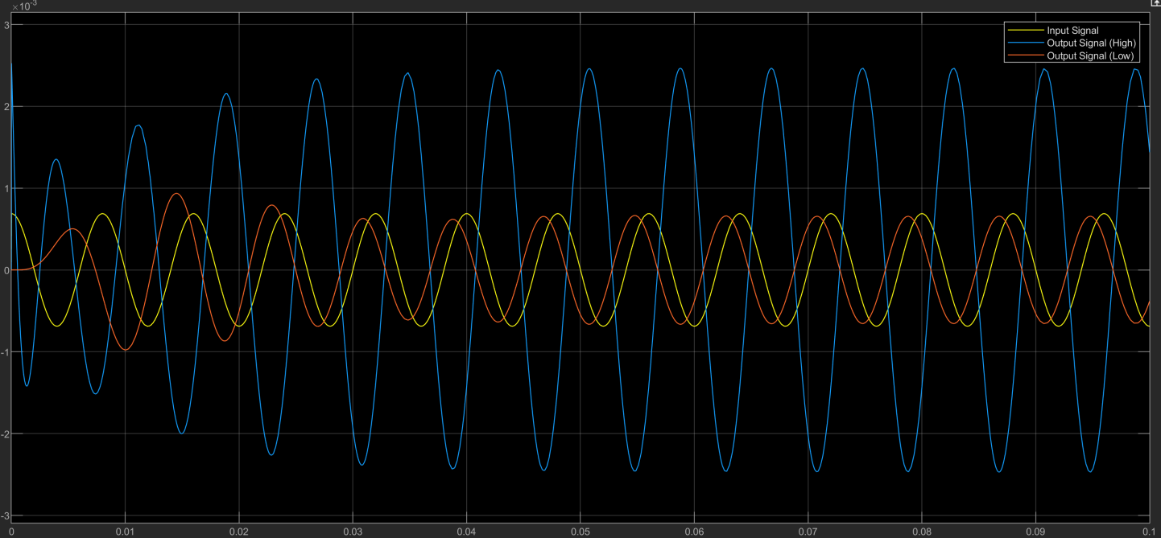
Chebyshev-Amplifier setup, 125 Hz
Notes:
125 Hz

Slide 17
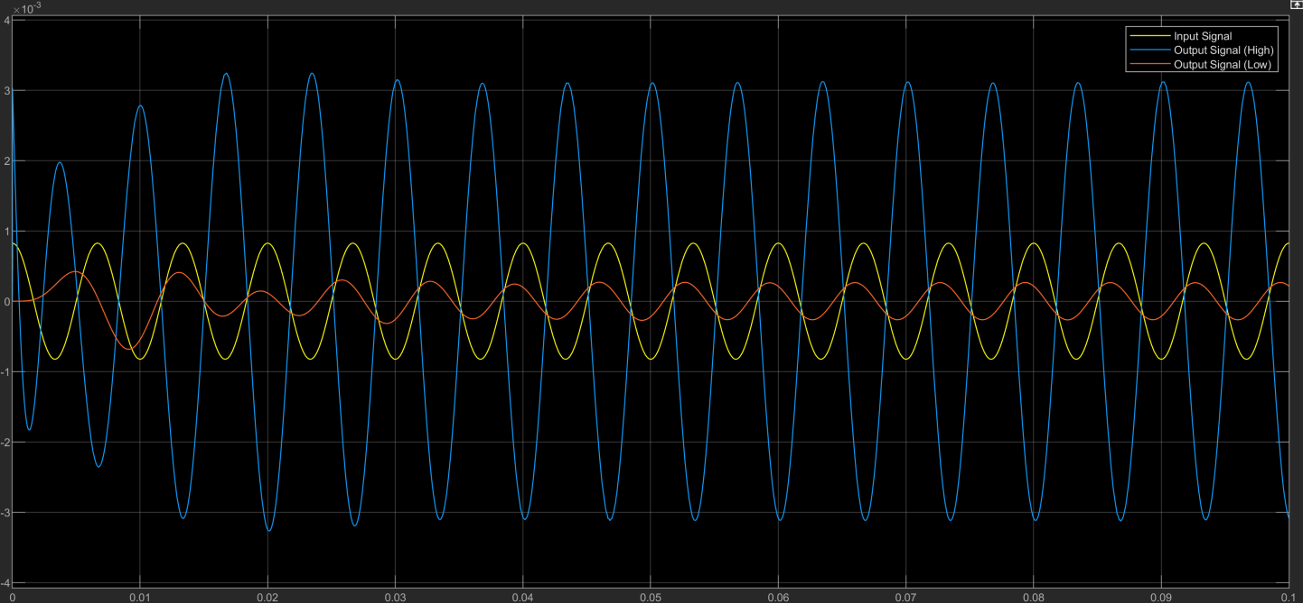
Chebyshev-Amplifier setup, 150 Hz

Slide 18
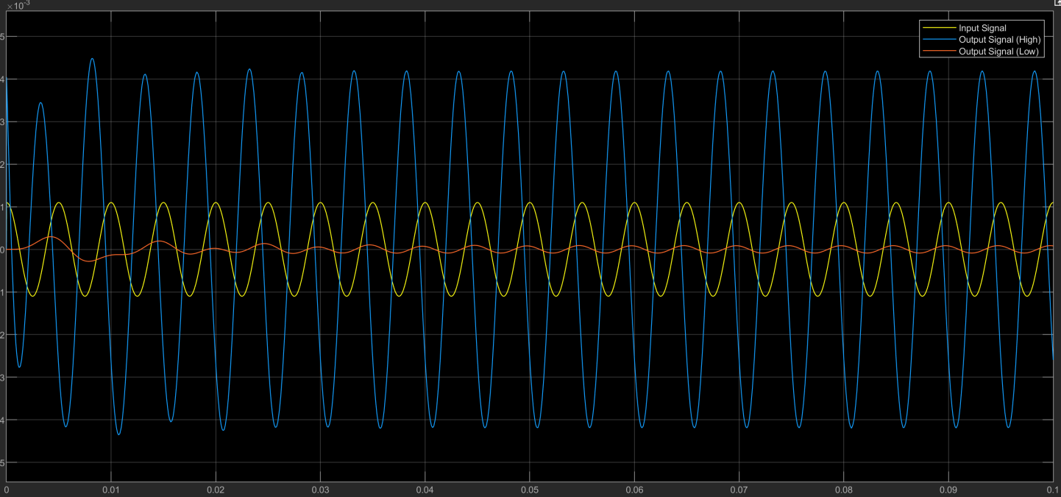
Chebyshev-Amplifier setup, 200 Hz

Slide 19
Final Test Summary Data
Butterworth-Amplifier
High Pass Current Gain (200 Hz):10.937 dB
High Pass Attenuation (200 Hz): -11.626 dB
Low Pass Current Gain (50 Hz): 10.74 dB
Low Pass Attenuation (50 Hz): -30.543 dB
Chebyshev-Amplifier
High Pass Current Gain (200 Hz): 11.609 dB
High Pass Attenuation (200 Hz): -22.237 dB
Low Pass Current Gain (50 Hz): 12.640 dB
Low Pass Attenuation (50 Hz): -29.293 dB

Slide 20
Final Conclusion
As you can see, the Chebyshev system provides overall better Gain, and decent attenuation of unwanted frequencies when compared to the Butterworth.
Thus, the team sides with the Chebyshev crossover network.

Slide 21
Questions?
Comments?

