Slide 1
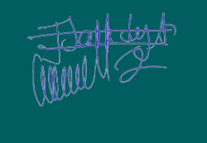
TraineE Certificate
The Level 3 Support service attests that
M. {{NOM}} ({{SSO}}) Attended with success the training program: {{FORMATION}}
the {{DATE_FORMATION}}.
Made the {{DATE_EDITION}}
Level 3 support-training supervisor: Jeanne-Sandya MESSAN-PWATY

