Slide 1
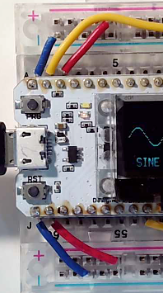
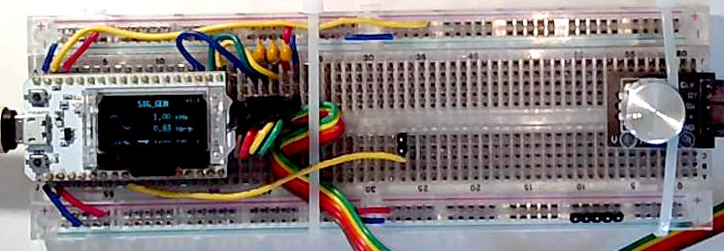
5V
5V(USB)
ESP32
SIG_GEN
Vs
Sine wave
10kHz
1.65Vp-p
2.5V dc
26
200
(GND)
3.3V
5V
GND
GND
3.3V
3.3V
GND
GND

Slide 2
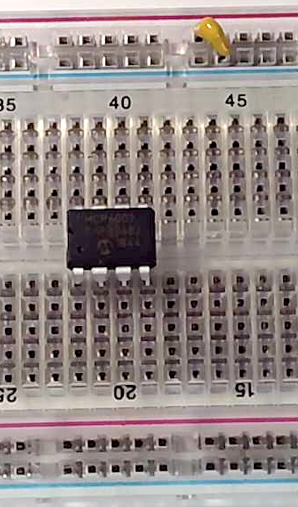
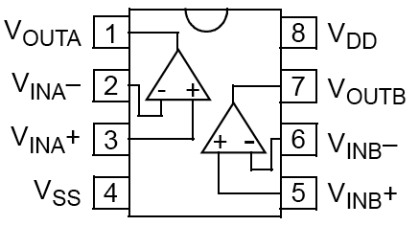

0.1uF
Decoupling
capacitor
5V
5V
0.1uF
notch
Pin 1
GND

Slide 3
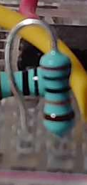
+
=
2.5V DC
10kHz sine wave
1.65V peak-to-peak
2.5V DC offset
+
Vs
-
10kHz sine wave
1.65V peak-to-peak
Vcc = 5v
200k
Pin 1
R1
0.1μ
3
8
C1
Vs
+
Vo
½ opamp
1
200k
2
R2
4
R3
Mount resistor on adjacent pins vertically
200k

Slide 4
Vcc = 5v
200k
Pin 1
R1
0.1μ
3
8
C1
Vs
+
Vo
½ opamp
1
200k
2
R2
4
R3
Mount resistor on adjacent pins vertically
200k
Vcc = 5v
8
Vs
+
Vo
R2
100k
20k
R1

Slide 5
Vcc = 5v
200k
R1
0.1μ
3
8
C1
Vs
+
Vo
10kHz sine wave
1.65V peak-to-peak
2.5V DC offset
½ opamp
1
200k
2
R2
4
R3
200k
200k
R4

Slide 6
Vcc = 5v
200k
R1
0.1μ
3
8
C1
+
Vo
+
½ opamp
1
2.5V DC
200k
2
R2
4
10kHz sine wave
1.65V peak-to-peak
R3
200k
200k
R4

Slide 7
Vcc = 5v
200k
R1
0.1μ
1μ
3
8
C1
+
Vo
+
C2
½ opamp
1
2.5V DC
200k
2
R2
4
10kHz sine wave
1.65V peak-to-peak
R3
200k
200k
R4
C3
1μ

Slide 8
Vcc = 5v
200k
R4
0.1μ
1μ
3
8
C1
+
V₁
+
C2
½ opamp
1
1V DC
200k
2
R3
4
R2
68k
200k
R1
C3
10μ

Slide 9
Vcc = 5v
200k
R4
0.1μ
1μ
3
8
C1
+
Vo
C2
½ opamp
1
200k
2
R3
4
10kHz sine wave
1V peak-to-peak
R2
68k
200k
R1
C3
10μ

Slide 10
Vcc = 5v
200k
R1
0.1μ
1μ
3
8
C1
+
1
Vo
200k
½ opamp
2
R2
4
R3
2k
200k
R4
1μ

Slide 11
Vcc = 5v
200k
R1
0.1μ
1μ
3
8
C1
1kHz sine wave
1.65V peak-to-peak
2.5V DC offset
R5
+
1
Vo
100k
200k
½ opamp
R6
2
Vs
1k
R2
4
R3
2k
200k
R4
1μ

Slide 12
Vcc = 5v
200k
R1
0.1μ
1μ
3
8
C1
1kHz sine wave
1.65V peak-to-peak
2.5V DC offset
R5
+
1
Vo1
100k
200k
½ opamp
R6
1k
2
Vs
R2
4
R3
20k
200k
R4
1μ

Slide 13
Vcc = 5v
200k
R1
0.1μ
1μ
3
8
C1
1kHz sine wave
1.65V peak-to-peak
2.5V DC offset
R5
+
1
Vo1
100k
200k
½ opamp
R6
1k
2
Vs
R2
4
R3
20k
200k
5V
R4
Vcc = 5v
1μ
10k
R7
5
+
7
Vo2
10k
R8
½ opamp
6
20k
R10
R9
200k

Slide 14
Vcc = 5v
200k
R1
0.1μ
1μ
3
8
C1
1kHz PWM signal duty cycle 25%
R5
+
1
Vo1
100k
200k
½ opamp
R6
1k
2
Vs
R2
4
R3
20k
200k
5V
R4
Vcc = 5v
1μ
10k
R7
5
+
7
Vo2
10k
R8
½ opamp
6
20k
R10
R9
200k

Slide 15
Vcc = 5v
Vcc = 5v
2.2k
200k
R11
R1
0.1μ
10k
R7
1μ
3
8
C1
mic
+
5
Vo2
1
Vo1
+
200k
½ opamp
7
2
10k
R8
½ opamp
R2
4
6
R3
20k
20k
200k
R10
R9
R4
200k
1μ

Slide 16
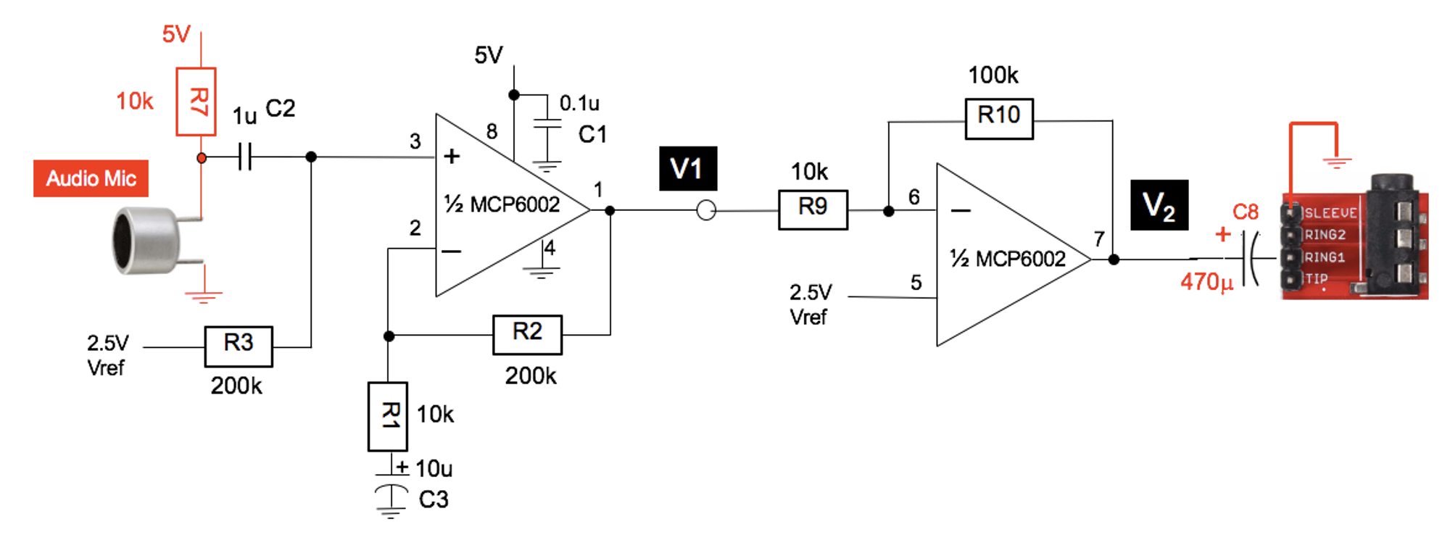
2.2k

Slide 17

+5v
C4
0.1μ
Vs
3
6
C1
+
220μ
sine wave
0.4V peak-to-peak
2.5V DC offset
10μ
5
+
LM386
2
Vo3
8Ω
4
0.01μ
C5
R12
68

Slide 18
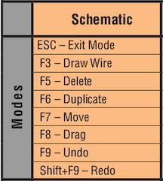
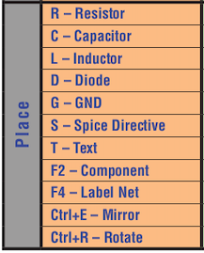

Slide 19
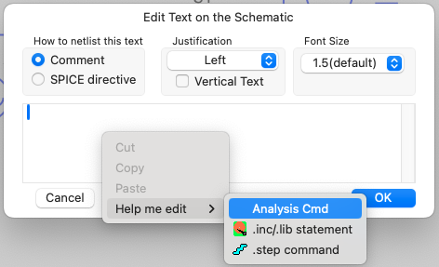

Slide 20
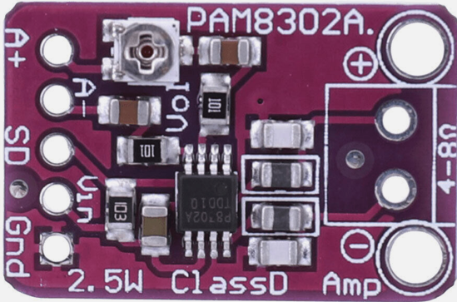
5V
Vs
sine wave
0.4V peak-to-peak
2.5V DC offset
8Ω

