Slide 1
Conda environments

Slide 2
Why should I use a package and environment management system?
Installing/updating scientific software and keeping working dependencies is challenging.
•It can be difficult to figure out what software is required for any particular research project.
•It is often impossible to install different versions of the same software package at the same time.
•Updating software required for one project can often “break” the software installed for another project.

Slide 3
Conda
•Conda is an open source package and environment management system that runs on Windows, Mac OS and Linux.
•Conda can quickly find, install, run, and update packages and their dependencies.
•Conda can create, save, load, and switch between project specific software environments on your local computer.
•Although Conda was created for Python programs, Conda can package and distribute software for any language such as R,
Ruby, Lua, Scala, Java, JavaScript, C, C++, FORTRAN.

Slide 4
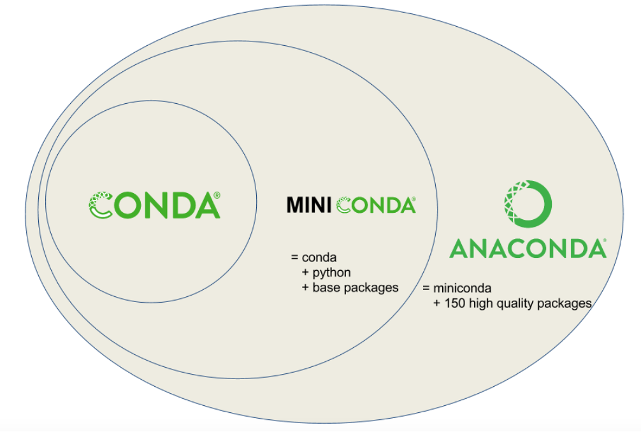
Anaconda-Miniconda-conda
Miniconda combines Conda with Python and a small number of core packages;
Anaconda includes Miniconda as well as a large number of the most widely used Python packages.

Slide 5
Why use Conda?
•Conda solves both package and environment management (can install different python and R versions)
•Conda provides prebuilt packages, avoiding the need to deal with compilers
•Conda is cross platform, with support for Windows, MacOS, GNU/Linux
•Conda environments are reproducible and portable
•Conda allows for using other package management tools (such as pip) inside Conda environments, where a library or tools is not already packaged for Conda.
•Additionally, Anaconda provides commonly used data science libraries and tools, such as R, NumPy, SciPy and TensorFlow

Slide 6
Useful links
•Tutorial
https://github.com/ELELAB/environments_workshop/blob/main/conda/conda.md
•Others
https://docs.conda.io/projects/conda/en/latest/glossary.html#miniconda-glossary
https://bioconda.github.io/
https://conda-forge.org/

