Slide 1

HOLY MARY INSTITUTE OF TECHNOLOGY AND SCIENCE
UGC-AUTONOMOUS, Accredited by NAAC – A Grade
AICTE, Recognized by UGC Under section 2(f) & 12(B), permanently
Affiliated to JNTUH
HITS EDC (Entrepreneur Development Cell)
EDC InCharge : Dr.E.Krishna Hari Sir
Corporate Relation Incharge HITS EDC : Samson Sir
PROJECT TITLE : A Technology – Driven Solution For Food Waste And Hunger Management
PS CATEGORY : Software
NAME : E. Durga Prasad
ROLL NUMBER : 22C91A0557
YEAR & BRANCH : 4 th & CSE

Slide 2
INTRODUCTION
Food wastage and hunger are two interconnected global and national issues that continue to affect millions of people every day. On one side, a significant amount of edible food is wasted at restaurants, weddings, hostels, supermarkets, and households due to overproduction, improper planning, and lack of redistribution mechanisms. On the other side, a large section of the population struggles with food insecurity, malnutrition, and irregular access to nutritious meals. This contrast highlights that the core problem lies not in food scarcity, but in inefficient food management and distribution. The Food Wastage and Hunger Management App is designed as a technology-driven solution to bridge the gap between surplus food and people in need. The platform enables food donors to quickly report excess food along with details such as quantity, location, and time, while NGOs, shelters, and volunteers can access this information in real time and arrange timely collection and distribution. By using location-based matching and efficient coordination, the app ensures that safe, edible food reaches the right beneficiaries before it goes to waste. This initiative promotes sustainability, social responsibility, and entrepreneurship by transforming food redistribution into an organized and scalable system. The app not only reduces food wastage and supports hunger relief but also creates opportunities for collaboration among communities, institutions, and social organizations. Through the effective use of technology, this solution aims to generate meaningful social impact while aligning with the objectives of the Entrepreneurship Development Cell.

Slide 3
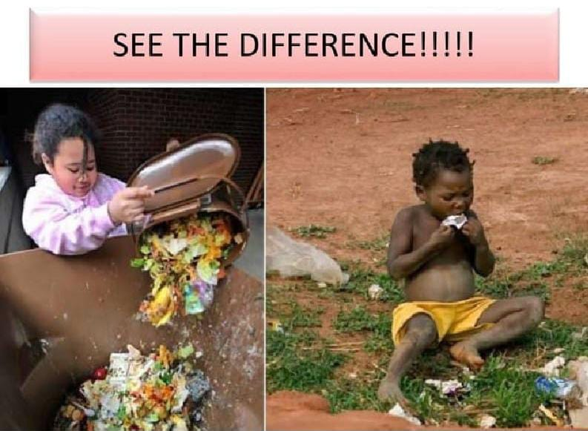
PROBLEM STATEMENT
Food wastage and hunger continue to exist as two major and interconnected social challenges in today’s society. Every day, a large amount of freshly prepared and edible food is wasted at restaurants, marriage halls, corporate events, hostels, supermarkets, and even households due to overproduction, inaccurate demand estimation, and lack of awareness about redistribution options. Most of this surplus food is disposed of as waste, contributing to environmental pollution and economic loss. At the same time, millions of people, especially underprivileged communities, daily wage workers, homeless individuals, and people in shelters, struggle to access sufficient and nutritious food. Despite the availability of surplus food, the absence of a structured and reliable mechanism prevents timely distribution to those in need. Existing donation methods are mostly informal, unorganized, and dependent on manual communication, which often results in delays, food spoilage, and safety concerns. The core problem lies in the lack of a unified, technology-based platform that can efficiently connect food donors, NGOs, volunteers, and beneficiaries in real time. Without proper coordination, location-based matching, and accountability, valuable food resources continue to go to waste while hunger persists. This situation highlights a critical need for an innovative, scalable, and sustainable solution that can manage surplus food effectively and ensure equitable food distribution.

Slide 4
MARKET GAP
Excess Food Going to Waste : Restaurants, events, and households generate tons of edible food daily that ends up in landfills . Current disposal methods are inefficient, causing economic loss and environmental harm.
Lack of Efficient Food Redistribution : No centralized platform connects food donors with those in need . NGOs and volunteers often rely on manual coordination, which is time-consuming and limits reach.
Limited Awareness Among Donors : Many people are unaware of how to donate leftover food safely . Fear of legal issues or hygiene concerns prevents donations.
Hunger & Food Insecurity : Millions of people, especially in urban and semi-urban areas, face irregular access to nutritious food . Existing charity mechanisms are fragmented and cannot handle sudden surges in demand.
Technology Gap : While food delivery apps exist, none focus on connecting surplus food directly to those who need it in real-time . There is an opportunity for a mobile solution that streamlines the donation and distribution process.

Slide 5
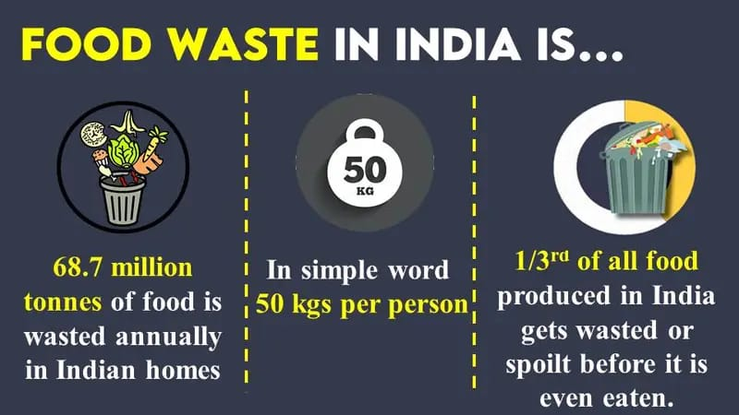
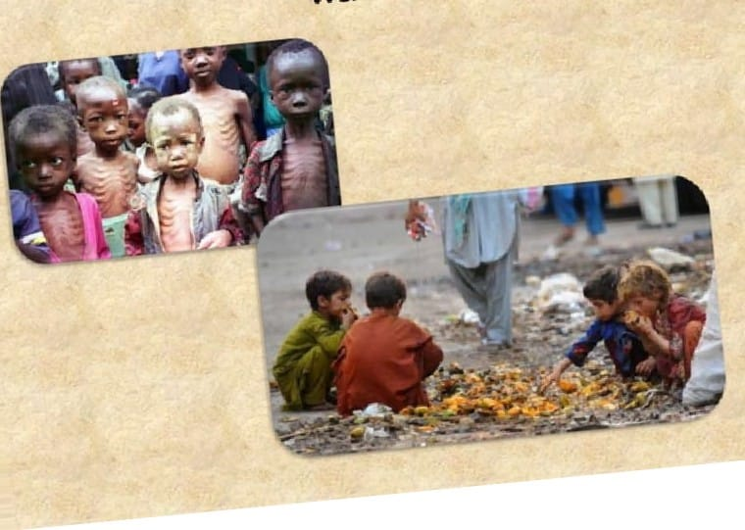
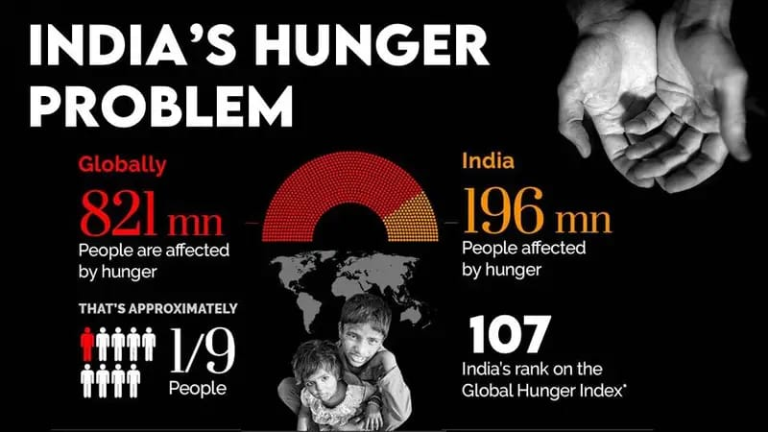
RESEARCH/SURVEY
According to the Global Hunger Index 2021, India ranks 101st out of 116 countries, with a score of 27.5, indicating a serious level of hunger. India has 189.2 million undernourished people, the highest in the world. India also has high rates of child malnutrition, stunting, wasting, and anaemia. Moreover, India faces the paradox of being self-sufficient in food production but not in food security, as millions of people lack access to adequate and nutritious food due to poverty, inequality, inefficiency, and wastage. Today we endeavour to write about Food Waste and a weakness as well as an opportunity that lies within our industry to support UNSDG 2 – Zero Hunger.

Slide 6
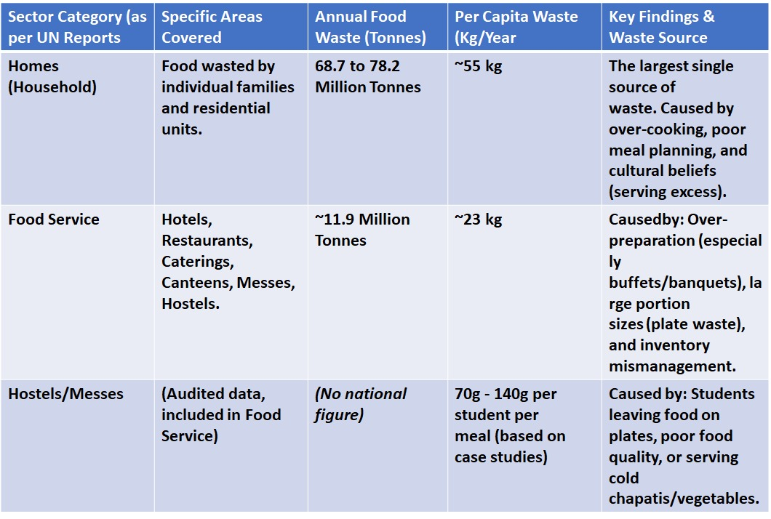
ESTIMATED FOOD WASTE BY DIFFERENT SECTORS IN INDIA

Slide 7
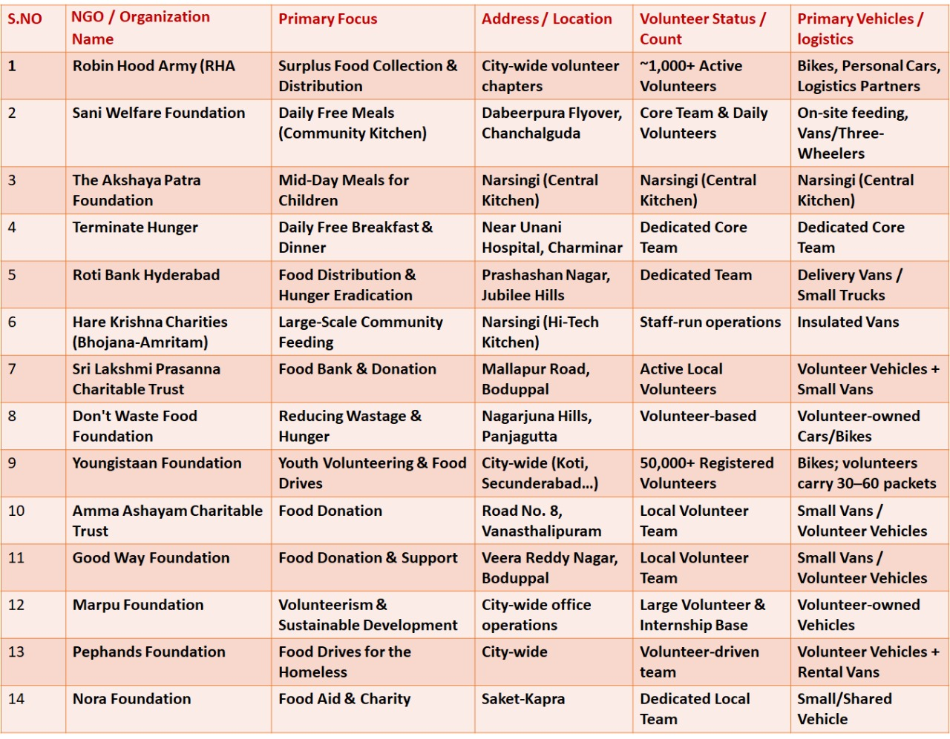
NGO’s in HYDERABAD

Slide 8
OBJECTIVES
1. To build a user-friendly mobile application that simplifies the food donation process for all users .
2. To minimize environmental impact by reducing food waste sent to landfills.
3. To create a transparent tracking system for donated food from source to destination.
4. To strengthen collaboration between donors, NGOs, volunteers, and local communities.
5. To raise awareness about food wastage and responsible consumption through digital campaigns.
6. To provide quick response during emergencies by enabling instant food availability notifications.
7. To support government and non-profit initiatives aimed at hunger eradication and sustainability.

Slide 9
PROPOSED SOLUTION
The proposed solution is a smart, mobile-based Food Wastage and Hunger Management Application designed to address the dual problems of excessive food wastage and widespread hunger. The platform acts as a centralized digital bridge connecting food donors such as households, restaurants, hotels, and event organizers with NGOs, volunteers, and underprivileged individuals who require food support.
The application enables donors to upload real-time information about surplus food, including quantity, type, location, and availability duration. Using GPS-based location matching and instant notifications, nearby volunteers or partner organizations are alerted to ensure quick pickup and distribution before the food expires. The system incorporates pickup scheduling, donor verification, and food safety guidelines to maintain hygiene and accountability throughout the process.
By automating coordination and communication, the proposed solution eliminates manual inefficiencies, reduces food disposal, and ensures timely food delivery to those in need. This technology-driven approach not only helps in hunger alleviation but also promotes environmental sustainability, social responsibility, and community engagement, making it a scalable and impactful solution for urban and semi-urban regions.

Slide 10
PRODUCT DESCRIPTION
The Food Wastage and Hunger Management App is a technology-driven solution designed to reduce food wastage and combat hunger by connecting surplus food providers with NGOs, volunteers, and people in need. The application enables households, restaurants, hotels, and event organizers to easily list excess edible food in real time.
Through location-based matching and instant notifications, the app ensures timely collection and safe distribution of food before it gets wasted. It also provides pickup scheduling, donor verification, and basic hygiene guidelines to maintain food quality. By acting as a bridge between food surplus and food scarcity, the platform promotes social responsibility, environmental sustainability, and community participation using a simple and user-friendly interface.

Slide 11
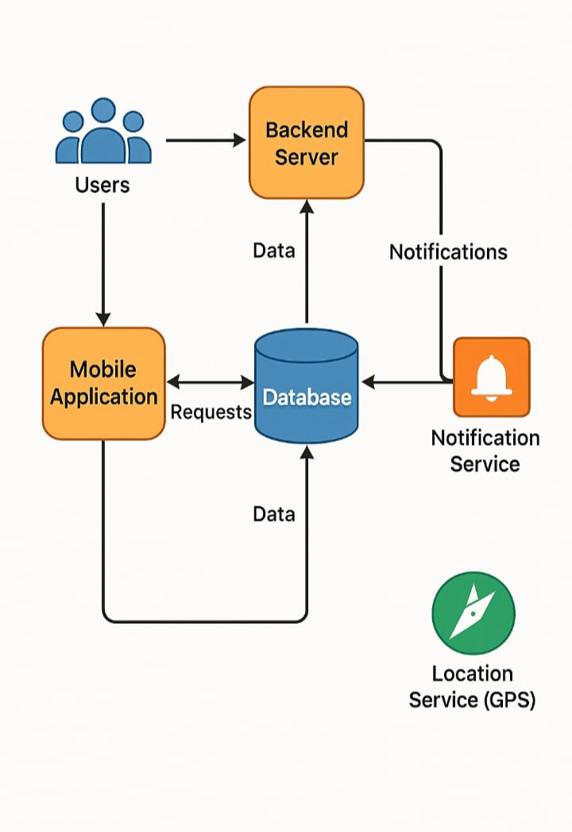
SYSTEM ARCHITECTURE
User Layer: Donors, NGOs, volunteers, and beneficiaries using the mobile app.
Application Layer: The mobile application interface where users register, post food details, and receive notifications.
Backend Server: Handles business logic, authentication, food listing management, and request processing.
Database: Stores user data, food donation details, pickup status, and history.
Notification Service: Sends real-time alerts to nearby volunteers and NGOs.
Location Service (GPS): Matches donors with nearby receivers efficiently.

Slide 12
TECHNOLOGIES USED
TECHNOLOGY STACK:
1.FRONT END
FLUTTER
REACT NATIVE
2.BACK END
NODE JS
FIRE BASE
3.DATABASE
MONGO DB
4.AI TOOLS FOR REDISTRIBUTION
RECOMMENDATION AI
CHATBOT SUPPORT
IMAGE RECOGNITION
Frontend (Mobile Application):Developed using Flutter and React Native to build a cross-platform mobile application with a responsive and user-friendly interface for Android and iOS users.
Backend Server : Node. js used to manage server-side logic, RESTful APIs, authentication, and food donation workflows.
Database : MongoDB for storing user profiles, food donation details, pickup status, and transaction history in a scalable NoSQL format.
Cloud & Backend Services : Firebase for user authentication, real-time updates, cloud storage, and push notifications.
AI-Based Recommendation System : AI algorithms to optimize food redistribution by recommending the nearest NGOs or volunteers based on location, food quantity, urgency, and demand.
Image Recognition : AI-based image recognition to analyze uploaded food images and help identify food type and basic quality before redistribution.

Slide 13
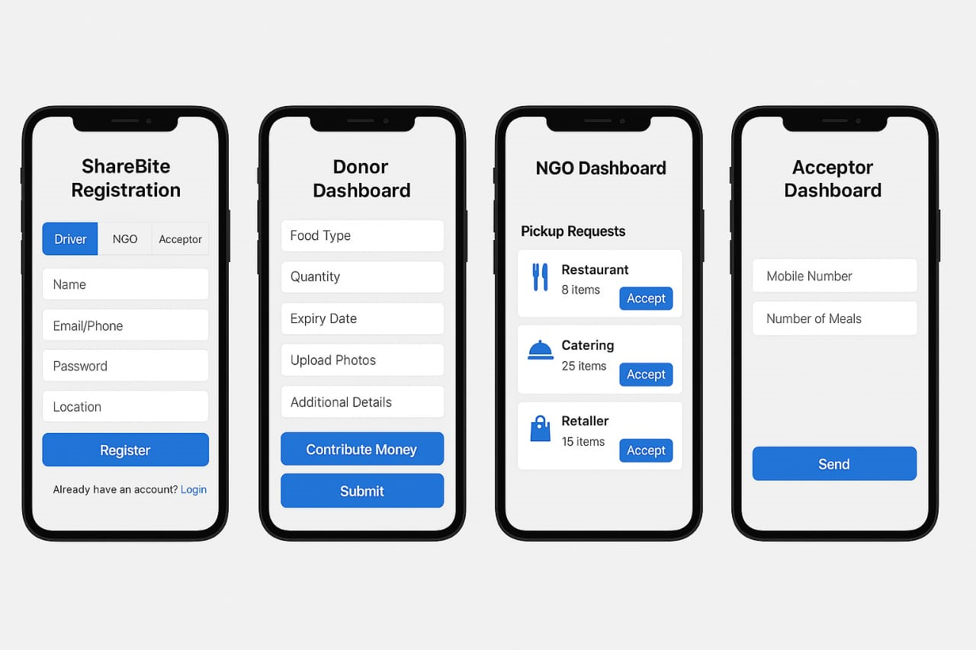
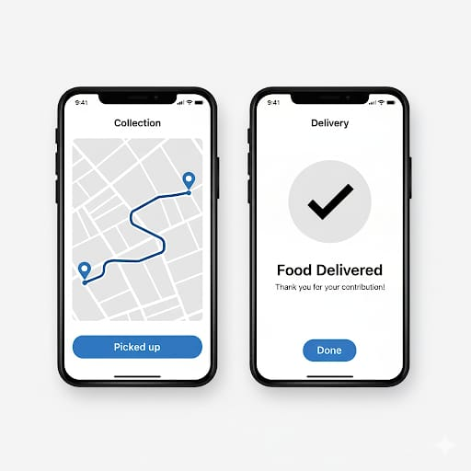
WORKING PROTOTYPE
Demo Link :
https://verdant-lamington-654a01.netlify.app/

Slide 14
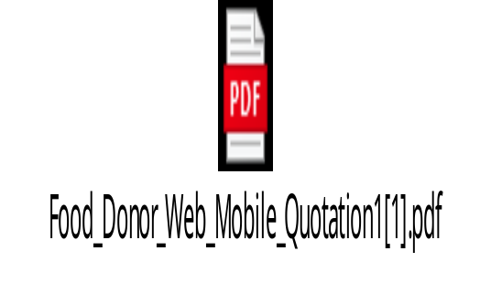
BUDGET PLANNING
Overall Budget : 4,00,000
Company Registration & Legal Compliance :
Private Limited Company Registration : 10,000 – 25,000
GST Registration : Free – 1,000
PAN &TAN for Company : 1,000 – 2,000
Trademark Registration : 7,000 – 15,000
Licences ( if food distribution involved ) : 5,000 – 20,000
Legal & Consultancy Fees : 10,000 – 30,000
Total : ~ 90,000/-
Marketing & Launch :
Online Marketing : 30,000
Branding & Promotion : 20,000
App Development & AI Integration : 1,50,000
Maintanence & Miscellaneous :
Server Hosting & Database (1 year) : 20,000
Updates & Bug Fixes : 30,000
Miscellaneous Expenses : 50,000

Slide 15
BUSINESS MODEL
The Food Wastage and Hunger Management App follows a social-impact–driven business model focused on sustainability rather than profit. The application is free to use for food donors, volunteers, NGOs, and beneficiaries to encourage maximum participation and social responsibility.
The platform partners with NGOs, food banks, government bodies, and community organizations to manage food collection and distribution efficiently. Operational sustainability is achieved through CSR funding, grants, sponsorships, and institutional partnerships.
In the long term, the app may generate revenue through premium analytics services for restaurants and hotels, logistics coordination support, and white-label solutions for NGOs and municipalities. This hybrid model ensures continuous operation, scalability, and long-term impact while maintaining its core mission of reducing food wastage and hunger.

Slide 16
IMPLEMENTATION PLAN
Requirement Analysis: Identify users, features, and finalize system architecture.
UI/UX Design: Design intuitive interfaces using Flutter and React Native.
Backend Development: Build APIs with Node.js, integrate Firebase authentication and MongoDB database.
Feature Integration: Implement food listing, GPS-based matching, notifications, chatbot, and image recognition.
AI Implementation: Develop AI-based recommendation system for efficient food redistribution.
Testing & Deployment: Test the application, deploy on cloud, and monitor performance.

Slide 17
ADVANTAGES
Cross-platform support using Flutter and React Native increases accessibility.
Secure authentication and data handling through Firebase services.
Scalable backend with Node.js and MongoDB supports future expansion.
AI-based image recognition improves food quality assessment.
Chatbot support provides 24/7 assistance to users.
Location-based matching reduces delivery time and food spoilage.
Supports CSR, NGO, and government hunger-relief initiatives.
Cost-effective solution with high social impact.

Slide 18

IMPACT
Reduces Food Wastage: Connects surplus food from homes, restaurants, and events to those in need, minimizing waste.
Fights Hunger: Ensures timely redistribution of edible food to underprivileged communities.
Promotes Awareness: Educates users on responsible food consumption and social responsibility.
Supports Sustainability: Contributes to a circular food ecosystem and reduces environmental impact.
Community Engagement: Encourages local participation and volunteerism for a social cause.
Data-Driven Insights: Tracks food patterns to improve future distribution strategies.

Slide 19
FEASIBILITY
Reduces Food Wastage: Connects surplus food from homes, restaurants, and events to those in need, minimizing waste.
2. Fights Hunger: Ensures timely redistribution of edible food to underprivileged communities.
3. Promotes Awareness: Educates users on responsible food consumption and social responsibility.
4. Supports Sustainability: Contributes to a circular food ecosystem and reduces environmental impact.
5. Community Engagement: Encourages local participation and volunteerism for a social cause.
6. Data-Driven Insights: Tracks food patterns to improve future distribution strategies.

Slide 20
LIMITATIONS
1. Dependence on User Participation: Effectiveness relies on active donors, NGOs, and volunteers.
2. Logistics Challenges: Timely collection and delivery of food may be difficult in remote areas.
3. Food Quality Assurance: Ensuring freshness and safety of donated food can be challenging.
4. Internet Requirement: System requires stable internet connectivity for real-time updates.
5. Initial Adoption Barriers: Awareness and trust-building among users may take time.
6. Limited Coverage Initially: Service may be restricted to selected locations in early stages.

Slide 21
FUTURE SCOPE
1. Wider Geographic Expansion: Extend services to multiple cities, states, and rural areas.
2. Advanced AI Integration: Improve food matching, demand prediction, and waste reduction using AI.
3. Government & NGO Collaboration: Partner with public bodies for large-scale impact.
4. Real-Time Logistics Tracking: Integrate GPS and route optimization for faster delivery.
5. Multi-Language Support: Enable regional languages to increase accessibility.
6. Monetization & Sustainability: Introduce CSR partnerships and premium services for long-term sustainability.

Slide 22
CONCLUSION
The Food Wastage and Hunger Management System provides an effective digital solution to reduce food wastage while addressing hunger. By connecting food donors, NGOs, and volunteers through a single platform, the system ensures timely food redistribution. With the use of modern technologies and AI-driven insights, the solution is scalable, cost-effective, and sustainable. This initiative not only supports social welfare but also promotes responsible food consumption and community participation.

Slide 23
Thank You
Any Questions ??
“Together, we can reduce food wastage and fight hunger.”

