Slide 1

ESRF STATUS REPORT
Antonia BETEVA
On behalf of the ESRF MXCuBE team:
Marcus Oskarsson, Daniele de Sanctis, Yan Walesch, Olof Svensson, Axel Bocciarelli, Jean Baptiste Florial (EMBL), Antonia Beteva

Slide 2

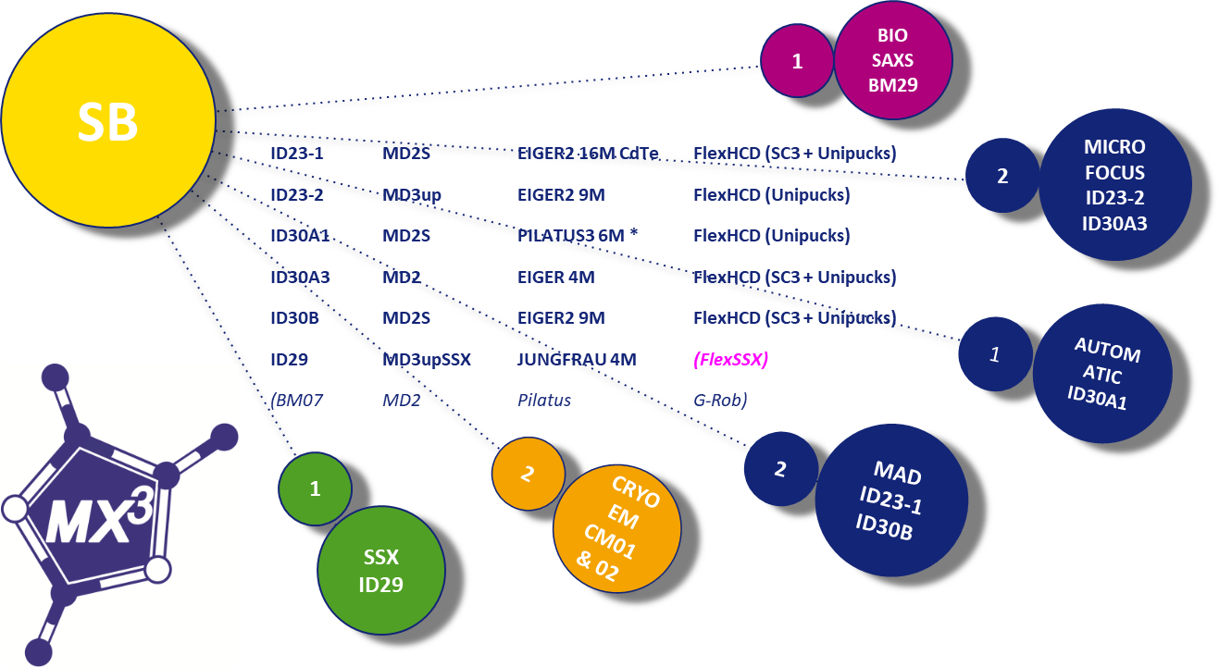
BRIEF BEAMLINE SUMMARY
* MASSIF-1 detector change to Pilatus4 X/XE 4M in 2025

Slide 3
MXCuBE STATUS
MXCuBE (same on all beamlines)
mxcubeweb 4.211.0 + ESRF (esrf.1024-1)
mxcubecore 1.167.0 + ESRF (esrf.1024-1)
Other deployment
ESRF repository moved from gitlab to github - public access!
https://github.com/mxcube/esrf-mxcubecore and esrf-mxcubeweb
Rebase with develop and deploy on the beamlines every second week
Cybersecurity
Vulnerability Scanner (metrics)
Web Application Firewall (WAF) – external application

Slide 4
Development since last meeting
AbstractLims initial PR with ISPyB and ICAT implementation *
SSO and proposal selection deployment (personal and proposal account) *
ID29 SSX - Argussight for Injector speed calculation **
Deploy MASSIF-1 workflows on other beamlines
* see Marcus highlight
** see Yan highlight

Slide 5
Plans for the next six months
Deploy SSO (and 2FA) and proposal selection with personal accounts only – December 2024
Advance on ID29 SSX features
MASSIF-1 continue the integration of the GΦL workflows.
Port data collection routines to Bliss
Camera hutch view in MXCuBE, using Argussight

Slide 6

NEWS
Yan Walesch joined the ESRF team
MXCuBE presented at the NOBUGS 2024 Conference
MXCuBE All In One - User Interface, Control, Collaboration - talk
https://indico.esrf.fr/event/114/contributions/799/ https://vimeo.com/1016409076/7213f63a26
MXCuBE Goes Serial - poster
https://indico.esrf.fr/event/114/contributions/743/

Slide 7

We are hiring

