Slide 2

Argussight
Argussight
Multi-view streamer for MXCuBE

Slide 3
Background & Motivation
Background
MXCuBE-WEB supports a single camera video stream
Limited interaction with the stream
Lack of real-time information on hutch activity and experimental environment
=> Our Solution: Introducing a multiple stream management system

Slide 4
Introducing Argussight
Argussight
Argussight is intended to complement and extend the capabilities of the Video-streamer:
Support connectivity with a wide range of camera types for live streaming
Allow dynamic stream modifications through client communication
Simplifies beamline-specific setups with YAML-based configurations

Slide 5
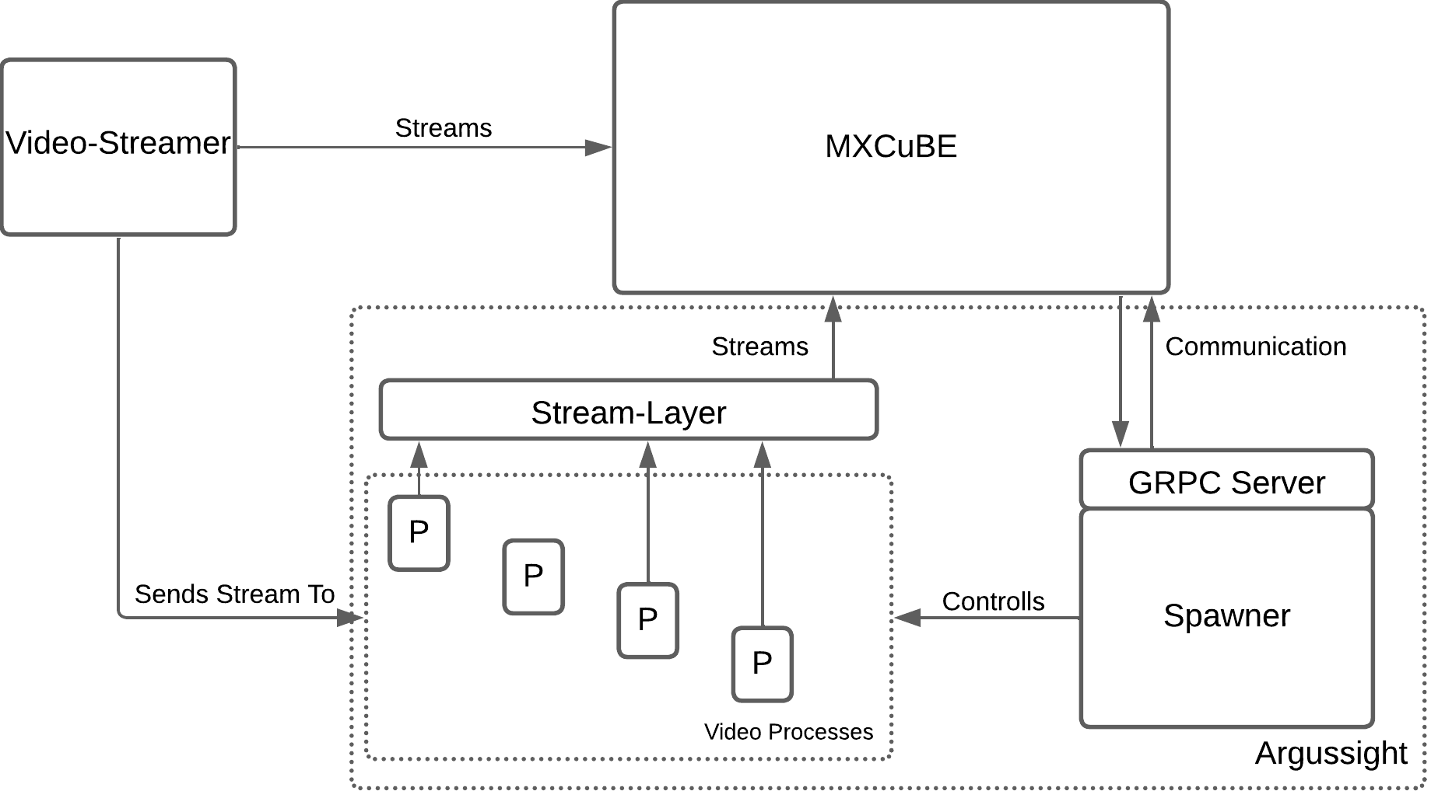
Argussight Overview
Spawner: The core of Argussight, responsible for controlling and spawning video processes
GRPC Server: Handles the communication with the client (MXCuBE)
Video processes: Each process handles a specific task (generating or modifying stream)
Stream-Layer: An abstraction layer between streaming processes and the outside world.

Slide 6
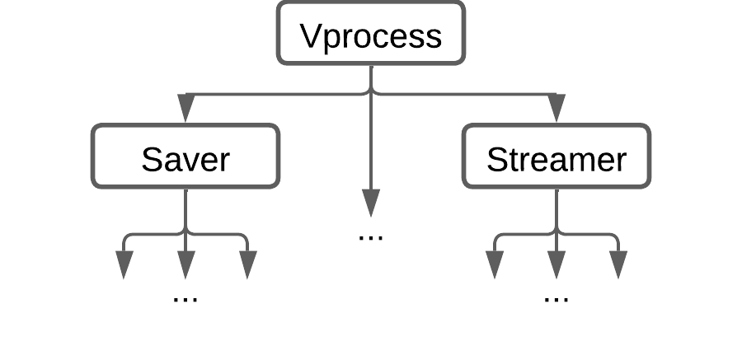
The Vprocess class
Philosophy of a unified base class design - Similar to HardwareObject
The base class abstracts and manages all camera stream-related operations, such as reading and handling streams.
Developers can focus on implementing specific tasks by working with one image at a time, without worrying about stream complexities.

Slide 7
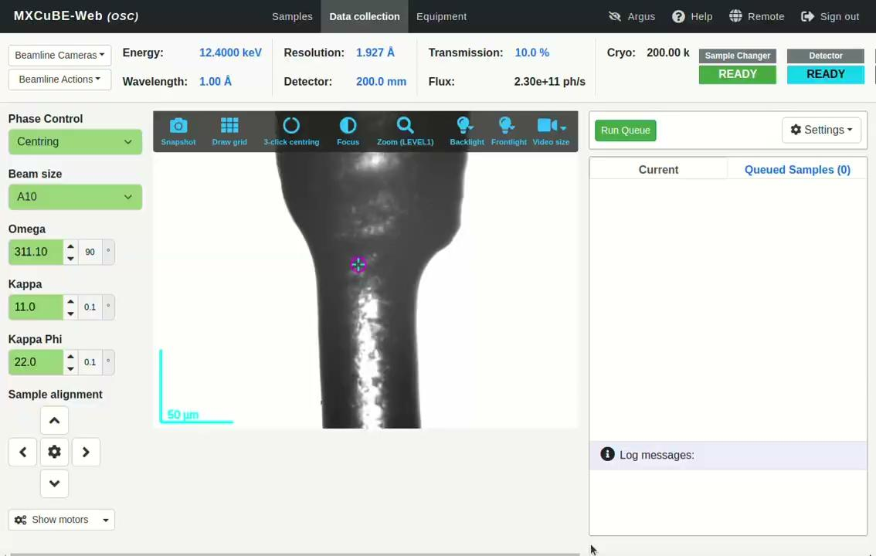
Demo

Slide 8
Current Status and Repository
Current Status: WiP
Actively working on implementing core functionalities and refining the design.
Starting to conduct early tests on a beamline to validate the system's performance and usability.
If you’ve worked on similar projects or have an interest in this area, your feedback and ideas would be greatly appreciated.
Documentation & Repository
https://github.com/walesch-yan/argussight
For MXCuBE integration: work on yw-argus branches in the mxcube/esrf-mxcubeweb and mxcube/esrf-mxcubecore repositories

Slide 9
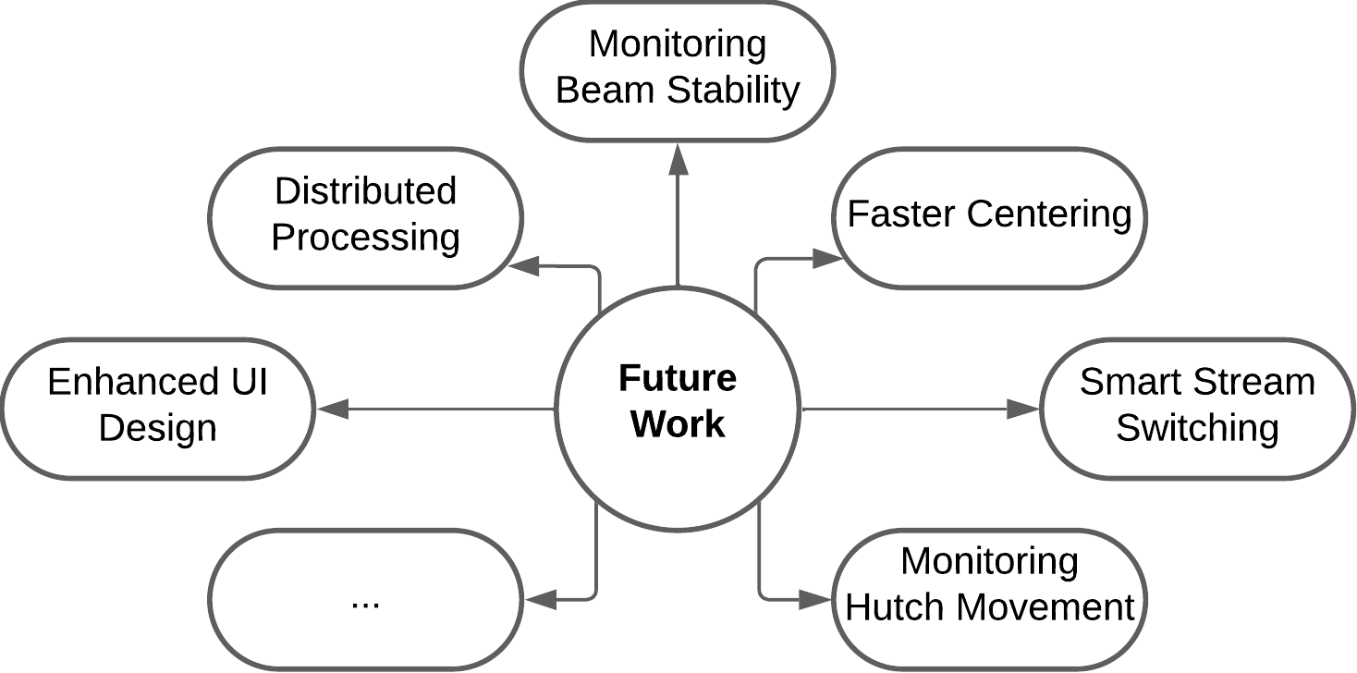
Future Goals and Ideas

Slide 10


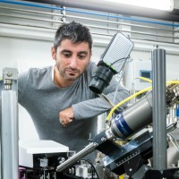
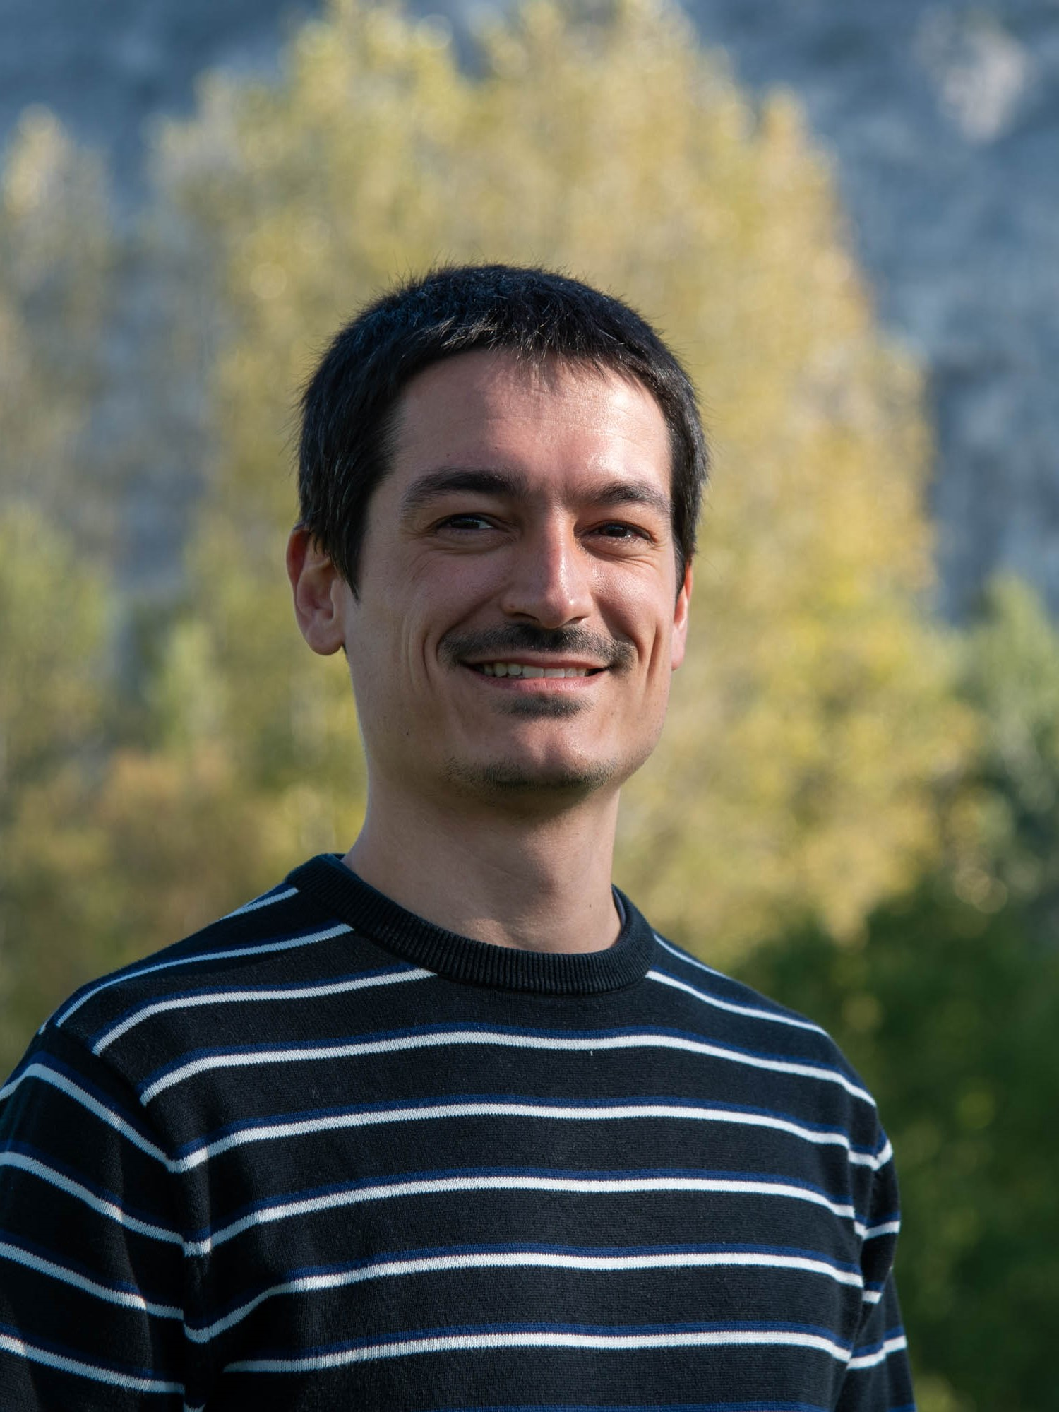
Acknowledgement
Antonia Beteva
Marcus Oskarsson
Daniele De Sanctis
Axel Bocciarelli
And everyone that contributed to the MXCuBE project

Slide 11
Questions?
Thank you for
your attention!

