Slide 1
MXCuBE meeting 2024-11-21 Dan Tiberiu Costin

Slide 2
SOLEIL PX1 MXCUBE
Moving from testing to production.
Code evaluation
Repository structure and development strategy

Slide 3
Main particularities
SampleView
Uses a Redis camera
Sample Changer - uses 2 tango devices
PX1Cryotong Cats90
PX1CatsMaint CatsMaint
Diffractometer - custom Smargon diffractometer
PX1MiniDiff GenricDiffractometer
stepper zoom motor based on AbstractNState
inherits from
inherits from
inherits from

Slide 4
Challenges
Configuring the zoom motor and sample centring into the latest version MXCuBE (develop).
Integrating the collect procedure
Setting up a secure user login

Slide 5
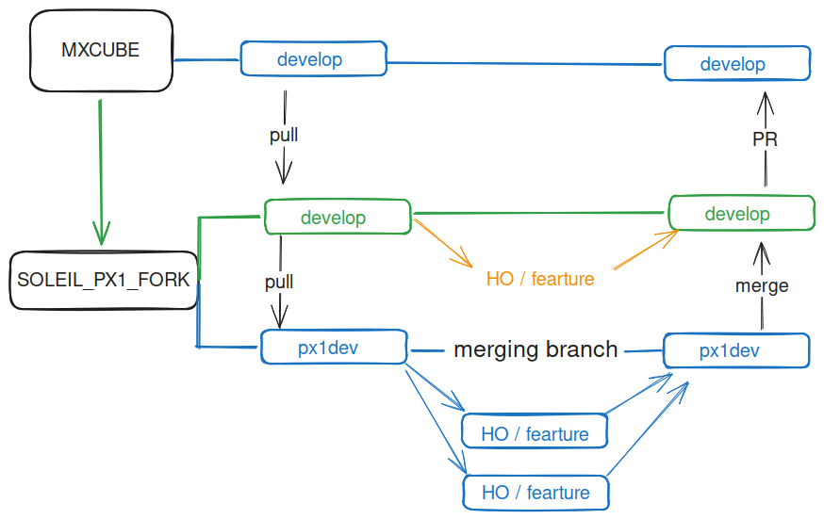
Development strategy
Similar to Git-Flow...
… with some turbulence

Slide 6
Code Report
Pylint evaluation of mxcubecore: 5.49/10
Issues
7078 mxcubecore/HardwareObjects/XSDataMXv1.py
3199 mxcubecore/HardwareObjects/XSDataAutoprocv1_0.py
1788 mxcubecore/HardwareObjects/XSDataCommon.py
899 mxcubecore/HardwareObjects/XSDataMXCuBEv1_4.py
733 mxcubecore/HardwareObjects/XSDataMXCuBEv1_3.py
552 mxcubecore/HardwareObjects/XSDataControlDozorv1_1.py
513 mxcubecore/utils/units.py
306 mxcubecore/HardwareObjects/QtInstanceServer.py
288 mxcubecore/HardwareObjects/Cats90.py
271 mxcubecore/HardwareObjects/ISPyBClient.py
268 mxcubecore/model/queue_model_objects.py
268 mxcubecore/HardwareObjects/Camera.py
251 mxcubecore/HardwareObjects/MiniDiff.py
182 mxcubecore/HardwareObjects/GenericDiffractometer.py
151 mxcubecore/HardwareObjects/sample_centring.py
136 mxcubecore/HardwareObjects/Microdiff.py
Small changes in these files will probably not pass the Pylint PR tests.

Slide 7
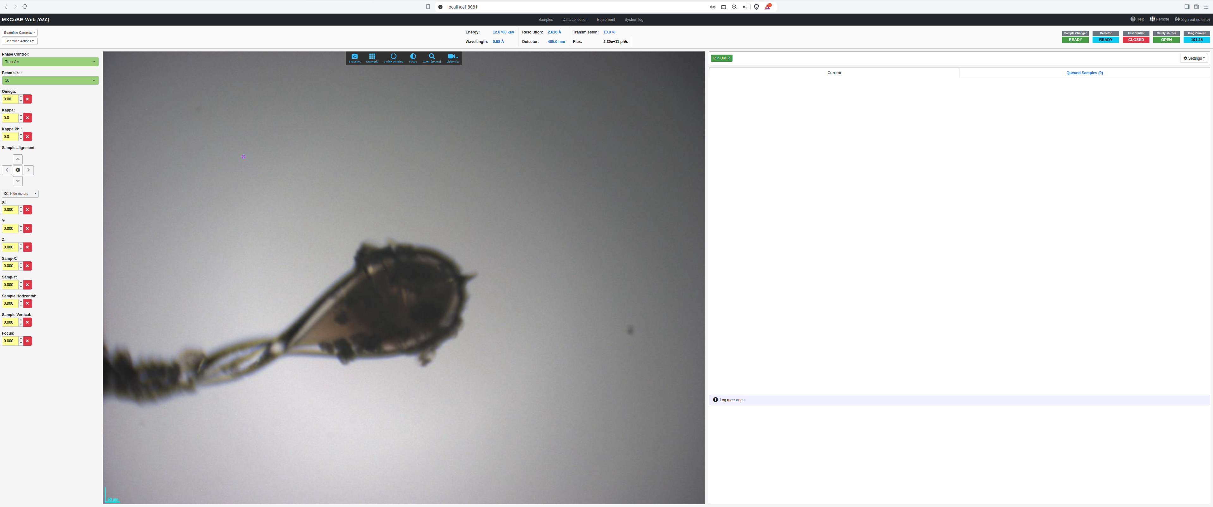

Sampla wash ?
Could use a wash button !

Slide 8
Thank you !

Slide 9
