Slide 1
Data QC and Exploratory Data Analysis (Afternoon session)
Olivier Delaneau
University of Geneva
19/05/2017

Slide 2
Outline
Haplotype estimation
Genotype imputation
Reference panels
Imputation performance

Slide 3
Haplotype estimation
We observe genotypes for each individual
G
2 1 1 2 2 1 1 1 0 2 1 2 2 1 1 1 2 1 1 0

Slide 4
Haplotype estimation
We observe genotypes for each individual
G
2 1 1 2 2 1 1 1 0 2 1 2 2 1 1 1 2 1 1 0
Phasing
1 0 0 1 1 1 0 1 0 1 0 1 1 0 1 1 1 0 1 0
1 1 1 1 1 0 1 0 0 1 1 1 1 1 0 0 1 1 0 0
We want to recover the underlying haplotypes
Complex problem:
N heterozygotes -> 2^{N} haplotypes
N heterozygotes -> 2^{N-1} pairs of haplotypes

Slide 5
Haplotypes in disease genetics
Estimation of haplotypes from array-based and sequencing studies is an important problem for multiple reasons:
Construction of reference panels of haplotypes (HapMap, 1000 Genomes, UK10K, GoNL, etc…).
Imputation of Genome Wide Association Studies (i.e. GWAS).
Detection of novel associations in GWAS or fine-mapping of known effects e.g. compound heterozygotes.

Slide 6
Haplotypes in population genetics
1. Mapping selection
3. Mapping admixture
EUR
H
H
AFR
Selection event
Admixture event
Sabeti et al, Nature 2002
Price et al, PLOS Genet 2009
2. Mapping IBD
4. Estimating recombination rates
H
H
Shared IBD track
cM/Mb
Browning et al, Genetics 2013
O’connell et al, PLOS Genet 2013

Slide 7
Basic idea of phasing
0 1 0 1 1 1 0 1 0 1 1 1 1 0 0 0 1 0 1 0
0 1 0 1 1 1 0 1 0 1 1 1 1 0 0 0 1 0 1 0
1 0 1 1 1 0 1 0 0 1 0 1 1 1 1 1 1 1 0 0
1 0 1 0 0 0 1 0 1 0 0 0 0 1 1 1 0 1 0 1
0 1 0 1 1 1 0 0 0 1 0 1 1 1 1 1 1 1 0 0
1 0 1 1 1 0 1 0 1 0 0 0 0 1 0 0 1 0 1 0
0 1 0 1 1 1 0 1 0 1 1 1 1 0 1 1 1 1 0 0
1 0 1 1 1 0 1 0 1 0 0 0 0 1 0 0 1 0 1 0
2 1 1 2 2 1 1 1 0 2 1 2 2 1 1 1 2 1 1 0
H
G
Haplotype estimation works iteratively.

Slide 8
Basic idea of phasing
0 1 0 1 1 1 0 1 0 1 1 1 1 0 0 0 1 0 1 0
0 1 0 1 1 1 0 1 0 1 1 1 1 0 0 0 1 0 1 0
1 0 1 1 1 0 1 0 0 1 0 1 1 1 1 1 1 1 0 0
1 0 1 0 0 0 1 0 1 0 0 0 0 1 1 1 0 1 0 1
0 1 0 1 1 1 0 0 0 1 0 1 1 1 1 1 1 1 0 0
1 0 1 1 1 0 1 0 1 0 0 0 0 1 0 0 1 0 1 0
0 1 0 1 1 1 0 1 0 1 1 1 1 0 1 1 1 1 0 0
1 0 1 1 1 0 1 0 1 0 0 0 0 1 0 0 1 0 1 0
2 1 1 2 2 1 1 1 0 2 1 2 2 1 1 1 2 1 1 0
H
G
It takes each individuals genotype vector (G) in turn
and estimates the underlying haplotypes using the current
haplotype estimates of other individuals (H).

Slide 9
Haplotype structure
Many generations
Individuals share stretches of haplotypes inherited from common ancestors
Notes:
To do so, it borrows the following idea from population genetics.
Assuming that at some point of human history, you had this pool of haplotypes in the population, …
…. after many generations and therefore many recombination events, your pool of haplotypes will look like this:
Mosaics of ancestral haplotypes with breaking points that are usually located within what we call recombination hotspots.
As a consequence of this, individuals in a population tend to share relatively long stretches of haplotypes inherited from a common ancestor.

Slide 10
Basic idea of phasing
0 1 0 1 1 1 0 1 0 1 1 1 1 0 0 0 1 0 1 0
0 1 0 1 1 1 0 1 0 1 1 1 1 0 0 0 1 0 1 0
1 0 1 1 1 0 1 0 0 1 0 1 1 1 1 1 1 1 0 0
1 0 1 0 0 0 1 0 1 0 0 0 0 1 1 1 0 1 0 1
0 1 0 1 1 1 0 0 0 1 0 1 1 1 1 1 1 1 0 0
1 0 1 1 1 0 1 0 1 0 0 0 0 1 0 0 1 0 1 0
0 1 0 1 1 1 0 1 0 1 1 1 1 0 1 1 1 1 0 0
1 0 1 1 1 0 1 0 1 0 0 0 0 1 0 0 1 0 1 0
1 0 1 1 1 0 1 0 0 1 0 1 1 1 1 1 1 1 0 0
0 1 0 1 1 1 0 1 0 1 1 1 1 0 0 0 1 0 1 0
2 1 1 2 2 1 1 1 0 2 1 2 2 1 1 1 2 1 1 0
H
h₁
h₂
G
It uses Hidden Markov Models (Li and Stephens, 2005) that models the underlying haplotypes as mosaics of haplotypes of other individuals.

Slide 11
Popular phasing methods
There are several popular methods for haplotype estimation from genotype data:
IMPUTE2 - https://mathgen.stats.ox.ac.uk/impute/impute_v2.html
MACH - http://www.sph.umich.edu/csg/abecasis/MACH/
BEAGLE - http://faculty.washington.edu/browning/beagle/beagle.html
SHAPEIT2 - http://mathgen.stats.ox.ac.uk/genetics_software/shapeit/shapeit.html
EAGLE - https://data.broadinstitute.org/alkesgroup/Eagle/
SHAPEIT3 - http://mathgen.stats.ox.ac.uk/genetics_software/shapeit/shapeit.html

Slide 12
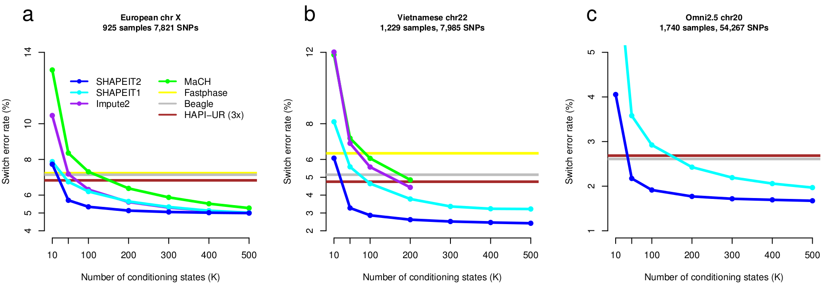
Measuring performance
2013
Truth
1 0 0 1 1 0 0 1 0 1 1
0 1 1 0 0 1 1 0 1 0 0
Estimation
1 0 0 1 1 0 0 1 0 1 1
0 0 1 1
0 1 1 0 0 1 1 0 1 0 0
1 1 0 0
Switch error rate = 2/10 = 20%
Small GWAS
100s samples x 500K SNPs
Medium GWAS
1000s samples x 500K SNPs
Big GWAS
1000s samples x 2.5M SNPs
Notes:
For this, we applied it on three data sets representative of GWAS at that time:
Few hundreds samples typed on a 500K array
Thousands of samples typed on the same array
And thousands of samples typed on a denser array with 2.5M SNPs.
Here you have the switch error rate as a function of the number of conditioning haplotypes used in the estimation…
… and you can see in blue that we were also doing much better than all other competitor methods in all three cases even when using a small number of conditioning haplotypes.
So all this was encouraging and this is why …

Slide 13
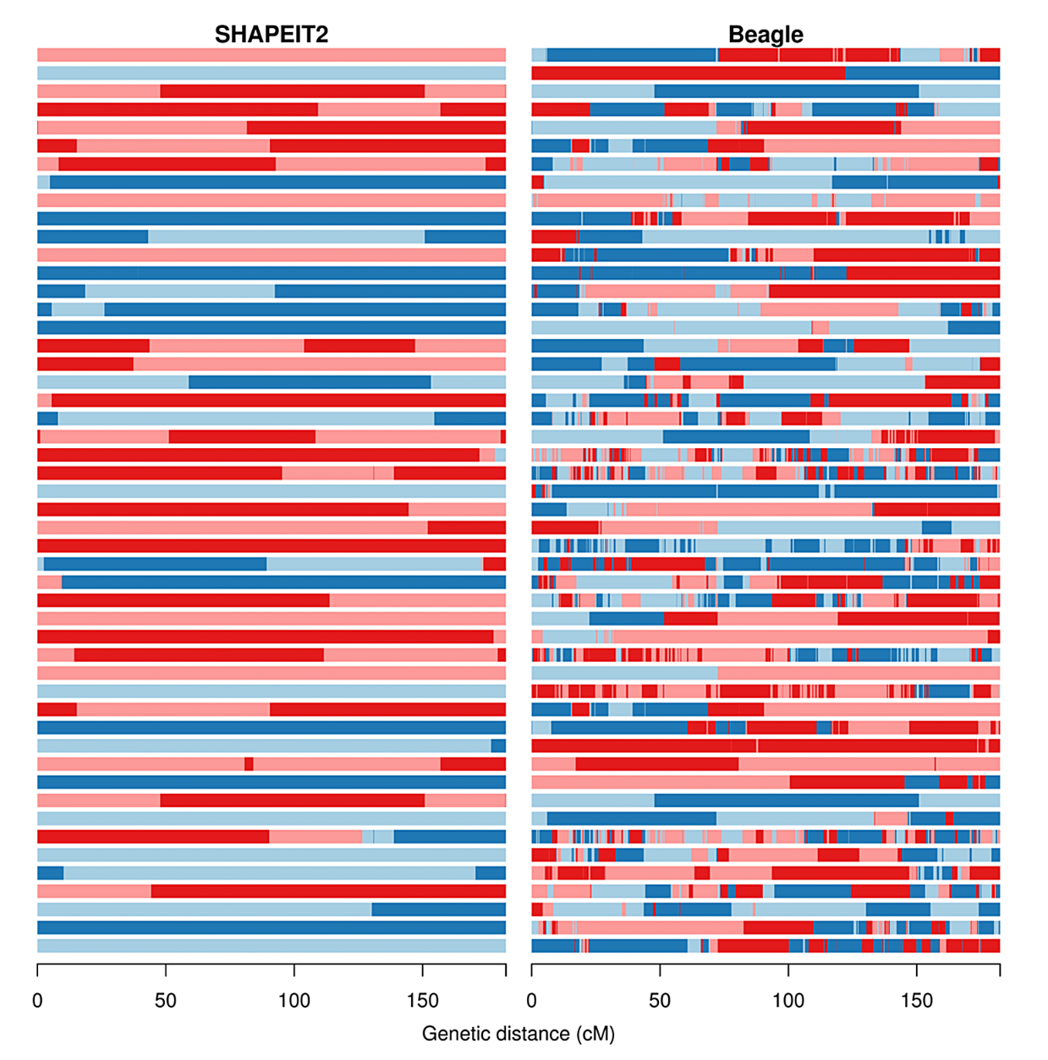
Measuring performance
2013
Truth
1 0 0 1 1 0 0 1 0 1 1
0 1 1 0 0 1 1 0 1 0 0
Estimation
1 0 0 1 1 0 0 1 0 1 1
0 0 1 1
0 1 1 0 0 1 1 0 1 0 0
1 1 0 0
Switch error rate = 2/10 = 20%
O’Connell et al, Plos Gen. 2014
Notes:
When we apply our new method on samples from an isolated population so with lots of cryptic relatedness, this is what we get compared to another key competitor method; beagle.
You can see here that our new long range phasing approach was doing much better, with in some case giving correct haplotypes over complete chromosomess.
So, it works well for related people, what about unrelateds?

Slide 14
Limitation of genotyping data
1
2
0
0
1
1
1
1
0
0
0
0
0
1
1
1
0
1
1
2
0
0
1
1
Study
Samples
2
2
0
0
0
0
1
1
1
1
0
1
0
2
0
0
1
1
1
1
1
1
1
2
SNPs genotyped in a genomic study: 1 to 5M variants, 100s to 1000s of samples
Notes:
A typical GWAS consists of genotype data in 1000’s of samples and many 100,000s of SNPs.
The image on the slide shows a cartoon of such a dataset, with each row corresponding to the genotypes of an individual, and each column is a SNP. 0,1 and 2 are used to denote the copies of one of the alleles at each SNP.
Typical GWAS chips only assay a small proportion of all the SNPs that exist in the human population.

Slide 15
Limitation of genotyping data
0
0
1
1
1
0
0
1
1
0
0
0
1
1
1
0
0
0
0
0
1
1
1
0
1
1
1
0
0
1
1000
Genomes
1
1
1
1
1
0
0
0
1
0
0
0
0
0
0
1
0
1
1
0
0
0
1
1
1
1
1
0
0
1
1
2
0
0
1
1
1
1
0
0
0
0
0
1
1
1
0
1
1
2
0
0
1
1
Study
Samples
2
2
0
0
0
0
1
1
1
1
0
1
0
2
0
0
1
1
1
1
1
1
1
2
This is far less that what we’ve got in sequencing based studies
Notes:
In addition to a given GWAS dataset large scale reference datasets exist in humans. Such datasets, produced by projects such as the HapMap Project, 1000 Genomes project and the HRC, consist of estimated haplotypes at a much larger number of SNPs than will have been assayed in a GWAS.
The slide illustrates this idea using a cartoon, with the 4 haplotypes represented above the GWAS samples. It can be seen then that the reference dataset, often referred to as a haplotype reference panel, has SNP data at many more SNPs than the GWAS samples. This makes it clear that there are many genotypes in the GWAS samples that have not been directly assayed.

Slide 16
Limitation of genotyping data
0
0
1
1
1
0
0
1
1
0
0
0
1
1
1
0
0
0
0
0
1
1
1
0
1
1
1
0
0
1
1000
Genomes
1
1
1
1
1
0
0
0
1
0
0
0
0
0
0
1
0
1
1
0
0
0
1
1
1
1
1
0
0
1
1
2
0
0
1
1
1
1
0
0
0
0
0
1
1
1
0
1
1
2
0
0
1
1
Study
Samples
2
2
0
0
0
0
1
1
1
1
0
1
0
2
0
0
1
1
1
1
1
1
1
2
Poor
Signal
Resolution
Notes:
In addition to a given GWAS dataset large scale reference datasets exist in humans. Such datasets, produced by projects such as the HapMap Project, 1000 Genomes project and the HRC, consist of estimated haplotypes at a much larger number of SNPs than will have been assayed in a GWAS.
The slide illustrates this idea using a cartoon, with the 4 haplotypes represented above the GWAS samples. It can be seen then that the reference dataset, often referred to as a haplotype reference panel, has SNP data at many more SNPs than the GWAS samples. This makes it clear that there are many genotypes in the GWAS samples that have not been directly assayed.

Slide 17
Solution: Imputation
0
0
1
1
1
0
0
1
1
0
0
0
1
1
1
0
0
0
0
0
1
1
1
0
1
1
1
0
0
1
1000
Genomes
1
1
1
1
1
0
0
0
1
0
0
0
0
0
0
1
0
1
1
0
0
0
1
1
1
1
1
0
0
1
1
?
?
?
2
?
0
?
?
?
?
0
1
?
1
1
?
?
?
1
?
0
?
?
?
?
0
0
?
0
0
?
?
?
1
?
1
?
?
?
?
1
0
?
1
1
?
?
?
2
?
0
?
?
?
?
0
1
?
1
Study
Samples
2
?
?
?
2
?
0
?
?
?
?
0
0
?
0
1
?
?
?
1
?
1
?
?
?
?
1
0
?
1
0
?
?
?
2
?
0
?
?
?
?
0
1
?
1
1
?
?
?
1
?
1
?
?
?
?
1
1
?
2
Un-typed variants are treated as missing data.
Notes:
In effect the GWAS dataset has a large amount of missing data. Represented here by grey question marks.

Slide 18
Solution: Imputation
0
0
1
1
1
0
0
1
1
0
0
0
1
1
1
0
0
0
0
0
1
1
1
0
1
1
1
0
0
1
1000
Genomes
1
1
1
1
1
0
0
0
1
0
0
0
0
0
0
1
0
1
1
0
0
0
1
1
1
1
1
0
0
1
1
1
2
2
2
0
0
1
2
0
0
0
1
1
1
1
1
1
1
1
0
0
1
2
1
0
0
0
0
0
0
0
1
1
1
1
1
2
1
0
1
1
0
0
1
1
2
2
2
2
0
0
1
2
0
0
0
1
1
1
Study
Samples
2
1
2
2
2
0
0
0
2
2
0
0
0
0
0
1
1
1
1
1
1
1
1
1
1
1
1
0
0
1
0
0
2
2
2
0
0
2
2
2
2
0
1
1
1
1
1
1
1
1
1
1
1
1
1
1
1
1
1
2
The goal of imputation is to estimate the missing genotypes at these variants
Notes:
In effect the GWAS dataset has a large amount of missing data. Represented here by grey question marks.

Slide 19
Solution: Imputation
0
0
1
1
1
0
0
1
1
0
0
0
1
1
1
0
0
0
0
0
1
1
1
0
1
1
1
0
0
1
1000
Genomes
1
1
1
1
1
0
0
0
1
0
0
0
0
0
0
1
0
1
1
0
0
0
1
1
1
1
1
0
0
1
1
1
2
2
2
0
0
1
2
0
0
0
1
1
1
1
1
1
1
1
0
0
1
2
1
0
0
0
0
0
0
0
1
1
1
1
1
2
1
0
1
1
0
0
1
1
2
2
2
2
0
0
1
2
0
0
0
1
1
1
Study
Samples
2
1
2
2
2
0
0
0
2
2
0
0
0
0
0
1
1
1
1
1
1
1
1
1
1
1
1
0
0
1
0
0
2
2
2
0
0
2
2
2
2
0
1
1
1
1
1
1
1
1
1
1
1
1
1
1
1
1
1
2
High
Signal
Resolution

Slide 20
Combining genotype data sets
0
0
1
1
1
0
0
1
1
0
0
0
1
1
1
0
0
0
0
0
1
1
1
0
1
1
1
0
0
1
1000
Genomes
1
1
1
1
1
0
0
0
1
0
0
0
0
0
0
1
0
1
1
0
0
0
1
1
1
1
1
0
0
1
1
2
0
0
1
1
1
1
0
0
0
0
0
1
1
1
0
1
Study 1
1
2
0
0
1
1
0
1
1
0
1
1
0
0
1
0
2
0
2
2
0
0
1
0
Study 2
1
1
0
1
1
1
Notes:
Add refs: T2D (Zeggini), Crohn’s meta-analyses (Barrett); if you want to see a good example...

Slide 21
Combining genotype data sets
0
0
1
1
1
0
0
1
1
0
0
0
1
1
1
0
0
0
0
0
1
1
1
0
1
1
1
0
0
1
1000
Genomes
1
1
1
1
1
0
0
0
1
0
0
0
0
0
0
1
0
1
1
0
0
0
1
1
1
1
1
0
0
1
1
1
2
2
2
0
0
1
1
2
0
0
1
1
1
1
1
1
1
1
0
0
1
0
1
0
0
0
0
0
0
0
1
1
1
1
1
2
1
1
1
1
0
0
1
Study 1
1
2
2
2
2
0
0
1
0
1
0
0
1
1
1
0
0
0
1
1
1
1
2
0
1
1
1
1
1
2
0
0
0
0
0
1
1
2
0
2
1
1
0
0
1
1
1
2
2
1
0
0
1
0
1
1
1
0
0
1
Study 2
0
0
1
1
1
0
0
2
1
1
0
0
1
1
1
High
Signal
Resolution

Slide 22
How does it work?
0
0
1
1
1
0
0
1
1
0
0
0
1
1
1
0
0
0
0
0
1
1
1
0
1
1
1
0
0
1
1
1
1
1
1
0
0
0
1
0
0
0
0
0
0
1
0
1
1
0
0
0
1
1
1
1
1
0
0
1
1
?
?
?
2
?
0
?
?
?
?
0
1
?
1
1
1
0
0
0
0
0
1
1
1
0
1
1
2
0
0
1
1
2
2
0
0
0
0
1
1
1
1
0
1
0
2
0
0
1
1
1
1
1
1
1
2

Slide 23
How does it work?
0
0
1
1
1
0
0
1
1
0
0
0
1
1
1
0
0
0
0
0
1
1
1
0
1
1
1
0
0
1
1
1
1
1
1
0
0
0
1
0
0
0
0
0
0
1
0
1
1
0
0
0
1
1
1
1
1
0
0
1
1
?
?
?
2
?
0
?
?
?
?
0
1
?
1
1
1
0
0
0
0
0
1
1
1
0
1
1
2
0
0
1
1
Phase
haplotypes
2
2
0
0
0
0
1
1
1
1
0
1
0
2
0
0
1
1
1
1
1
1
1
2
0
1
0
0
1
1
1
1
0
0
0
0

Slide 24
How does it work?
0
0
1
1
1
0
0
1
1
0
0
0
1
1
1
0
0
0
0
0
1
1
1
0
1
1
1
0
0
1
1
1
1
1
1
0
0
0
1
0
0
0
0
0
0
1
0
1
1
0
0
0
1
1
1
1
1
0
0
1
1
?
?
?
2
?
0
?
?
?
?
0
1
?
1
1
1
0
0
0
0
Match
haps to
panel
0
1
1
1
0
1
1
2
0
0
1
1
Phase
haplotypes
2
2
0
0
0
0
1
1
1
1
0
1
0
2
0
0
1
1
1
1
1
1
1
2
0
1
0
0
1
1
1
1
0
0
0
0

Slide 25
How does it work?
0
0
1
1
1
0
0
1
1
0
0
0
1
1
1
0
0
0
0
0
1
1
1
0
1
1
1
0
0
1
Impute
missing
alleles
1
1
1
1
1
0
0
0
1
0
0
0
0
0
0
1
0
1
1
0
0
0
1
1
1
1
1
0
0
1
1
1
2
2
2
0
0
1
2
0
0
0
1
1
1
1
1
0
0
0
0
Match
haps to
panel
0
1
1
1
0
1
1
2
0
0
1
1
Phase
haplotypes
2
2
0
0
0
0
1
1
1
1
0
1
0
2
0
0
1
1
1
1
1
1
1
2
0
1
0
0
1
1
1
1
0
0
0
0

Slide 26
How does it work?
Fine-scale
Recombination
Map
… 1 1 1 0 1 0 1 0 1 0 1 0 1 1 …
… 0 0 1 1 1 1 1 0 0 0 0 1 1 1 ...
… 1 1 1 1 0 0 0 0 0 1 1 1 0 1 ...
… 0 0 1 0 1 0 1 1 1 0 0 1 0 1 ...
… 1 ? 2 ? ? 1 ? 0 ? 0 ? ? 2 2 …
1000
Genomes
An individuals
genotype vector

Slide 27
How does it work?
Fine-scale
Recombination
Map
… 1 1 1 0 1 0 1 0 1 0 1 0 1 1 …
… 0 0 1 1 1 1 1 0 0 0 0 1 1 1 ...
… 1 1 1 1 0 0 0 0 0 1 1 1 0 1 ...
… 0 0 1 0 1 0 1 1 1 0 0 1 0 1 ...
… 1 ? 2 ? ? 1 ? 0 ? 0 ? ? 2 2 …
1000
Genomes
An individuals
genotype vector
The model says that an individuals genotype is constructed by copying alleles along two paths through the space of haplotypes. The switch rates of the paths are controlled by the recombination map. Mutation events are also allowed.

Slide 28
How does it work?
Fine-scale
Recombination
Map
… 1 1 1 0 1 0 1 0 1 0 1 0 1 1 …
… 0 0 1 1 1 1 1 0 0 0 0 1 1 1 ...
… 1 1 1 1 0 0 0 0 0 1 1 1 0 1 ...
… 0 0 1 0 1 0 1 1 1 0 0 1 0 1 ...
… 1 1 2 1 1 1 1 0 1 0 0 1 2 2 …
1000
Genomes
*
*
An individuals
genotype vector
0
1
2
0
1
2
0.01
0.18
0.81
0.15
0.7
0.15
We produce estimates of genotype uncertainty at both untyped and typed genotypes

Slide 29
Accounting for genotype uncertainty
There are several ways the imputed genotype probabilities can be used.
Threshold the probability distribution to give genotype calls
Use the expected allele counts
Average over uncertainty
Can be done in both the Frequentist and Bayesian frameworks
Very few implementations (SNPtest)
AA
AB
BB
0 x 0.01 + 1 x 0.18 + 2 x 0.81 = 1.8
0.01
0.18
0.81
Notes:
Once genotypes have been imputed we will be interested in using them for testing association with a phenotype of interest.
There are several ways in which this can be carried out.
The simplest method is to threshold the probability distributions of each imputed genotype to give genotype calls which can be tested in the usual way.
Another way is to construct an expected allele count from the genotype distribution which can then be tested for association with the phenotype.
Our recommended method is to use the probability distribution in the right way by averaging over the uncertainty in the genotypes. This can be done using bothe Bayesian or Frequentist methods and both are implemented in our package SNPTEST.

Slide 30
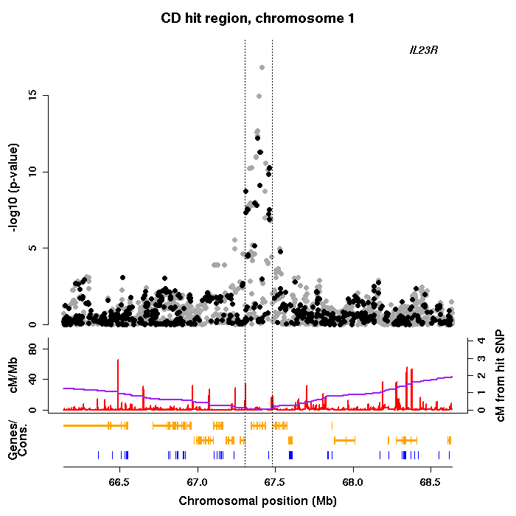
Image from The Wellcome Trust Case Control Consortium (2007) Genomewide association study of 14,000 cases of seven common diseases and 3,000 shared controls. Nature 447;661-78. DOI: 10.1038/nature05911.
Notes:
In this region on chr 1 for Chron’s diseease there has been a substantial boost in the signal.

Slide 31
Genome build
The Human Reference Sequence is updated periodically, each version is referred to a ‘genome build’.
Positions of SNPs can change between builds.
Almost all imputation programs align SNPs between the reference panels and the GWAS datasets using the position of SNPs.
So it is very important that the genotypes of your GWAS are mapped to the same genome build as the reference panel you are using.
Currently, all the most commonly used reference panels use build 37/38.
Notes:
When using imputation it is critical that the positions and allele labels match up between the genotype data and the panel of haplotype data that is being used.
For example, the latest release of the HapMap haplotype data (rel#22) uses alleles for each SNP that are expressed relative to the + strand of the human reference sequence (NCBI Build 37). Thus it is important that the alleles in your genotype data are expressed using the same strand and use Build 37 base-pair positions.
This problem actually only affects A/T and G/C SNPs as all other classes of SNPs can aligned by taking the complement of the alleles.
In the absence of strand information estimates of minor allele frequencies in the genotype and haplotype data can be used to align A/T and G/C SNPs.
There are no A/T or G/C SNPs on the Illumina chips so this problem does not affect these chips.

Slide 32
Strand issue
Genotypes from SNP chips are called relative to either the + or – strand of the human reference genome.
Maternal
chromosome
ACGTAGCTCTCTGATCGAT + strand
TGCATCGAGAGACTAGCTA - strand
ACATAGCTCTCTGAACGAT + strand
TGTATCGAGAGACTTGCTA - strand
Paternal
chromosome
+ strand GA
- strand CT
+ strand TA
- strand AT
Haplotype reference panels have alleles aligned to the + strand.
Genotype chips can have a mixture of genotypes from + and - strand
This needs to be fixed prior to imputation.
The strand info about all chips can be found here
http://www.well.ox.ac.uk/~wrayner/strand/
Notes:
When using imputation it is critical that the positions and allele labels match up between the genotype data and the panel of haplotype data that is being used.
For example, the latest release of the HapMap haplotype data (rel#22) uses alleles for each SNP that are expressed relative to the + strand of the human reference sequence (NCBI Build 37). Thus it is important that the alleles in your genotype data are expressed using the same strand and use Build 37 base-pair positions.
This problem actually only affects A/T and G/C SNPs as all other classes of SNPs can aligned by taking the complement of the alleles.
In the absence of strand information estimates of minor allele frequencies in the genotype and haplotype data can be used to align A/T and G/C SNPs.
There are no A/T or G/C SNPs on the Illumina chips so this problem does not affect these chips.

Slide 33
Information metric
Once imputation has been carried out, it is a good idea to try and measure how well imputed the genotypes are at each SNP. IMPUTE produces an information measure for each SNP in the range [0,1]:
1 means there is no uncertainty at all in any of the imputed genotypes.
0 means there is complete uncertainty for all of the genotypes.
Approximately, an information measure of α means the imputed genotypes contain as much information as αN genotypes that are completely certain (where N is the total number of genotypes).
In recent published studies (especially those that have used imputation for meta-analysis), variants with info<0.4 have been excluded from the study.
Image from J. Marchini and B. Howie (2010) Genotype imputation for genome-wide association studies. Nature Reviews Genetics doi:10.1038/nrg2796
Notes:
When using imputation it is critical that the positions and allele labels match up between the genotype data and the panel of haplotype data that is being used.
For example, the latest release of the HapMap haplotype data (rel#22) uses alleles for each SNP that are expressed relative to the + strand of the human reference sequence (NCBI Build 37). Thus it is important that the alleles in your genotype data are expressed using the same strand and use Build 37 base-pair positions.
This problem actually only affects A/T and G/C SNPs as all other classes of SNPs can aligned by taking the complement of the alleles.
In the absence of strand information estimates of minor allele frequencies in the genotype and haplotype data can be used to align A/T and G/C SNPs.
There are no A/T or G/C SNPs on the Illumina chips so this problem does not affect these chips.

Slide 34
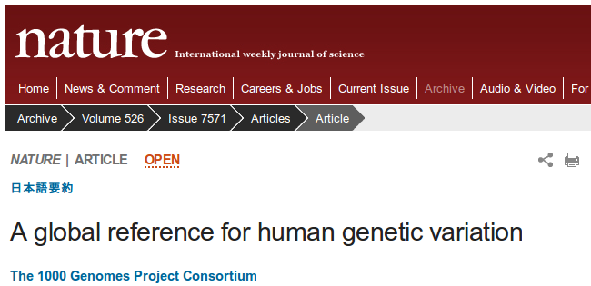
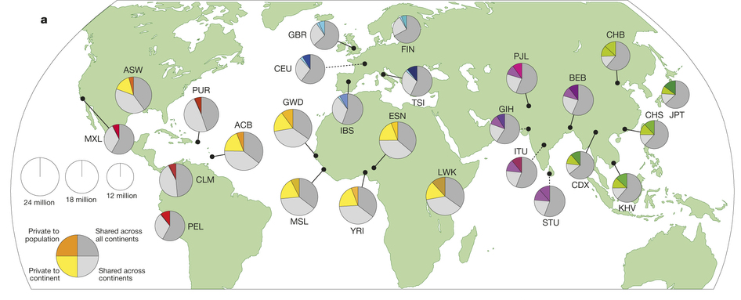
1000 Genomes project
2015
Population | Number of samples
African | 661
Americas | 347
Est Asian | 504
European | 503
South Asian | 489
Total | 2,504
Type of variants | Number of variants
Bi-allelic SNPs | 81,102,777
Bi-allelic Indels | 3,196,364
Multi-allelic SNPs | 274,425
Multi-allelic Indels | 169,601
Structural variants | 58,713
Total | 84,801,880
Notes:
The most popular reference panel of haplotypes so far is probably the one provided by the 1000 Genomes project.
In this project, up to 2.5 thousands samples from all over the world were collected and whole genome sequenced in order to build a nearly complete catalog of human genetic variations.

Slide 35
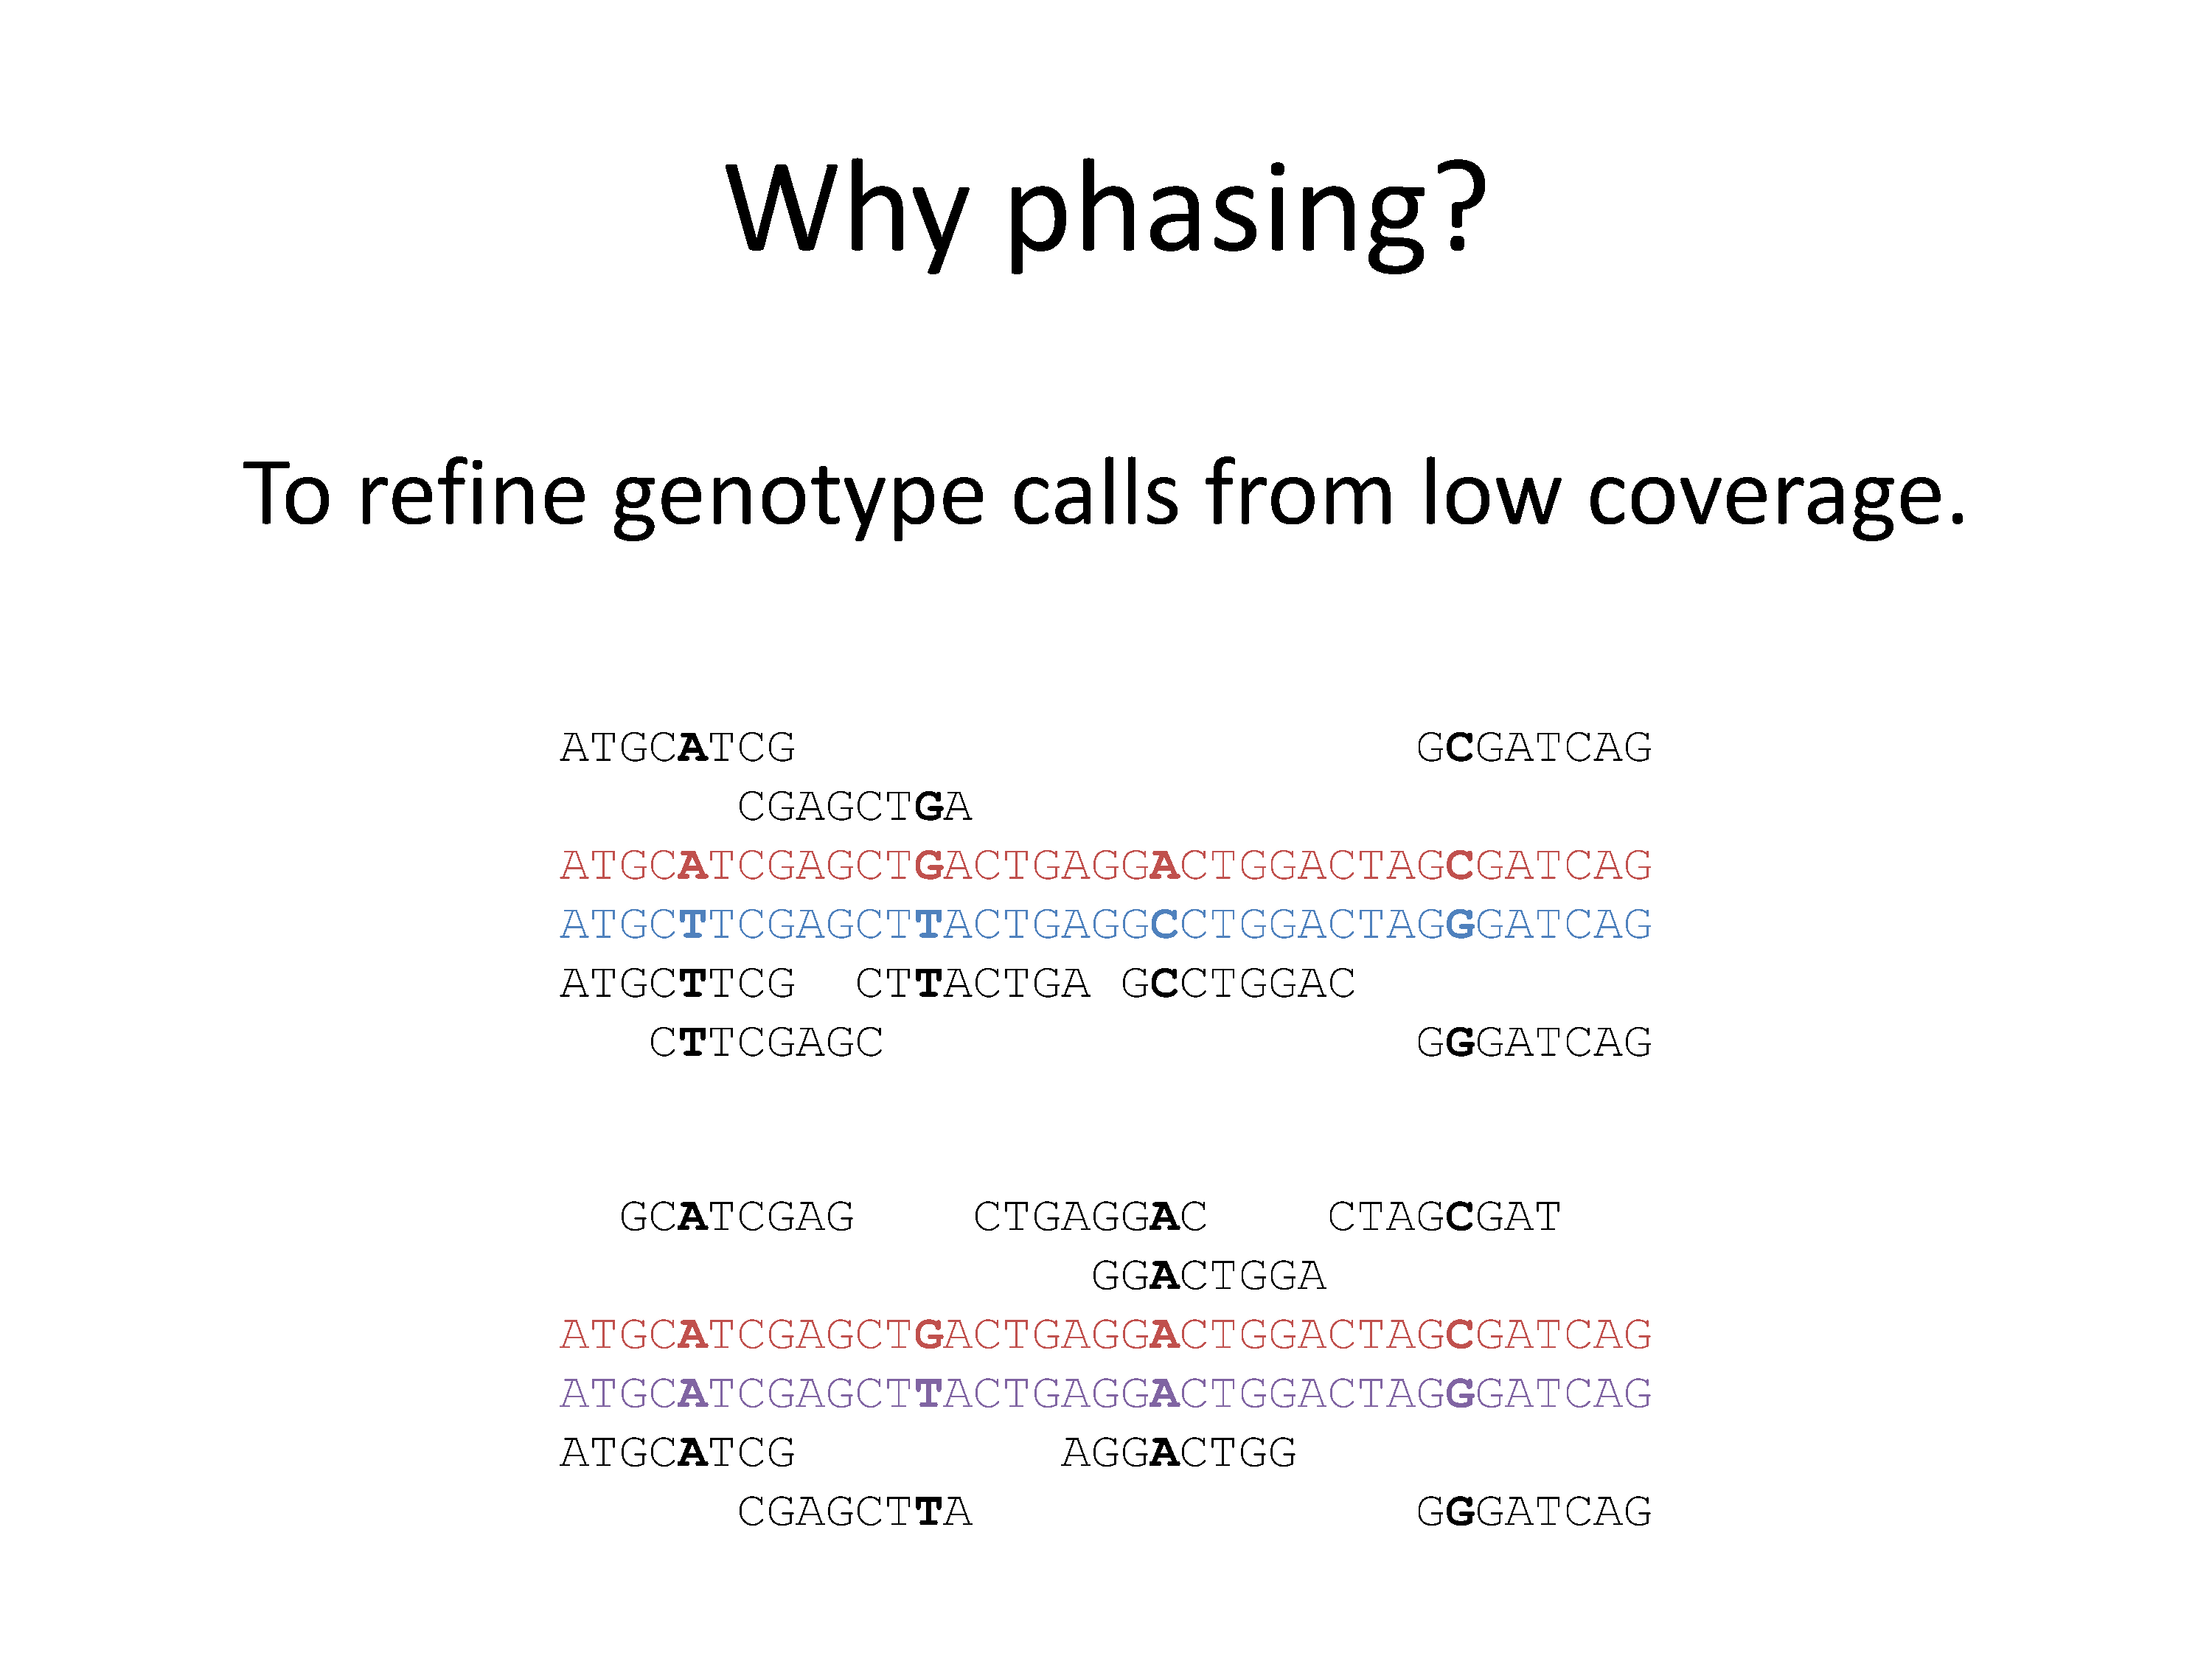
Why did we phase 1000 Genomes?
To get fully resolved haplotypes, obviously,
Notes:
On top of this, this phasing is also required to refine the genotype calls from low coverage sequencing.
With low coverage, some of the alleles may not be covered by reads and thus are impossible to directly type.
However, you work at the haplotype level, you can combine the reads from multiple individuals and virtually increase your coverage to get better genotype calls.
To do so, you need a method that estimate in turn the haplotypes from the reads and the genotypes from the haplotypes.

Slide 36
Why did we phase 1000 Genomes?
To get fully resolved haplotypes, obviously,
But also to refine the genotype calls.
Notes:
On top of this, this phasing is also required to refine the genotype calls from low coverage sequencing.
With low coverage, some of the alleles may not be covered by reads and thus are impossible to directly type.
However, you work at the haplotype level, you can combine the reads from multiple individuals and virtually increase your coverage to get better genotype calls.
To do so, you need a method that estimate in turn the haplotypes from the reads and the genotypes from the haplotypes.

Slide 37
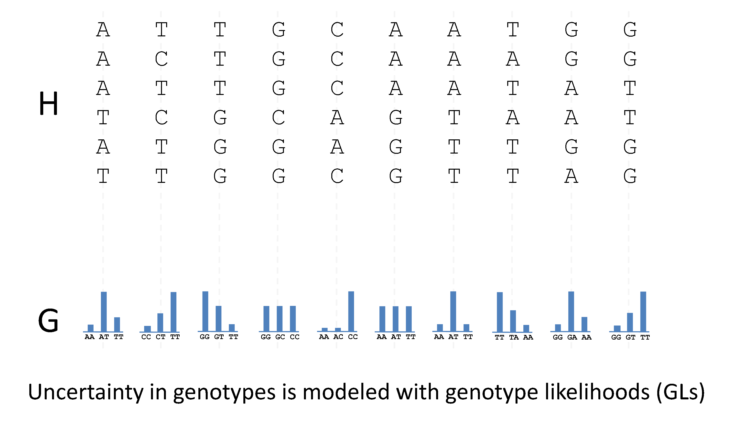
How does it work?
Notes:
With low coverage data, you cannot directly determine accurately the genotypes, instead you use genotype likelihood which captures uncertainty in the genotype definition.
It can be flat when no reads are available and skewed toward a particular genotype when many reads support it.

Slide 38
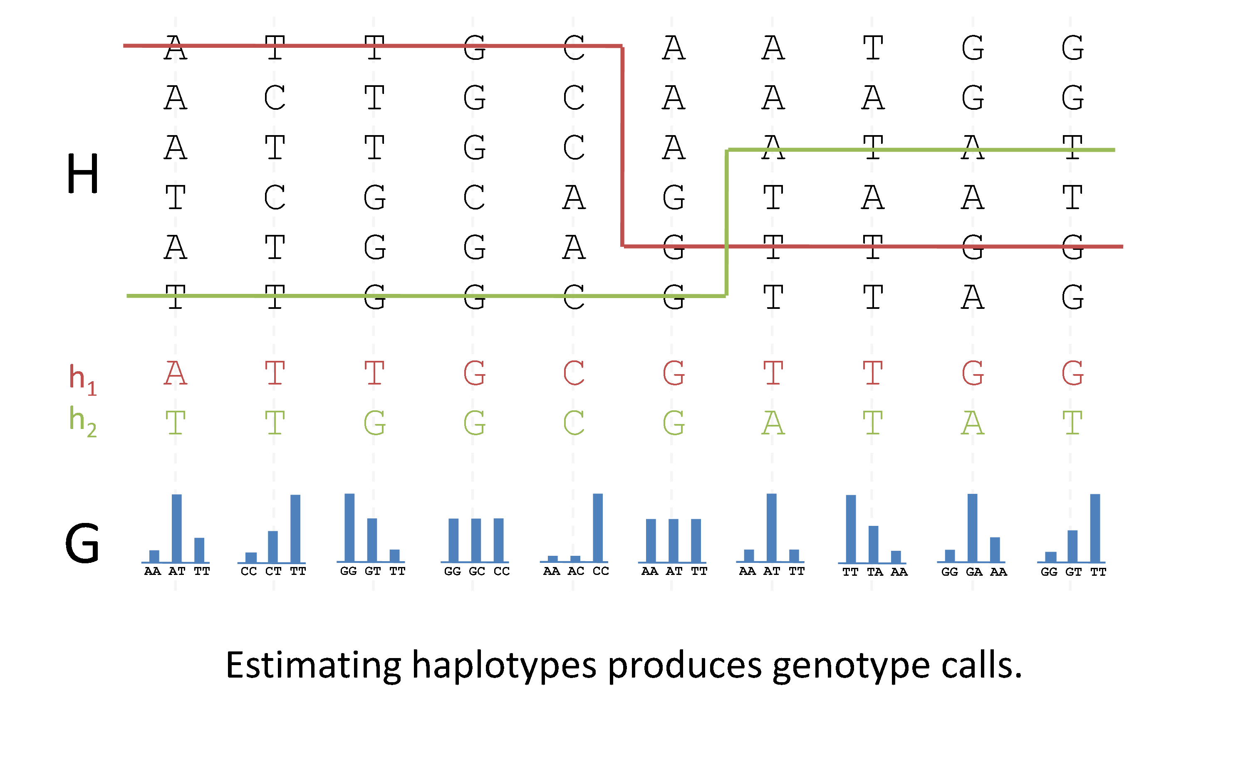
How does it work?
Notes:
As a first step, I developed an extension of the HMM to handle this data.
This produces a pair of haplotypes and as a by product genotype calls for each variant.

Slide 39
Measuring imputation performance
Complete Genomics
Genotypes
Notes:
Once applied on the data, which took 3000 CPU months in total , we got a whole genome haplotype collections that we validated in multiple way.
Given that these haplotypes are mainly used for downstrean imputation into GWAS, which actually is genotype predictions at untyped variants, I’m only presenting here a validation based on this aspect.
To do so, we used data from complete genomics samples that were very deeply sequenced at 80x.

Slide 40
Measuring imputation performance
Genotypes on Illumina 1M
Genotypes NOT on Illumina 1M
Notes:
We split the variants into two sets: variants present on the illumina 1M and those that are not; this set basically mimicking a standard GWAS.

Slide 41
Measuring imputation performance
1000 Genomes
haplotypes
Genotypes on Illumina 1M
Genotypes NOT on Illumina 1M
Notes:
Then, we use the generated 1000 genomes haplotypes …

Slide 42
Measuring imputation performance
1000 Genomes
haplotypes
Genotypes on Illumina 1M
Impute
Genotypes NOT on Illumina 1M
Notes:
… to preduct all genotypes not on the illumina 1M.

Slide 43
Measuring imputation performance
1000 Genomes
haplotypes
Genotypes on Illumina 1M
Impute
Genotypes NOT on Illumina 1M
Imputed genotypes
Notes:
We extracted them ….

Slide 44
Measuring imputation performance
1000 Genomes
haplotypes
Genotypes on Illumina 1M
Impute
R²
R²
Genotypes NOT on Illumina 1M
Imputed genotypes
MAF
Notes:
… and compared them to the true ones that were excluded in the first step.
In practice we measure the correlation between the true and imputed genotypes as a function of the minor allele frequency.
A common trend here is that rare variants are more challenging to predict than common ones.

Slide 45
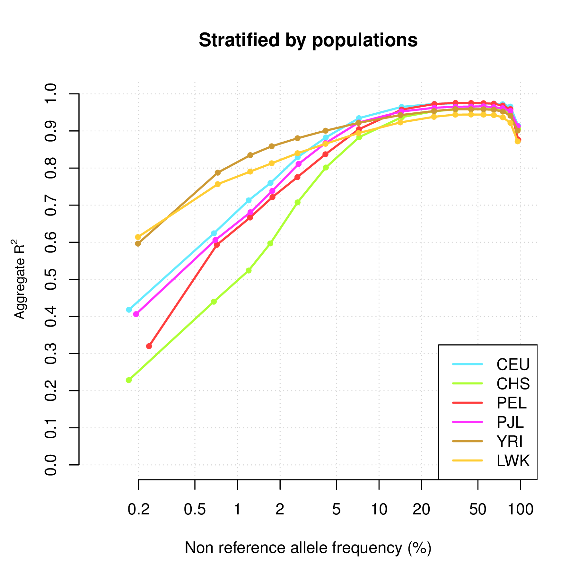
Notes:
Here, the results we got stratified by imputed population.
Here you can see that we got very good imputations of common variants.
And rare variants are better imputed for africans, then europeans and south asians and then east asians.

Slide 46
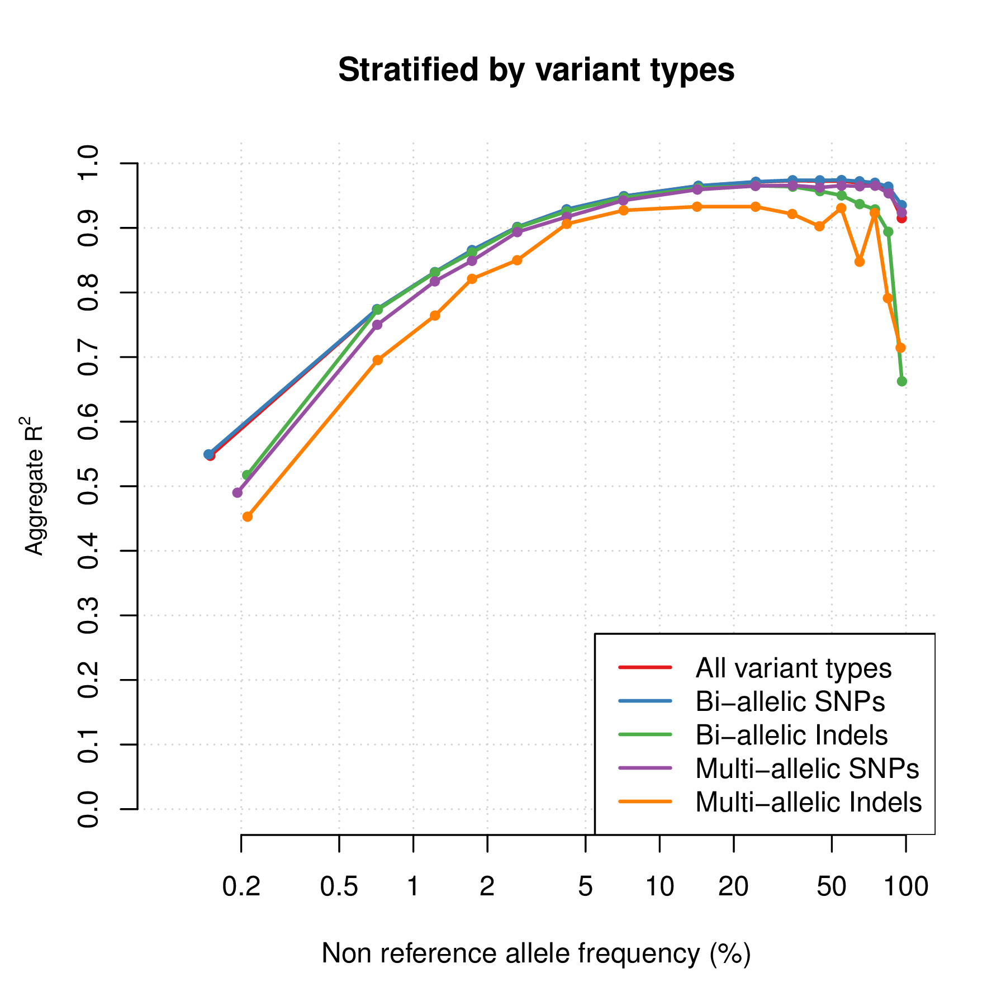
Notes:
If we stratified the imputation qualtiy by variant type,

Slide 47
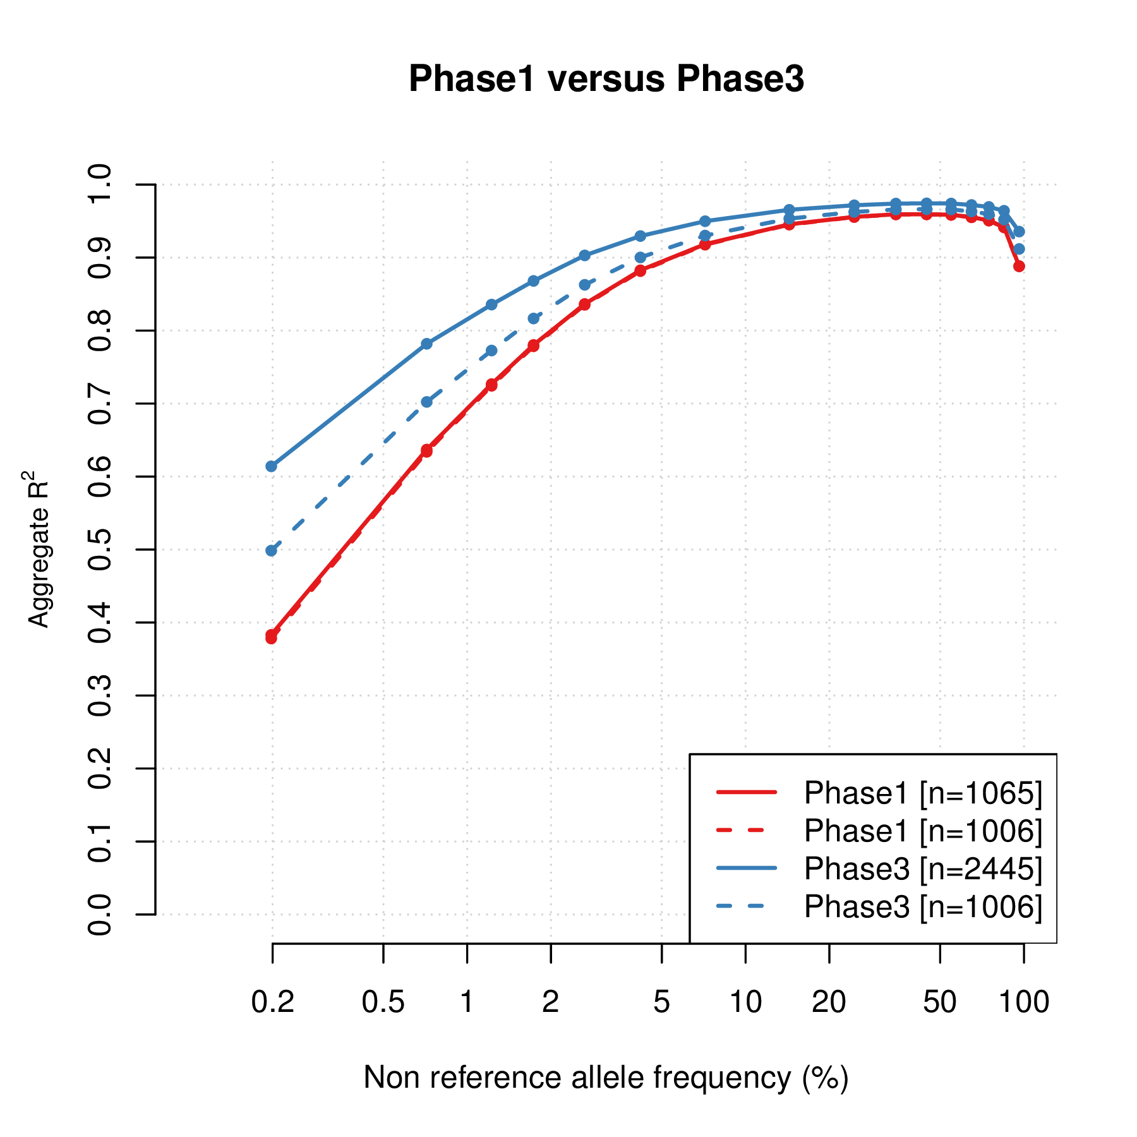
Notes:
And if we compare to what we get with the phase 1 haplotypes, we get much better quality .
Even if we use the set of 2000 haplotypes common to 2 phases as reference.
We believe this results from better sequencing, and more importantly better methods involved in the data processing.

Slide 48
Haplotype reference panels
Reference | Year | # haplotypes | # populations | # variants
HAPMAP 2 | 2006 | 420 | 3 | 2,139,483
HAPMAP 3 | 2009 | 2,368 | 11 | 1,440,616
1000GP Pilot | 2010 | 358 | 3 | 14,894,361
1000GP 2010 | 2010 | 1,258 | 14 | 22,242,654
1000GP Interim | 2011 | 2,186 | 14 | 38,558,931
1000GP Phase 1 | 2012 | 2,186 | 14 | 38,219,282
Reference | Year | # haplotypes | populations | # variants
1000GP Final | 2014 | ~5,000 | 25 | ~80,000,000
UK10K | 2013/14 | ~8,000 | UK | ~50,000,000
GoT2D | 2013/14 | ~5,600 | European | ~27,000,000
GoNL | 2013/14 | 1,000 | NL | ~20,000,000
Q Which reference panel to use for imputation into GWAS?

Slide 49
The Haplotype Reference Consortium
http://www.haplotype-reference-consortium.org/
The HRC data will NOT be publically available, as HapMap and 1000GP haplotypes are, due to consent issues. A subset of HRC haplotypes will be available via EGA for the sole purpose of imputation.
Currently 2 imputation servers exist that allow users to upload genotypes from their GWAS samples, and have imputation carried out remotely and efficiently https://imputation.sanger.ac.uk/
https://imputationserver.sph.umich.edu
A phasing server for high coverage sequenced samples is also available
https://phasingserver.stats.ox.ac.uk/

Slide 50
The Haplotype Reference Consortium
Dataset | Samples | Coverage
IBD | 4514 | 2-4x
UK10K | 3781 | 6.5x
Sardinia | 3514 | 4x
GoT2D | 2874 | 4x + Exome
1000GP Phase 3 | 2535 | 4x + Exome
BRIDGES | 2489 | 6-8x
AMD | 2099 | 4x
Finland | 1941 | 4-6x
MCTFR | 1339 | 10x
HUNT | 1024 | 4x
GECCO | 954 | 4-6x
Project MinE | 943 | 45x
GPC | 767 | 30x
GoNL | 748 | 12x
inCHIANTI | 680 | 7x
Orkney | 399 | 4x
Neptune | 253 | 4x
FVG | 250 | 4-10x
MANOLIS | 249 | 4x
Val Borbera | 225 | 6x
 | 32,488
Goal : create a European haplotype map of over 50,000+ haplotypes by combining together many low-coverage sequencing studies.
Release 1
64,976 haplotypes
39,235,157 SNPs
estimated MAC >= 5
McCarthy et al. (2016) A reference panel of 64,976 haplotypes for genotype imputation. Nature Genetics 10.1038/ng.3643

Slide 51
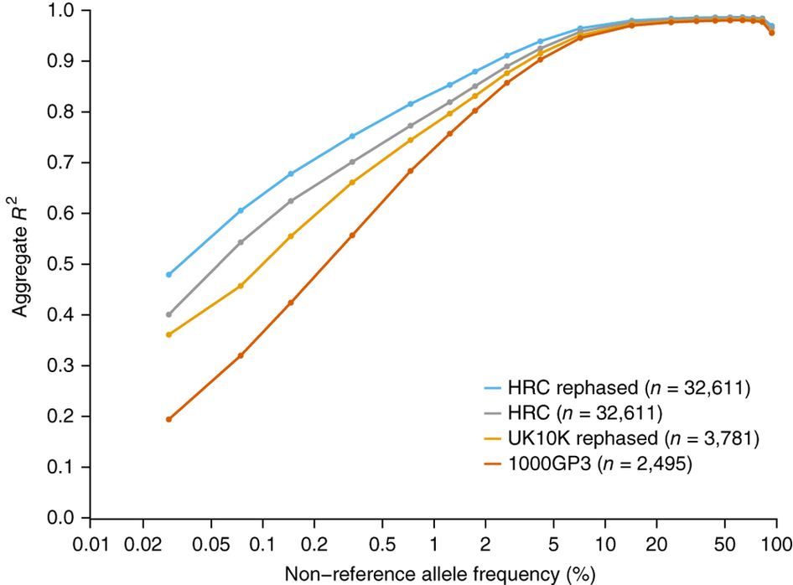
The Haplotype Reference Consortium

Slide 52
Acknowledgments

Slide 53
The afternoon practical

