Slide 1
Data QC and Exploratory Data Analysis (Morning session)
Olivier Delaneau
University of Geneva
19/05/2017

Slide 2
Outline

Slide 3
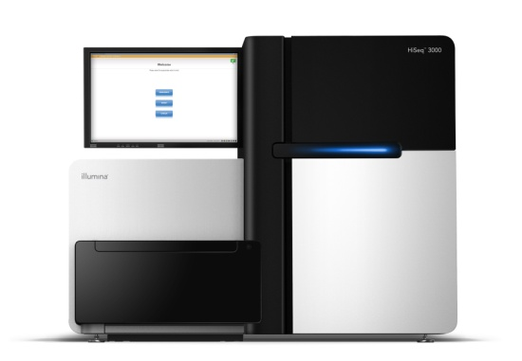

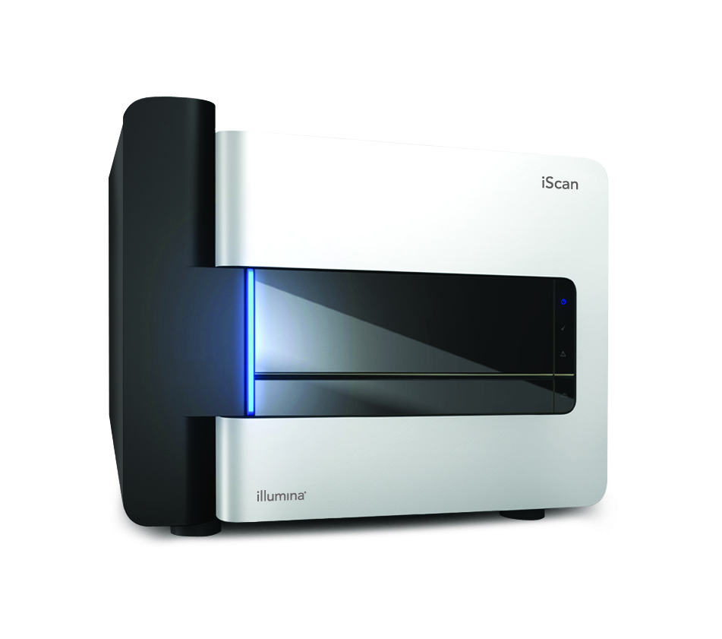
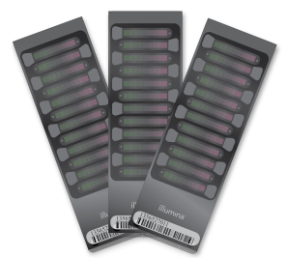
How to read genetic variants?
Sequencing
Sequencer
Variant/Genotype calling
REF
DNA
Map read onto the reference genome and identify variants
Genotyping
Array scanner
Genotype calling

Slide 4
Computing genotype likelihoods
REF
A
1
P( R | G )
0
AA AT TT

Slide 5
Computing genotype likelihoods
REF
A
A
1
P( R | G )
0
AA AT TT

Slide 6
Computing genotype likelihoods
REF
A
A
A
1
P( R | G )
0
AA AT TT

Slide 7
Computing genotype likelihoods
REF
A
A
A
T
1
P( R | G )
0
AA AT TT

Slide 8
Computing genotype likelihoods
REF
A
A
A
T
T
1
P( R | G )
0
AA AT TT

Slide 9
Computing genotype likelihoods
REF
A
A
A
T
T
A
T
A
A
T
1
P( R | G )
0
AA AT TT

Slide 10
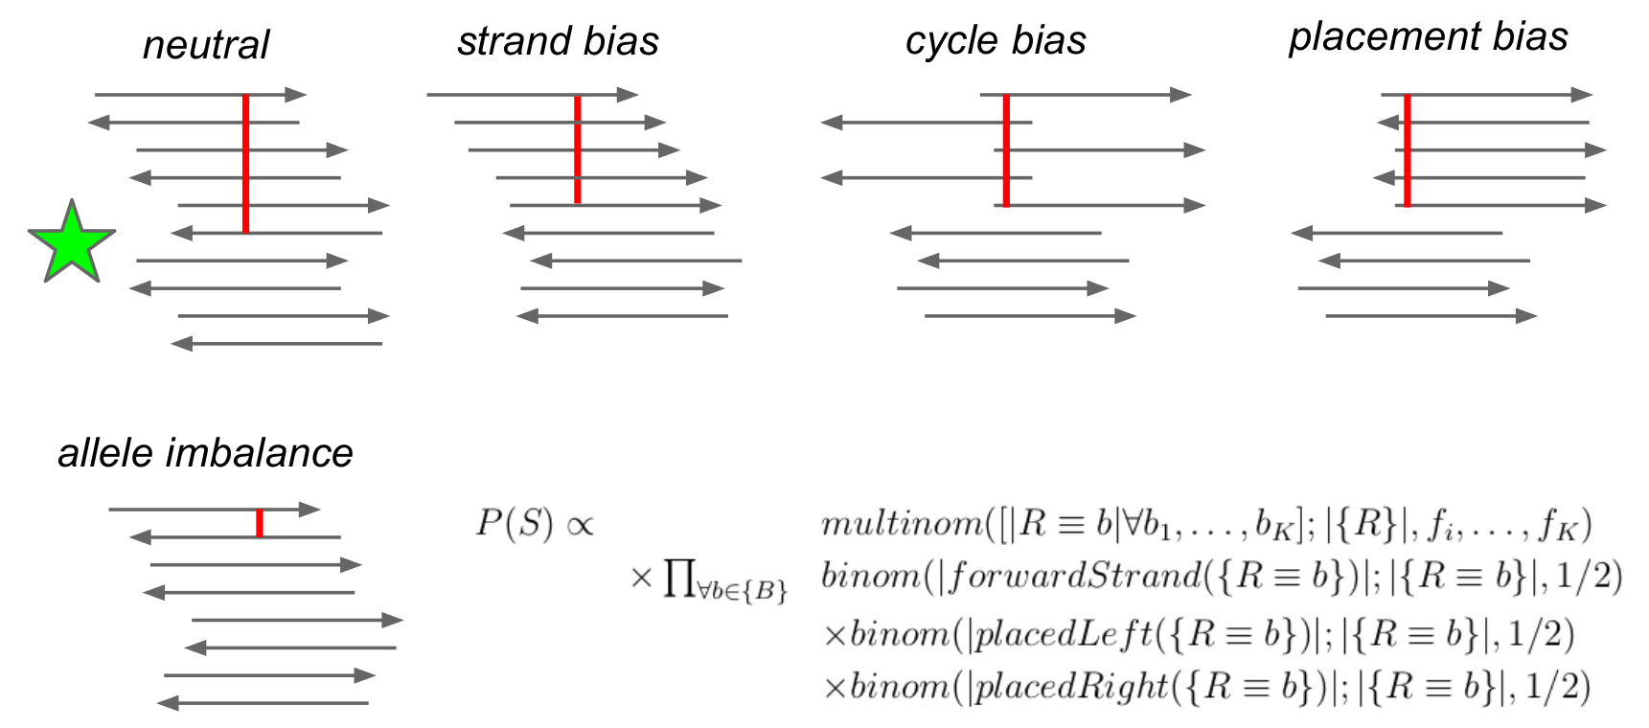
Accounting for sequencing biases
These biases are either modeled in the genotype likelihoods (e.g. FreeBayes) or can be filtered out after variant calling (e.g. samtools) by statistical testing.

Slide 11
Refining genotype calls
P( R | G )
Genotype likelihood

Slide 12
Refining genotype calls
Bayes theorem:
P( G | R ) ~
P( R | G )
x
P( G )
Genotype probability
Genotype likelihood
Prior (Uniform, Frequency or LD)

Slide 13
Refining genotype calls
Bayes theorem:
P( G | R ) ~
P( R | G )
x
P( G )
Genotype probability
Genotype likelihood
Prior (Uniform, Frequency or LD)
1
1
1
P( G | R )
0.50
~
P( R | G )
0.50
X
P( G )
Uniform prior:
0.35
0.35
0.33
0.33
0.33
0.15
0.15
0
AA AT TT
0
AA AT TT
0
AA AT TT

Slide 14
Refining genotype calls
Bayes theorem:
P( G | R ) ~
P( R | G )
x
P( G )
Genotype probability
Genotype likelihood
Prior (Uniform, Frequency or LD)
1
1
1
P( G | R )
0.50
~
P( R | G )
0.50
X
P( G )
Uniform prior:
0.35
0.35
0.33
0.33
0.33
0.15
0.15
0
AA AT TT
0
AA AT TT
0
AA AT TT
1
0.69
1
1
f(T) = 0.4
Frequency prior:
(samtools)
P( G | R )
~
P( R | G )
0.50
X
P( G )
0.48
0.35
0.36
0.16
0.15
0.15
0.16
0
AA AT TT
0
AA AT TT
0
AA AT TT

Slide 15
Genotype calling from chips
Intensity for allele A
Intensity for allele B

Slide 16
Genotype calling from chips
A/A
A/B
Intensity for allele A
B/B
Intensity for allele B

Slide 17
Genotype calling from chips
A/A
A/B
Too far from cluster centroids
=
Missing data point
Intensity for allele A
B/B
Intensity for allele B

Slide 18
Genotype calling from chips
Approaches to call genotypes from intensities (GenomeStudio, APCA or Chiamo)
Automated approaches to call genotypes at millions of SNPs prior to the analysis.
Any finding need to be checked manually and carefully.

Slide 19
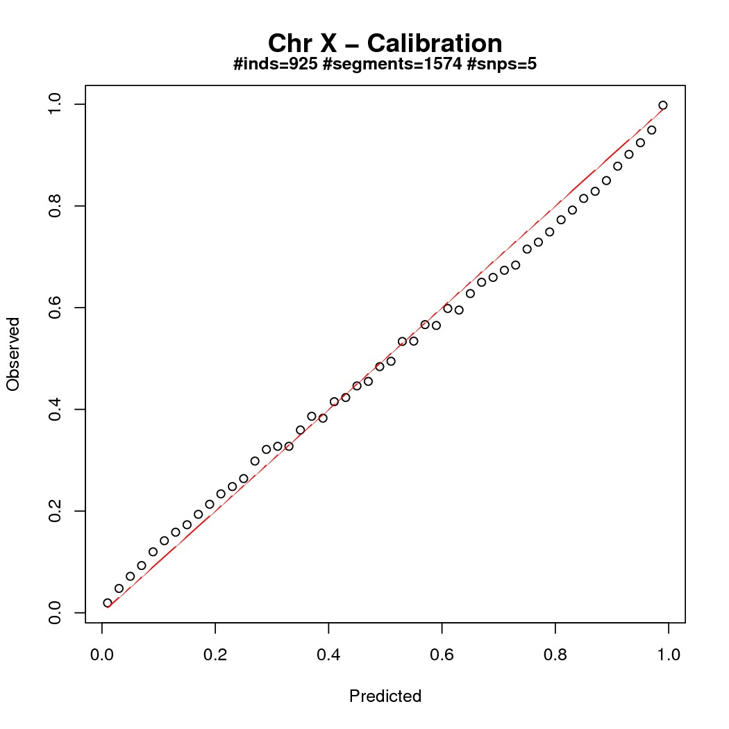
What do I do with genotype probabilities?
Good calibration plot
We usually set as missing all genotypes with low prob. The threshold we use depends on the study design.
Can we afford some incorrect calls? Two scenarios:
Interest in global patterns, a value of 0.9 is okay,
Interest in some particular variants, a value 0.999 is more adapted.
Proportion of true genotypes
Genotype probability bins

Slide 20
The goal of Quality Control
Errors in genotype calling can introduce systematic bias in downstream analysis and can increase the chance of false discoveries.
Assess data quality to remove sub-standard genotypes, samples and variants from subsequent analysis.
There are standardized QC procedures implemented in well-established software packages.

Slide 21
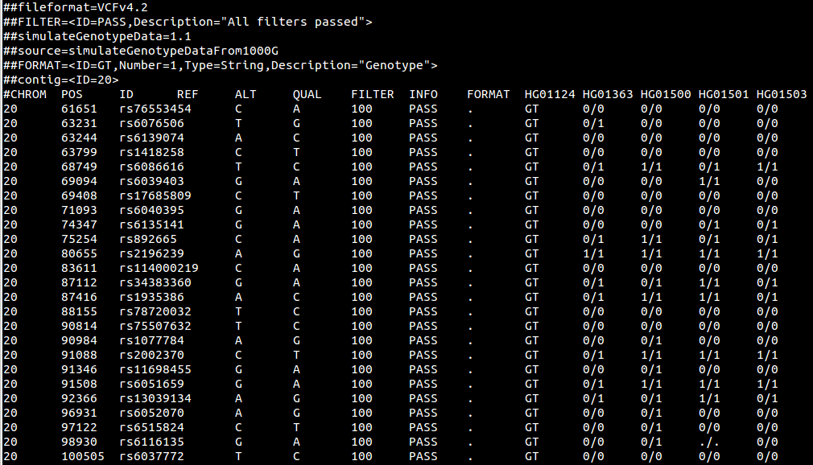
Variant Call Format
Sample IDs
HEADER
HG01124 has genotype TC at rs6086616
Variants
Missing genotype
Position
Reference
Quality
Annotation
Genotypes
Chromosome
Variant
Alternative
Filter
Genotype field

Slide 22
Basic operations on VCF
BCFtools (www.htslib.org)
Efficient data management
Excellent API to develop new tools
VCFtools (vcftools.sourceforge.net)
Standard data analysis (frequency, LD, etc…)
PLINK1.9 (www.cog-genomics.org/plink2
Efficient implementation of all PLINK functionalities (e.g. association testing)

Slide 23
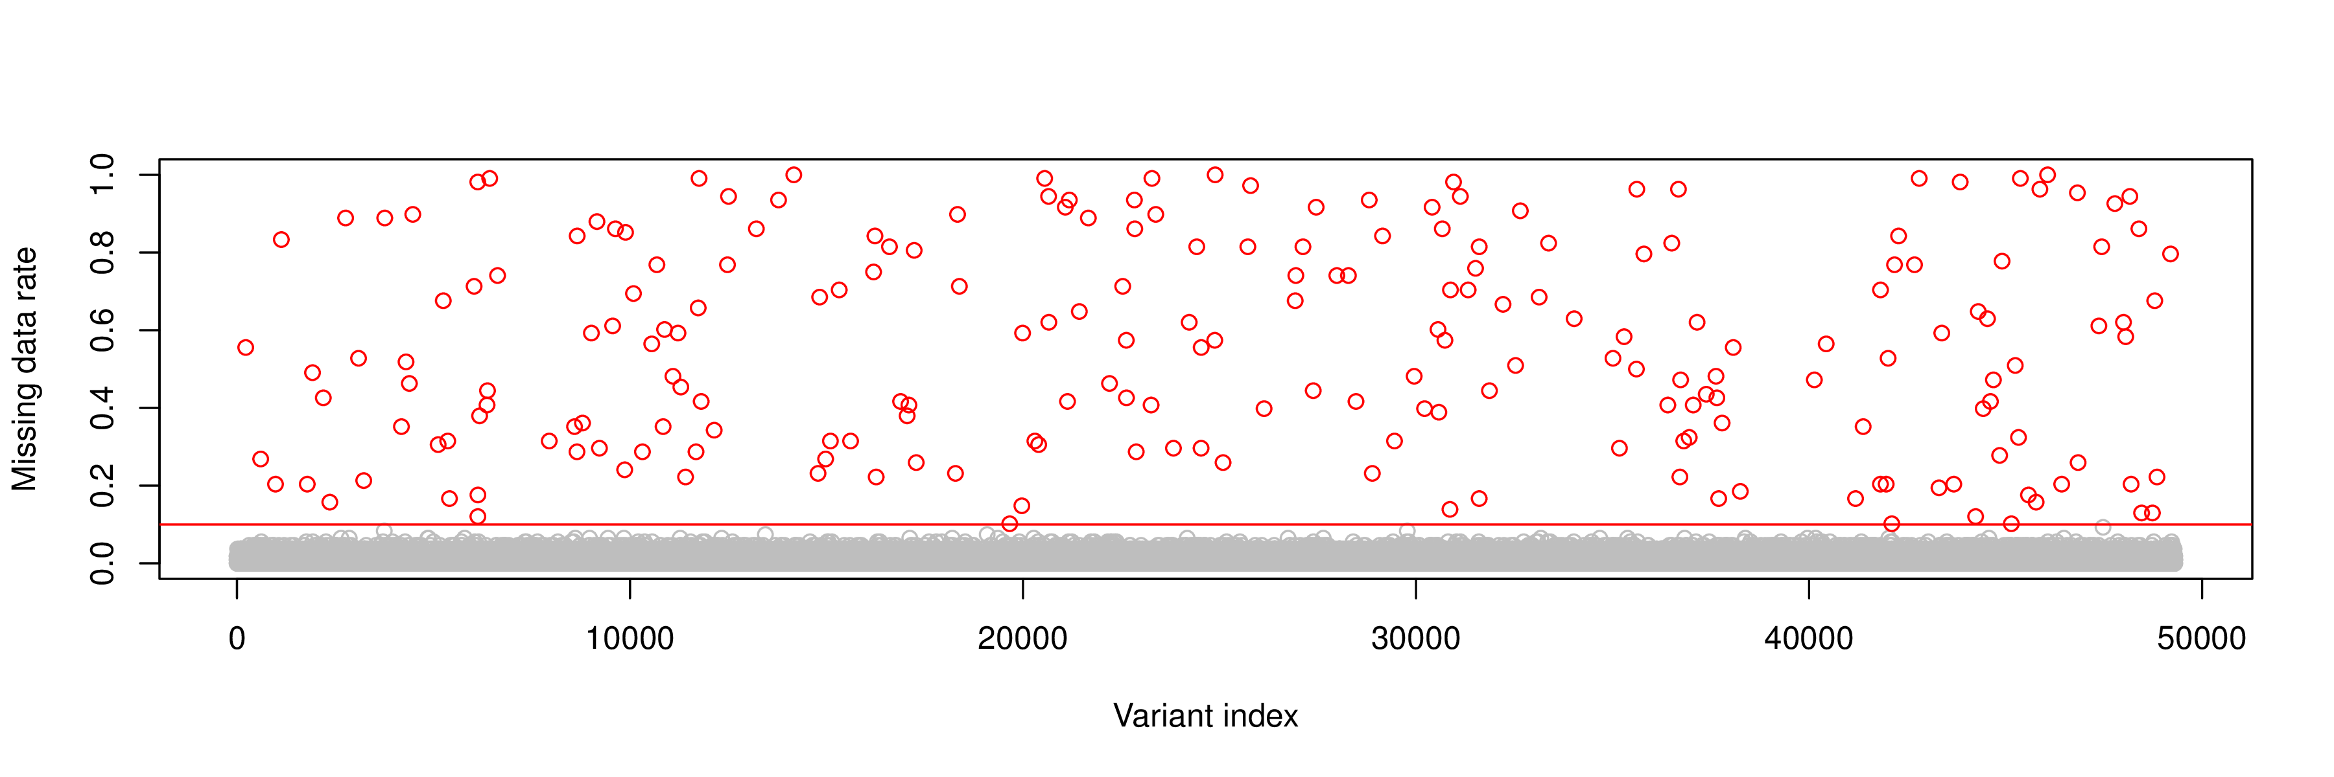
Filter variants with low call rates
Apply threshold to genotype probabilities in order to call genotype, otherwise treated as missing. The choice of calling threshold will impact results:
Too low: include poor quality genotypes.
Too high: unnecessarily remove high quality genotypes, or may introduce bias by preferentially calling specific genotypes.
Variants with poor call rates (i.e. high missing data rates) likely result from poor genotype calling. They need to be removed from the data.

Slide 24
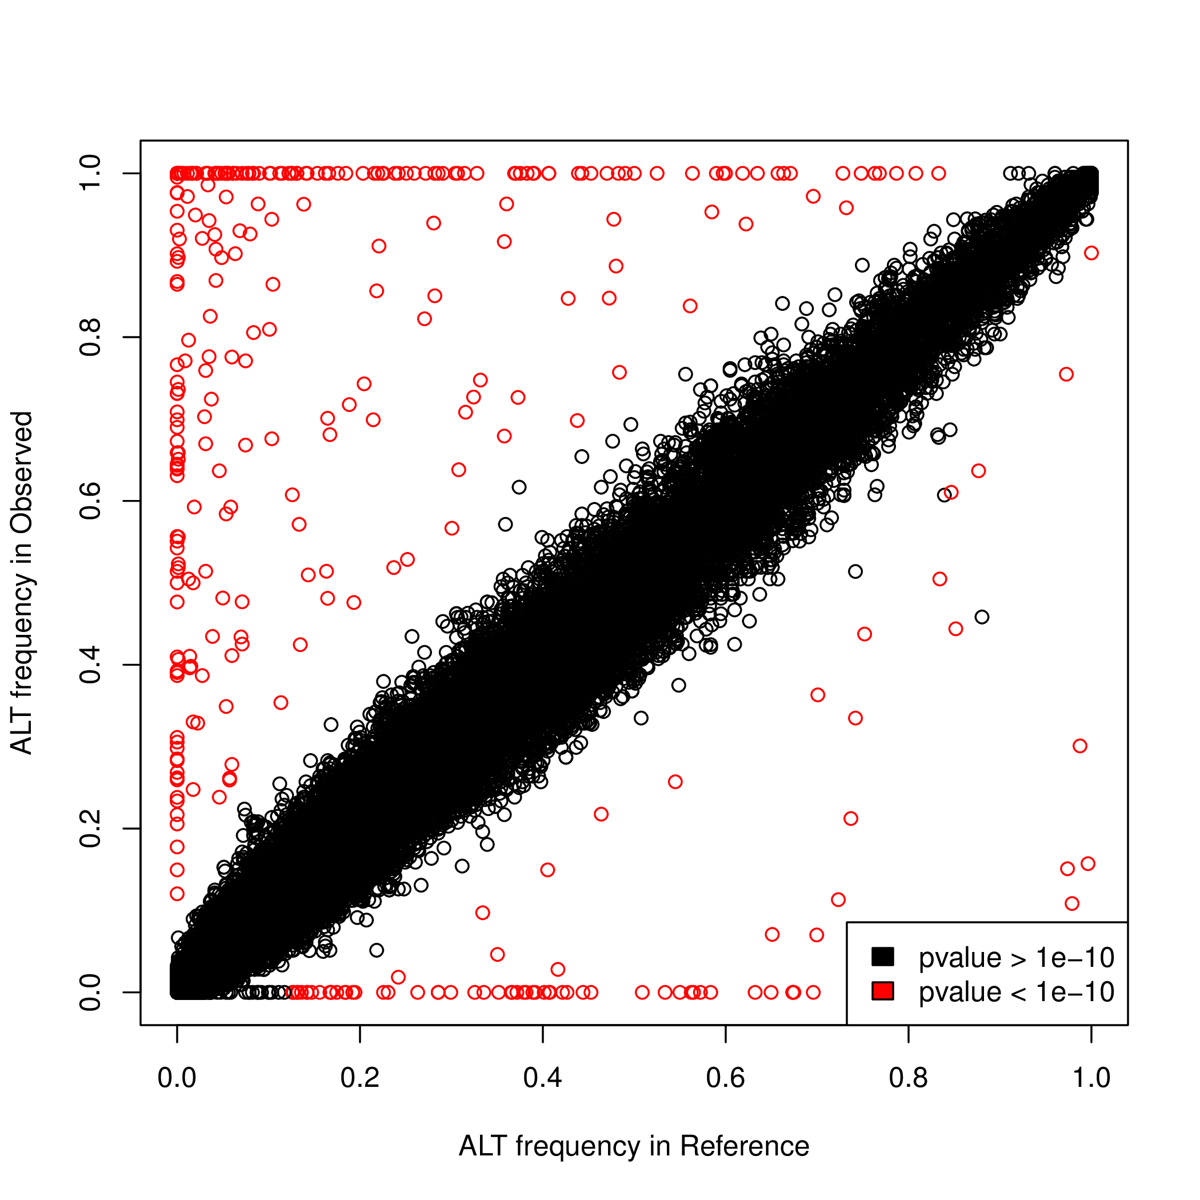
Check variant frequencies
To detect genotyping errors, one can also use large and high quality reference panels such as 1000 Genomes.
We compare the variant frequencies in our data to the frequencies in 1000 Genomes from a relevant population.
Then, one can test for massive differences and remove the corresponding variants.
ALT frequency in myData
ALT frequency in 1000 Genomes

Slide 25
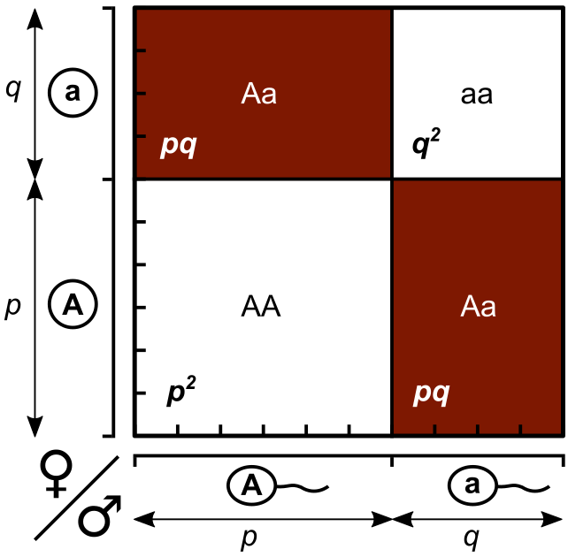
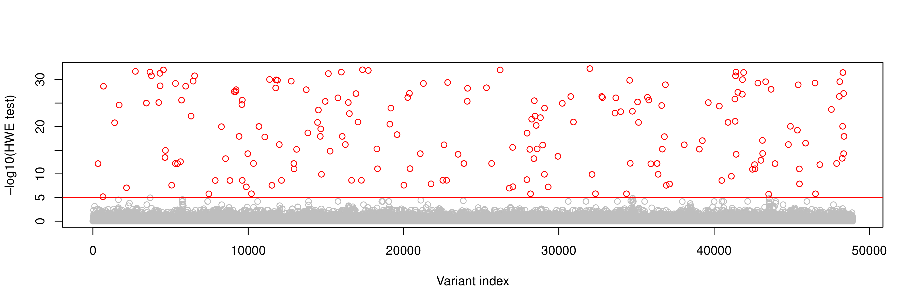
Check Hardy Weinberg Equilibrium
Under the assumption of random mating between individuals in a population, we have the following relationships between allele frequencies and genotype frequencies.
This can also be used to assess the quality of the genotype data by statistical testing (Wigginton, Cutler and Abecasis, 2005).

Slide 26
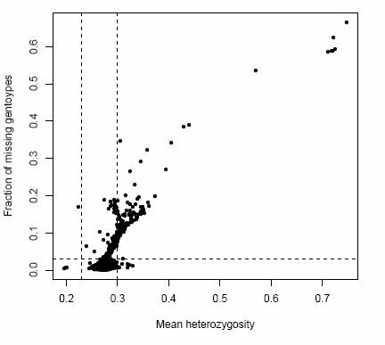
Filter samples with low call rate

Slide 27
Gender check with chromosome X
Each individual plotted twice according to reported gender: females in red and males in blue.
Should these samples be removed from the study or the sex corrected based on heterozygosity? May impact on results if sex is adjusted for in the analysis or if sex specific analyses are to be undertaken.

Slide 28
Check relatedness
Over M markers, the IBS between the ith and jth individuals is given by
where G_{ik} and G_{jk} denote the number of minor alleles (0, 1 or 2) carried by the ith and jth individuals at variant k.
Identical samples will share IBS near to 100% (allowing for genotyping errors).
Related individuals will share higher IBS than unrelated individuals.

Slide 29
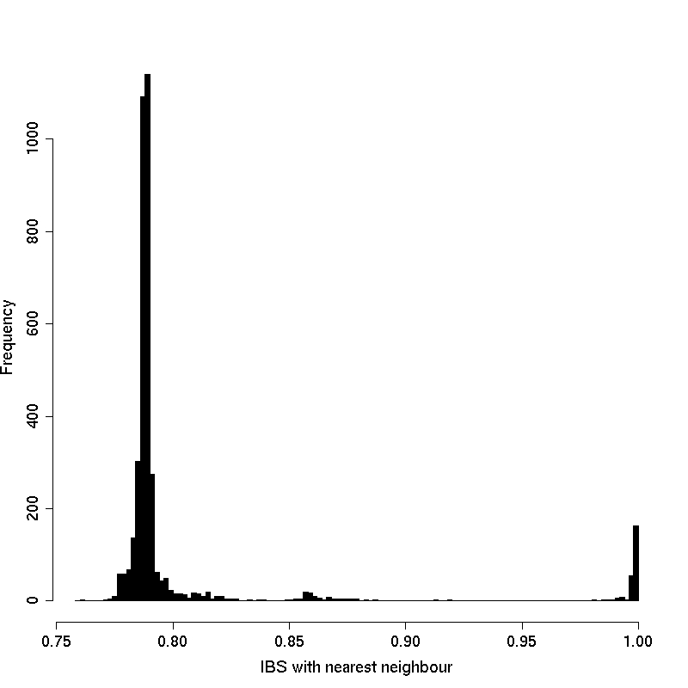
Check relatedness
Duplicates
Relateds

Slide 30
Alternative checks for relatedness
IBS can be used to estimate the proportion of the genome at which a pair of individuals share 0, 1 or 2 chromosomes IBD “identical by descent” (denoted z0, z1, or z2).
Once relative spotted, two options:
Accounting for relatedness in downstream analysis,
Remove close relatives.
Z1
Z0

Slide 31
Population stratification
PCA calculate axes of genetic variation that maximise the variability between individuals.
Plotting axes of genetic variation from PCA including 1000 genomes samples can be used to identify population outliers.
Axes of genetic variation can be used as covariates in the downstream analysis to adjust for the effects of population structure.
Alternative methods exist such as MDS for instance as implemented in PLINK.

Slide 32
Population stratification
Individuals
Individuals
0/0 0/0 … 0/1
0/1 0/1 … 1/1
0/0 1/1 … 1/1
… … … …
0/0 0/0 0/0 0/1
0 0 … 1
1 1 … 2
0 2 … 2
… … … …
0 0 0 1
Dosages
Variants
Variants

Slide 33
Population stratification
Individuals
Individuals
0/0 0/0 … 0/1
0/1 0/1 … 1/1
0/0 1/1 … 1/1
… … … …
0/0 0/0 0/0 0/1
0 0 … 1
1 1 … 2
0 2 … 2
… … … …
0 0 0 1
Dosages
Variants
Variants
PCA
Indiv.
PC2
PC1

Slide 34
Population stratification
Individuals
Individuals
0/0 0/0 … 0/1
0/1 0/1 … 1/1
0/0 1/1 … 1/1
… … … …
0/0 0/0 0/0 0/1
0 0 … 1
1 1 … 2
0 2 … 2
… … … …
0 0 0 1
Dosages
Variants
Variants
PCA
Indiv.
PC2
PC1
Novembre et al. (2008).

Slide 35
What do I do with my PCs?
1. Remove outliers from analysis
2. Account for structure
By defining ethnic groups
By using the PC loadings as covariates
WTCCC (2007)

Slide 36
Summary
QC criteria are subjective and vary from one study to another.
Variant QC filters should eliminate the worst quality markers without “throwing the baby out with the bathwater”.
Sample QC filters should not be so stringent as to remove the majority of the analysis cohort.
Any finding should be followed up with visual inspection of the raw data (i.e. sequencing reads or cluster plots).

Slide 37
Practical
The goal of the practical of this morning is to go from raw to usable genotype data.
We will use multiple standard QC steps both at the variant and sample levels.
The resulting data set will be used as starting material for the practical of this afternoon.

