Slide 1
The coalescent made fun and easy
Andy Clark
EMBO 2017 Population Genomics
Napoli – 23 April 2018

Slide 2
What is the coalescent?
A mathematical construct of the genealogical process describing a random sample of alleles from a population.
A way to model drift and mutation.
Only parameters are:
Population size (N)
Sample size (n)
Mutation rate (μ)

Slide 3
What good is the coalescent?
Makes the mathematics to derive many aspects of population genetics much easier.
Super-fast to simulate.

Slide 4
Objectives
To thoroughly understand why the coalescent is useful.
To be able to explain it to your grandmother.
To be able to code up a simulations, even if trapped in an elevator on a cruise ship with no internet.
To have FUN

Slide 5
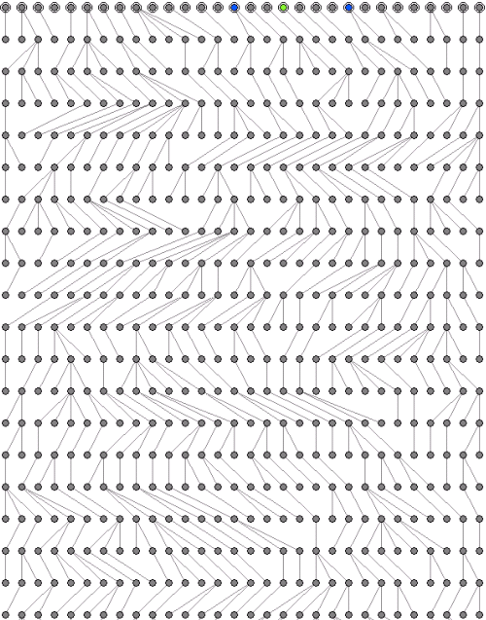
Past

Slide 6
Past
TIME

Slide 7
Past
TIME
Present

Slide 8
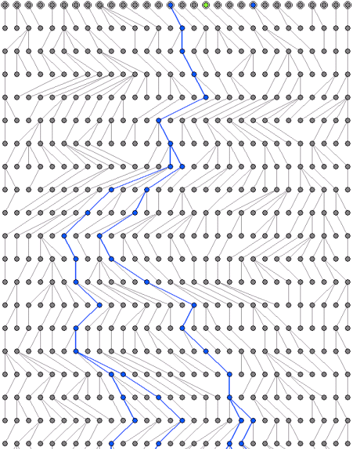
The coalescent considers a collection of genes observed in the present, and asks about their past genealogy.

Slide 9
Thinking backwards in time
Start with the current sample of n haploid individuals.
They represent n lineages.
In the previous generation, these n lineages may have been independent, or there may have been n-1 lineages.
We assume that the sample size much smaller than the population, or n << N.
This guarantees that n never steps to n-2 lineages.

Slide 10
This process gives us a perfect, bifurcating tree, stepping from 5 lineages, to 4, to 3, to 2 and finally coming together in one single common ancestor of the entire sample.
What else do we need to draw the tree?
BRANCH LENGTHS!

Slide 11
Sidebar 1: the exponential distribution
Consider the waiting time to failure.
Suppose Pr(failure each day) = x
Then Pr (not failing) = 1 - x
Pr(not failing for 4 days) = (1- x)(1- x)(1- x)(1- x)
NOTE: (1- x)^{t} ~ e^{-xt} when x is small.
So Pr(failing at time t) = te^{-xt}
The mean of an exponential with parameter x is 1/x.
R statement to give n draws from exp is rexp(n,x).

Slide 12
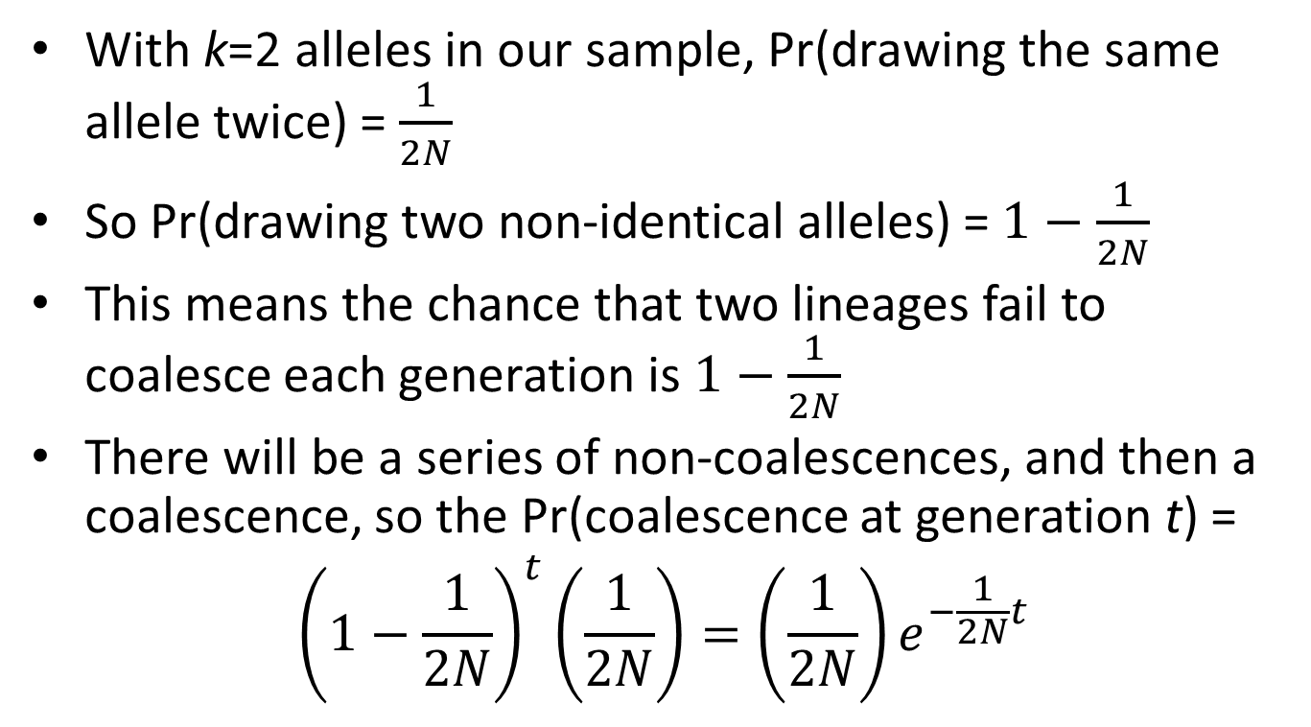
Branch lengths
With k=2 alleles in our sample, Pr(drawing the same allele twice) = $\frac{1}{2N}$
So Pr(drawing two non-identical alleles) =$1−\frac{1}{2N}$
This means the chance that two lineages fail to coalesce each generation is $1−\frac{1}{2N}$
There will be a series of non-coalescences, and then a coalescence, so the Pr(coalescence at generation t) =
$${\left(1−\frac{1}{2N}\right)}^{t}\left(\frac{1}{2N}\right)=\left(\frac{1}{2N}\right)e^{−\frac{1}{2N}t}$$

Slide 13
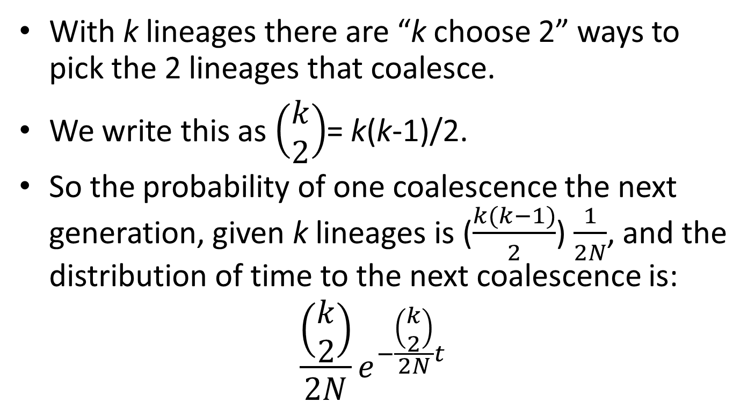
Coalescence among k lineages
With k lineages there are “k choose 2” ways to pick the 2 lineages that coalesce.
We write this as $\left(\begin{matrix}k \\ 2\end{matrix}\right)$= k(k-1)/2.
So the probability of one coalescence the next generation, given k lineages is ($\frac{k(k−1)}{2}$) $\frac{1}{2N}$, and the distribution of time to the next coalescence is:
$$\frac{\left(\begin{matrix}k \\ 2\end{matrix}\right)}{2N}e^{−\frac{\left(\begin{matrix}k \\ 2\end{matrix}\right)}{2N}t}$$

Slide 14
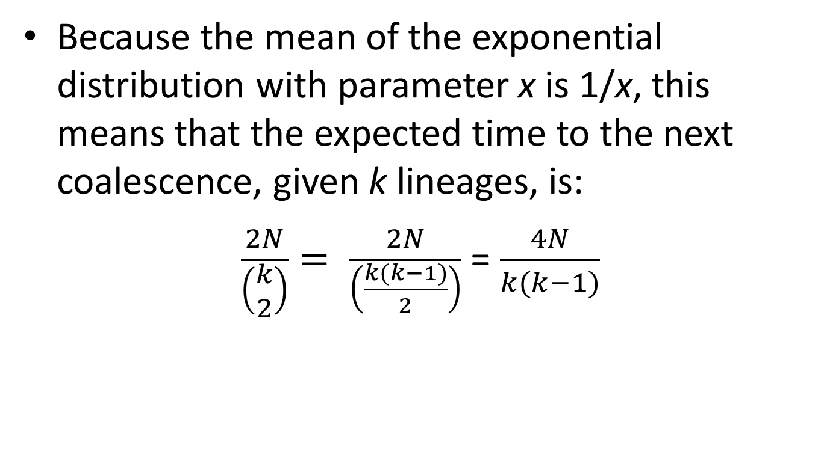
Expected time to next coalescence
Because the mean of the exponential distribution with parameter x is 1/x, this means that the expected time to the next coalescence, given k lineages, is:
$\frac{2N}{\left(\begin{matrix}k \\ 2\end{matrix}\right)}= \frac{2N}{\left(\frac{k(k−1)}{2}\right)}$ = $\frac{4N}{k(k−1)}$
This means that the time to the next coalescence is relatively short when there are many lineages, and after successive coalescences, the time to the next coalescence gets longer and longer.

Slide 15
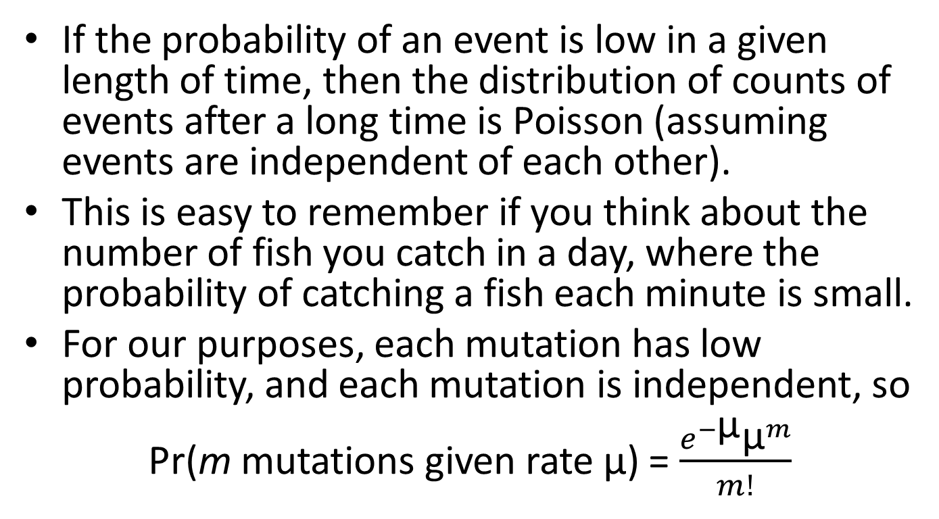
Sidebar 2: The Poisson distribution
If the probability of an event is low in a given length of time, then the distribution of counts of events after a long time is Poisson (assuming events are independent of each other).
This is easy to remember if you think about the number of fish you catch in a day, where the probability of catching a fish each minute is small.
For our purposes, each mutation has low probability, and each mutation is independent, so
Pr(m mutations given rate μ) = $\frac{e^{−\text{μ}}{\text{μ}}^{m}}{m!}$

Slide 16

How many mutations (segregating sites) are expected between a pair of alleles?
The tree for two alleles is simply an inverted V, where the branch length t is the expected time to coalescence:
E(time to coalesce two alleles) = E( ) = 2N
Mutations are accumulating on each branch from a current allele back to the common ancestor, so the expected number of mutations is 2μ ×(branch length) = 2μ × 2N = 4Nμ
$$\frac{1}{2N}e^{−\frac{1}{2N}t}$$

Slide 17
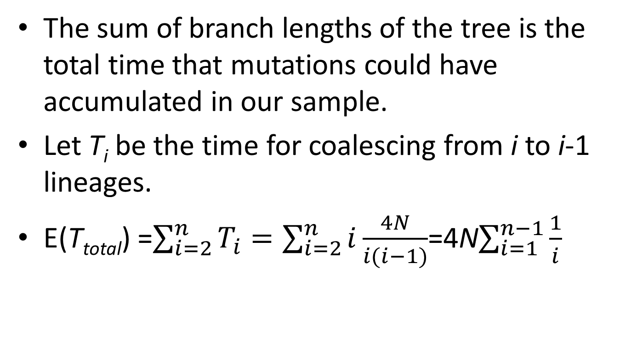
What is the total length of the branches of the genealogy?
The sum of branch lengths of the tree is the total time that mutations could have accumulated in our sample.
Let T_{i} be the time for coalescing from i to i-1 lineages.
E(T_{total}) =$\sum_{i=2}^{n}{T_{i}}=\sum_{i=2}^{n}{i\frac{4N}{i(i−1)}}$=4N$\sum_{i=1}^{n−1}{\frac{1}{i}}$

Slide 18
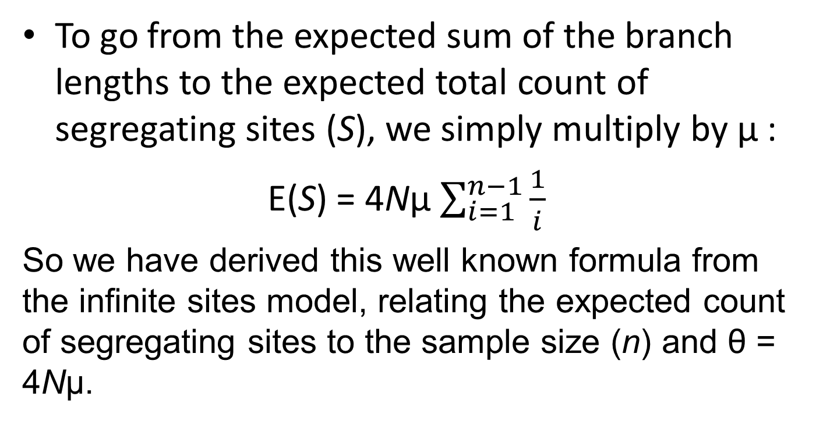
Expected count of segregating sites
To go from the expected sum of the branch lengths to the expected total count of segregating sites (S), we simply multiply by μ :
E(S) = 4Nμ $\sum_{i=1}^{n−1}{\frac{1}{i}}$
So we have derived this well known formula from the infinite sites model, relating the expected count of segregating sites to the sample size (n) and θ = 4Nμ.

