Slide 1


Selection: phenotypes and genotypes
Andrea Manica
2017 EMBO lecture

Slide 2
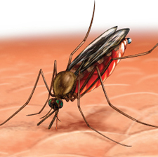

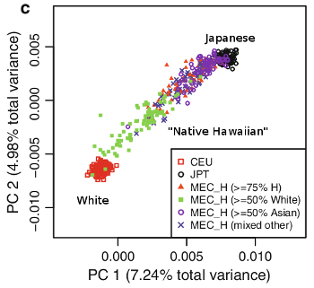

Outline
Some classic examples
Selection scans vs GWAS
Challenges
Practical

Slide 3
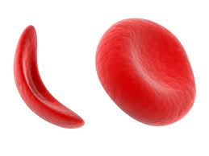
Some “classics”
Sickle cell anaemia – heterozygote advantage in the presence of malaria
But is this the driver of this mutation? Beware of “just so stories”
Recent test suggest significant association in terms of geographic spread in Africa, but not Asia or Americas
Piel et al Nat Comm (2010)

Slide 4
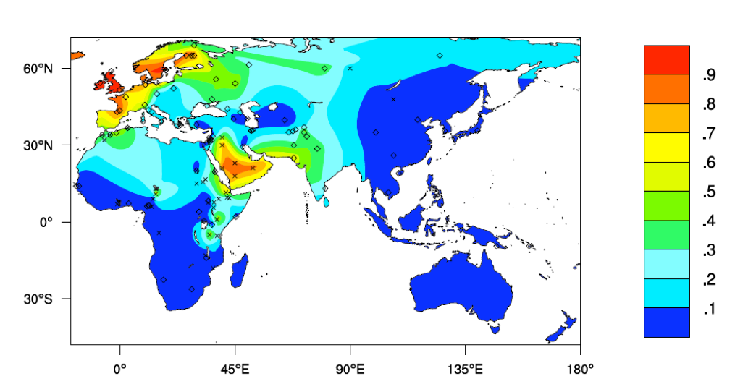
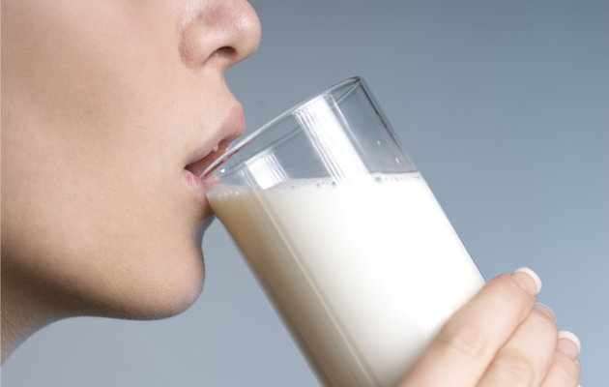
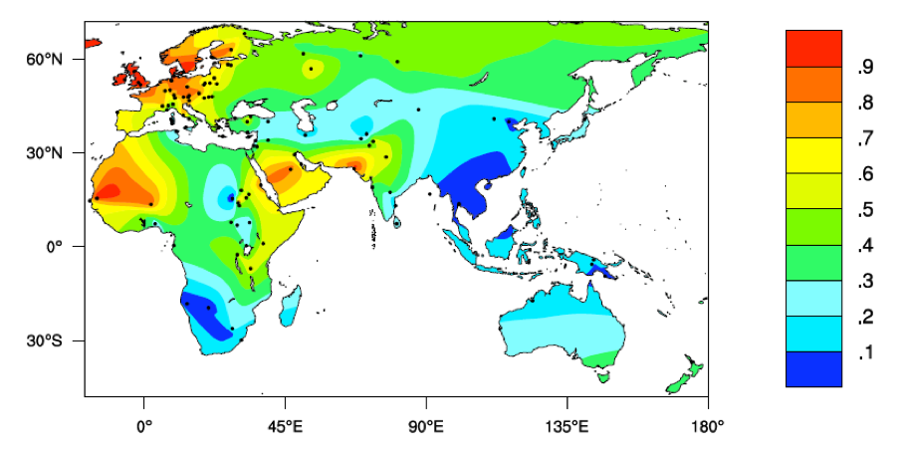
Some “classics”
Lactose tolerance – ability to digest milk in adulthood
SNPs giving lactose tolerance
Multiple mutations giving the same phenotype
distribution of phenotype
European version suggested to arrive with Neolithic farmers
But high frequency only following the Bronze age arrival of Steppe ancestry

Slide 5
Selection in AMHs populations
Many scans for regions under selection
Look for genomic regions with unusual characteristics that are likely signatures of selection
Many selection statistics, with different properties. Some focus on individual loci, others on haplotypes
Grossman et al Cell (2013)

Slide 6
Problem with selection scans
Different scans give very different lists of loci under selection:
Different statistics detecting different types of selection events?
Different population panels?
Lots of false positives?
Ideally use functional studies to confirm candidates (e.g. Toll-Like Receptor TLR5 response to flagellin in transgenic mice)
But expensive and time consuming
Grossman et al Cell (2013)

Slide 7
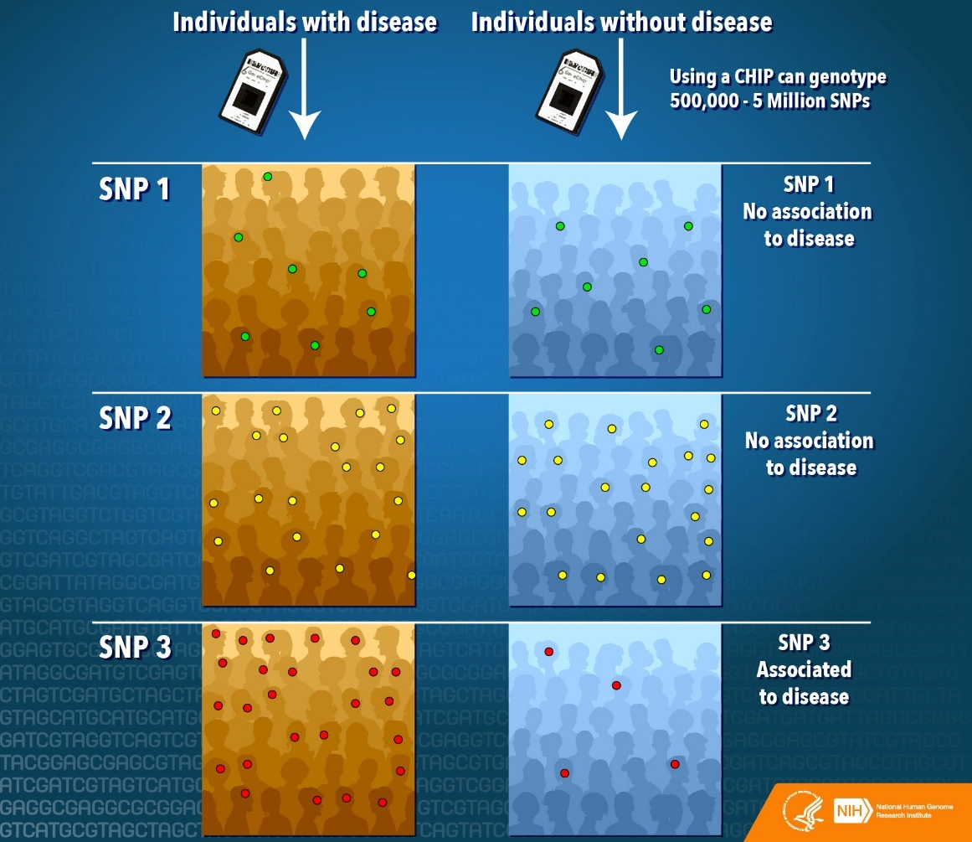
Genome Wide Association Studies
For known phenotypes, we can look for Single Nucleotide Polymorphisms (SNPs) associated with them
GWAS assume that common variants have important effects
Big debate on whether they delivered useful information
[...] the bulk of heritability in these conditions cannot be ascribed to loci that have emerged from GWAS [...]
Sir Alec Jeffreys

Slide 8
Genome Wide Association Studies
New SNPs being added constantly
Sample size matters a lot
Most SNPs have VERY small effects
Visscher et al AJHG (2012)

Slide 9
Selection in AMHs populations
Compare results to GWAS: large hits from selection scans often associated with a SNP from GWAS (but smaller hits not as easily classified)
Grossman et al Cell (2013)

Slide 10
GWAS – the basics
Simple summary for a binary phenotype
 | aa | aA | AA
Cases | r₀ | r₁ | r₂ | r
Control | s₀ | s₁ | s₂ | s
 | n₀ | n₁ | n₂ | n
H₀: Genotypes and phenotypes are independent
H₁: Genotypes frequencies differ between cases and controls
Simple contingency table, χ² test
It assumes codominance

Slide 11
GWAS – the basics
Additive model – simple allele test
 | aa | aA | AA
Cases | r₀ | r₁ | r₂ | r
Control | s₀ | s₁ | s₂ | s
 | n₀ | n₁ | n₂ | n
 | a | A
Cases | 2*r₀+r₁ | 2*r₂+r₁
Control | 2*s₀+s₁ | 2*s₂+s₁
Simple 2x2 table, χ² test
Fancier approaches, e.g. Cochran-Armitage test

Slide 12
Continuous phenotypes
Continuous phenotypes – e.g. BMI, cholesterol, etc.
We can model a Guassian response with a simple linear model (regression) framework:
Y = α + βX + ε
where X defines the genotype (# of A alleles in an individual), and ε is the error term
β ≠ 0 means that the number of A alleles is a predictor of the phenotype
The advantage of the regression framework is that we could also include additional covariates (smoking, # hours of exercise, etc.) that might affect the phenotype.

Slide 13
Regression and binary phenotypes
Binary responses can be modelled in a General Linear Model framework
Consider binary response:
Develop Coronary Heart Disease (CHD) vs Did NOT develop CHD
Y is the probability that an individual developed CHD
Phrase Y in terms of odds (Y to 1-Y):
Y=0.2 => 1 to 4

Slide 14
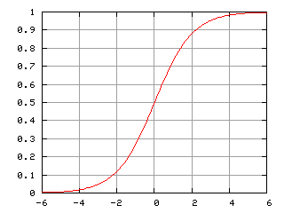

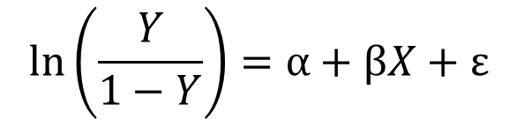
Regression and binary phenotypes
We can model the ln of the odds ratio (called a logit) as a linear response
$$\ln\left(\frac{Y}{1−Y}\right)=α+βX+ε$$
$$Y=\frac{1}{1+e^{−(α+βX+ε)}}=\frac{1}{1+e^{−z}}$$
Logistic equation

Slide 15
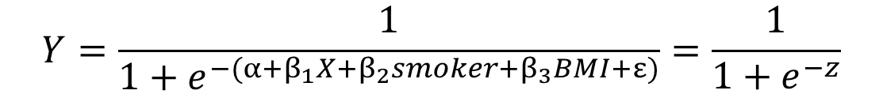
Regression and binary phenotypes
We could easily expand the model to include additional covariates besides the genotype information
$$Y=\frac{1}{1+e^{−(α+β_{1}X+β_{2}smoker+β_{3}BMI+ε)}}=\frac{1}{1+e^{−z}}$$
And by rephrasing X, we could model different types of dominance.

Slide 16
Challenges – Multiple testing
A type I error occurs when we reject the H₀ of no association, when in fact the null hypothesis is true.
It is important to correct for multiple testing to maintain the type I error rate for the experiment overall (i.e. all the SNPs tested in the association study).
Several solutions:
Bonferroni correction (0.05/#SNPs)
False Discovery Rate
Randomisation tests
Replication is necessary to confirm association.

Slide 17
Challenges - Stratification
Stratification (e.g. from population structure) can generate spurious results.
For small levels of stratification, we can use the genomic control approach
Under the assumption that most loci are neutral and the ones under selection have relatively small effects, we expect a χ² distribution with 1df for our test statistics.

Slide 18
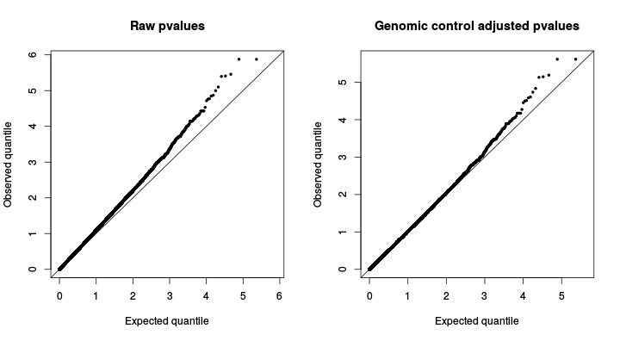
Challenges - Stratification
Look at a Q-Q plot
λ is the median of the test scores divided by the median of the expected χ²₁
We can use λ, if ≠1, as a correction factor

Slide 19
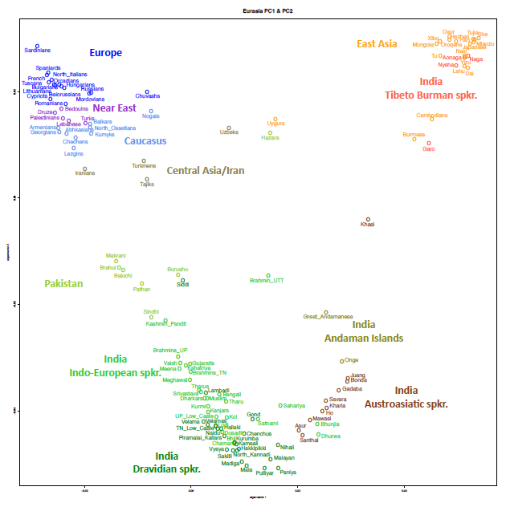
Challenges - Stratification
Genomic control not appropriate for strong stratification.
If discrete clusters, then we could simply compute stats within each stratum and pool stats.

Slide 20
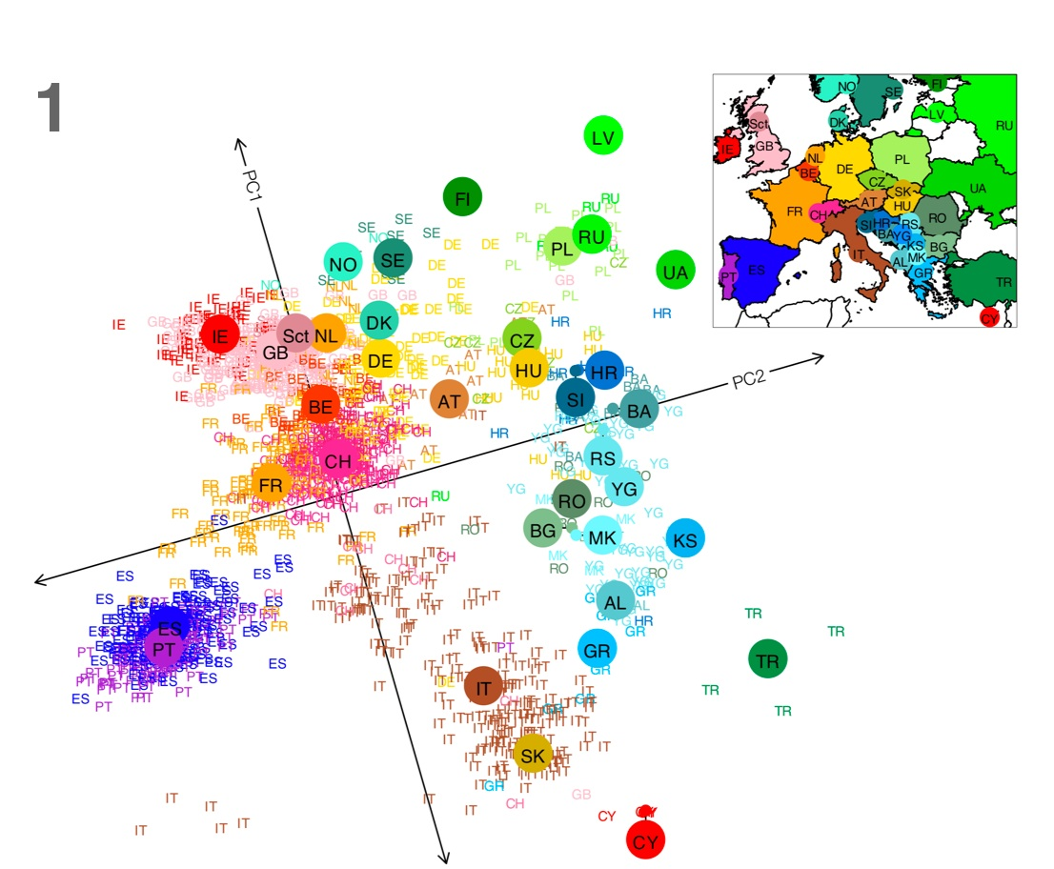

Challenges - Stratification
If stratification not discrete, then we can use PCA to provide information on the relationships between samples.
Use PCs as covariates to account for stratification
$$Y=\frac{1}{1+e^{−(α+β_{1}X+β_{2}PC1+β_{3}PC2+ε)}}$$

Slide 21
The importance of Quality Control
Data QC is ESSENTIAL! Significances are meaningless if assumptions are broken.
Olivier covered the key issues on the first day. You should always thoroughly clean your data before you do ANY analysis (GWAS is particularly affected by QC, but other approaches too!)
HWE is a key assumption, and something easy to test. Deviations from HWE are a good indication that your data might be problematic (but not always!).

Slide 22
Summary
Some classic examples
Selection scans vs GWAS
Challenges
Practical

Slide 23
Practical
Use the R package GenABEL for GWAS
Get an overview of your data
Run a simple GWAS
Run basic QC on data and see how it affects your results
Correct for stratification in a few ways

