Slide 1
Data QC and Exploratory Data Analysis
Olivier Delaneau
University of Geneva
21/04/2018

Slide 2
Outline
Methods for genotyping
File format for genotype data and standard data management tools
QC at the genetic variant level
QC at the sample level
Population structure
Information on the practical

Slide 3
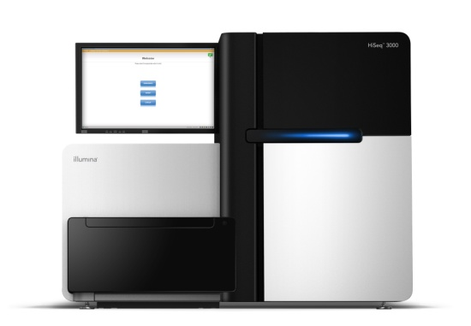

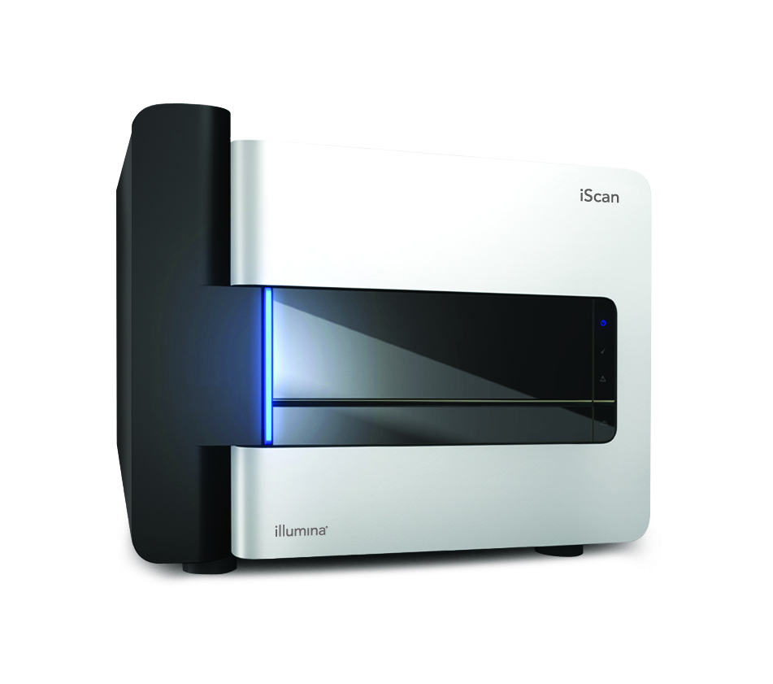
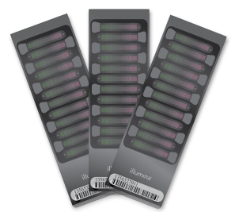
How to get genotype data?
Sequencing
Sequencer
Variant/Genotype calling
REF
DNA
Map read onto the reference genome and identify variants
Genotyping
Array scanner
Genotype calling
Notes:
Two ways of getting genotype data:
Sequencing or genotyping
Sequencing is a technic that allows screening in theory all accessible variants in the human genome.
DNA is basically broken into short fragments that are then sequenced and mapped onto a reference genome in order to detect variations and type these vriations.
Genotyping is another technic, cheaper, that only focuses on some known variations, usually in the order of millions.
These variations are tagged by probes on the chip , DNA is fragmeted, different alleles at these variants marked with different fluorescent dyes, then hybridized on the array.

Slide 4
How to get genotype data?
Sequencing
Sequencer
Variant/Genotype calling
REF
DNA
Map read onto the reference genome and identify variants
Genotyping
Array scanner
Genotype calling

Slide 5
Calling genetic variations
Raw reads (FASTQ)
Mapped reads (BAM)
QC on sequ.
reads
Variant and genotype
calling (VCF)
QC on variants
and individuals
Genotype data ready for analysis (VCF)

Slide 6
Computing genotype likelihoods
REF
A
1
P( R | G )
0
AA AT TT

Slide 7
Computing genotype likelihoods
REF
A
A
1
P( R | G )
0
AA AT TT

Slide 8
Computing genotype likelihoods
REF
A
A
A
1
P( R | G )
0
AA AT TT

Slide 9
Computing genotype likelihoods
REF
A
A
A
T
1
P( R | G )
0
AA AT TT

Slide 10
Computing genotype likelihoods
REF
A
A
A
T
T
1
P( R | G )
0
AA AT TT

Slide 11
Computing genotype likelihoods
REF
A
A
A
T
T
A
T
A
A
T
1
P( R | G )
0
AA AT TT

Slide 12
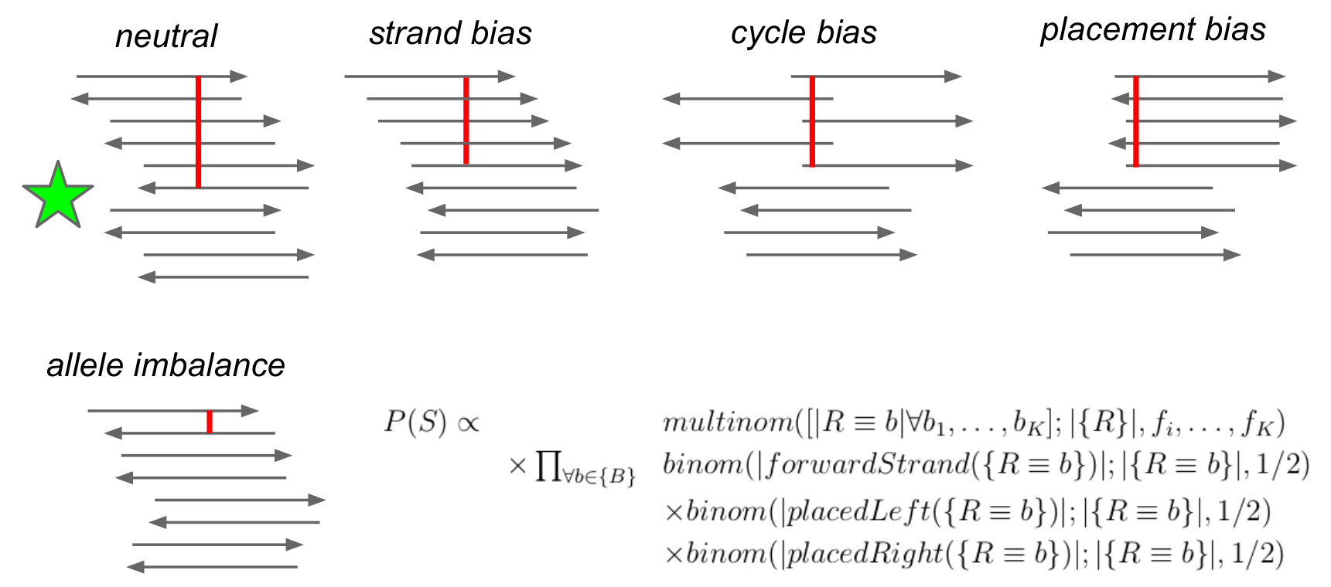
Accounting for sequencing biases
From Erik Garrison
These biases are either modeled in the genotype likelihoods (e.g. FreeBayes) or variants can be filtered out after calling (e.g. samtools) by statistical testing.

Slide 13
Refining genotype calls
P( R | G )
Genotype likelihood

Slide 14
Refining genotype calls
P( G | R ) ~
P( R | G )
x
P( G )
Genotype probability
Genotype likelihood
Prior (Uniform, Frequency or LD)

Slide 15
Refining genotype calls
P( G | R ) ~
P( R | G )
x
P( G )
Genotype probability
Genotype likelihood
Prior (Uniform, Frequency or LD)
1
1
1
P( G | R )
0.50
~
P( R | G )
0.50
X
P( G )
Uniform prior:
0.35
0.35
0.33
0.33
0.33
0.15
0.15
0
AA AT TT
0
AA AT TT
0
AA AT TT

Slide 16
Refining genotype calls
P( G | R ) ~
P( R | G )
x
P( G )
Genotype probability
Genotype likelihood
Prior (Uniform, Frequency or LD)
1
1
1
P( G | R )
0.50
~
P( R | G )
0.50
X
P( G )
Uniform prior:
0.35
0.35
0.33
0.33
0.33
0.15
0.15
0
AA AT TT
0
AA AT TT
0
AA AT TT
1
0.69
1
1
f(A) = 0.4
Frequency prior:
(samtools)
P( G | R )
~
P( R | G )
0.50
X
P( G )
0.48
0.35
0.36
0.16
0.15
0.15
0.16
0
AA AT TT
0
AA AT TT
0
AA AT TT

Slide 17
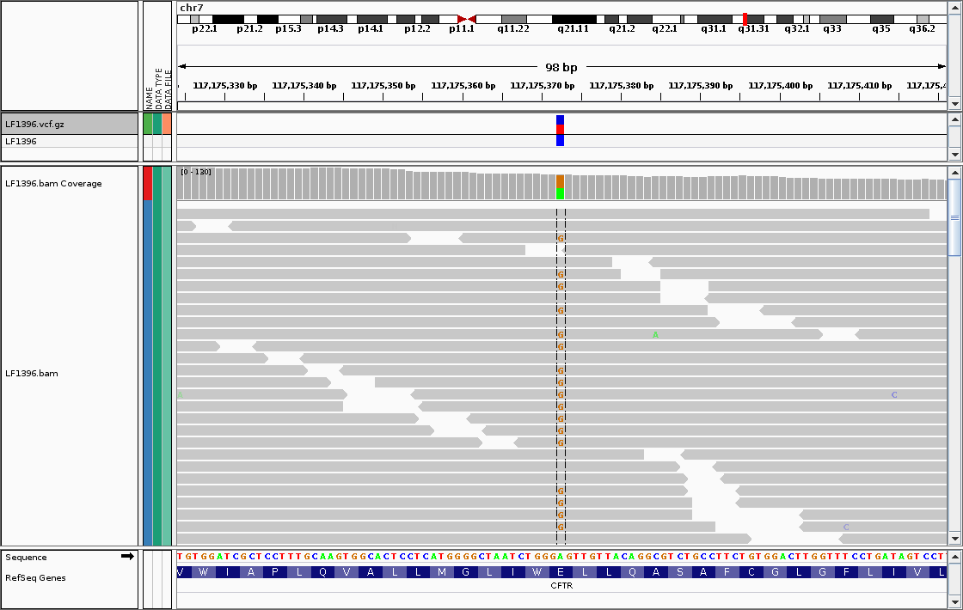
Integrative Genomics Viewer
http://software.broadinstitute.org/software/igv/

Slide 18
How to get genotype data?
Sequencing
Sequencer
Variant/Genotype calling
REF
DNA
Map read onto the reference genome and identify variants
Genotyping
Array scanner
Genotype calling

Slide 19
Genotype calling from chips
Intensity for allele A
Intensity for allele B

Slide 20
Genotype calling from chips
A/A
A/B
Intensity for allele A
B/B
Intensity for allele B

Slide 21
Genotype calling from chips
A/A
A/B
Too far from cluster centroids
=
Missing data point
Intensity for allele A
B/B
Intensity for allele B

Slide 22
Genotype calling from chips
Approaches to call genotypes from intensities (GenomeStudio, APCA or Chiamo)
Automated approaches to call genotypes at millions of SNPs prior to the analysis.
Any finding need to be checked manually and carefully.

Slide 23
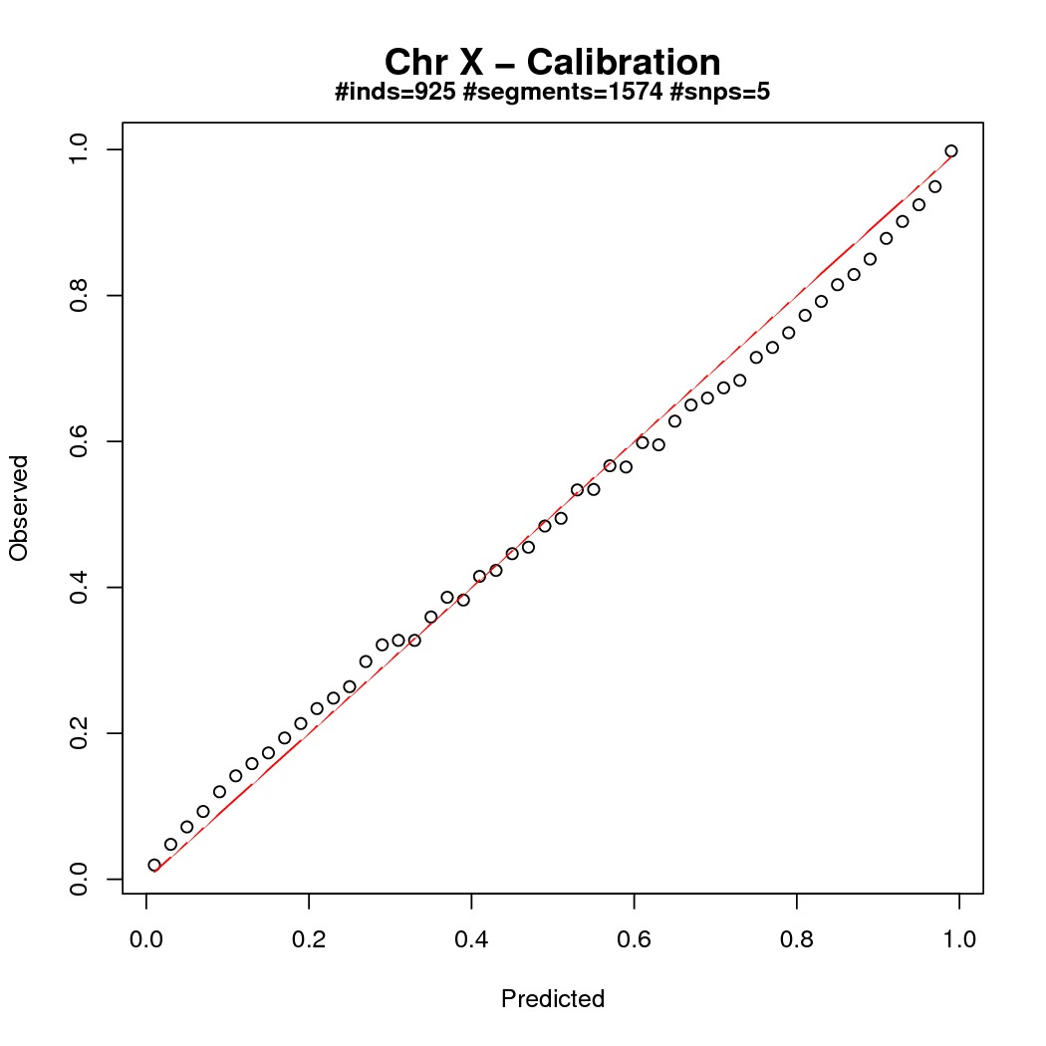
What does genotype probability mean?
Calibration plot
We usually set as missing all genotypes with low prob. The threshold we use depends on the study design.
Can we afford some incorrect calls? Two scenarios:
Interest in global patterns, a value of 0.95 is okay,
Interest in some particular variants, a value 0.999 is more adapted.
Proportion of true genotypes
Genotype probability bins

Slide 24
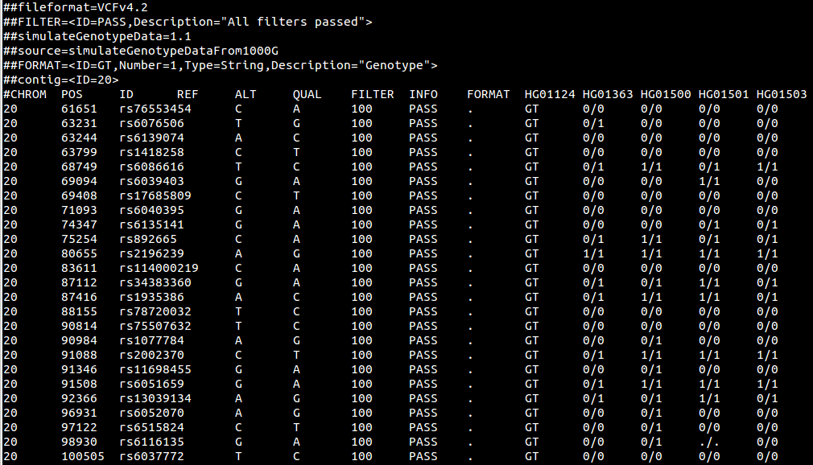
Variant Call Format
Sample IDs
HEADER
HG01124 has genotype TC at rs6086616
Variants
Missing genotype
Position
Reference
Quality
Annotation
Genotypes
Chromosome
Variant
Alternative
Filter
Genotype field

Slide 25
Basic operations on VCF
BCFtools (www.htslib.org)
Efficient data management
Excellent API to develop new tools
VCFtools (vcftools.sourceforge.net)
Standard data analysis (frequency, LD, etc…)
PLINK1.9 (www.cog-genomics.org/plink2)
Efficient implementation of all PLINK functionalities (e.g. association testing)

Slide 26
The goal of Quality Control
Errors in genotype calling can introduce systematic bias in downstream analysis and can increase the chance of false discoveries
Assess data quality to remove sub-standard genotypes, individuals and variants from subsequent analysis
To do so, there are standardized QC procedures implemented in well-established software packages

Slide 27
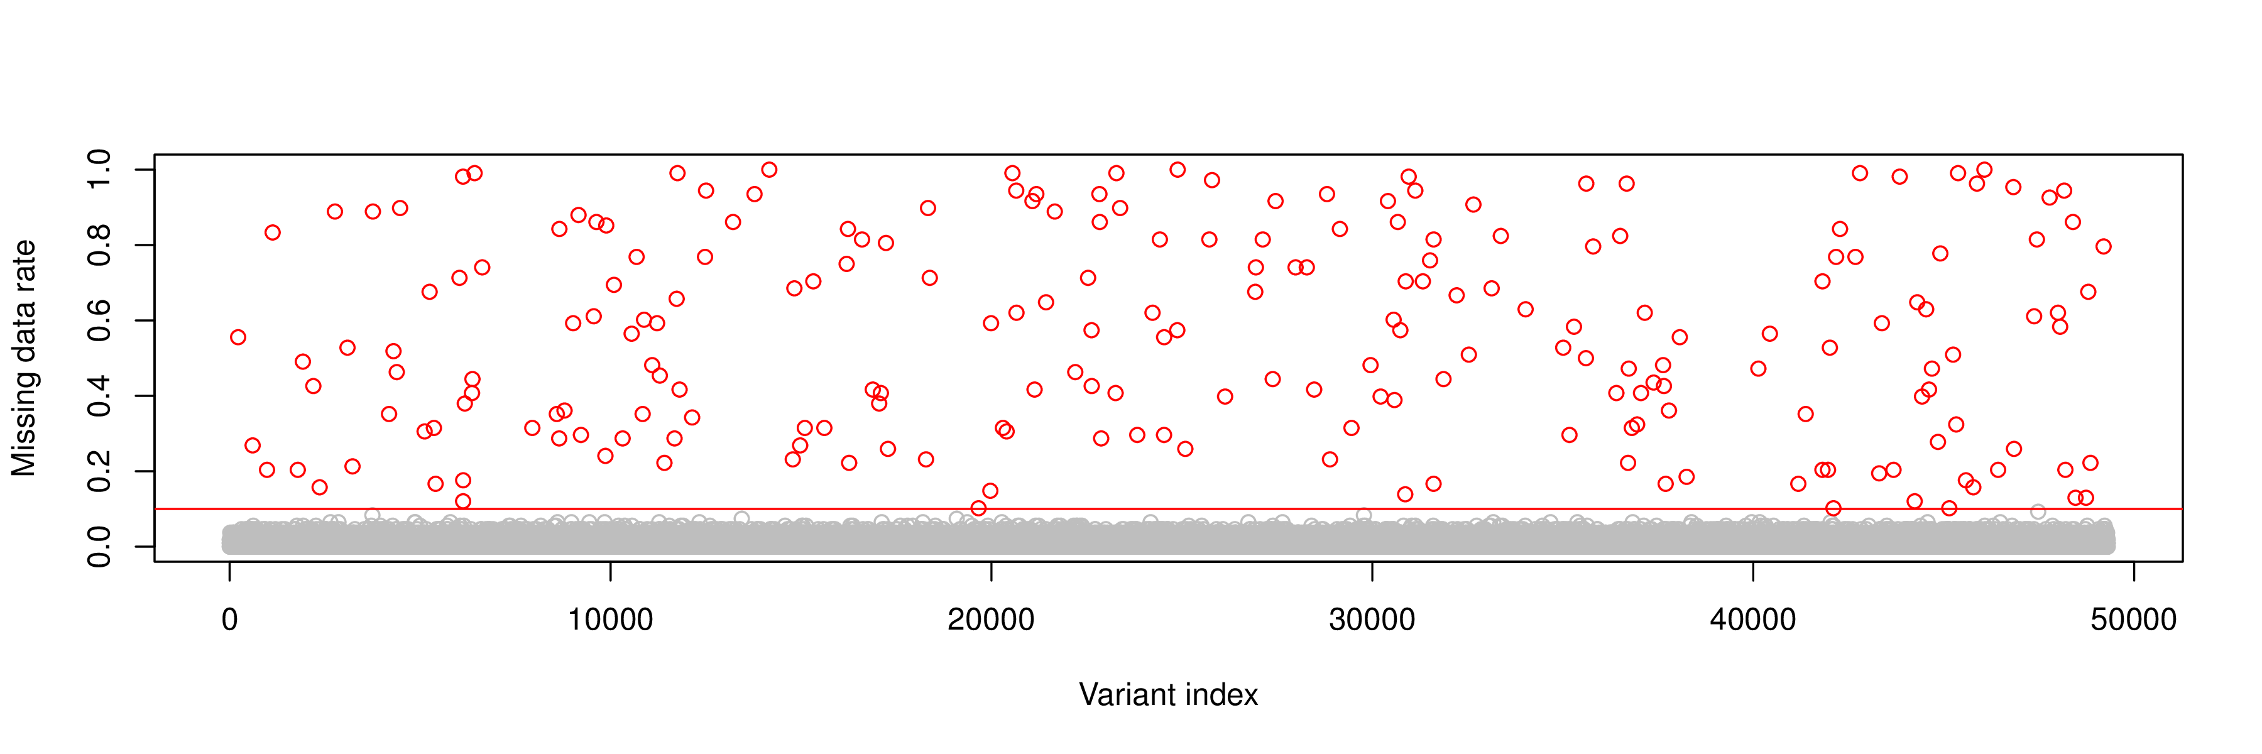
Filter variants with low call rates
Apply threshold to genotype probabilities in order to call genotype, otherwise treated as missing. The choice of calling threshold will impact results:
Too low: include poor quality genotypes.
Too high: unnecessarily remove high quality genotypes, or may introduce bias by preferentially calling specific genotypes.
Variants with poor call rates (i.e. high missing data rates) likely result from poor genotype calling. They need to be removed from the data.

Slide 28
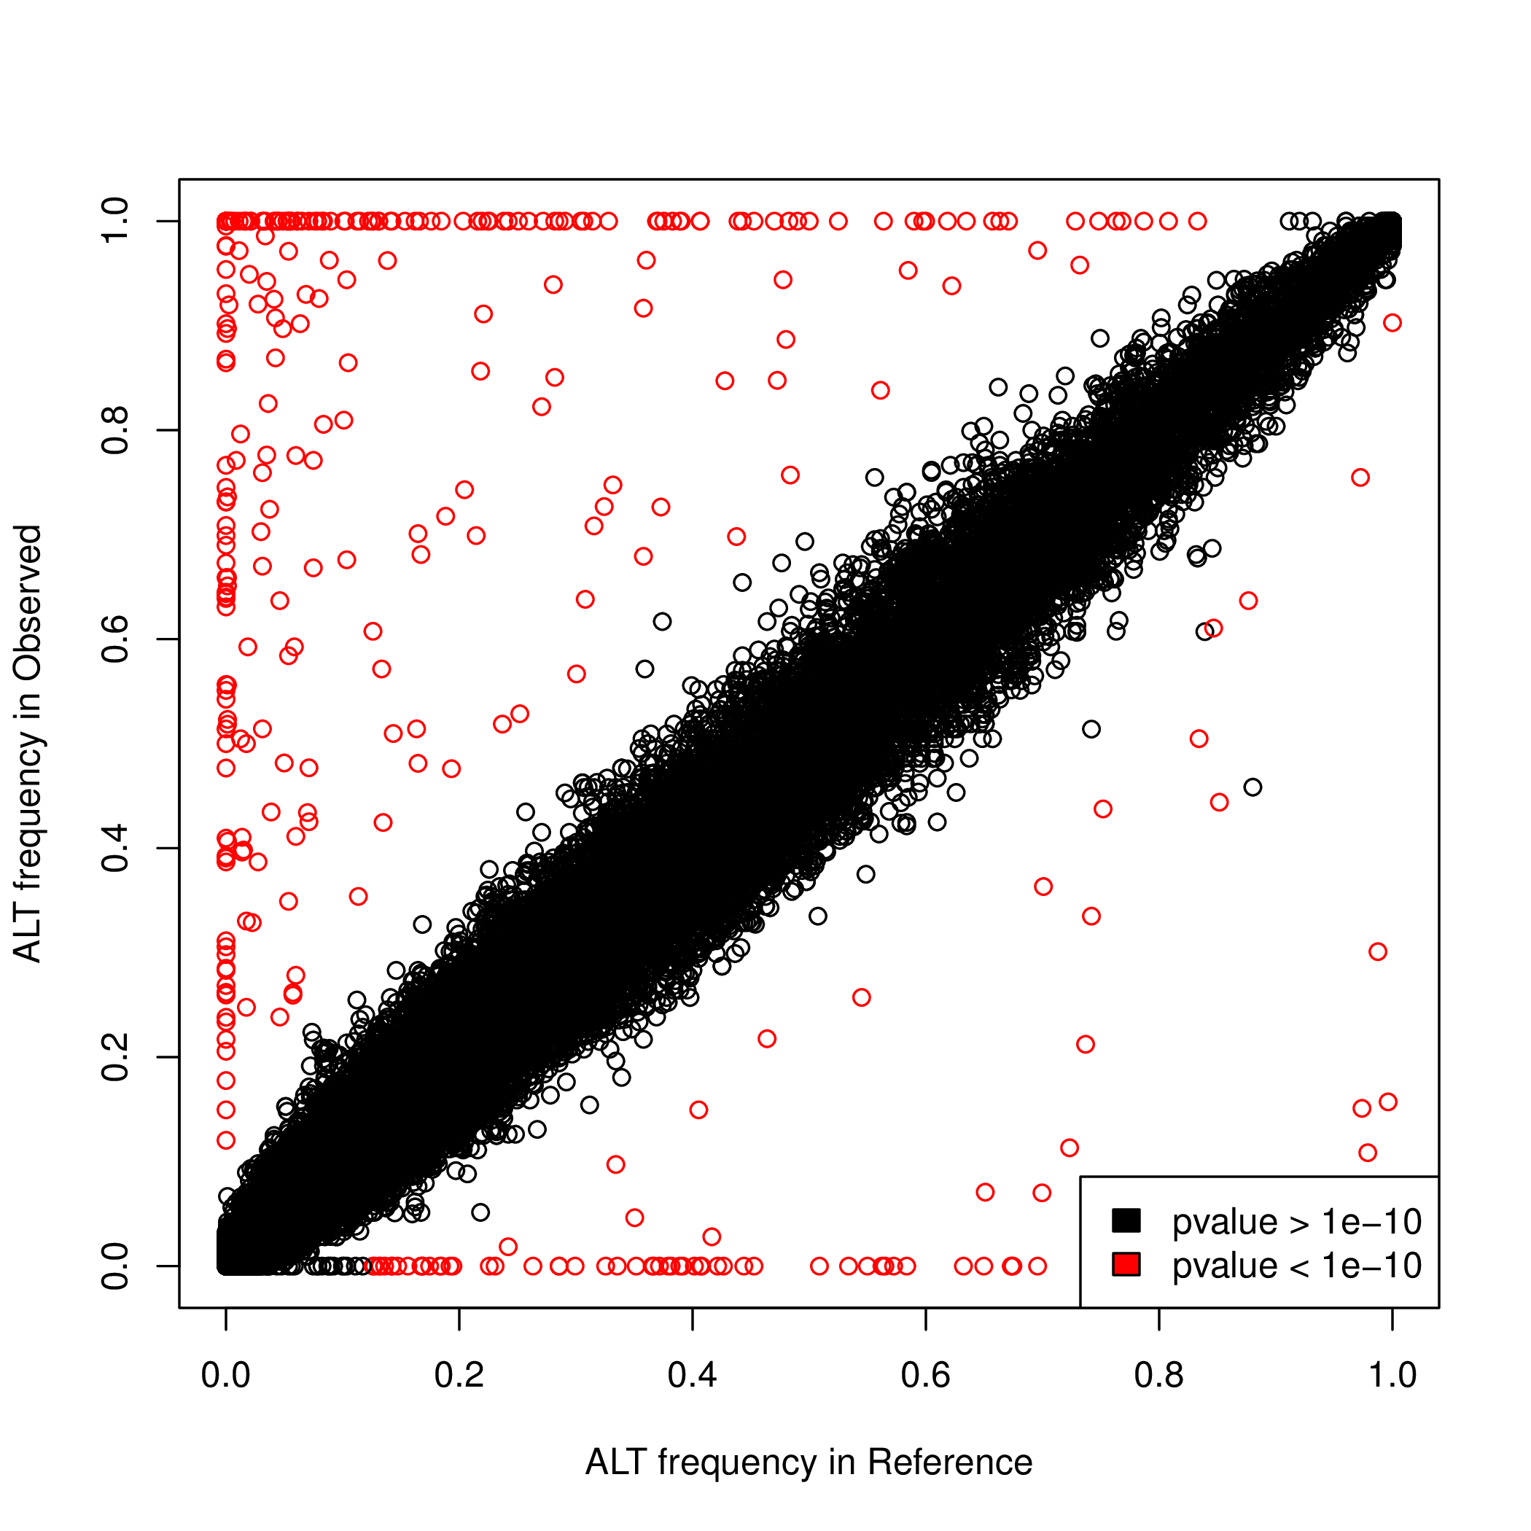
Check variant frequencies
To detect genotyping errors, one can also use large and high quality reference panels such as 1000 Genomes.
We compare the variant frequencies in our data to the frequencies in 1000 Genomes from a relevant population.
Then, one can test for massive differences and remove the corresponding variants.
ALT frequency in myData
ALT frequency in 1000 Genomes

Slide 29
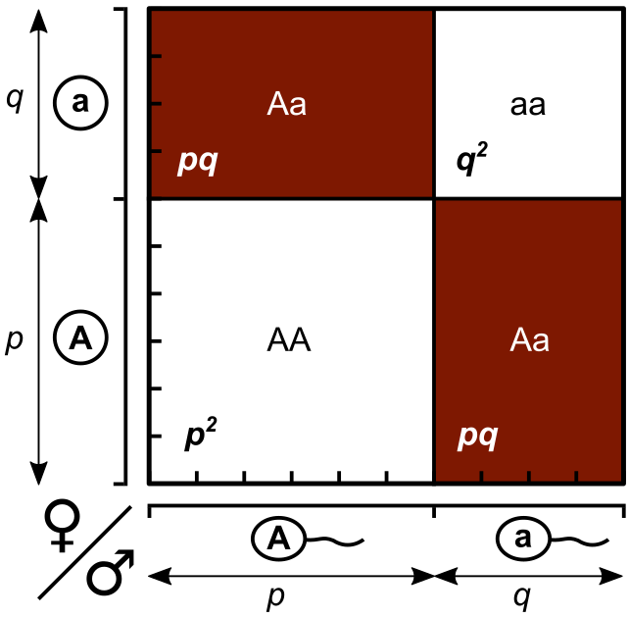
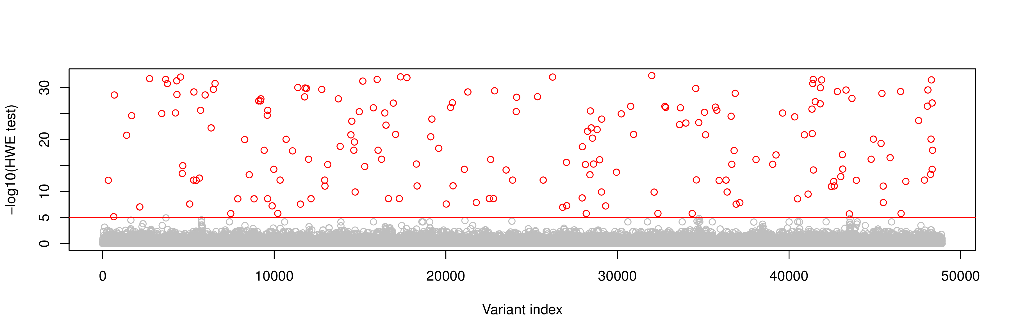
Check Hardy Weinberg Equilibrium
wikipedia
Under the assumption of random mating between individuals in a population, we have the following relationships between allele frequencies and genotype frequencies.
This can also be used to assess the quality of the genotype data by statistical testing (Wigginton, Cutler and Abecasis, 2005).

Slide 30
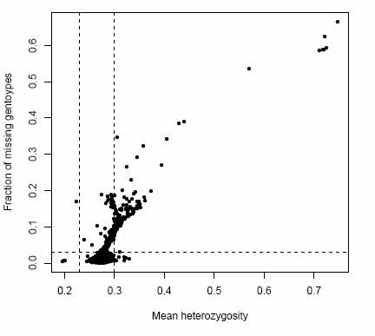
Filter samples with low call rate

Slide 31
Sex check with chromosome X
Each individual plotted twice according to reported sex: females in red and males in blue.
Should these samples be removed from the study or the sex corrected based on heterozygosity? May impact on results if sex is adjusted for in the analysis or if sex specific analyses are to be undertaken.

Slide 32
Check relatedness
Over M markers, the IBS between the ith and jth individuals is given by
where G_{ik} and G_{jk} denote the number of minor alleles (0, 1 or 2) carried by the ith and jth individuals at variant k.
Identical samples will share IBS near to 100% (allowing for genotyping errors).
Related individuals will share higher IBS than unrelated individuals.

Slide 33
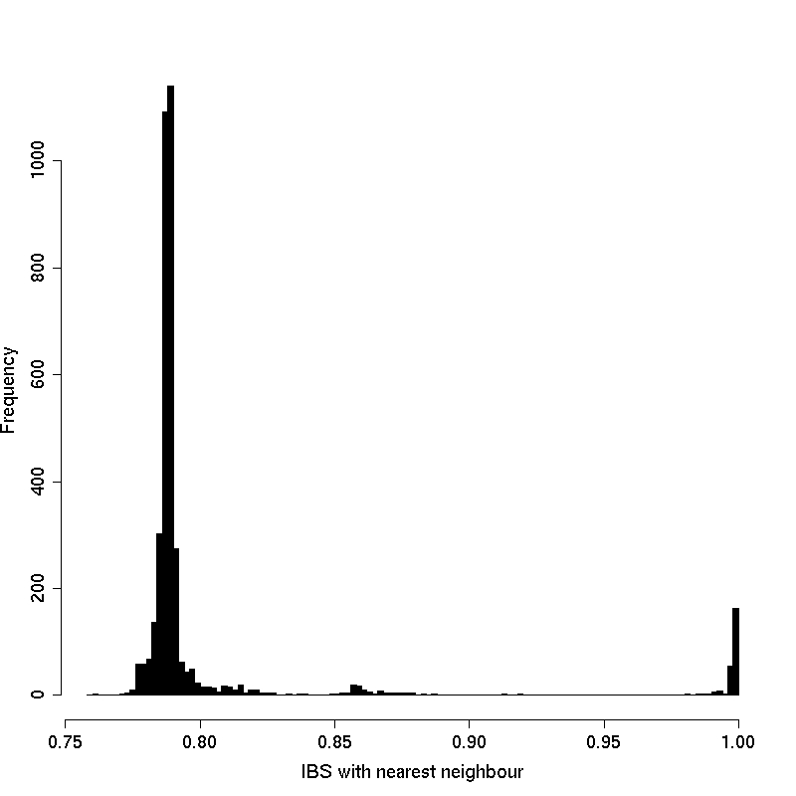
Check relatedness
Duplicates
Relateds

Slide 34
Alternative checks for relatedness
IBS can be used to estimate the proportion of the genome at which a pair of individuals share 0, 1 or 2 chromosomes IBD “identical by descent” (denoted z0, z1, or z2).
Once relative spotted, two options:
Accounting for relatedness in downstream analysis,
Remove close relatives.
Z1
Z0

Slide 35
Population structure
PCA captures widespread sub-structure in allele frequencies.
Top PCs reflect genetic variations due to ancestry.
Plotting top PCs including 1000 genomes samples can be used to identify population outliers.
Top PCs can be used as covariates in downstream analysis to adjust for population stratification.
Alternative methods exist such as MDS for instance as implemented in PLINK.

Slide 36
Population stratification
Individuals
Individuals
0/0 0/0 … 0/1
0/1 0/1 … 1/1
0/0 1/1 … 1/1
… … … …
0/0 0/0 0/0 0/1
Dosages+
MAF/LD filtering
0 0 … 1
1 1 … 2
0 2 … 2
… … … …
0 0 0 1
Variants
Variants

Slide 37
Population stratification
Individuals
Individuals
0/0 0/0 … 0/1
0/1 0/1 … 1/1
0/0 1/1 … 1/1
… … … …
0/0 0/0 0/0 0/1
Dosages+
MAF/LD filtering
0 0 … 1
1 1 … 2
0 2 … 2
… … … …
0 0 0 1
Variants
Variants
PCA
Indiv.
PC2
PC1

Slide 38
Population stratification
Individuals
Individuals
0/0 0/0 … 0/1
0/1 0/1 … 1/1
0/0 1/1 … 1/1
… … … …
0/0 0/0 0/0 0/1
Dosages+
MAF/LD filtering
0 0 … 1
1 1 … 2
0 2 … 2
… … … …
0 0 0 1
Variants
Variants
PCA
Indiv.
PC2
PC1
Novembre et al. (2008).

Slide 39
What do I do with my PCs?
1. Remove outliers from analysis
2. Account for structure
By defining ethnic groups
By using the PC loadings as covariates
WTCCC (2007)

Slide 40
Summary
QC criteria are subjective and vary from one study to another
Variant QC filters should eliminate the worst quality markers without “throwing the baby out with the bathwater”
Sample QC filters should not be so stringent as to remove the majority of the analysis cohort
Any finding should be followed up with visual inspection of the raw data (i.e. sequencing reads or cluster plots)

Slide 41
Practical
The goal of the practical of this afternoon is to go from raw to ready-to-analyze data
We will use multiple standard QC steps both at the variant and sample levels
The resulting data set will be used as starting material for the afternoon practical
Look at /home/delaneau, everything you need is there.

